Slide 1
Java with Postgres

Slide 2
Modules
Introducing use case
Steps for JDBC
Implementation of Use Case
JDBC
JDBC Drives
JDBC Classes
1
2
3
4
5
6

Slide 3
Introducing the Use Case

Slide 4
Bank Customer Management System.
Persist the customer data into tables using JDBC.
Save the customer details into database as and when new customer gets added.
Delete the customer details from database as and when admin requests to delete any customer.

Slide 5
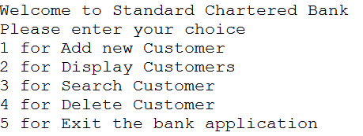
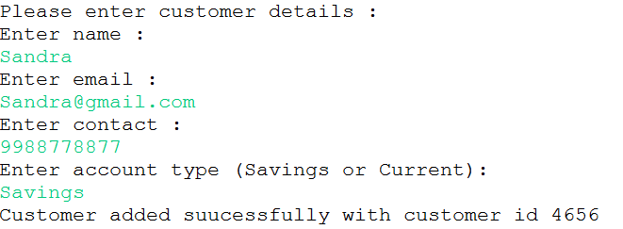
Bank Customer Management System
Display the menu to user
Create the customer class having fields cutsomerid as int, name as string, mailid as string contact as string and account type as string.
If user enters 1 , please provide the details. On valid entries these details should be added into the database with auto generated customerid.

Slide 6

Bank Customer Management System …
While adding the customer, make sure admin provides valid entries like name can only have alphabets, email should be valid one , contact no should have 10 digits and account type can be either Savings or current. If any one of the condition fails, the customer should not be added in the database and display the appropriate error message.
If user enters 2 , display all existing customer details using collection.
If user enters 3 , display the matched customer details.
If user enters 4 , delete the matched customer details.
If user enters 5, exit the application.

Slide 7
JDBC (Java Data Base Connectivity)

Slide 8
Module 5 : JDBC
Introduce the Use case
What is JDBC
Core JDBC Components
Connection
Steps for JDBC program
JDBC Driver and Type of JDBC Drivers
Statement
PreparedStatement
ResultSet

Slide 9

JDBC
Here is a list of popular open source and commercial relational databases which have JDBC drivers so you can use them from Java:
  Microsoft SQL Server
  H2Database
  MariaDB
  PostgreSQL
  My SQL
  Derby
  Oracle
The Java JDBC API (Java Database Connectivity) enables Java applications to connect to relational databases like MySQL, PostgreSQL, MS SQL Server, Oracle, H2 Database etc.
The JDBC API makes it possible to query and update relational databases, as well as call stored procedures, and obtain meta data about the database.
The Java JDBC API is part of the core Java SE SDK, making JDBC available to all Java applications that want to use it.
PostgreSQL driver
Java Application
JDBC
API
Oracle driver
Sybase driver

Slide 10
Core JDBC Components
The JDBC API consists of the following core parts:
  JDBC Drivers: A JDBC driver is a collection of Java classes that enables you to connect to a certain database. For instance, MySQL will have its own JDBC driver. A JDBC driver implements a lot of the JDBC interfaces. When your code uses a given JDBC driver, it actually uses the standard JDBC interfaces. The concrete JDBC driver used is hidden behind the JDBC interfaces. Thus you can plugin a new JDBC driver without your code noticing it.
  Connections: Once a JDBC driver is loaded and initialized, you need to connect to the database. You do so by obtaining a connection to the database via the JDBC API and the loaded driver. All communication with the database happens via a connection. An application can have more than one connection open to a database at a time. This is actually very common.
  Statements: A statement is what you use to execute queries and updates against the database. There are a few different types of statements like PreparedStatement, CallableStatement you can use. Each statement corresponds to a single query or update.
  Result Sets : When you perform a query against the database you get back a ResultSet . You can then traverse this ResultSet to read the result of the query.

Slide 11
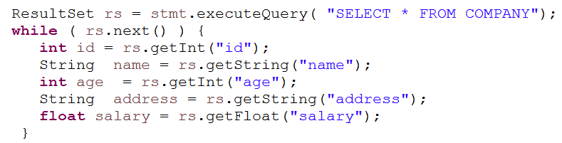
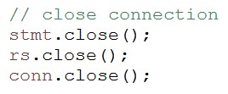
JDBC Steps
Register Driver
Get Connection
Create Statement
Execute Query
Close connection

Slide 12
Connection
A Connection is the session between java application and database. The Connection interface is a factory of Statement, PreparedStatement.
Commonly Used methods are:
  public Statement createStatement(): creates a statement object that can be used to execute SQL queries.
  public PrepareStatement prepareSatement(String sql): creates a prepare statement object that can be used to execute SQL queries.
  public void setAutoCommit(boolean status): is used to set the commit status.By default it is true.
  public void commit(): saves the changes made since the previous commit/rollback permanent.
  public void rollback(): Drops all changes made since the previous commit/rollback.
  public void close(): closes the connection and Releases a JDBC resources immediately.

Slide 13
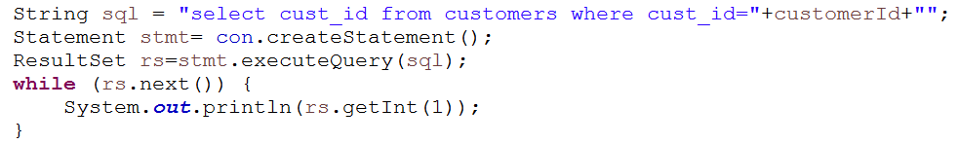
Statement
The Statement interface provides methods to execute queries with the database. The statement interface is a factory of ResultSet i.e. it provides factory method to get the object of ResultSet.
The commonly used methods are:
  public ResultSet executeQuery(String sql): is used to execute SELECT query. It returns the object of ResultSet.
  public int executeUpdate(String sql): is used to execute specified query, it may be insert, update, delete etc.
  public boolean execute(String sql): is used to execute queries that may return multiple results.

Slide 14
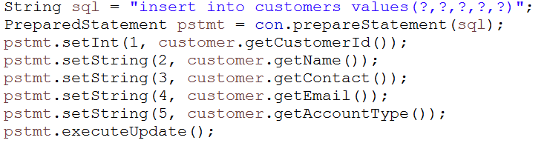
PreparedStatement
The PreparedStatement interface is a subinterface of Statement. It is used to execute parameterized query.
The performance of the application will be faster if you use PreparedStatement interface because query is compiled only once.
The commonly used methods are:
  public ResultSet executeQuery(): is used to execute SELECT query. It returns the object of ResultSet.
  public int executeUpdate(): is used to execute specified query, it may be insert, update, delete etc.
  public boolean execute(): is used to execute queries that may return multiple results.

Slide 15
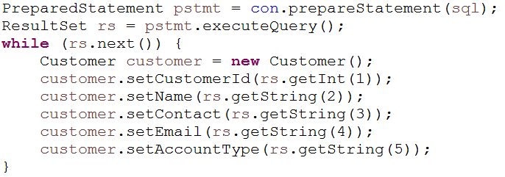
ResultSet
The object of ResultSet maintains a cursor pointing to a row of a table. Initially, cursor points to before the first row.
The commonly used methods are:
  public boolean next(): is used to move the cursor to the one row next from the current position.
  public boolean previous(): is used to move the cursor to the one row previous from the current position.
  public int getInt(int columnIndex): is used to return the data of specified column index of the current row as int.
  public int getInt(String columnName): is used to return the data of specified column name of the current row as int.

Slide 16
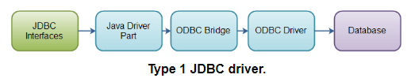
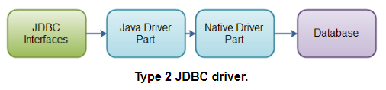
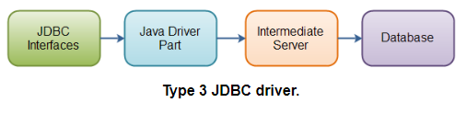
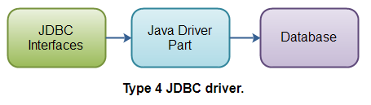
Types of JDBC Driver
There are four different JDBC driver types. Today most of the drivers are Type 4.
These driver types are:
  Type 1: JDBC-ODBC bridge JDBC driver
  Type 2: Java + Native code JDBC driver
  Type 3: All Java + Middleware translation JDBC driver
  Type 4: All Java JDBC driver.
Notes:
http://tutorials.jenkov.com/jdbc/driver-types.html

