Slide 1

JalSuraksha
AI-Powered Groundwater Intelligence System
Date: 29/10/2026
Project Work Phase-I (EAI753)
B.Tech CSE(Data Science)
Project Guide:
Dr. Ajay Rastogi
Aman Khan(TCA2366003)
Mohd Shami(TCA2366017)
Firoj (TCA2366010)
COLLEGE OF COMPUTING SCIENCES AND IT
TEERTHANKER MAHAVEER UNIVERSITY, MORADABAD

Slide 2
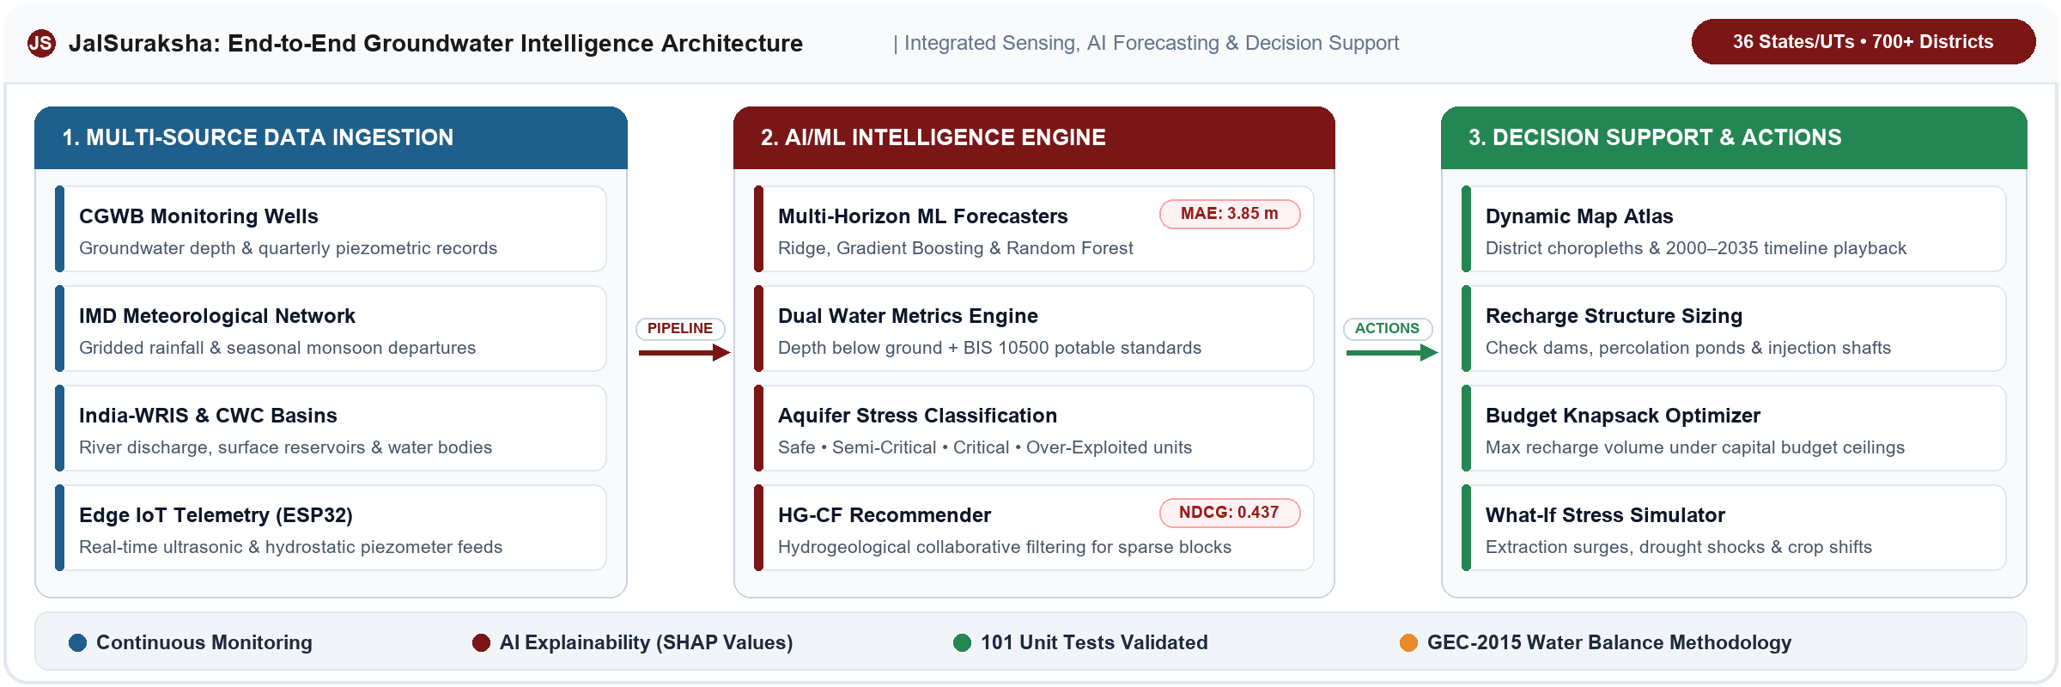
Introduction
JalSuraksha (HydroRaksh) is an AI-powered groundwater intelligence and decision-support platform for India. It combines groundwater, rainfall, and water-quality data from CGWB, IMD, India-WRIS, and CWC to forecast groundwater levels, flag water-stress risk, and recommend recharge and conservation actions. It covers 36 States/UTs and 700+ districts.
In simple words, JalSuraksha is a smart tool that helps people monitor groundwater, predict water levels, identify water-related risks, and make better decisions to save water.

Slide 3
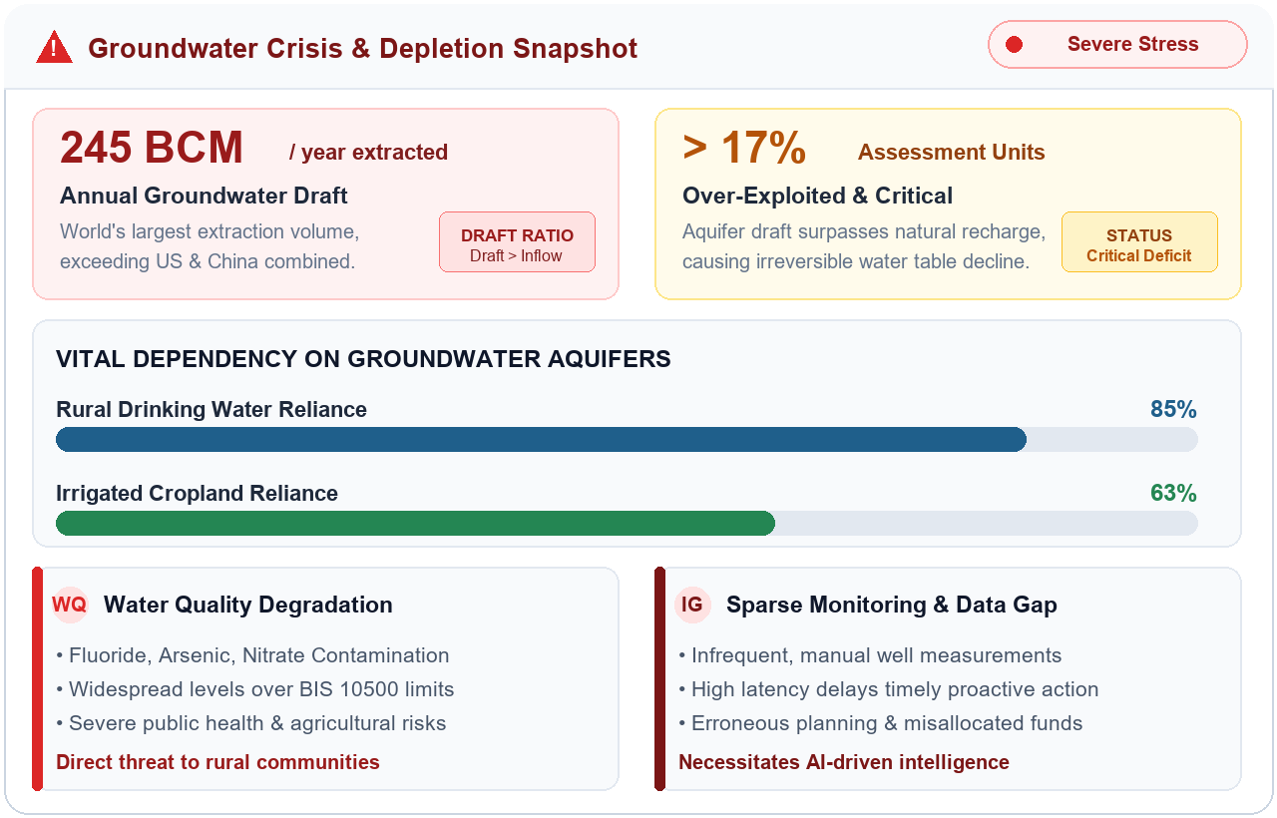
Problem Statement
Groundwater is under pressure from heavy extraction and changing rainfall, while people lack timely, local information to act on. JalSuraksha addresses this with AI and data analysis.
India withdraws about 245 billion m³ of groundwater a year; over 17% of assessment units are Over-Exploited.
63% of irrigated cropland and 85% of rural drinking water depend on aquifers.
Rainfall changes make water availability difficult to predict.
Water-quality problems (fluoride, arsenic, nitrate) affect health and agriculture.
Monitoring is sparse and largely manual, so clear groundwater information is hard to get.
Impact
Slow, sparse analysis delays local planning and makes it harder to choose effective water-management actions.

Slide 4
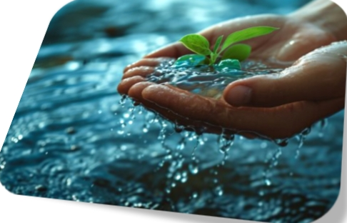
Solution Overview
JalSuraksha provides an integrated platform for groundwater intelligence and water-resource decision support, working in five steps:
Monitor: Collect groundwater, rainfall, and water-quality data.
Analyze: Find groundwater trends and water-stress conditions.
Predict: Forecast groundwater levels with ML models (Ridge, Gradient Boosting, Random Forest).
Recommend: Suggest recharge and water-conservation interventions using the HG-CF recommender.
Act: Plan with dashboards, district comparison, what-if simulation, and exportable reports.

Slide 5
System Architecture
A modular architecture converts raw water-related data into useful insights.
Public Sources
CGWB, IMD, India-WRIS, CWC
Data Sources: CGWB, IMD, India-WRIS, CWC, and IoT sensors.
Ingestion & Validation: Cleaning, missing-value handling, and feature engineering.
AI/ML Engine: Models forecast groundwater levels; SHAP explains them.
Risk Analysis: Water-stress score and groundwater risk classes.
Recommendation Engine: Recharge and conservation options.
Web Application: Flask UI and Super Intelligence Lab with FastAPI services.
Decision Support: Helps users plan suitable interventions.
Ingestion Pipelines
Feature Engineering & Validation
Model Training
Serialized Artifacts
FastAPI & Flask Backend
Edge IoT Telemetry
ESP32 sensors
Flask Web UI & Super Intelligence Lab
JSON User Store

Slide 6
Technologies Used
Technology | Purpose
Python | Used for AI, machine learning, and data analysis.
Flask | Runs the main web application and Super Intelligence Lab.
FastAPI | Provides async APIs for data and analysis.
SQLAlchemy | Connects Python with the database.
TimescaleDB | Stores groundwater data over time.
Pandas | Cleans and processes datasets.
Scikit-learn | Builds and tests ML models.
Ridge Regression | Best forecaster in testing (MAE 3.85 m).
Gradient Boosting | Tree-based groundwater-level forecasting.
Random Forest | Predicts levels using multiple decision trees.
Gensim | LDA topic modeling of hydrogeological reports.
SHAP | Explains factors behind model predictions.
JupyterLab | 16 notebooks for experiments and model development.
HTML, CSS, JavaScript | Used to create the web interface.

Slide 7
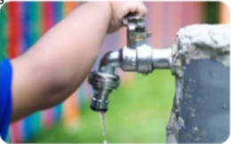
Dataset used
JalSuraksha combines information from multiple public water-related sources:
CGWB: groundwater depth data from monitoring wells.
IMD: rainfall and weather information.
India-WRIS: water-resources information for analysis and planning.
CWC: reservoir and river-gauge information.
Water quality (BIS 10500): pH, EC, TDS, fluoride, arsenic, and nitrate, where available.
Dataset preparation process:
Collect available datasets.
Check data quality and missing values.
Standardize formats and relevant features.
Prepare time-based and location-based records.
Use prepared data for model training, testing, and analysis.
CGWB
Groundwater depth observations from monitoring networks.
IMD
Rainfall and rainfall-departure information.
India-WRIS & CWC
River basin, reservoir and gauge-discharge information.

Slide 8
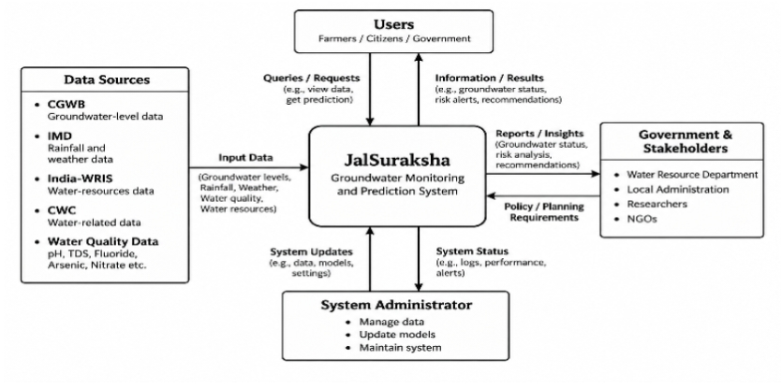
Context Diagram

Slide 9
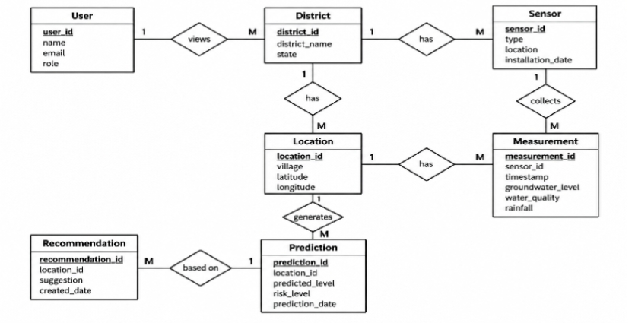
Entity Relationship Diagram (ERD)

Slide 10
Platform Modules & Key Features
Dynamic Atlas
36 States/UTs, district boundaries, 2000–2035 timeline playback
Dual Water Metrics
Groundwater depth plus BIS 10500 quality, with data provenance labels
ML Forecaster
Multi-horizon forecasts (random forest, gradient boosting, ridge)
HG-CF Recommender
Hydro-geological intervention recommendations for data-sparse blocks
LDA Literature Miner
Topics from CGWB reports and citizen grievances
Water Balance Audit
GEC-2015 recharge, extraction, and net deficit
Recharge Sizing
Check dams, percolation ponds, injection wells, recharge shafts
Budget Optimizer
Knapsack allocation of interventions under capital ceilings
What-If Simulator
Extraction, rainfall, and recharge stress testing
Also included: rooftop rainwater harvesting sizing, crop-shift advisory, NRW leakage audit, borewell failure portal, 75-district comparison with CSV export, and IoT sensor ingestion.

Slide 11
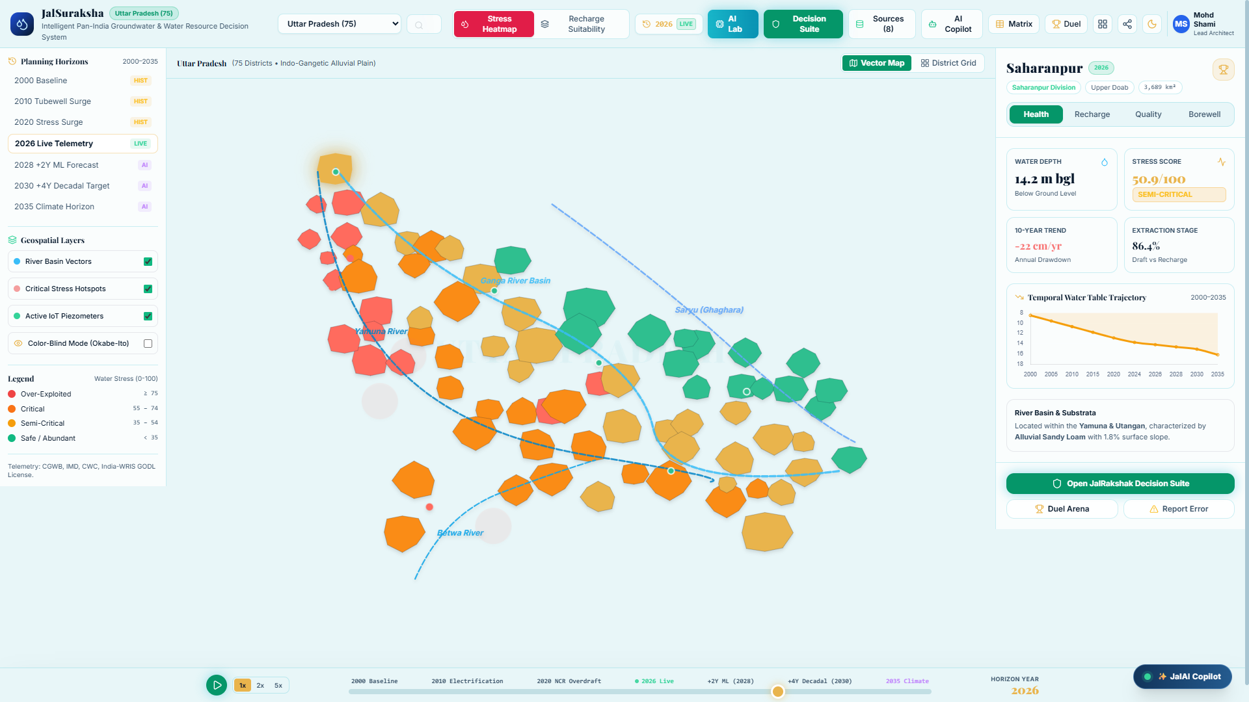
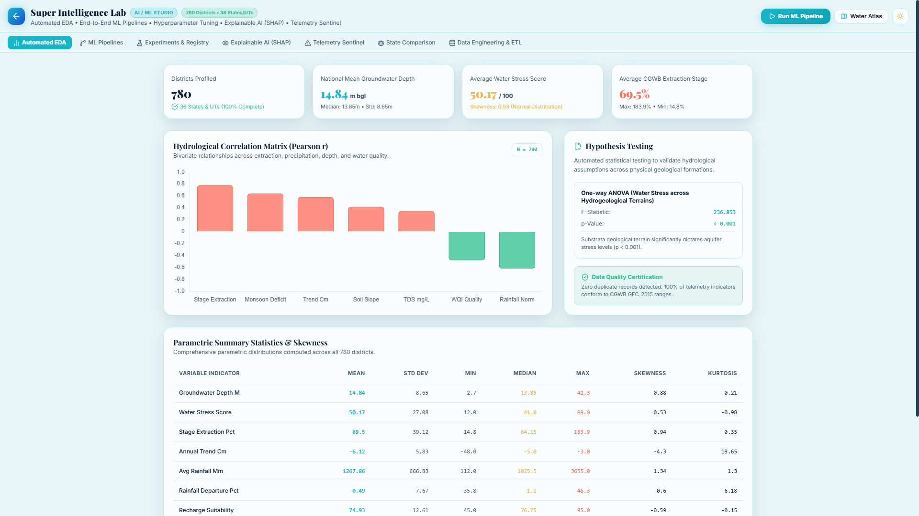
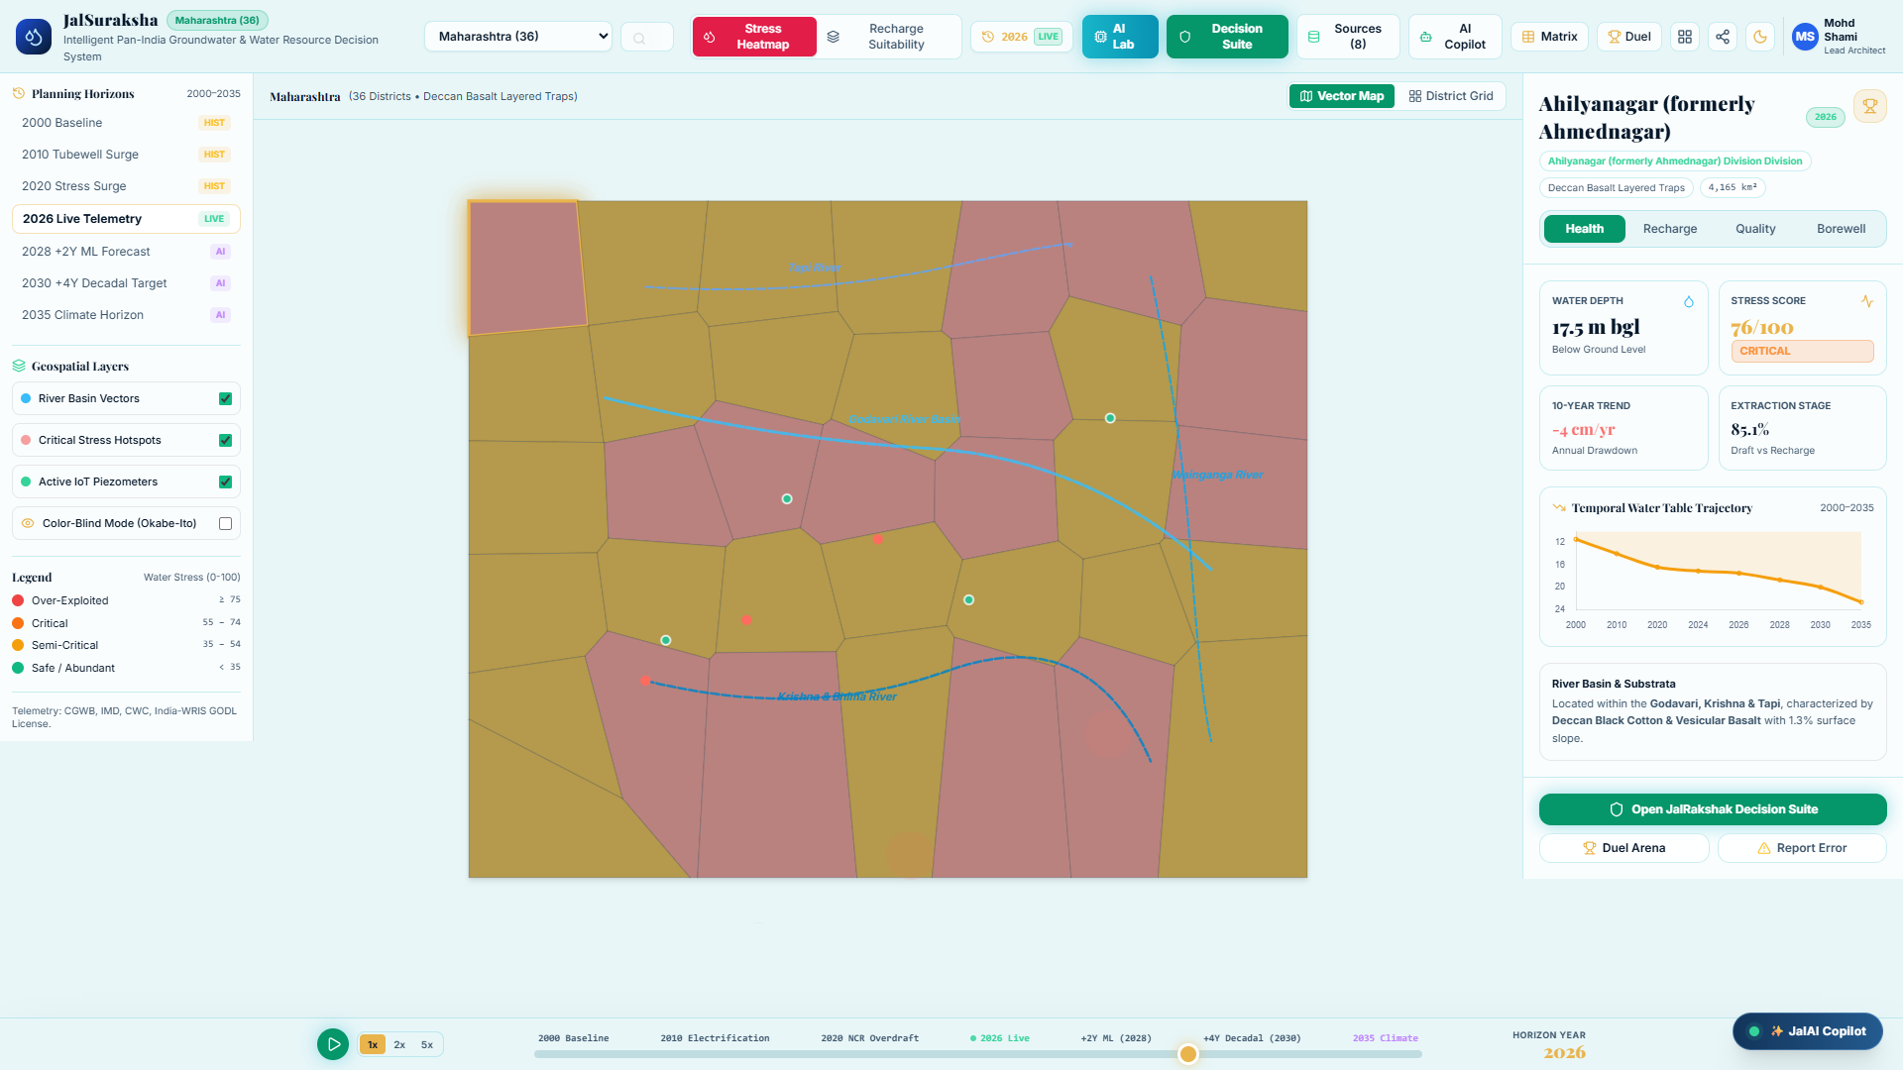
Application Screenshots
Core map canvas and intelligence dashboard: district choropleth, aquifer risk classes, 2000–2035 timeline.

Slide 12
Model Evaluation
3.85 m
Best forecast MAE (Ridge), vs 29.85 m for naive persistence; RMSE 4.35 m
0.437
HG-CF recommender NDCG@5 (Precision@5 0.197, MAE 0.123) on 118 held-out pairs
5.17 m
Held-out geographic MAE (Agra, Patna, Meerut; 9 samples, R² 0.127) — more data needed

Slide 13
Conclusion & Future Scope
Conclusion
Future Scope
Delivers a working, tested platform (101 unit tests) covering 36 States/UTs and 700+ districts.
ML forecasts cut error from 29.85 m (naive) to about 3.85 m MAE.
HG-CF recommends interventions even where local data is sparse.
Dashboards, simulators, and reports turn public data into decisions.
Validate on more districts and states beyond the 3-district hold-out.
Add sequence models (e.g., LSTM) for longer-horizon forecasts.
Scale live IoT piezometer feeds from ESP32 sensors.
Wider live data connectors and multilingual, accessible interfaces.

Slide 14
Thank You!
JalSuraksha: AI-Powered Groundwater Intelligence System
Questions & Answers | Open for Discussion
Project Guide:
Dr. Ajay Rastogi
Project Team:
Aman Khan (TCA2366003)
Mohd Shami (TCA2366017)
Firoj (TCA2366010)
COLLEGE OF COMPUTING SCIENCES AND IT
TEERTHANKER MAHAVEER UNIVERSITY, MORADABAD

