Slide 1

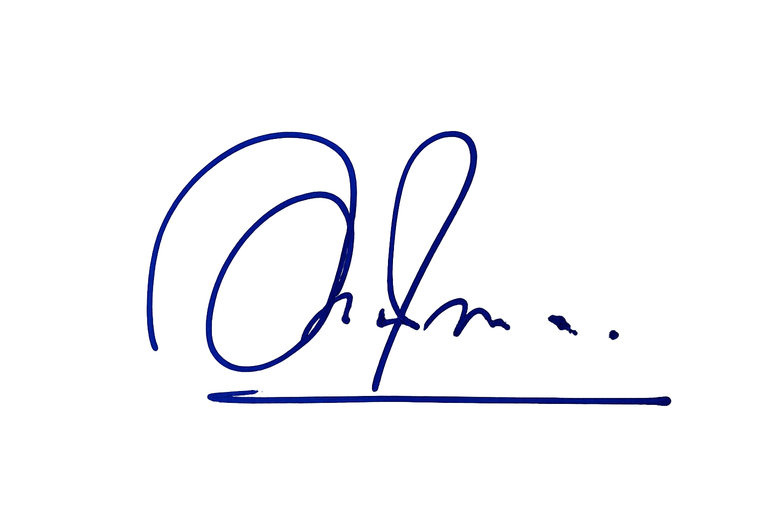
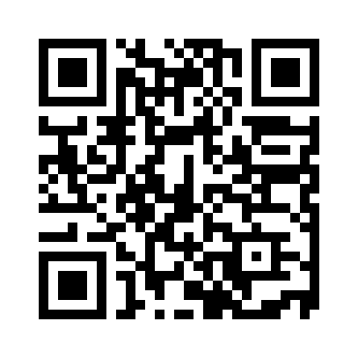

GD GOENKA UNIVERSITY
यूजीसी तथा राष्ट्रीय व्यावसायिक शिक्षा एवं प्रशिक्षण परिषद (एनसीवीईटी) द्वारा मान्यता प्राप्त
Recognised by UGC & NCVET
कौशल योग्यता प्रमाणपत्र
Certificate for Skill Competency
Certificate No:
This is to certify that Mr./Ms./Mx
S/O, D/O, W/O
Date of Birth
Enrolment No
has successfully cleared the assessment in the job role/qualification
of Duration
with
Grade/%
Date of Issue:
Program Director
Digitally verified Certificate

