Slide 1
Developing APIs using the Actor Model in ASP.NET Core
Mike Gritz

Slide 2
Agenda
Brief History
Architectural Concepts
Practical Use Cases
.NET Implementations
Akka.NET
Orleans.NET
Trade-offs
Demo
Questions

Slide 3
Brief History
The actor model is a conceptual model to deal with concurrent computation.
Originated in 1973.

Slide 4
Architectural Concepts
An actor is a fundamental unit of computation.
Everything is an actor instead of an object
No shared state between actors
Asynchronous message passing
Mailboxes to buffer incoming messages
Actors Are about the Separation of Concerns and Containment
Notes:
What is the Actor Model?
An actor is a fundamental unit of computation and everything is an actor.
The only allowed operations for an actor are:
to create another actor,
to send a message
or to designate how to handle the next message
First two operations are quite easy to understand. Let’s focus on the last one. An actor can hold its own private state and it can decide how to process the next message based on that state. Let’s imagine an actor that stores a total balance of our account. If our actor receives a message with a new transaction, it updates its state by adding the new amount to the already calculated total balance which means that for the next message the state of the actor will be different.
Properties of the actors
Actors are lightweight and it is easy to create thousands or even millions of them as they require fewer resources than threads.
Let’s have a look at the actors in more details. Actors are isolated from each other and they do not share memory. They have a state, but the only way to change it is by receiving a message. Every actor has its own mailbox, which is similar to a message queue. Messages are stored in actors’ mailboxes until they are processed. Actors, after created, are waiting for messages to arrive. Actors can communicate with each other only through messages. Messages are sent to actors’ mailboxes and processed in FIFO (first in, first out) order. Messages are simple, immutable data structures that can be easily sent over the network.
Conceptually an actor can handle only 1 message at a time. Actors are decoupled, they work asynchronously and they don’t need to wait for a response from another actor.
Addresses
Actors have addresses, so it’s possible for an actor to send a message to another actor by knowing its address. An actor can only communicate with actors whose addresses it has. An actor has addresses of the actors it has itself created and it can obtain other addresses from a message it receives. One actor can have many addresses. We need to remember that address is not equal to identity, so it doesn’t mean that two actors with the same identity have the same address.
Actors can run locally or remotely on another machine. It is completely transparent for the system as actors communicate through addresses which can be local or remote.
Fault tolerance
Now, let’s look at the fault tolerance. In the Actor Model, actors can supervise other actors. An actor can supervise the actors it creates and can decide what to do in case of failure. A supervisor can, for example, restart a supervised actor or redirect messages to another actor. It leads us to self-healing systems.
Pros and cons
Let’s have a look at the pros and cons of the Actor Model.
PROS
easy to scale
fault tolerance
geographical distribution
not sharing state
CONS
actors are susceptible to deadlocks
overflowing mailboxes

Slide 5
Practical Use Cases
Online Gaming
Finance
Statistics
Betting
Social Media
Telecom
Internet of Things
Notes:
Akka.NET is used by many large organizations and in industries such as investment and merchant banking, retail and social media, simulation, gaming and betting, automobile and traffic systems, health care, data analytics, and much more. Any system that has the need for high-throughput and low latency is a good candidate for using Akka.NET.
Transaction processing (Online Gaming, Finance/Banking, Trading, Statistics, Betting, Social Media, Telecom)
Service backend (any industry, any app)
Concurrency/parallelism (any app)
Simulation
Master/Worker, Compute Grid, MapReduce etc.
Batch processing (any industry)
Camel integration to hook up with batch data sources Actors divide and conquer the batch workloads
Communications Hub (Telecom, Web media, Mobile media)
Gaming and Betting (MOM, online gaming, betting)
Scale up, scale out, fault-tolerance / HA
Business Intelligence/Data Mining/general purpose crunching
Internet of Things
Complex Event Stream Processing
Blockchain

Slide 6
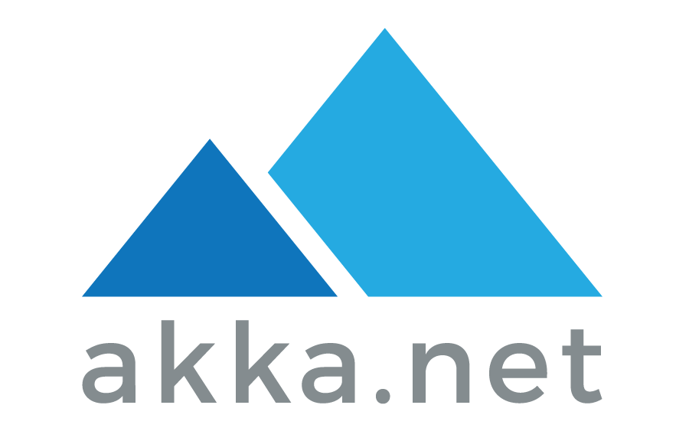

.NET Implementations

Slide 7
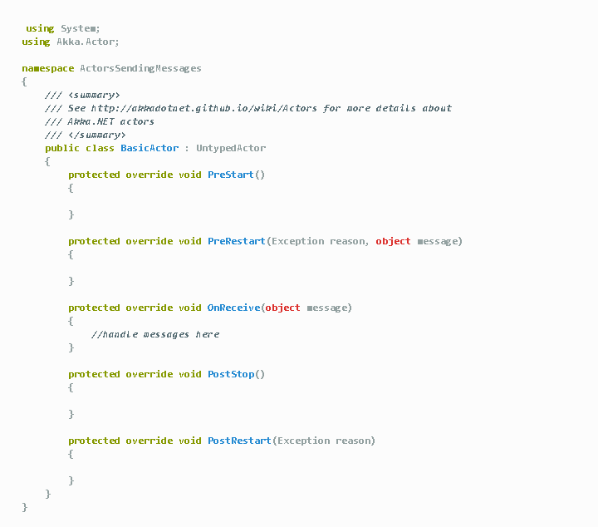
Akka.NET
Untyped Actor
Messages
Actor System
Notes:
https://petabridge.com/blog/akkadotnet-what-is-an-actor/
There are many types of Actors in Akka.NET, but all of them derive from the UntypedActor.
You might have noticed the following method on my BasicActor definition above:
The OnReceive method is where any actor receives its messages. In Akka.NET a “message” is just a C# object. A message can be an instance of a string, an int or a user-defined class like OfficeStaff.RequestMoreCoffee.
Actors are typically programmed only to handle a few specific types of messages, but nothing bad happens if an actor receives a message it can’t handle. Typically it just logs the message as “unhandled” and moves on.
Actors Communicate Via Message Passing
Well for starters, message passing is asynchronous - the actor who sent the message can continue to do other work while the receiving actor processes the sender’s message.
So in effect, every interaction one actor has with any other actor is going to be asynchronous by default.
Actors Send Messages to Actor References, Not Directly to Actors
Protocol - just like how you can have HTTP and HTTPS on the web, Akka.NET supports multiple transport protocols for inter-process communication. The default protocol for single-process actor systems is just akka://. If you’re using remoting or clustering, you’ll typically use a socket transport like akka.tcp:// or akka.udp:// to communicate between nodes.
ActorSystem - every ActorSystem instance in Akka.NET has to be given a name upon startup, and that name can be shared by multiple processes or machines that are all participating in a distributed ActorSystem.
Address - if you’re not using remoting, then the address portion of an ActorPath can be omitted. But this is used to convey specific IP address / domain name and port information used for remote communication between actor systems.
Path - this is the path to a specific actor at an address. It’s structure just like a URL path for a website, with all user-defined actors stemming off of the /user/ root actor.
All Messages Sent to An ActorReference Are Placed In A “Mailbox” That Belongs to the Actor.

Slide 8
Orleans.NET
Grains
Silos
Cluster
Client
Liveliness
Notes:
Before diving into how we can build an application, we will see some of the keywords which can are employed in the framework but also in the documentation.
Grain
Grains are the heart of the application, business logic, validation of business logic and storage are handled from within the grain. It is the actor containing the business logic. A grain can be either stateless or stateful and can also have its state persisted. We interact with grains in a asynchronous fashion, any call is asynchronous and return a Task. It is also possible to have the grain return a value back to the caller.
Concurrency is also handle by Orleans, every grain is ensure process request in a synchronous way. This makes thinking about the state within the grain much easier as there will never be concurrent threads modifying the grain state.
Silo
A silo is the process where a grain get executed. Multiple silos together form a cluster. In the most simplistic development, all silos share the same set of grain implementation.
When a client needs to get a grain, it will contact the silo through its gateway, then Orleans decides which silo will instantiate the grain. This is one of the properties of the virtual actor, we do not decide how silos are managed and where grains are instantiated, Orleans takes care of it for us. To get a grain, all we know is the cluster we wish to contact and where to find the gateways available (membership table).
Cluster
A cluster is composed by a set of silos. Within the cluster, the availability of the silos is maintained through via the membership table. A cluster is also identified by the deployment identifier. It can be seen as the unit accessible by the client. The cluster can be seen as the server too.
Client
A client is the caller needed the grain. The Orleans client is the service provided to talk to the cluster. It contains more in it like the message gateway which keeps track of alive/dead gateways. Usually the client is created within the client application needing to call grains, like an ASP.NET application.
Liveness
The liveness is what defines how do silos know about other silos joining the cluster or being alive/dead. In reliable environment, the liveness implemented through a membership table stored in a reliable structure such as SQLserver or ZooKeeper. But during development, the liveness is provided by a membership table stored in the state of a grain, inside the primary silo (which is also the seed node).

Slide 9
Trade-offs
Orleans.NET is a simplified toolkit for building distributed systems and allow non-experts to write efficient, scalable and reliable distributed services.
Akka.NET is a full scale toolkit for building distributed systems and offers much more granular access to the various aspects that make up the actor model.
Notes:
The most interesting aspect in this section is the difference in primary focus between the two projects:
The primary focus of Orleans is to simplify distributed computing and allow non-experts to write efficient, scalable and reliable distributed services.
Akka is a toolkit for building distributed systems, offering the full power but also exposing the inherent complexity of this domain.
Both projects intend to be complete solutions, meaning that Orleans’ second priority is to allow experienced users to control the platform in more detail and adapt it to a wide range of use-cases, while Akka also raises the level of abstraction and offers simplified but very useful abstraction.
Another difference is that of design methodology:
The guiding question for Orleans is “what is the default behavior that is most natural and easy for non-experts?” The second question is then how the expert can make their own decision.
Akka’s guiding question is “what is the minimal abstraction that we can provide without compromises?” This means that “good default” for us is not driven by what users might expect, but what we think users will find most useful for reasoning about their program once they have understood the abstraction—familiarity is not a goal in itself.
https://github.com/akka/akka-meta/blob/master/ComparisonWithOrleans.md

Slide 10
Demo
Calculator
http://localhost:3000/
https://github.com/codeznstuff/ActorModelDemo

Slide 11
Questions

