Slide 1

Office Network Lab
ENVIRONMENT 01 / Workplace services and assessment
FTP file transfer and SMB file sharing
HOW IT RUNS
FILE ACCESS
Docker Desktop + WSL 2
REMOTE ACCESS
SSH login and credential checks
Real services run in containers behind 127.0.0.2.
COMPARISON
Open and restricted endpoints
Backend: pyftpdlib, AsyncSSH, Impacket and Redis.
ASSESSMENT
Service discovery and evidence-based ranking
01

Slide 2
Office Network | Assessment Results
5 observed policy issues / findings from a recorded run
FTP · 2121
Anonymous login accepted
16 REDIS CVE CANDIDATES
Version matches need package and patch verification before applicability is confirmed.
SMB · 1445
Guest access accepted
SMB · 1445/1446
Signing not required on two endpoints
NEXT STEP
Restrict access, enforce signing and retest.
SSH · 2222
Prohibited lab credential accepted
02

Slide 3
IoT Network Lab
ENVIRONMENT 02 / Telemetry and device management
MQTT broker access and sensor messages
HOW IT RUNS
TELEMETRY
Docker Desktop + WSL 2
MONITORING
SNMP device-management requests
An isolated container network uses 127.0.0.3 as its local gateway.
TRANSPORT
TLS certificate and trust checks
Backend: aMQTT, PySNMP, TLS and Redis.
ASSESSMENT
Service discovery and evidence-based ranking
03

Slide 4
IoT Network | Assessment Results
4 observed policy issues / findings from a recorded run
MQTT · 1883
Anonymous access accepted
14 REDIS CVE CANDIDATES
Both labs use Redis. Version matches require verification; they are not confirmed exploits.
SNMP · 1161
Public community accepted
TLS · 8883
Certificate expired
NEXT STEP
Restrict access, replace the certificate and retest.
TLS · 8883
Certificate trust check failed
04

Slide 5
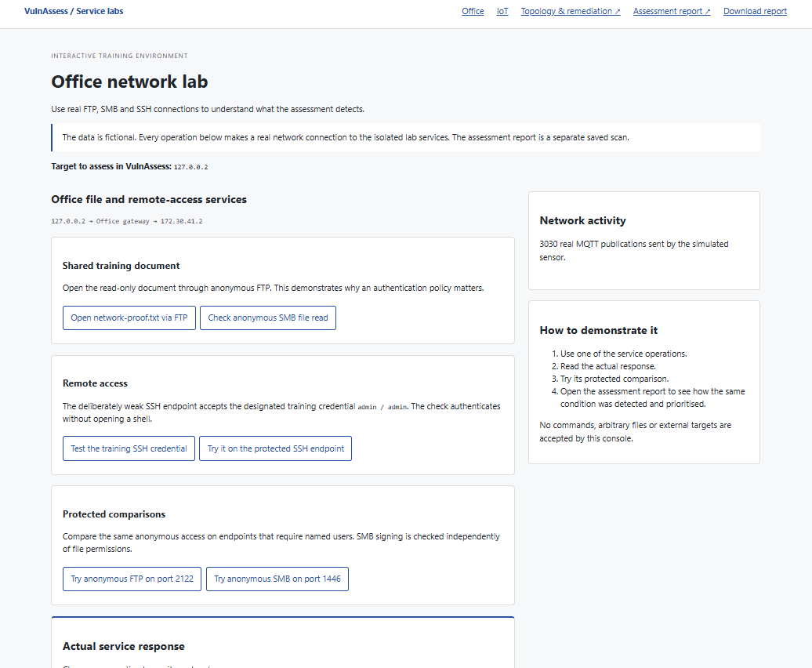
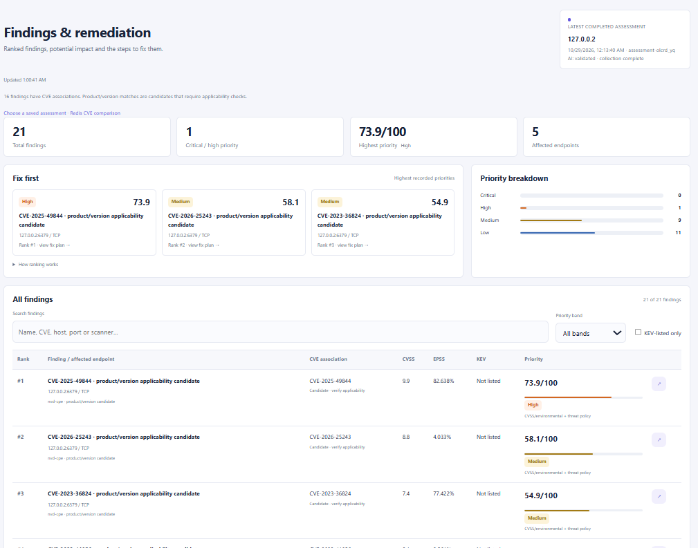
Office Lab | Demonstration
Lab interface and recorded assessment
LAB INTERFACE
RECORDED FINDINGS
05

Slide 6
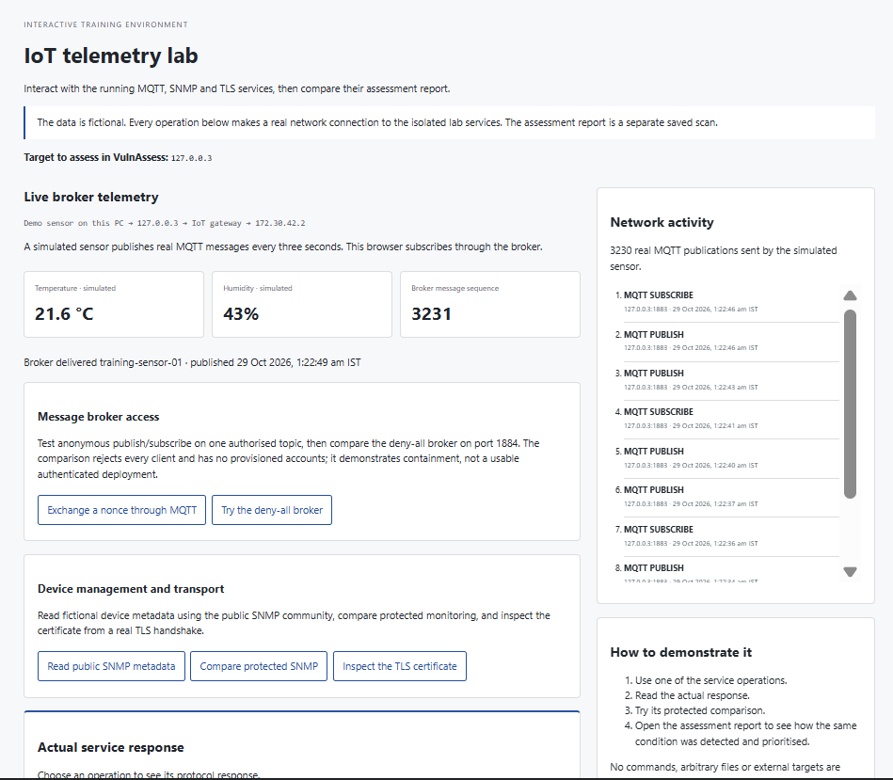
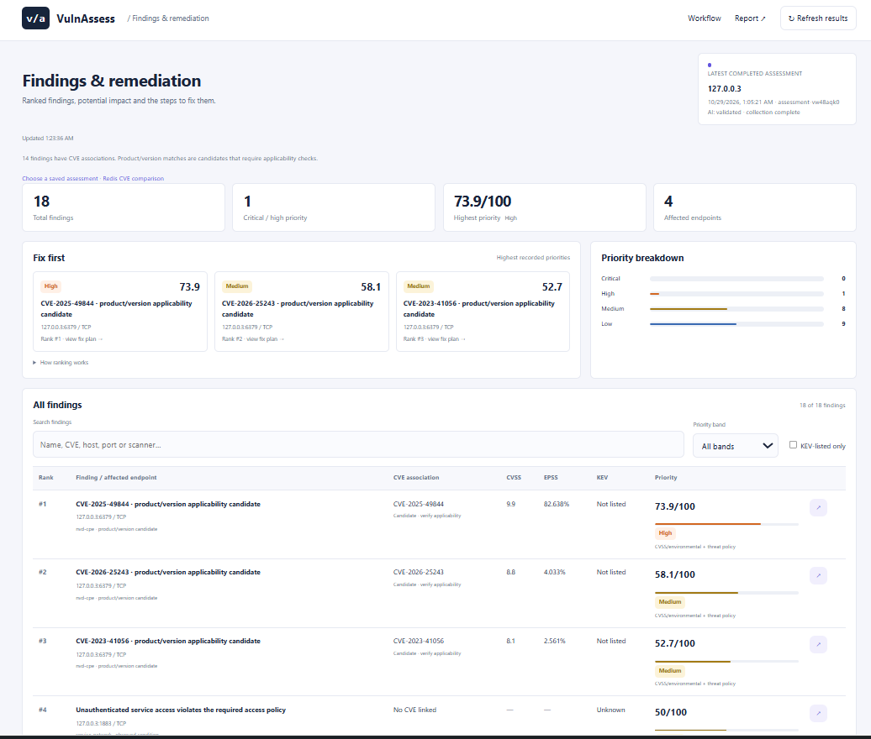
IoT Lab | Demonstration
Lab interface and recorded assessment
LAB INTERFACE
RECORDED FINDINGS
06

