Slide 1
OFFICE ENVIRONMENT
Office network lab
A simulated workplace with real network services
HOW IT RUNS
Docker Desktop + WSL 2
File access
FTP file transfer and SMB file sharing
Containers run real services behind the local gateway at 127.0.0.2.
Remote access
SSH login and credential checks
Comparison
Open and restricted endpoints
Backend
Assessment
Service discovery and evidence-based ranking
Python: pyftpdlib, AsyncSSH, Impacket
Redis 7.0.11
Nmap and protocol checks collect evidence. Context, threat data and AI help explain the results.
VulnAssess / Network environments
01
Notes:
Docker Compose defines office, office-gateway and a separately pinned Redis 7.0.11 container. The gateway exposes loopback 127.0.0.2, while services communicate on an internal Docker network. Docker Desktop on this PC uses WSL 2. Ports 2122, 2223 and 1446 provide comparison endpoints, although SMB signing must still be checked separately. Sources: C:/Users/aksha/Downloads/DE_Project/vulnassess-integration/labs/service_networks/compose.yaml and labs/service_networks/office.py.

Slide 2
OFFICE ENVIRONMENT
Office network: what was found
05
Security problems detected
FTP 2121 Anonymous login accepted
observed policy issues
SMB 1445 Guest access accepted
SMB 1445 / 1446 Signing not enforced
SSH 2222 A prohibited lab credential worked
16 Redis CVE candidates
Redis version matches require a package and patch check before CVE applicability is confirmed.
Action: restrict guest access, enforce signing and remove the weak credential. Retest each change.
VulnAssess / Network environments
02
Notes:
Evidence: saved assessment assessment-olcrd_yq, host 127.0.0.2. Five service-network policy findings: FTP authentication at TCP/2121, SMB authentication and signing at TCP/1445, SMB signing at TCP/1446, and the designated lab credential at SSH TCP/2222. There were also 16 nvd-cpe product/version candidates for Redis 7.0.11. CVE applicability depends on package/patch status, configuration and advisory prerequisites; it is not confirmed by a version match. Source: C:/Users/aksha/Downloads/DE_Project/vulnassess-integration/data/live/raw/assessment-olcrd_yq/case.json.

Slide 3
IOT ENVIRONMENT
IoT network lab
A simulated device network with real message traffic
HOW IT RUNS
Docker Desktop + WSL 2
Telemetry
MQTT sensor messages and broker access
An isolated container network uses the local gateway at 127.0.0.3.
Monitoring
SNMP device-management requests
Transport
TLS certificate and trust checks
Backend
Assessment
Service discovery and evidence-based ranking
Python: aMQTT, PySNMP, TLS
Redis 7.0.12
VulnAssess checks broker access, management responses and certificate trust, then prioritizes the evidence.
VulnAssess / Network environments
03
Notes:
Docker Compose defines iot, iot-gateway and a separate Redis 7.0.12 container on an internal Docker network. MQTT uses aMQTT 0.11.4; SNMP uses PySNMP 7.1.30; Python cryptography supplies the training certificate. The gateway maps TCP and UDP ports onto host loopback 127.0.0.3. Comparison endpoints include MQTT 1884 and SNMP 1162. Sources: C:/Users/aksha/Downloads/DE_Project/vulnassess-integration/labs/service_networks/compose.yaml, labs/service_networks/iot.py and labs/service_networks/requirements.txt.

Slide 4
IOT ENVIRONMENT
IoT network: what was found
04
Security problems detected
MQTT 1883 Anonymous access accepted
observed policy issues
SNMP 1161 Public community accepted
TLS 8883 Certificate expired
TLS 8883 Certificate trust check failed
14 Redis CVE candidates
Both labs use Redis. Version matches require verification; they are not confirmed exploits.
Action: restrict MQTT and SNMP access, replace the certificate, and retest.
VulnAssess / Network environments
04
Notes:
Evidence: saved assessment assessment-4diydwjb, host 127.0.0.3. Four service-network findings: anonymous MQTT access at TCP/1883, SNMP public-community access at UDP/1161, expired TLS certificate at TCP/8883, and certificate-chain trust verification failure at the same TLS endpoint. The latter two are separate checks on one certificate, not two different endpoints. Fourteen NVD product/version candidates were recorded for Redis 7.0.12; package applicability and exploitability remain unverified. Source: C:/Users/aksha/Downloads/DE_Project/vulnassess-integration/data/live/raw/assessment-4diydwjb/case.json.

Slide 5
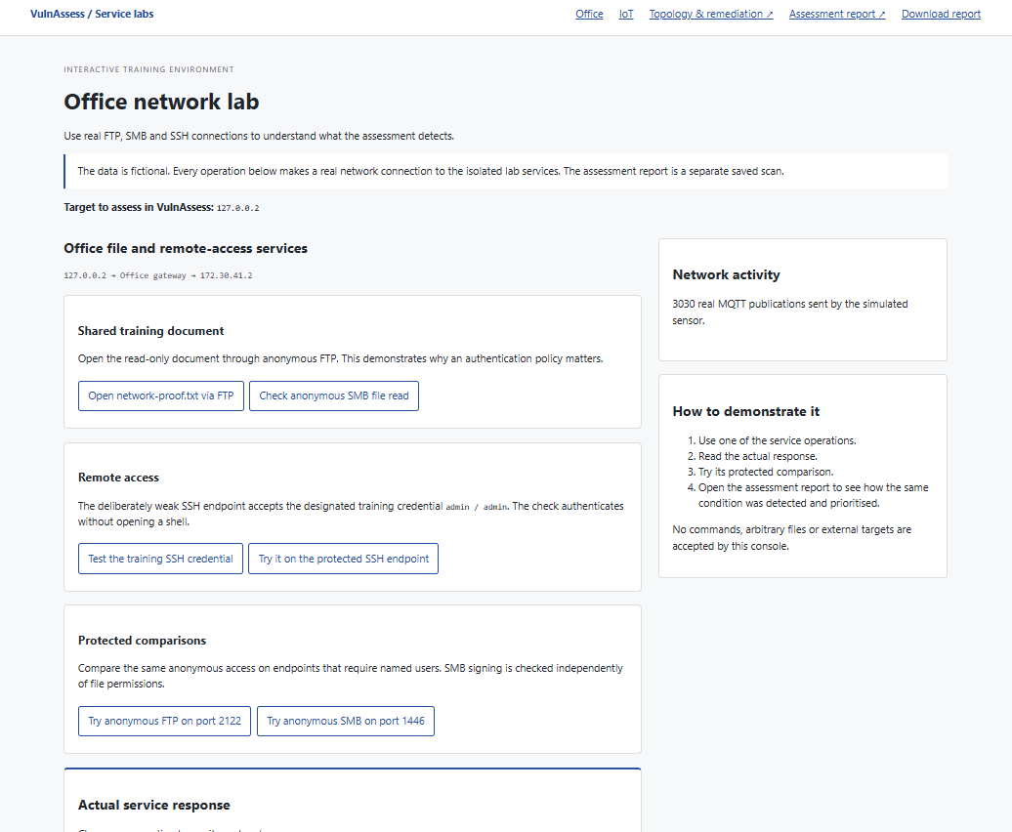
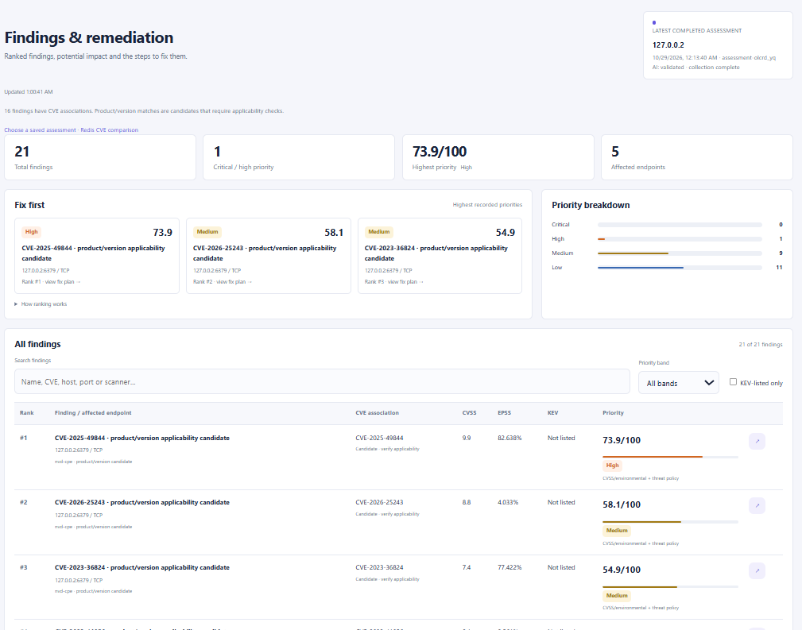
Office lab and assessment
Lab interface
Recorded findings
Notes:
Screenshots supplied in the original presentation. The left image shows the local lab interface; the right image shows the assessment results. CVE version matches shown in the results are candidates and require applicability verification.

Slide 6
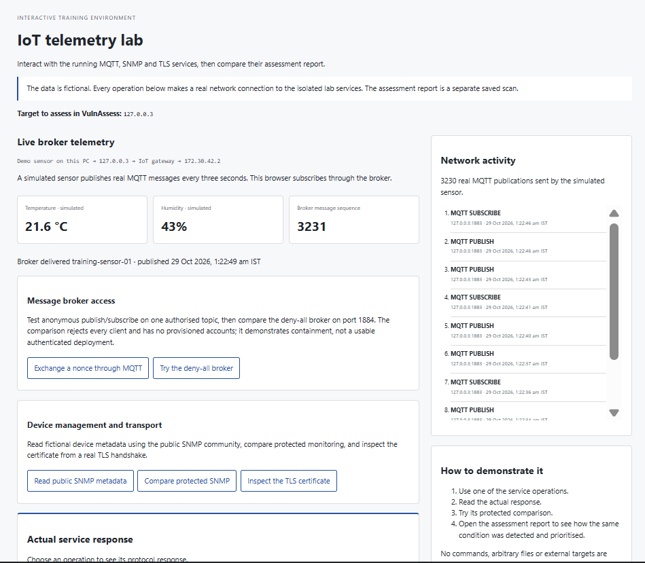
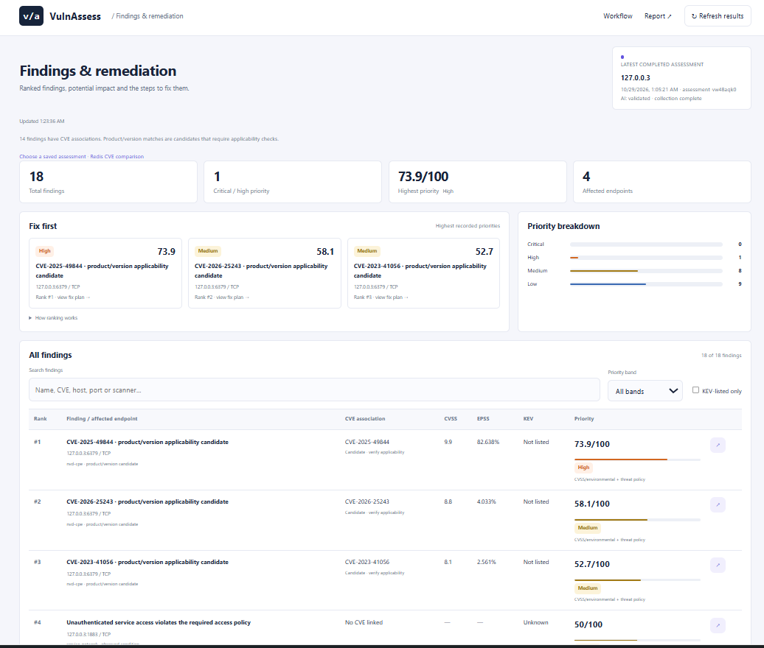
IoT lab and assessment
Lab interface
Recorded findings
Notes:
Screenshots supplied in the original presentation. The left image shows the local lab interface; the right image shows the assessment results. CVE version matches shown in the results are candidates and require applicability verification.

