Slide 1
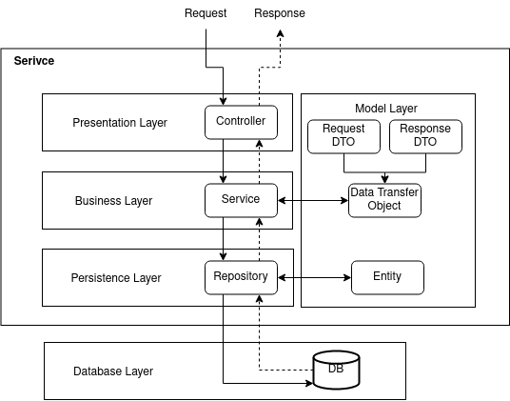
ProcessorInfoDTOSerializer
HardwareInfoDto
HardwareInfoController
HardwareInfoService
HardwareInfoDao
HardwareInfo

Slide 2
http://localhost:8080/hardwareinfo
HardwareInfo
HardwareInfoDao
public HardwareInfo getHardwareInfo() {
CriteriaBuilder cb = entityManager.getCriteriaBuilder();
CriteriaQuery<HardwareInfo> cq = cb.createQuery(HardwareInfo.class);
Root<HardwareInfo> rootEntry = cq.from(HardwareInfo.class);
CriteriaQuery<HardwareInfo> all = cq.select(rootEntry);
TypedQuery<HardwareInfo> allQuery = entityManager.createQuery(all);
allQuery.setMaxResults(1); // Define consulta deve retornar um registro
try {
return allQuery.getSingleResult();
} catch (NoResultException e) {
// Se nenhum resultado for encontrado, retorne null ou
// trate de acordo com sua lógica de negócio
return null;
}
}
HardwareInfoController
@GET
@Produces(MediaType.APPLICATION_JSON)
public String getHardwareInfo() {
return hardwareInfoService.getHardwareInfo();
}
HardwareInfoService
TypedQuery<HardwareInfo> allQuery = entityManager.createQuery(all);
public String getHardwareInfo() {
HardwareInfo hardwareInfo = hardwareInfoDao.getHardwareInfo();
ObjectMapper objectMapper = new ObjectMapper();
try {
return objectMapper.writeValueAsString(hardwareInfo);
} catch (JsonProcessingException e) {
// Trate a exceção ou retorne uma mensagem de erro apropriada
e.printStackTrace();
return "";
}
}
MySQL
Application.properties
# MySQL
quarkus.datasource.db-kind=mysql
quarkus.datasource.jdbc.url=jdbc:mysql://localhost:3306/pedra_hard_scan
quarkus.datasource.jdbc.driver=com.mysql.cj.jdbc.Driver
quarkus.datasource.username=rei
quarkus.datasource.password=123456
quarkus.hibernate-orm.database.generation=update
# quarkus.hibernate-orm.database.generation=update
quarkus.hibernate-orm.sql-load-script=insert-hardwareinfo.sql

