Slide 1
Problem & Solution
Why LacDictee exists
The Problem
The Solution
• Teachers correct dictée by hand
• 1–2 hours per class, per week
• Repetitive, error-prone process
• No structured feedback for students
• Upload reference text + student photo
• OCR reads handwriting automatically
• Claude AI detects errors
• Instant report with grade suggestion
⚡
Up to
→
90%
time saved
"We turn a 2-hour correction task into a 2-minute review."

Slide 2
Business Model
Who, How, and Where we grow
Customers
Market
Revenue
Go-To-Market
• French teachers
• Language schools
• Tutors & parents
• EdTech & Language Learning
• Growing AI adoption
• Underserved teacher segment
• Freemium — free for individuals
• Subscription (monthly / yearly)
• School licensing (future)
• Teacher Slack / LinkedIn groups
• Direct school outreach
• Demo-based adoption
Value Proposition
Before LacDictee
After LacDictee
Time Saved
1–2 hrs / week
2–5 minutes
80–90%
Organization
MVP: Solo founder | Next: AI engineer · Frontend dev · Education expert

Slide 3
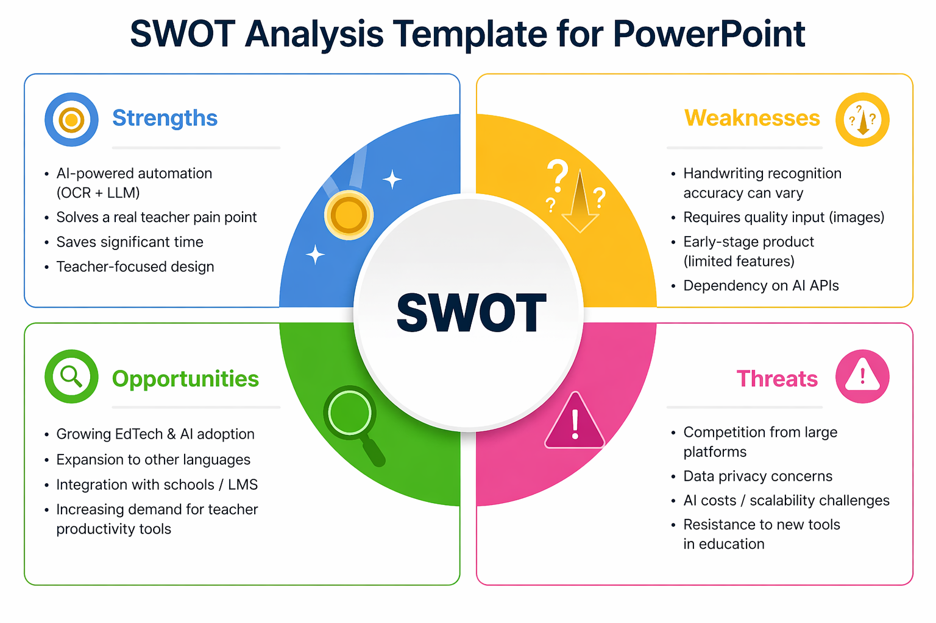
SWOT Analysis
Honest view of where we stand
Key Takeaways
Strength
Real problem, AI-powered, time-saving
Weakness
OCR depends on handwriting quality
Opportunity
EdTech growth + AI adoption wave
Threat
Privacy concerns + big competitors
LacDictee — MVP Architecture Defense — April 24, 2026

