Slide 1
Introduction to Computer Science
With the Python programming language

Slide 2
What is required for something to be considered a computer?
Microwave
Doorbell
Vending machine
Lamp
Calculator

Slide 3
Definitions
Computer: A machine that can carry out a sequence of operations as specified in a computer program.
Computer program: A detailed set of instructions telling a computer exactly what to do.

Slide 4
When was the first computer invented?
1920s
1837
1956
1984
1837 – Charles Babbage described his “analytical engine” which could perform arithmetic, control logic flow via branching and loops, and contained a means of storing the results.

Slide 5
What advantages do we gain with modern computers?
SPEED!!!!

Slide 6
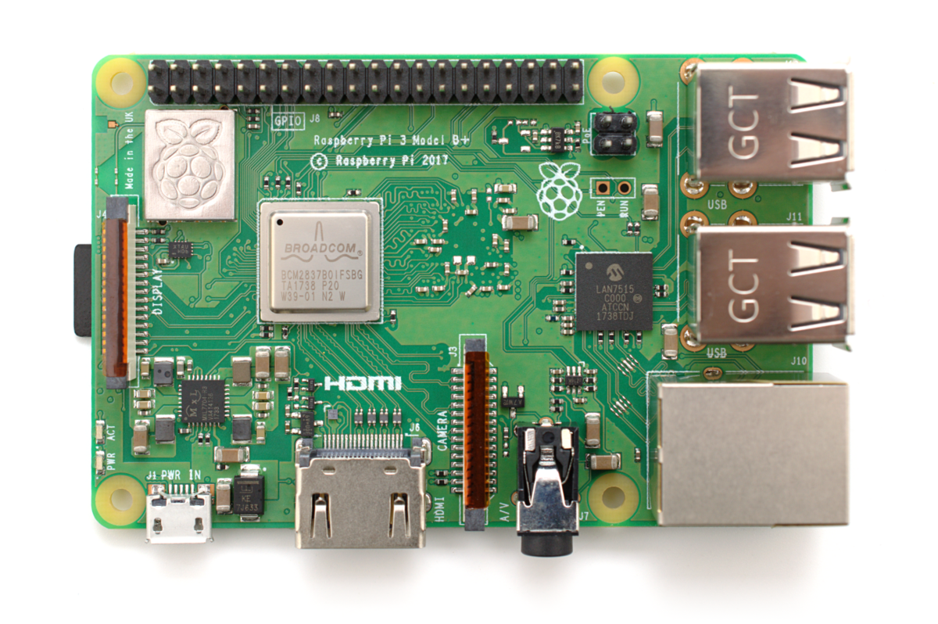

Slide 7
Main parts of a programmable computer
CPU – central processing unit
RAM – random access memory / volatile memory
HD / SSD – permanent storage mediums / stable memory
Input devices – mouse, keyboard, touch
Output devices – monitor, printer, motors

Slide 8
Computers
In the end, they are primarily used for running programs
As commonplace as cars, and like cars understanding how they work is different than being able to use them.
Computers are to computer science as telescopes are to astronomy. They (computers) are an important tool in the subject, but not the sole focus of it.
Like woodshop, know your tools, lets label the parts of the PI.

Slide 9
Linux shell
Terminal, command line, bash shell
Allows for launching all the various scripts, executables, and tools
Some command we will need to get around with:
ls - prints all files/folders in the current directory
cd - changes the current directory to a new one
mkdir - creates a new directory with the given name
mv - moves a file/folder from one location to another
cat - prints the contents of a file
cp - copies a file/folder from one location to another
nano - starts the text editor we will use in class to create our programs

Slide 10
Lab - create the following directory structure
+---Middle-Earth
| Hobbit
| Fellowship-of-the-Rings
| The-Two-Towers
| Return-of-the-King
|
\---Narnia
The-Lion-the-Witch-and-the-Wardrobe
Prince-Caspian
The-Voyage-of-the-Dawn-Treader
The-Silver-Chair
The-Horse-and-His-Boy
The-Magicians-Nephew
The-Last-Battle

Slide 11
Day 2 – Agenda
Give thanks
Orderly HW setup (4 items)
Programming languages
Pseudocode
Nano
Python
If time permits, guessing game

Slide 12
Software programs
"And the borrower is servant to the lender" (Prov 22:7), additionally, the hardware is servant to the software.
Software is written in one or more programming languages.
Two types of programming languages:
Compiled: takes the human readable text, and compiles/translates it to a form that the CPU can directly execute. Examples: C/C++, assembly, Ada, D, Rust
Interpreted: will execute the code one-instruction at a time, via an interpreter (a.k.a. virtual machine).

Slide 13
Pseudocode
Explaining what the code is doing, in human readable terms
Helps workout ideas, issues, and flow
Can be coded in any language, as it is human readable words/phrases
Example: print to the screen all odd numbers up to N
input = <get input number from user>
counter = 1
While counter is less than input:
If counter is odd:
print counter to screen
Increment counter to the next number
Notes:
Examples:
Sum of 1…N
Sum of odd numbers 1…N

Slide 14
Nano
One of those linux tools we will be using for programming
Much like a very simplified word processor, only fully controlled by the keyboard
Nano <name of file>
In the help menu at the bottom, ^ means the CTRL key
CTRL + O = save a file to disk, must give full path
CTRL + X = exits the program
CTRL + C = prints information about the file/cursor/state

Slide 15
Python
It is an interpreted language.
Allows for a REPL (read-evaluate-print-loop) in which we can interactively use the language
We will run this from the linux shell
From the terminal, try typing in:
python -c "print( 'Hello world' )"
What is displayed in response?
LAB

