Slide 1

Power Automate and Logic Apps: A Beginners Guide to Choosing The Correct Tech
Mandar Dharmadhikari

Slide 2





Who am I?
Manager at Accenture
Azure and Power Platform Architect and Developer
Agile and Continuous Delivery enthusiast
codidharma
@codidharma
mandar-dharmadhikari
https://codidharma.com

Slide 3
Agenda
Compare and Contrast features of Power Automate and Azure Logic Apps
Study use case and make a decision whether to use Power Automate or Logic Apps

Slide 4

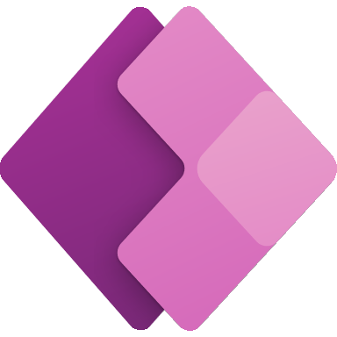
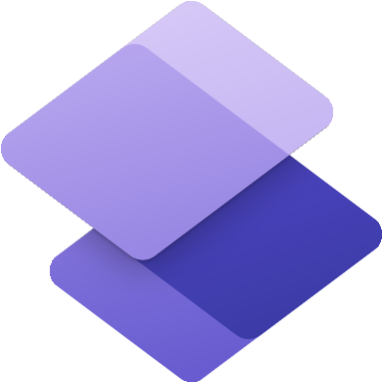
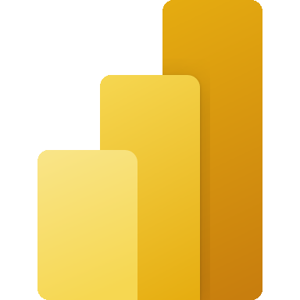



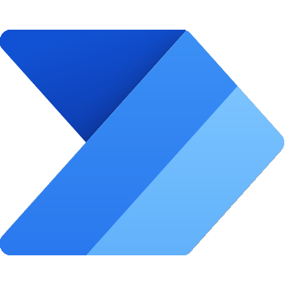
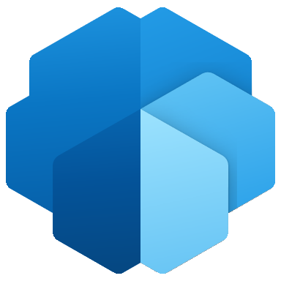

Power Platform: AN Introduction
ACT
Turn ideas into organizational solutions by enabling everyone to build custom apps that solve business challenges.
Quickly build low-code business websites for delivering vital information and services to your customers.
AUTOMATE
Boost business productivity to get more done by giving everyone the ability to automate organizational processes.
Act
The Organization
Analyze
Automate
ASSIST
Make informed, confident business decisions by putting data-driven insights into everyone’s hands.
ed.
ASSIST
Easily build chatbots to engage conversationally with your customers and employees—no coding required
Quickly build low-code business websites for delivering vital information and services to your customers.
ed.
Assist
Notes:
This is what I call the feedback loop every organization goes through in general. Something similar to your regular T shirt Quote “Eat- Workout- Sleep- Repeat”.
Talk about Act, Automate, Assist and Analyze
There are many ways to achieveing this feedback loop, employing pro developers or resorting to Low Code/ No Code paradigm of software development.
Microsoft Power Platform caters to the Low Code No Code paradigm of software development.
It provides different tools which work seamlessly with each other and other Microsoft Suite of Products like Azure and Microsoft 365 products like Outlook 365, Teams etc
The interconnectedness of the tools allows the citizen developers with the business knowledge to churn out apps / automations and ai models and analytics quickly.
Does that mean we do not need pro developers any more?
Not at all,
power platform provides the tools to bring agility and boosts the productivity of the workers by giving them the power to create apps that solve problems
Power platform with its low code no code tool, provides the agility to the organization in a fact that they can release software/ products MVPs quickly to market and get feedback on these and can have pro developers move in after analysis

Slide 5
Power Automate: an Introduction
Power Automate is a set Low Code automation workflow services provided as part of the Power Platform
With hundreds of connectors and pre built templates, automation of mundane tasks and mission critical tasks is very easy
Power Automate Generally Comprises of Following Different Flows
Digital Process Automation Flows: These are the flows used to automate business processes like approvals, teams creation, employee onboarding etc. These flows can be scheduled, automated, triggered from mobiles using Power Automate mobile etc.
Robotic Process Automation: Also called as desktop flows, these allows the developers to automate the tasks where generally APIs are not available to communicated with the systems. E.g. To automate policy issuance when the insurance system does not have API and is very old. This serves as a robust midterm continuity solution before the legacy system modernization
Business Process Flow: These flows provide a guided experience to get work done or achieve data entry. E.g. A business process flow to control how the machine part moves on the assembly line through production to quality control to shipping

Slide 6
Logic Apps: An Introduction
Azure Logic Apps is a cloud platform to create and run automated workflows using the low code software design paradigm.
With hundreds of connectors and pre built templates, automation of mundane tasks and mission critical tasks is very easy
Azure Logic Apps generally come in two flavors
Consumption : This mode allows the organization to deploy the logic apps in a multi tenant environment
Standard: This mode allows the organization to get dedicated compute and storage space

Slide 7
Comparison parameters
Service Subscription
Service Organization
Security
Design and Build
Operations and ALM
Governance

Slide 8
Service Subscription
Power Automate
Azure Logic Apps
Software as a Service offering
Multi Tenant in nature
Integrated out of box with the organization Azure Active Directory
Platform as a Service Offering
Supports both multi tenant (Consumption) and single tenant (Standard) options
Integrated out of the box with Azure Active Directory

Slide 9
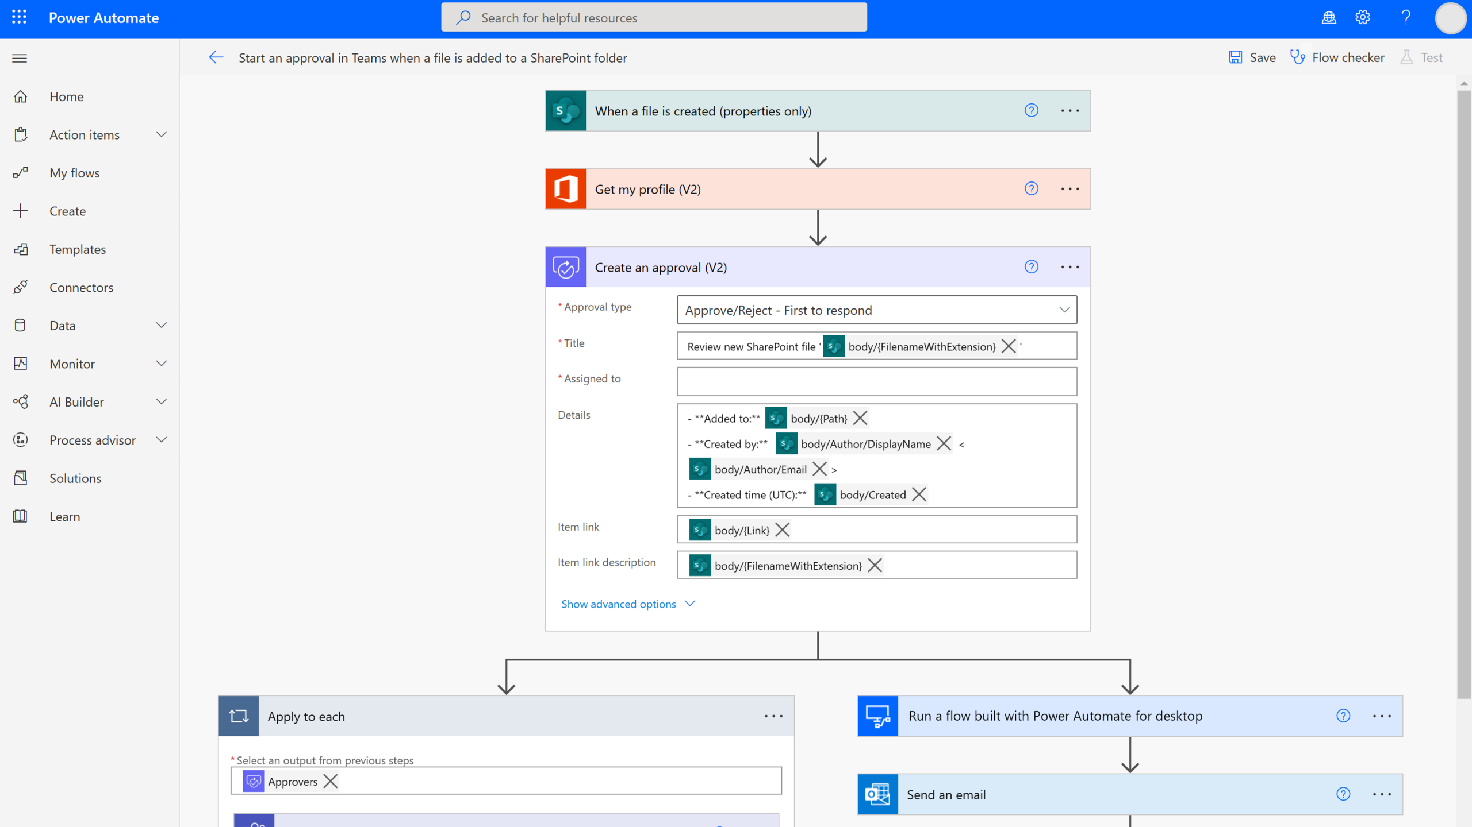
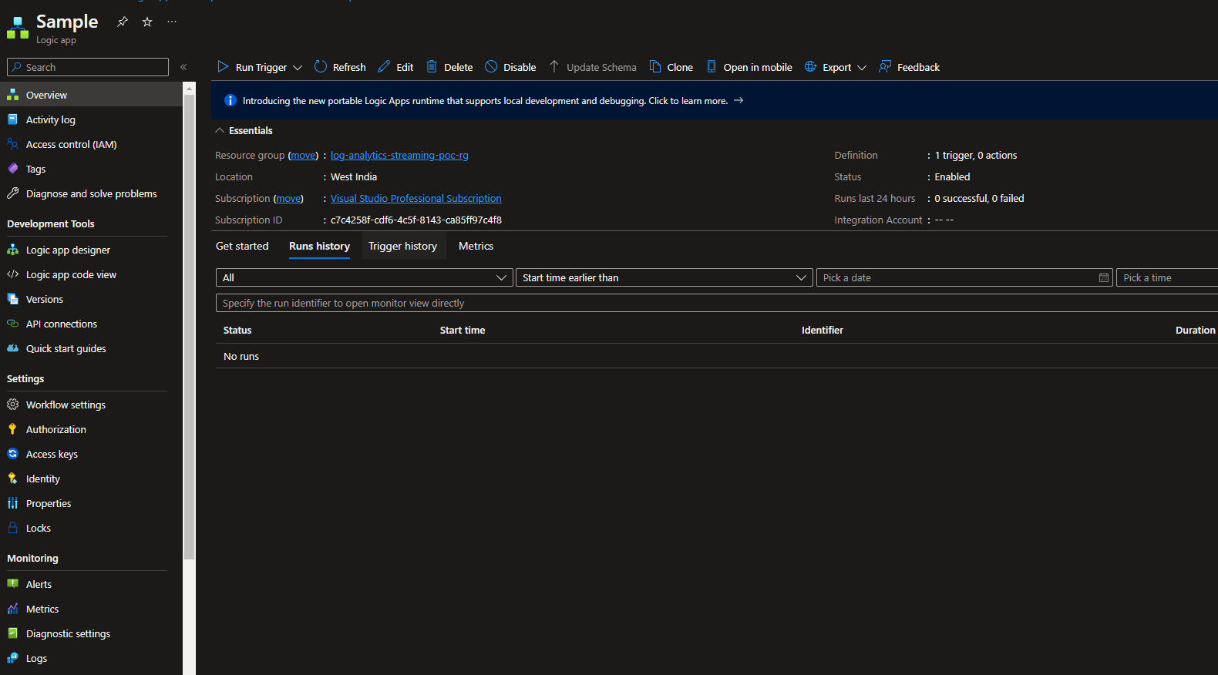
Service Organization
Power Automate
Azure Logic Apps
Power platform is organized based on the concept of the environments
Each environment is a separate entity which allows the org admins to set separate security policies and governance guidelines
Access to the environments and the power automates can be controlled using Security Groups, Teams and Business Units
Power Automate resided under an environment
Power Automates can be built directly under context of the user in the environment and also can be grouped together in solutions to manage the ALM in a better way
Power Automate can be accessed/ built/managed through the power automate portal which provides a stream line view of the related activities
Azure resources are organized using a hierarchy of the Subscription > Resource Groups
Each subscription and resource group and logic app is a separate entity and allows the org admins to setup security and governance guidelines in a hierarchical as well as the individual fashion
Access to the Azure Logic Apps can be controlled using Access to Subscription, Resource group and individual logic app using Role Based Access Control
Azure Logic Apps need to be built under the context of the resource group
Azure Logic Apps can built and deployed using Azure Portal or Visual Studio Code or Visual Studio. The portal experience is generic in nature and derives from the standard experience for most Azure Services

Slide 10
Security
Power Automate
Azure Logic Apps
Azure AD serves as primary security level.
Further restrictions can be placed using the Environments, security groups and out of the box and custom security roles
API connectivity is secured using latest security protocols like SAML, OAUTH, HTTPS, Service Principals etc
On Premises connectivity is secured through the On Premises Data Gateway
Grouping of the connectors to exchange data between systems can be controlled using Data Loss Prevention Policies
License serve as another layer of security to provide access to the environments and the flows
Azure AD serves as primary security level.
Further restrictions can be placed using RBAC on resource groups and individual logic apps
API connectivity is secured using latest security protocols like SAML, OAUTH, Easy AUTH, Private endpoints, HTTPS, Managed Identities, Service Principals, IP Restrictions etc
On Premises connectivity is secured through the On Premises Data Gateway
Azure Logic Apps and the related resources can be grouped together and the connectivity can be limited using Virtual Networks (Logic Apps Standard and ISE environments)

Slide 11
Design and Build
Power Automate
Azure Logic Apps
Drag and Drop Low code mode of development
Design time errors can be identified using Flow Checker
There are hundreds of connectors built to connect with different systems
Ready made templates make building flows very easy
High Cohesion with the Microsoft 365 and other Power Platform services
Easy to set up teams, power apps integrations and approvals flows
Some connectors are premium connectors and require special licensing conditions to be met
Drag and Drop Low code mode of development
Design time errors can be identified when developers try to save logic app. More Verbose errors
There are hundreds of connectors built to connect with different systems
Easy to setup varied automation workflows for tasks ranging from cloud administration to resources management
Basic Approvals possible
Full support for building event driven, highly distributed enterprise integrations
Full support for B2B development scenario

Slide 12
Operations AND ALM
Power Automate
Azure Logic Apps
Design time errors can be identified using Flow Checker
Run history is available on the flow run details page
Performance of the connectors and errors etc can be monitored in the Power Platform Admin Centre
ALM can be bit tricky. Deployment from one environment requires flow connection fixed
Design time errors can be identified when developers try to save logic app. More Verbose errors
Run history is visible on the Portal and in Visual Studio as required
Major metrics, Errors etc. can be monitored in Azure
Ability to set up in depth observability using Azure Monitor
Streamlined ALM. CI CD setup is easy through the use of Bicep/ ARM templates. Deployment from one environment to another requires connection fix if done manually

Slide 13
Governance
Power Automate
Azure Logic Apps
Power Platform Admin Centre serves as the central location for all PP governance
Grouping of the connectors to exchange data between systems can be controlled using Data Loss Prevention Policies
Cross Tenant Restrictions can be placed
Power Platform Centre of Excellence Starter Kit to help Org Set up their COE
Azure Identity And Access Management
Azure Policies

Slide 14
Licensing
Power Automate
Azure Logic Apps
Developers/ Systems need licenses to build and Run Power Automate.
If the Org wants to utilize full capabilities of different Power Automate flows, dedicated licenses like Power Automate Per user Plan, Power Automate per user with attended RPA plan etc.
Orgs get the right to use Power Automate if they purchase any of the following licenses(Power Automate licenses are seeded)
Microsoft 365
Dynamics 365 Licenses
Power Apps per app plans
Power Apps per User plan
Power Apps Plan 1 or 2(grandfathered)
Use of premium connectors differs in case of seeded and dedicated licenses.
Seeded License: e.g. If a power apps call a flow which uses a premium license like HTTP, then a user having power apps license can execute the power automate as it is running within the context of the app
Dedicated License: A user / system needs to have a dedicated license to run the flow if it is not executed in a context of an app.
Azure Logic Apps Consumption works on Pay as You go model
Azure Logic Apps Standard pricing is governed by the Standard Plan for billing and pricing and is based on different parameters like vCPU and memory, Trigger actions and operation, storage operations, use of integration accounts etc.

Slide 15
Use Case

Slide 16
Good Banking CORP LTD.
Good Banking Corp has a backend Loans origination system which stores and manages the loans provided to different parties. The system exposes a exhaustive set of APIs to provide a way to consume/ update loan data
Good Banking Corp has a Customer Management system built using VB.NET and is a windows application.
Good Banking Corp plans to build a customer website which allows the prospective customers to submit the loan applications
Good Banking Corp also plans to build an Underwriting application for the bank underwriters to make a decision on the loans application
Good Banking Corp wants to implement following process for the requirements above
Faster go to market with a Minimal Viable Product to start exploring if they are on correct track
Implement a Guided Loans Origination Process for the Loans Officers
Implement a Guided Underwriting Process for the Underwriters
Implement integrations as required

Slide 17
Lets Analyze

Slide 18
Faster go to market with a Minimal Viable Product to start exploring if they are on correct track
Faster GTM means adoption of the low code – no code tools and services, so we select Power Platform. Since we have selected power platform, we choose Azure as the Cloud Service Provider due to the synergy between Power Platform and Azure
Implement a Guided Underwriting Process for the Underwriters
Implement Model Driven apps with business process flow for guided experience.
Implement approvals, meeting creations, contextual chats, Dataverse updates etc. with other team members using Power Automate as it has high cohesion with M365 and Power Platform products
Implement a Guided Loans Origination Process for the Loans Officers
Implement the business process flow (Power Automate) and embed in a model driven apps which the loans officer can use
On passing of the loan, the loan needs to sync back to the Originations System. Since it exposes API, and such APIs can be reused in other places and might need complex mapping and transformation logic, Create Logic Apps as the façade/ orchestrators on top of the Originations system and secure them through APIM. Call the Logic Apps through Power Automate Flows embedded in Model Driven Apps
Create a Desktop flow to sync the customer information into the legacy Customer Information System

Slide 19
Conclusion
There is no straight answer to the question: Power Automate or Logic Apps
It depends on the use case and the requirements
The organization which chooses the correct tool enable correct set of developers, will most likely succeed

Slide 20
Thank You !!!
codidharma
@codidharma
mandar-dharmadhikari
https://codidharma.com

