Slide 1

Department of Computer Science & Engineering
Acharya Institute of Technology
Soladevanahalli, Bengaluru 560 107
Presentation on
Decentralized To-Do List
A Blockchain-Based Task Management System
Presented by
Group No | Sl. No | Name | USN
4 | 1 | Chaithra C | 1AY23CS059
Dept of CSE

Slide 2
INTRODUCTION
Traditional to-do list applications rely on centralized systems, which can lead to data manipulation, security risks, and lack of user control.
Blockchain technology enables decentralized, transparent, and tamper-proof data management.
This project presents a Decentralized To-Do List that uses smart contracts to securely store and manage tasks on the blockchain.
The system ensures user ownership, data integrity, and trustless task management through wallet-based authentication.
Dept of CSE

Slide 3
PROBLEM STATEMENT
Most existing task management applications rely on centralized storage systems, which makes user data vulnerable to unauthorized changes, loss, or manipulation
Hence, there is a need for a decentralized system that ensures secure, transparent, and tamper-resistant task management
OBJECTIVES
To design and develop a decentralized task management system using blockchain technology
To integrate wallet-based authentication for user identity and data ownership
To provide efficient task operations such as adding, updating, deleting, and tracking completion status
Dept of CSE

Slide 4
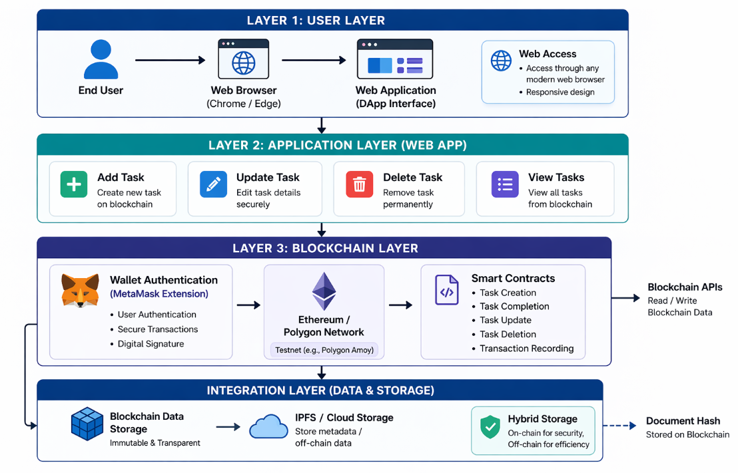
BLOCK DIAGRAM OF PROPOSED METHODOLOGY
Dept of CSE

Slide 5
PROPOSED METHODOLOGY
User Access & Interaction: Users access the system through a web browser and interact with the decentralized web application interface to manage their tasks.
Wallet Connection & Authentication: Users connect their wallet using MetaMask, which verifies their identity and ensures secure access to the system.
Task Creation & Management: Users can create, update, delete, and view tasks through the web interface, enabling efficient task management.
Transaction Processing: Each task operation is treated as a transaction and sent to the blockchain network for processing.
Smart Contract Execution: Smart contracts handle all task-related operations such as creation, updating, deletion, and status tracking securely.
Blockchain Validation: The blockchain network validates each transaction and ensures it is securely recorded in an immutable manner.
Dept of CSE

Slide 6
Requirement Specification
Non-Functional Requirements:
Sl. No | Non-Functional Requirement specification | Purpose
1 | Performance & Response Time | To ensure the system processes task operations quickly and provides real-time updates without delay.
2 | Transparency | To provide a clear and verifiable system where all task operations are recorded on blockchain and can be trusted by users.
3 | Data Security & Integrity | To protect task data using blockchain technology, preventing unauthorized access, modification, or deletion.To ensure that once a task is recorded, it remains immutable and tamper-proof.
Dept of CSE

Slide 7
Requirement Specification
Functional Requirements:
Sl. No | Functional Requirement specification | Purpose
1 | User Authentication (Wallet-Based Login) | To allow users to securely access the system using MetaMask wallet authentication.
2 | Task Creation & Storage | To enable users to create tasks and store them securely on the blockchain.
3 | Task Management (Update & Delete) | To allow users to update or delete tasks as needed.
4 | Task Status & Retrieval | To allow users to mark tasks as completed/pending and view tasks from the blockchain.
Dept of CSE

Slide 8
Software Requirements
Sl. No | Software Requirement detail
 | Software Tool Name | Software class (frame work/ programming language/ database/front end technology or other tools) | Purpose
1 | Visual Studio Code | Code Editor / Development Environment | Used for developing frontend interface and writing smart contract code.
2 | Node.js | Runtime Environment | Used to run the application and manage blockchain interaction.
3 | Solidity & Remix IDE | Blockchain Programming Language & Development Tool | Used to write, compile, and deploy smart contracts for task management
3 | MetaMask & Ethers.js | Wallet & Blockchain Interaction Library | Used for wallet authentication and interaction between web app and blockchain.
Dept of CSE

Slide 9
Hardware Requirements
Sl. No | Hardware Requirement details
 | Hardware device Name | Hardware device specification | Purpose
1 | Laptop / Desktop Computer | Intel i5 or higher, 8 GB RAM, 256 GB Storage | Used for developing the web application, writing smart contracts, and testing the system.
2 | Stable Internet Connection | Minimum 10–20 Mbps broadband | Required for interacting with blockchain network, MetaMask transactions, and real-time task updates.
3 | Blockchain Node / Network Access | Polygon Amoy Testnet (via MetaMask) | Used to deploy, run, and interact with smart contracts on the blockchain network.
Dept of CSE

Slide 10
Details of Project Modules Identified
Project Module Number | Project Module Name | Functional Requirement achieved | Project Objective Achieved
Module 1 | User Interface Module | • Connect wallet (MetaMask) • Add tasks • Update/Delete tasks • View tasks | • Provide easy and interactive user experience • Enable efficient task management
Module 2 | Task Management Module | • Create task • Update task • Delete task • Mark task as completed | • Manage tasks effectively • Track task progress accurately
Module 3 | Blockchain Module | • Store tasks on blockchain • Execute smart contract functions • Record transactions | • Ensure data security and immutability • Provide transparent and tamper-proof system
Module 4 | Data Retrieval & Display Module | • Fetch tasks from blockchain • Display real-time task data | • Provide updated task information • Improve usability and user trust
Dept of CSE

Slide 11
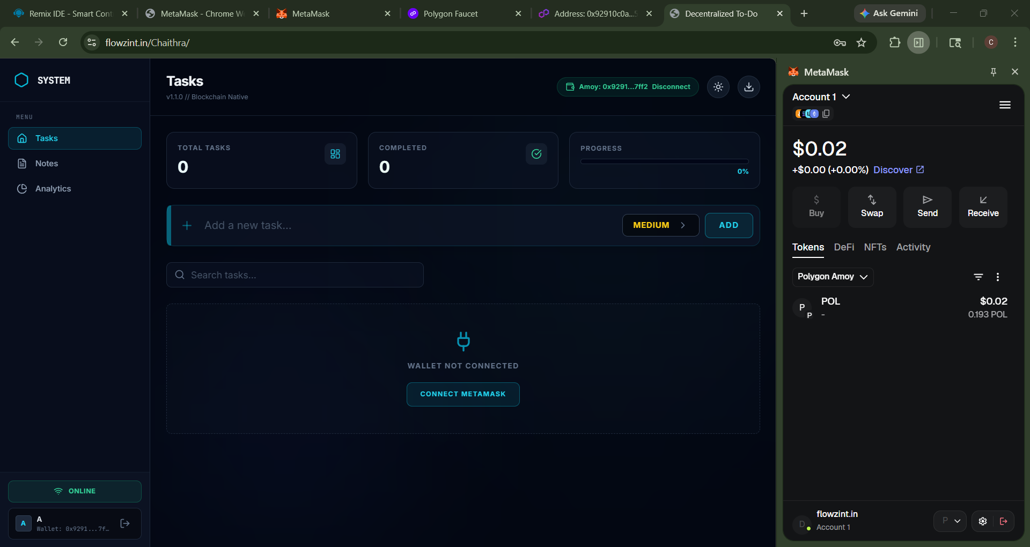
PROJECT TESTING SCREENSHOT
Dept of CSE

Slide 12
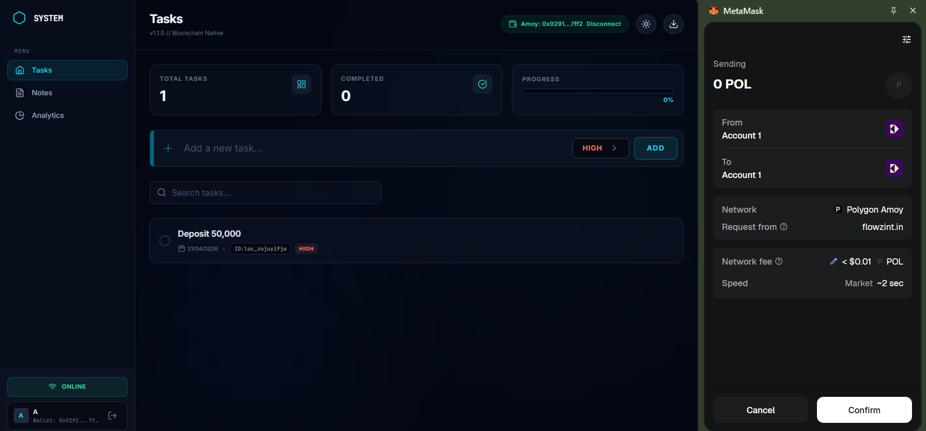
PROJECT TESTING SCREENSHOT
Dept of CSE

Slide 13
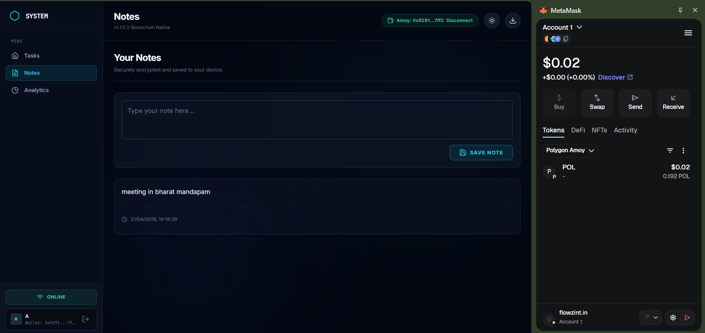
PROJECT TESTING SCREENSHOT
Dept of CSE

Slide 14
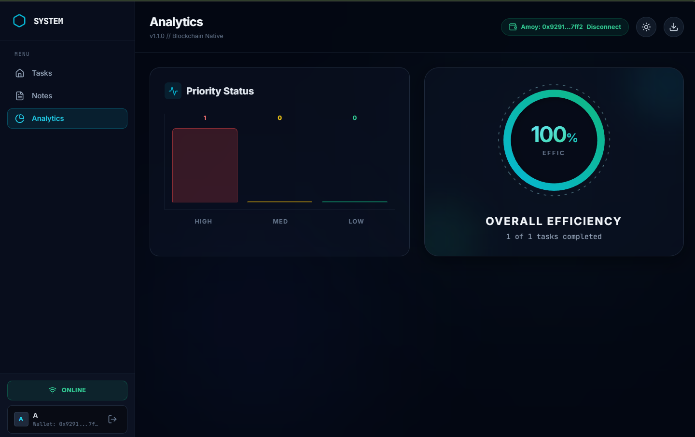
PROJECT TESTING SCREENSHOT
Dept of CSE

Slide 15
RESULTS & DISCUSSIONS
RESULTS:
The system successfully enabled secure and transparent task management using blockchain.
Each task operation was recorded as an immutable transaction, preventing unauthorized modification.
The system ensured user-controlled data access through wallet authentication, enhancing security.
Task operations such as creation, update, and deletion were performed efficiently and accurately.
Tasks were fetched and displayed in real-time, providing a smooth user experience.
DISCUSSIONS:
Blockchain technology improved security, transparency, and reliability in task management.
The decentralized system removed dependency on a central authority or server.
Smart contracts ensured automation and consistency in task operations.
It demonstrates strong potential for secure decentralized applications in real-world use cases.
Dept of CSE

Slide 16
CONCLUSION & FUTURE SCOPE
CONCLUSION :
The Blockchain-Based To-Do System provides a secure, transparent, and tamper-proof task management platform.
Smart contracts automate task operations, reducing manual effort and errors.
Real-time task updates improve efficiency and provide a smooth user experience.
Overall, the system increases trust, security, and data integrity in task management.
FUTURE SCOPE:
Integration with advanced authentication methods for enhanced security and user verification.
Deployment on public blockchain networks for large-scale real-world usage.
Development of a mobile-friendly or progressive web application for better accessibility.
Dept of CSE

Slide 17
REFERENCES
[1] Nakamoto, S. (2008), Bitcoin: A Peer-to-Peer Electronic Cash System
[2] Buterin, V. (2014), Ethereum Whitepaper
[3] Polygon Technology – https://polygon.technology
[4] Ethers.js Documentation – https://docs.ethers.org
[5] MetaMask Documentation – https://metamask.io
[6] Solidity Documentation – https://docs.soliditylang.org

Slide 18

Dept of CSE

