Slide 1

Welcome to the course of
Full Stack Development
TCS693
Prepared by:
Sharath K R
Assistant Professor, Dept of CSE
Graphic Era ( Deemed to be University)
“ Beginning is always difficult don’t give up”

Slide 2
UNIT – 1 08 Hours
HTML: Introduction to HTML5, How HTML5 is different from previous HTML versions, Semantic elements of HTML5, HTML5 Tags and Syntax, HTML-formatted tables, Lists, Forms, Images and Icons, Hyperlink tag, Videos, Useful tags, Accessibility in HTML5, The W3C Markup Validation Service.
CSS: Introduction and need of CSS, basic syntax and structure, types of CSS, background images, colors and properties, manipulating texts, using fonts, borders and boxes, padding, margin, positioning using CSS. Introduction to Bootstrap.

Slide 3
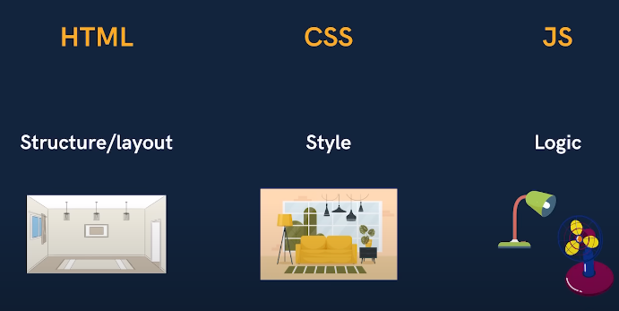
Introduction to HTML HTML stands for Hyper Text Markup Language
Hypertext defines the link between the web pages. The markup language is used to define the text document within the tag which defines the structure of web pages
HTML is the language in which most websites are written. HTML is used to create pages and make them functional.

Slide 4
Html 5
Latest version of Html.
It has improved the markup available for documents and has introduced application programming interfaces (API) and Document Object Model (DOM).
Features of Html 5
It has introduced new multimedia features which supports both audio and video controls by using <audio> and <video> tags.
Drag and Drop- The user can grab an object and drag it further dropping it to a new location.
Geo-location services- It helps to locate the geographical location of a client.
Uses SQL database to store data offline.
Allows drawing various shapes like triangle, rectangle, circle, etc.
Easy DOCTYPE declaration i.e., <!doctype html>

Slide 5
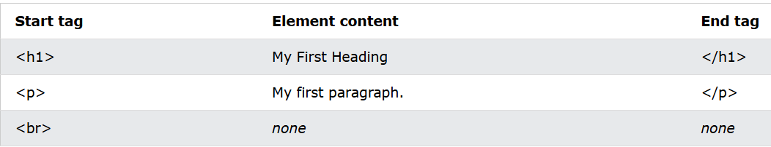
What is a HTML element?
An HTML element is defined by a start tag, some content, and an end tag:
Some Html elements do not have content, they are called empty elements, they don’t have end tags.
What is the purpose of web browser?
The purpose of a web browser (Chrome, Edge, Firefox, Safari) is to read HTML documents and display them correctly.
A browser does not display the HTML tags, but uses them to determine how to display the document

Slide 6
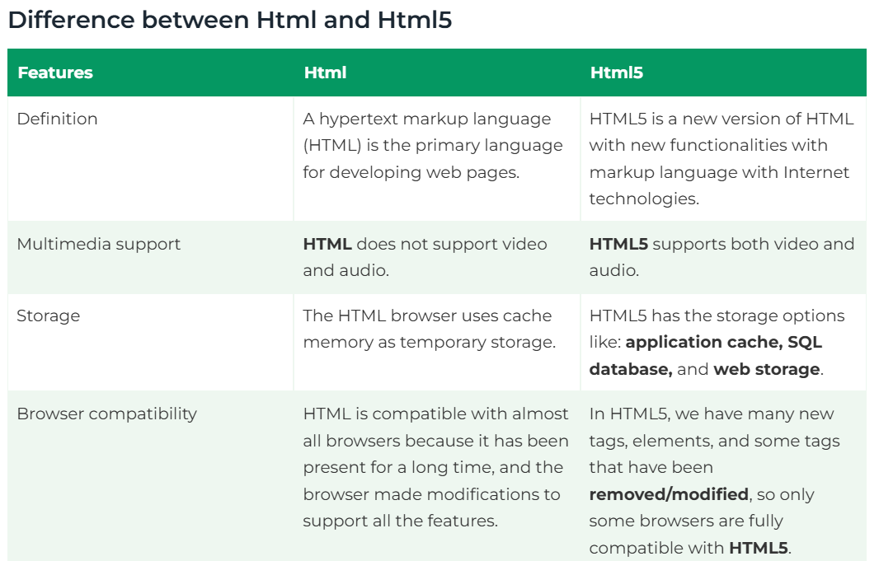

Slide 7
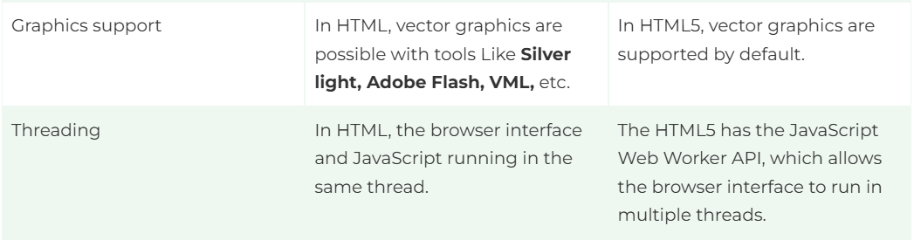
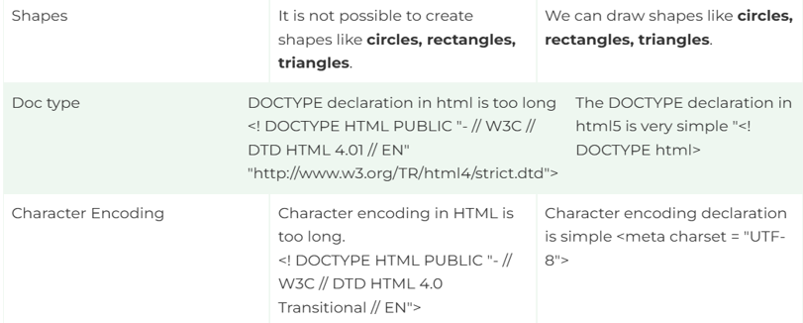

Slide 8
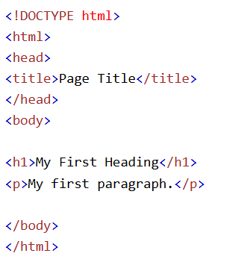
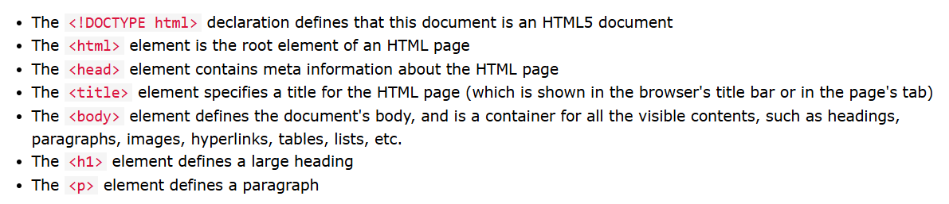
HTML Structure

Slide 9
Basic tags in HTML
The <html> tag is the parent tag for all HTML elements. Everything related to create an HTML document must be written inside the <html> tag. CSS, JavaScript, and jQuery must also be written inside this tag.
The <head> tag is a container tag for all those elements that are not directly displayed on the webpage but required for the page functionalities. It contains meta tags
The <title> tag is used to define the title of the webpage that you can see in the browser's tab, bookmarks list, and search engine results.
The <body> tag is the container tag for all those elements, which represents the main content of a webpage that displays on the browser.

Slide 10
The <h1> tag is one of the heading tags. It is the most important heading tag, which defines the main title or headline of the webpage.
The <p> tag defines a paragraph, anything written inside <p> and </p> displays as a paragraph on the webpage. Use multiple <p> tags to display text in different paragraphs.
Whenever you use the <br /> element, anything following it starts from the next line. This tag is an example of an empty element
The <center> tag aligns text, images, or other HTML elements in the middle of a web page.
The horizontal rule (<hr>) tag displays a horizonal line. A horizontal line visually breaks up sections of a document.
Non-breaking spaces prevent an automatic line break and are displayed using the &nbsp; entity.

Slide 11
HTML Attributes
HTML attributes are special words that provide additional information to an HTML element. Attributes are placed inside the element's opening tag, and they are used to configure or adjust the element's behavior.
<p align="left">Left Aligned</p>
The id attribute of an HTML tag can be used to uniquely identify any element within an HTML page.
Image Tag
An <img> element must have two attributes: src, which fetches the image from the specified source, and alt, which provides alternative text for the image.
Marquee tag
The <marquee> tag is used to create a scrolling effect for text or images. This tag can make content move left, right, up, or down, adding an interactive element to your web page.

Slide 12
Semantic Elements of Html 5
HTML5 introduced a range of semantic elements that clearly describe their purpose in human and machine-readable language. Unlike non-semantic elements, which provide no information about their content, semantic elements clearly define their content.
For instance, <form>, <table>, and <article> tags clearly define the content and purpose, to the browser.
Why Use Semantic HTML Tags?
Accessibility: Semantic elements make web pages more accessible. Screen readers and other assistive technologies can interpret the structure and navigate the content more efficiently.
Maintainability: Semantic HTML helps create a logically structured document, which is easier to read and maintain.

Slide 13
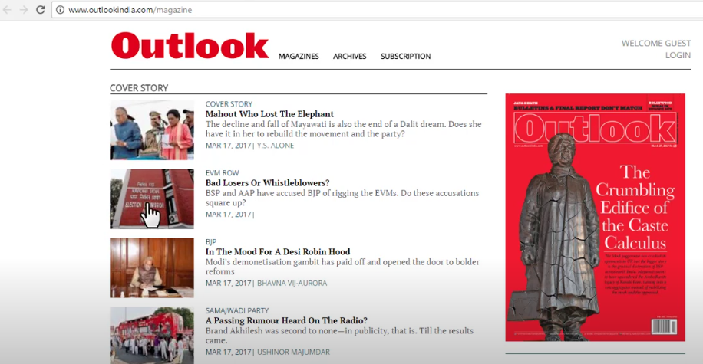

HTML 5 Tags
The <article> Tag
The <article> tag is used for content that stands alone and can be independently distributed or reused, such as a blog post or news article.

Slide 14
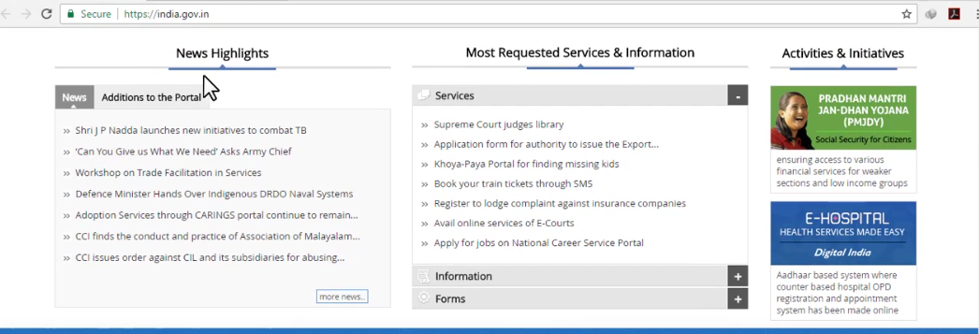
The <aside> Tag
It is used to place content in a sidebar i.e. aside from the existing content. It is related to surrounding content.
The Details and Summary Tag
The “details” defines additional details that the user can hide or view. “summary” defines a visible heading for a “details” element.
The Header Tag
As the name suggests, it is for the header of a section introductory of a page. There can be multiple headers on a page. Example: Logos, Name of the content

Slide 15
The Footer Tag
Footer located at the bottom of any article or document, they can contain contact details, copyright information etc. There can be multiple footers on a page.
The Main Tag
It defines the main content of the document. The content inside the main tag should be unique.
The Section Tag
A page can be split into sections like Introduction, Contact Information, Details, etc and each of these sections can be in a different section tag.
The nav Tag
It is used to define a set of navigation links in the form of a navigation bar or nav menu.
The Mark Tag
It is used to highlight the text.

Slide 16
The Anchor Tag
The <a> tag defines a hyperlink, which is used to link from one page to another.
The most important attribute of the <a> element is the href attribute, which indicates the link's destination.
The Button Tag
The <button> tag defines a clickable button.
Inside a <button> element you can put text (and tags like <i>, <b>, <strong>, <br>, <img>, etc.). That is not possible with a button created with the <input> element!

Slide 17
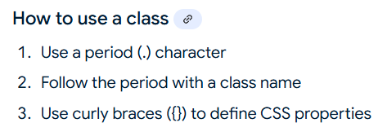
The Div Tag
The <div> tag defines a division or a section in an HTML document.
The <div> tag is used as a container for HTML elements - which is then styled with CSS or manipulated with JavaScript.
The <div> tag is easily styled by using the class or id attribute.
Any sort of content can be put inside the <div> tag!

Slide 18
.
The Style tag
The <style> tag is used to define style information (CSS) for a document.
Inside the <style> element you specify how HTML elements should render in a browser.
The <style> element must be included inside the <head> section of the document.
HTML Tables
HTML tables allow web developers to arrange data into rows and columns.
A table in HTML consists of table cells inside rows and columns.
Each table cell is defined by a <td> and a </td> tag. (td → Table data)
Each table row starts with a <tr> and ends with a </tr> tag.
Some times you want your cells to be table header cells. In those cases use the <th> tag instead of the <td> tag:
A table cell can contain all sorts of HTML elements: text, images, lists, links, other tables, etc.

Slide 19
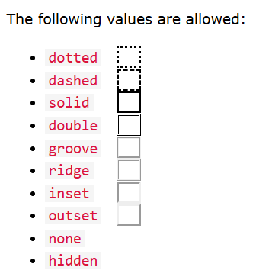
Table borders, Use collapse to avoid double line in borders.
With the border-radius property, the borders get rounded corners,
With the border-style property, you can set the appearance of the border.
To set the width of a table, add the style attribute to the <table> element:
To make a cell span over multiple columns, use the colspan attribute:

Slide 20
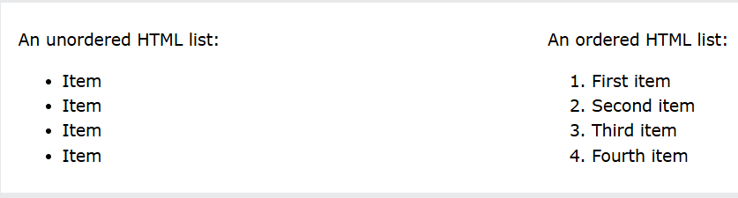
HTML Lists
HTML lists allow web developers to group a set of related items in lists.
There are 2 types of lists:
The items in an ordered list are automatically renumbered when items are added or removed
The items in an unordered list are marked with bullets by default.
An unordered list starts with the <ul> tag. Each list item starts with the <li> tag.
An ordered list starts with the <ol> tag. Each list item starts with the <li> tag.
Additional List item Markers can be used for unordered lists.

Slide 21
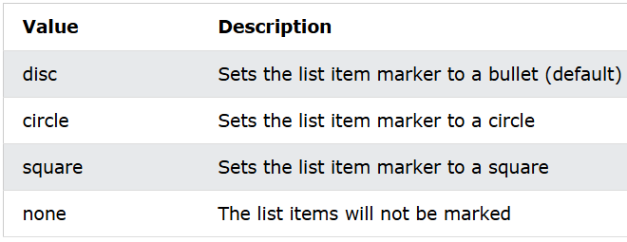
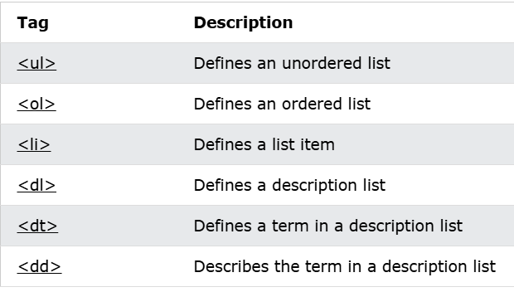
HTML also supports description lists.
A description list is a list of terms, with a description of each term.
The <dl> tag defines the description list, the <dt> tag defines the term (name), and the <dd> tag describes each term:

Slide 22
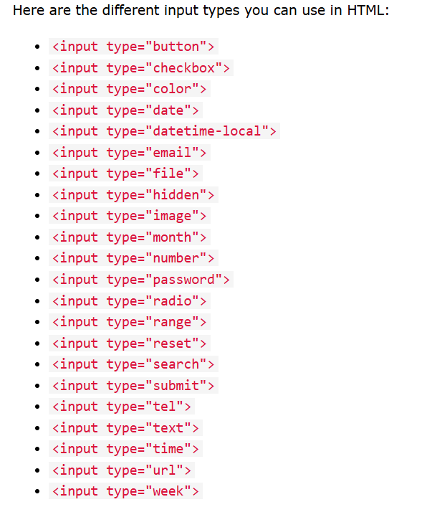
HTML Forms
An HTML form is used to collect user input. The user input is most often sent to a server for processing.
The <form> element is a container for different types of input elements, such as: text fields, checkboxes, radio buttons, submit buttons, etc.

Slide 23
The form-handler is typically a server page with a script for processing input data. The form-handler is specified in the form's action attribute.
The <select> element is used to create a drop-down list.
The <select> element is most often used in a form, to collect user input.
Label: Defines a label for an element.
For: When used together with the <label> element, the for attribute specifies which form element a label is bound to. The for attribute of <label> must be equal to the id attribute of the related element to bind them together.
Id: The id attribute assigns an identifier to the <label> element. The id allows JavaScript to easily access the <label> element. It is also used to point to a specific id selector in a style sheet.
Value: The value attribute is used differently for different input types: For "button", "reset", and "submit" - it defines the text on the button. For "text", "password", and "hidden" - it defines the initial (default) value of the input field.

Slide 24
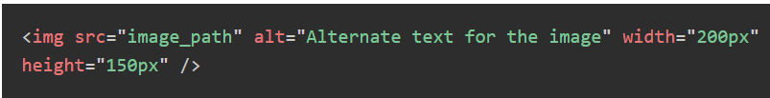
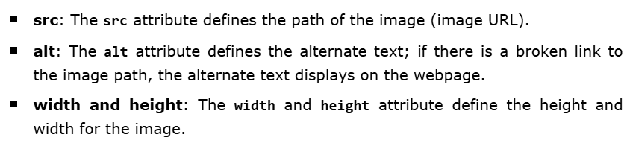
HTML Images and Icons
HTML images provide visual content for web pages, enhancing user experiences and conveying information. They can be photographs, graphics, icons, or illustrations.
Image location (path) must be clearly defined in the src attribute. You can follow the absolute path, which starts with root directory (/), then directory name (if any), and then image name with its extension.

Slide 25
Image Border
You can specify the border and its thickness in terms of pixels using the border attribute. A thickness of 0 means there is no border around the picture.
Image Alignment
By default, the image will align at the left side of the page, but you can use the align attribute to set it in the center or right.
Animated Images
You can also use animated images (having .gif extensions) on the webpages. There is no specific attribute required to show animated images; you can simply set the path of the animated image (.gif) in the src attribute.
Image Responsiveness
You can also make the images responsive, which will automatically adjust their size based on the device’s screen size and resolution.
Using
CSS
Picture tag

Slide 26
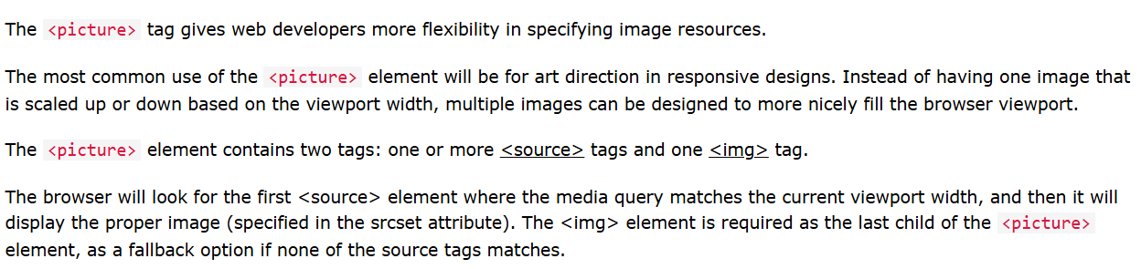
Using CSS, you can set the width of the image to 100%, which allows the image to scale proportionally to its parent container.
You can also display different images in different sizes or resolutions by using the <picture> tag, which is useful when you want to display different images based on the device.

Slide 27
HTML Icons
Icons in HTML are small images that show actions or items on a website, like a "home" button or a "search" symbol. They help people find things easily.
To insert an icon, add the name of the icon class to any inline HTML element.
The <i> and <span> elements are widely used to add icons.
To add icons to your HTML, you can use an icon library such as Font Awesome or Material Icons.
Here's an example of how to include Font Awesome icons in your HTML code:
First, add the Font Awesome CSS link to your HTML document's head section:
<link href="https://fonts.googleapis.com/icon? Family=Material+Icons" rel="stylesheet">
Next, add the icon class to the HTML element where you want to display the icon:
<i class="fas fa-heart"></i>
In this example, fas is the style prefix for the regular Font Awesome icons, and fa-heart is the icon class for the heart icon. You can search for available icons on the Font Awesome website.

Slide 28
The "rel" attribute in a <link> tag specifies the relationship between the current HTML document and the linked resource, essentially telling the browser and search engines how the linked document is connected to the current page, providing context about the link's purpose.
"stylesheet": Links to an external stylesheet for the current page
"alternate": Indicates an alternative version of the current document, like a printable version
"prev": Specifies the previous page in a series
"next": Specifies the next page in a series
Hyper Link Tag
Links are found in nearly all web pages. Links allow users to click their way from page to page.
You can click on a link and jump to another document.
A link does not have to be text. A link can be an image or any other HTML element!

Slide 29
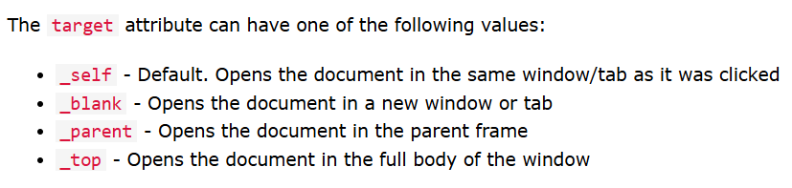
The most important attribute of the <a> element is the href attribute, which indicates the link's destination.
The link text is the part that will be visible to the reader.
<a href="https://www.geu,ac,in/"> Visit Graphic Era University </a>
By default, links will appear as follows in all browsers:
An unvisited link is underlined and blue
A visited link is underlined and purple
By default, the linked page will be displayed in the current browser window. To change this, you must specify another target for the link.
The target attribute specifies where to open the linked document.

Slide 30
Absolute and Relative URL’s
Both examples above are using an absolute URL (a full web address) in the href attribute.
A local link (a link to a page within the same website) is specified with a relative URL (without the "https://www" part):
Audio Tag
The <audio> tag is used to embed sound content in a document, such as music or other audio streams.
The <audio> tag contains one or more <source> tags with different audio sources. The browser will choose the first source it supports.
There are three supported audio formats in HTML: MP3, WAV, and OGG.

Slide 31
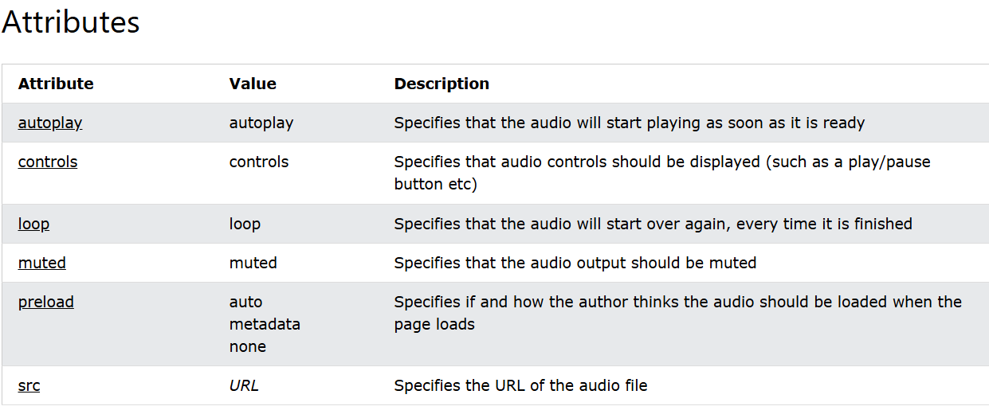

Slide 32
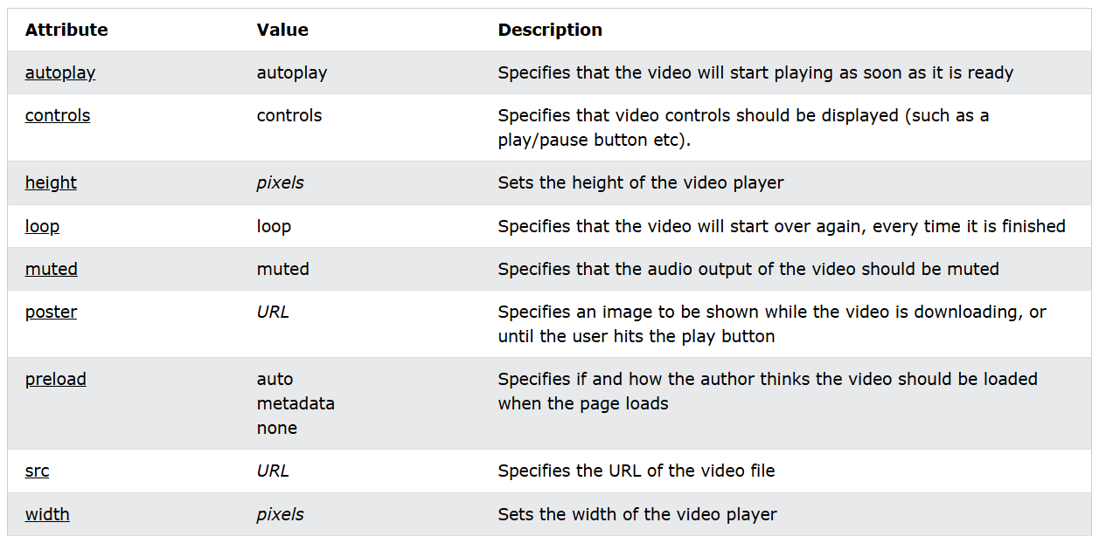
Video Tag
The <video> tag is used to embed video content in a document, such as a movie clip or other video streams.
The <video> tag contains one or more <source> tags with different video sources. The browser will choose the first source it supports.

Slide 33
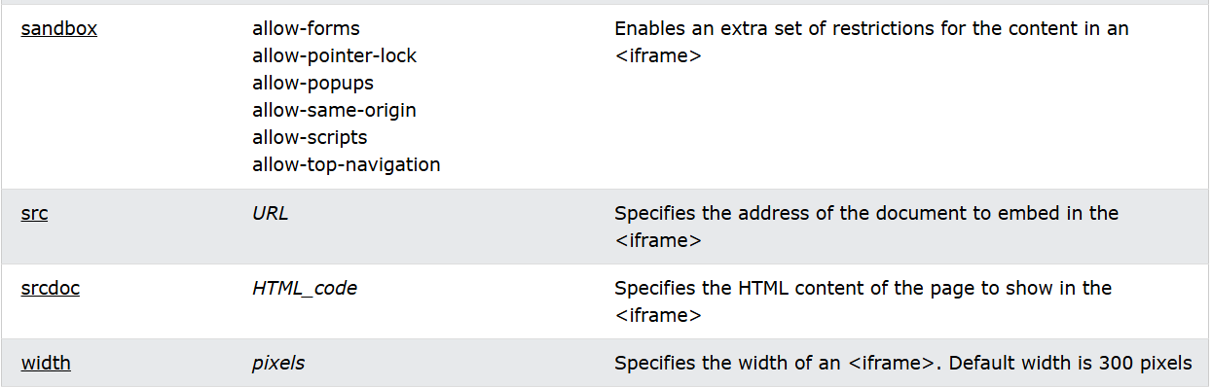
Useful Tags
Button Tag
Inside a <button> element you can put text (and tags like <i>, <b>, <strong>, <br>, <img>, etc.). That is not possible with a button created with the <input> element!
Iframe tag
The <iframe> tag specifies an inline frame.
An inline frame is used to embed another document within the current HTML document.

Slide 34
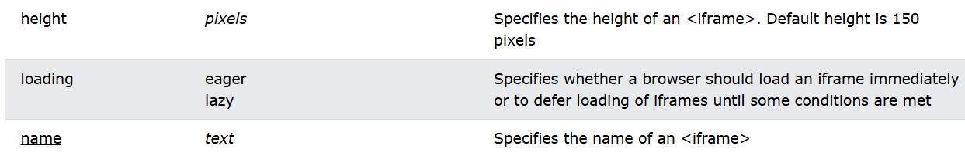
Meter Tag
The <meter> tag defines a scalar measurement within a known range, or a fractional value. This is also known as a gauge.
Examples: Disk usage, the relevance of a query result, etc.
Progress Tag
The <progress> tag represents the completion progress of a task.
The <progress> tag is not suitable for representing a gauge (e.g. disk space usage or relevance of a query result). To represent a gauge, use the <meter> tag instead.

Slide 35
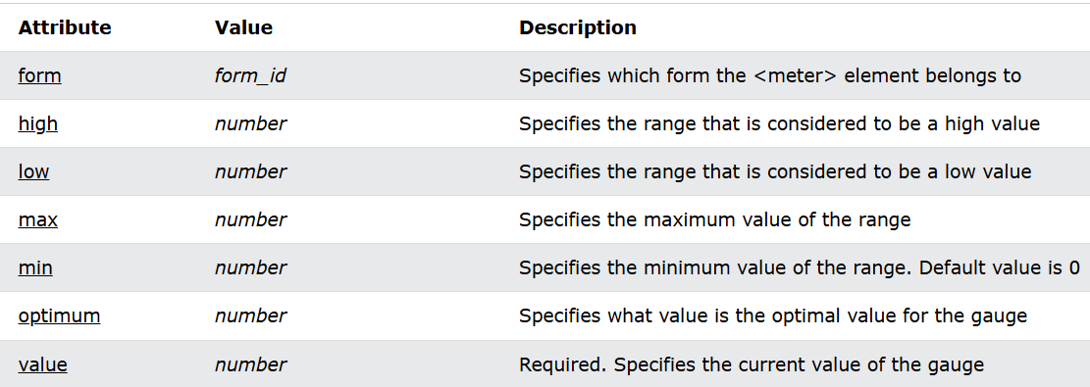
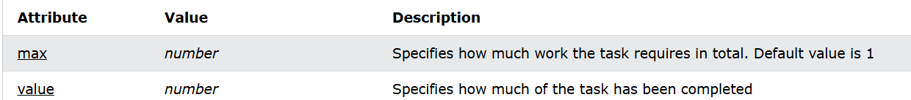

Slide 36
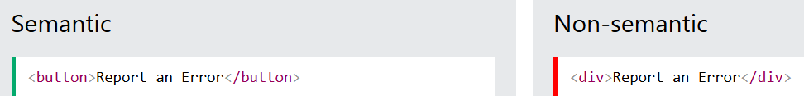
Accessibility in HTML 5
Accessibility in web refers to designing and developing websites, web applications, and digital content in a way that makes them usable and accessible for people with disabilities. This means that people with disabilities should be able to perceive, understand, navigate, interact with, and contribute to the web.
1. Semantic HTML
Semantic HTML means using correct HTML elements for their correct purpose as much as possible. Semantic elements are elements with a meaning; if you need a button, use the <button> element (and not a <div> element).
Semantic HTML gives context to screen readers, which read the contents of a page out loud.

Slide 37
With the button example in mind:
buttons have more suitable styling by default
a screen reader identifies it as a button
focusable
Clickable
Examples of non-semantic elements: <div> and <span> - Tells nothing about its content.
Examples of semantic elements: <form>, <table>, and <article> - Clearly defines its content.
2. Headings are important
Headings are defined with the <h1> to <h6> tags.
Search engines use the headings to index the structure and content of your web pages.
Users skim your pages by its headings. It is important to use headings to show the document structure and the relationships between different sections.

Slide 38
Screen readers also use headings as a navigational tool. The different types of heading specify the outline of the page. <h1> headings should be used for main headings, followed by <h2> headings, then the less important <h3>, and so on.
3. Use Alternative Text
The alt attribute provides an alternate text for an image, if the user for some reason cannot view it (because of slow connection, an error in the src attribute, or if the user uses a screen reader).
The value of the alt attribute should describe the image.
if a browser cannot find an image; it will display the value of the alt attribute:
4. Use clear language
Always use a clear language, that is easy to understand. Also try to avoid characters that cannot be read clearly by a screen reader.

Slide 39
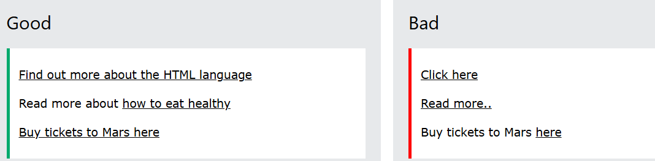
For example:
Keep sentences as short as possible
Avoid dashes. Instead of writing 1-3, write 1 to 3
Avoid abbreviations. Instead of writing Feb, write February
Avoid slang words.
5. Create Good link text
A link text should explain clearly what information the reader will get by clicking on that link.

Slide 40
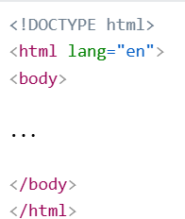
6 Declare the language
You should always include the lang attribute inside the <html> tag, to declare the language of the Web page. This is meant to assist search engines and browsers.
The following example specifies English as the language
7 Use Figures and Captions
HTML includes two elements — <figure> and <figcaption> — which associate a figure of some kind (it could be anything, not necessarily an image) with a figure caption

Slide 41
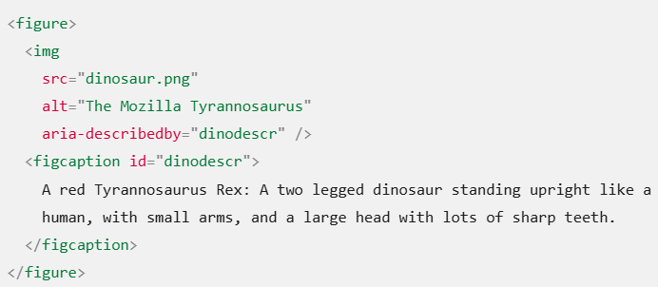
The W3C Markup Validation Service.
The Markup Validation Service is a validator by the World Wide Web Consortium (W3C) that allows Internet users to check pre-HTML5 HTML and XHTML documents for well-formed markup against a document type definition (DTD).
Markup validation is an important step towards ensuring the technical quality of web pages.

Slide 42
Introduction and Need of CSS
CSS is the language we use to style a Web page.
CSS stands for Cascading Style Sheets
CSS describes how HTML elements are to be displayed on screen, paper, or in other media
CSS saves a lot of work. It can control the layout of multiple web pages all at once
External stylesheets are stored in CSS files.
HTML was NEVER intended to contain tags for formatting a web page!
HTML was created to describe the content of a web page, like:
<h1>This is a heading</h1>
<p>This is a paragraph.</p>
When tags like <font>, and color attributes were added to the HTML 3.2 specification, it started a nightmare for web developers. Development of large websites, where fonts and color information were added to every single page, became a long and expensive process.
To solve this problem, the World Wide Web Consortium (W3C) created CSS.
CSS removed the style formatting from the HTML page!

Slide 43
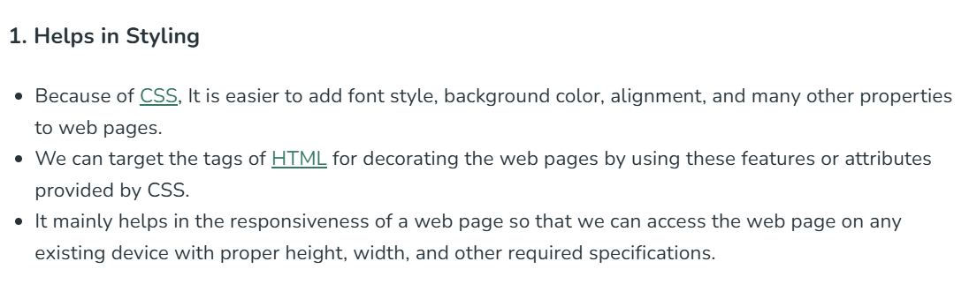
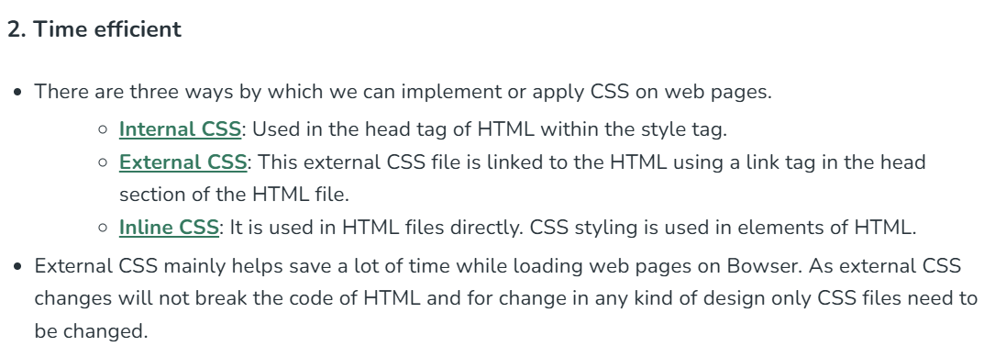
Need of CSS

Slide 44
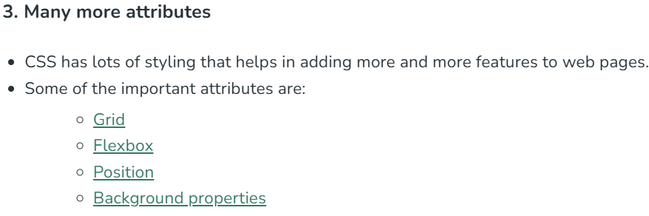
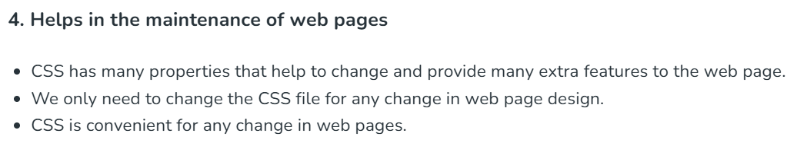

Slide 45
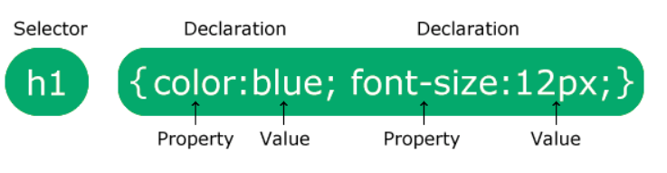
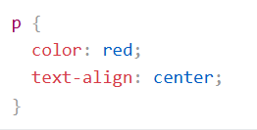
Basic Syntax and Structure
A CSS rule consists of a selector and a declaration block.
The selector points to the HTML element you want to style.
The declaration block contains one or more declarations separated by semicolons.
Each declaration includes a CSS property name and a value, separated by a colon.
Multiple CSS declarations are separated with semicolons, and declaration blocks are surrounded by curly braces.

Slide 46
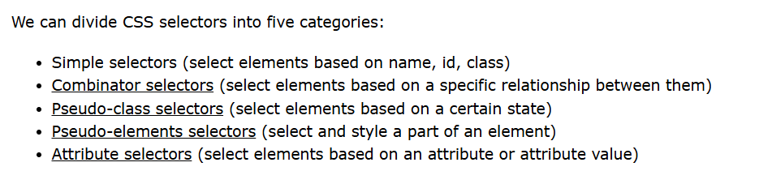
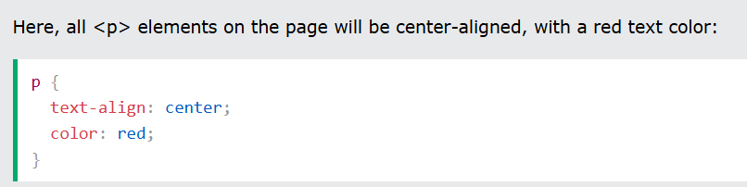
CSS Selectors
A CSS selector selects the HTML element(s) you want to style.
1. The Element Selector
The element selector selects HTML elements based on the element name.

Slide 47
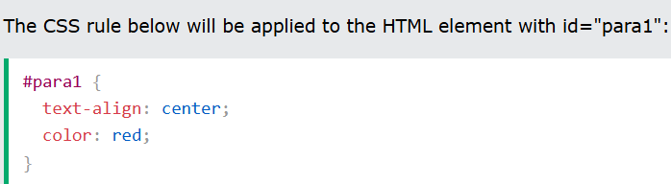
2. The CSS id Selector
The id selector uses the id attribute of an HTML element to select a specific element.
The id of an element is unique within a page, so the id selector is used to select one unique element!
To select an element with a specific id, write a hash (#) character, followed by the id of the element.
3. The CSS class selector
The class selector selects HTML elements with a specific class attribute.
To select elements with a specific class, write a period (.) character, followed by the class name.

Slide 48
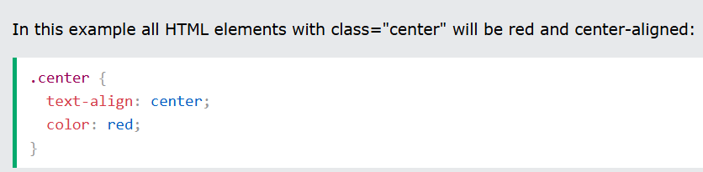
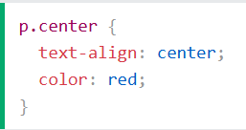
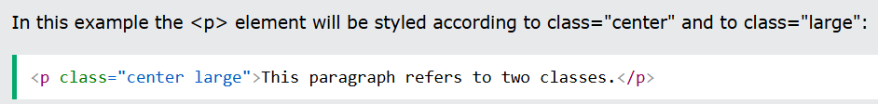
You can also specify that only specific HTML elements should be affected by a class.
HTML elements can also refer to more than one class.

Slide 49
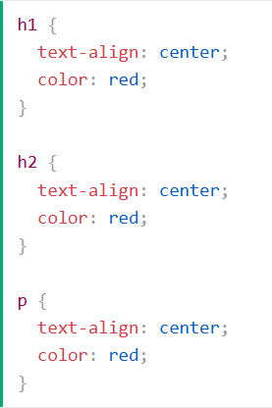
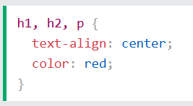
4,The CSS Grouping Selector
The grouping selector selects all the HTML elements with the same style definitions.
Look at the following CSS code (the h1, h2, and p elements have the same style definitions):
It will be better to group the selectors, to minimize the code.
To group selectors, separate each selector with a comma.

Slide 50
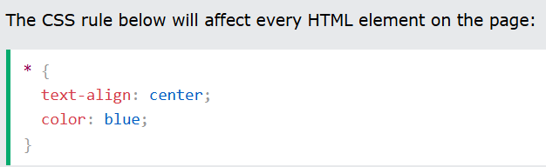
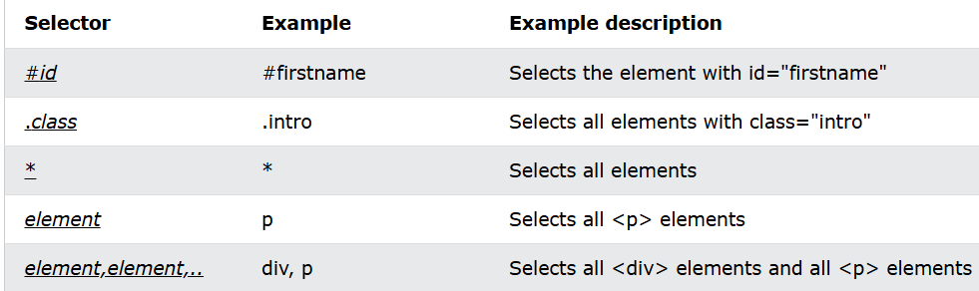
5. The CSS Universal Selector
The universal selector (*) selects all HTML elements on the page.

Slide 51
Types of CSS
When a browser reads a style sheet, it will format the HTML document according to the information in the style sheet.
There are three ways of inserting a style sheet:
External CSS
Internal CSS
Inline CSS
External CSS
With an external style sheet, you can change the look of an entire website by changing just one file!
Each HTML page must include a reference to the external style sheet file inside the <link> element, inside the head section.
An external style sheet can be written in any text editor, and must be saved with a .css extension.
The external .css file should not contain any HTML tags.

Slide 52
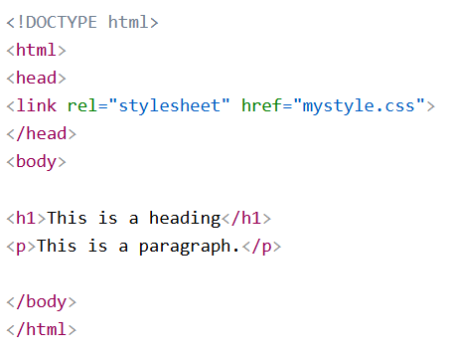
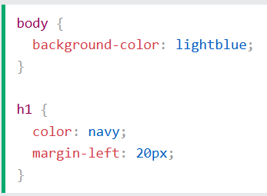

Internal CSS
An internal style sheet may be used if one single HTML page has a unique style.
The internal style is defined inside the <style> element, inside the head section.

Slide 53
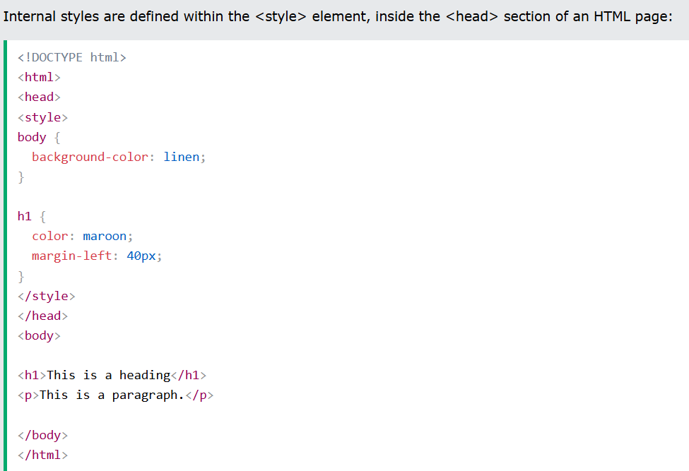

Slide 54
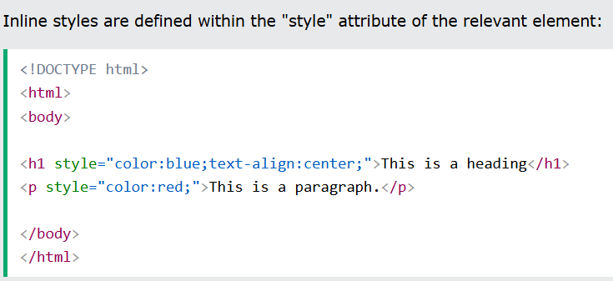
Inline CSS
An inline style may be used to apply a unique style for a single element.
To use inline styles, add the style attribute to the relevant element. The style attribute can contain any CSS property.
Multiple Style Sheets
If some properties have been defined for the same selector (element) in different style sheets, the value from the last read style sheet will be used.

Slide 55
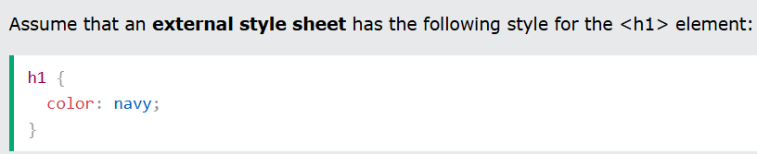



Slide 56

Cascading Order
What style will be used when there is more than one style specified for an HTML element?
All the styles in a page will "cascade" into a new "virtual" style sheet by the following rules, where number one has the highest priority:
Inline style (inside an HTML element)
External and internal style sheets (in the head section)
Browser default

Slide 57
CSS Colors
Colors are specified using predefined color names, or RGB, HEX, HSL, RGBA, HSLA values.
CSS Background Color
You can set the background color for HTML elements
You can set the color of text
You can set the color of borders

Slide 58


CSS Comments
Comments are used to explain the code, and may help when you edit the source code at a later date.
Comments are ignored by browsers.
A CSS comment is placed inside the <style> element, and starts with /* and ends with */:
CSS Backgrounds
The CSS background properties are used to add background effects for elements.

Slide 59


CSS background-color
The background-color property specifies the background color of an element.
The opacity property specifies the opacity/transparency of an element. It can take a value from 0.0 - 1.0. The lower value, the more transparent:

Slide 60


CSS background-image
The background-image property specifies an image to use as the background of an element.
By default, the image is repeated so it covers the entire element.
CSS background-repeat
By default, the background-image property repeats an image both horizontally and vertically.
Some images should be repeated only horizontally or vertically, or they will look strange
The background image can also be set for specific elements, like the <p> element:

Slide 61





CSS background-position
The background-position property is used to specify the position of the background image.

Slide 62


CSS background - Shorthand property
To shorten the code, it is also possible to specify all the background properties in one single property. This is called a shorthand property.
Instead of writing:

Slide 63

CSS Formatting Text
CSS has a lot of properties for formatting text.
Text Color
The color property is used to set the color of the text. The color is specified by:
a color name - like "red"
a HEX value - like "#ff0000"
an RGB value - like "rgb(255,0,0)“
Text alignment and direction

Slide 64


Text Decoration
Text Transformation
Tells the type of case to be used in text, lowercase, upper case and Capitalize

Slide 65


Text Spacing
Text Shadow

Slide 66


CSS Fonts
Choosing the right font has a huge impact on how the readers experience a website.
The right font can create a strong identity for your brand.
Using a font that is easy to read is important. The font adds value to your text. It is also important to choose the correct color and text size for the font.
Font Style

Slide 67

Font Size
The font-size property sets the size of the text.
Being able to manage the text size is important in web design. However, you should not use font size adjustments to make paragraphs look like headings, or headings look like paragraphs.
Font Shorthand
To shorten the code, it is also possible to specify all the individual font properties in one property.

Slide 68

CSS Borders
The CSS border properties allow you to specify the style, width, and color of an element's border.

Slide 73
THANK YOU

