Slide 1
ALAN WAKE
Tear Down

Slide 2
Level Design
Story
Guide
Tell
Based on
World Setting
Present

Slide 3
Cauldron Lake,
Bright Falls
(World’s 7th deepest lake)
Human’s imagination
Source of power
Darkness
Light
Weakness
Location
Mind control,
Telekinesis,
Weather control
Twisting Reality
Abilities
Purpose
Expand,
Take over
Notes:
Some basic information about “Darkness”

Slide 4
Write himself into
Alan Wake
Horror Fiction
Wife of
Write
Protect
Make come true
Want
To
Control
Try
To
Save
Caught Up
In
Alice
Light
Capture
Reality
Dream
Darkness
Disperse
Twist
Swing between
Notes:
Here is an outline description of the story

Slide 5
Rock Music
Create
Anderson Brothers
Predict “Lady of light”
Self mutilate to get rid of
Synthia Weaver
Cautious of
Guide
Turn to
Alan Wake
Become agent of
Darkness
To
Try to control
Babara
Magic switch & Script
Help
Wife of
Drown
Seal
Thomas Zayne
Capture
Want to resurrect
Give
Story
Write
Predict
Reshape
Story
Write
Eventually decide to perish together
Write for
Notes:
The experiences of some important NPCs in the story

Slide 6
Retrieve Babara,
But realize she’s occupied by Darkness
Despair,
Write the ending of the story,
Bury Darkness along with himself
1978
Thomas Zayne
Thomas Zayne in Alan’s story
Babara
Recreate
Desperate,
Write for Darkness,
Hope to save lover
Taken by Darkness, keep fighting against it
Drown in the lake, taken by Darkness
Rewrite the story
of Alan
Alan Wake
Alice
Realize something’s wrong,
Write himself into the story
Experience the horror of the story
Save Alice from Darkness at the price of himself
NOW
Twisted stories of two writers
Notes:
The storylines of Thomas Zayne and Alan Wake

Slide 7
Return to & Wake up
“Lost” Alan
Thomas Zayne
“Awake”
Alan
Bring into the story
Rescue
Reshape
Write
Experience
Story
Present
Present
Anderson Brothers
Foretell
Describe
Music
Manuscripts
Self-fulfilling prophecy
Notes:
Some examples of self-fulfilling prophecy

Slide 8
Attack
when darkness is gone
Dodge
Enemy Attack
Guns
Torch Light
Enemy
Player
Enemy
Slow Down
Dispel darkness
Flash Bomb
Flare
Keep away for a while
Darkness
Dispel darkness within explosion radius
Fatal if close enough
Turn on/off
Environmental Light
Combat Process

Slide 9
Oppressive, grim enemies
Dark, cold environment
Distortions, Blurs, Twists
Terrorful ambient sound
Original Music
Low ammo maximum
Scant
Supplies
Dodge
Reload
Zoom
torch
light
Limited Resources
Relative
Slow Movement
Visual
Audio
Elegant
Art Design
Challenging Mechanics
FEAR
Restricted Combat Space
Mysterious, compelling story
Slow Recovery Speed
HP
Torch light battery
Self-fulfilling prophecies
Extra Narratives
Twisted storylines
Notes:
Alan Wake deliver the feeling of fear successfully

Slide 10
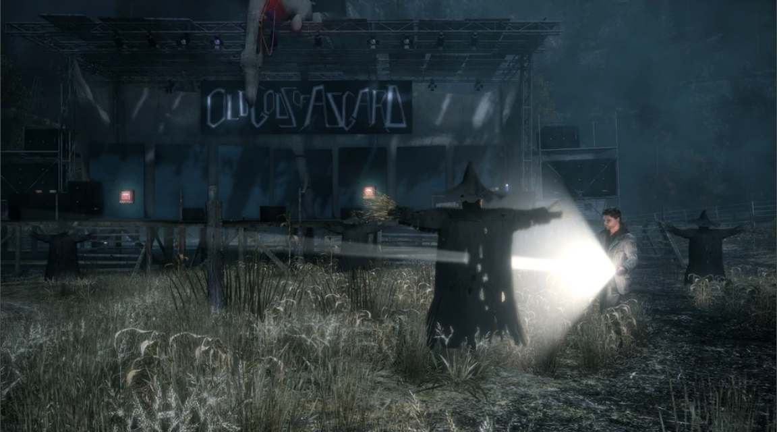
Scant
Supplies
Abundant ammunition & batteries
Fight Alone
With a funny friend
Dark，haunted Environment
Lighting & fireworks everywhere
Disturbing Silence
Loud, crazy rock music
Narrow Space
Wide farm field，
Broad view
FEAR
JOY
Things get different at Anderson Farm
Notes:
The Anderson Farm level is my favorite. It gives the player a perfect chance to vent his/her stress, frustration and fear

Slide 11
Story
Mechanics
Urgency
Slow Recovery
Require
Encourage
Immediate Movement
Conflict
Wait for a while
Damage
Consistency
Conflict between game mechanics and storytelling
Notes:
Here is a problem worth noting. In some cases, Alan Wake is supposed to move quickly to another place because of something urgent, say, his friend Barry is in danger. But due to the game mechanics, it would be preferable for the player to wait for a while so that the hero’s HP and torch light battery can recover. Or even worse, the player may spend minutes searching for supplies before getting back to the storyline.

