Slide 1
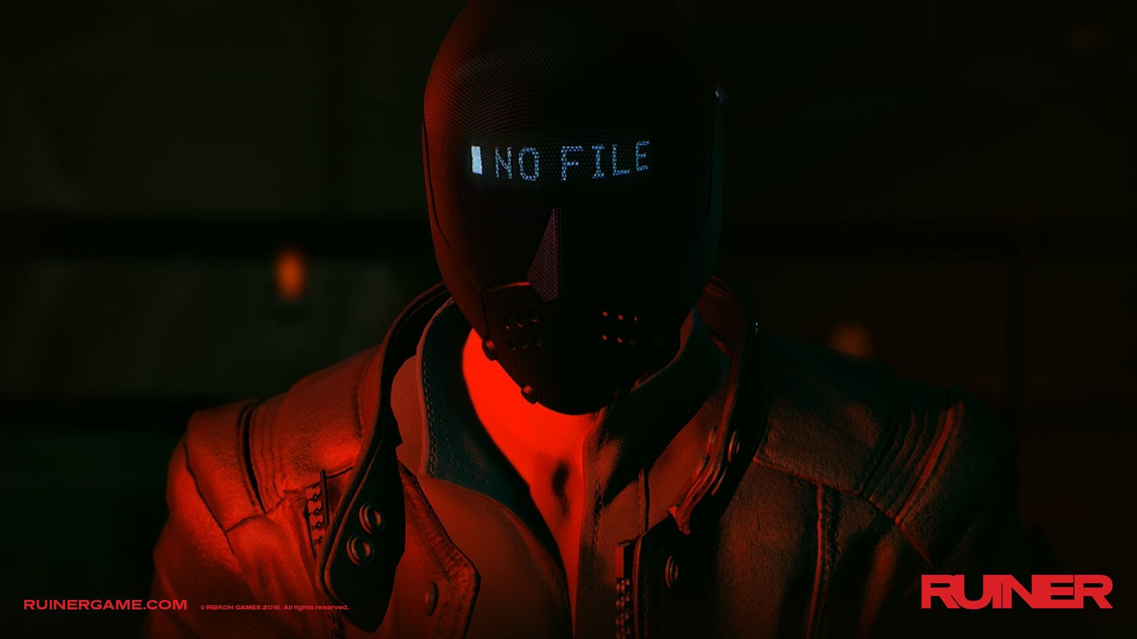
RUINER
Tear Down

Slide 2
Combat System
Level Design
Support
Reflect
Guide
Present
World Setting
Based on
Story

Slide 3
Network & Hack
Biotech implants
Crimes
Polarization of wealth
Sci-Fi
weapon system
High Tech
Low Life
Anarchy
Society Background
Advanced AI
Cyberpunk
Low Resolution Screen
Neon Light
Art Style
Chinese Characters
Visual
Audio
Synthwave/Lo-Fi
Cyborg
Yakuza
Chaotic futuristic City
Glitch Sound FX
Electronic Voice
Notes:
RUINER presents a typical cyberpunk world

Slide 4
Environment Supplies
Enemy Loot
HP，Energy，Weapon, EXP
Energy
HP
Cost
Player
Enemy
Enemy Attack
Cold Weapon
Fire Arm
-HP/Energy
Skills
Dodge/Block
Dodge/Block
Player
Attack
-HP/Debuff
Notes:
Here is a rough summary of a combat

Slide 5
Convert
Turn energy into HP
Supply
Request supply helicopter
Attack
Grenade
Move
teleport
Skills
Buff
Sense overload, Slow motion
Defend
Energy shield, Shock shield
Disturb
Hack enemies,
EMP explosion
Value Increase
HP/energy/ammo maximum, Attack damage, Supplies
Trade for
Recover
Skill Points
Environment/Enemy Loot
Level Reward
Notes:
RUINER offers a large variety of skills and supports recovering skill points, allowing the player to switch between multiple combat styles.

Slide 6
Spawn position
Move
Teleport
HP
Energy
Ammo
Enemy Position
Execution time limit
Bullet Speed
Player Status
Close Combat
Shooter
Explosives
Security system
Attack Type
Movement
Area attack
Self-explosive
Enemy action delay
Fast enemy movement
Looted weapons & recovery items
Environmental
threats
Enemy Behavior
Combination of enemy types
Slow motion system
Reaction time
Amount of information
Variances & unpredictability
Combat Pace
Notes:
The combat pace is fast and well designed in most levels. I’d like to take a close look at it.

Slide 7
Character Build
Major story
Mission Area
Player
Level 1
Level 2
…
Take on mission
Bonus (skins, awards etc. )
Side ops, stories
South District, Rengkok
Return to
Notes:
The game experience is generally linear. Although some side ops and stories are added to South of Rengkok, the safe zone, they don’t contribute much to player’s experience.

Slide 8
Fast combat pace
Practice
Challenging
combat experience
Pass a level
Achievement
Aggressive enemy AI
Fail
Reddish Hue
Enemy appearance
Art Style
Violence
Cutscenes
HP Recovery Mechanic
Execution
Interaction
Encourage
Involve
Kill the Boss
Hacked
Denial to the mission’s meaning
Lost
Find your brother
Cheated
Notes:
Here are some emotional feelings delivered by RUINER.

