Slide 1
Red Dead Redemption 2
Character Shaping
Example Analysis

Slide 2
Authur Morgan
Story
Player’s Choice
Loyal
Frank
Chivalrous
Seeking Redemption
Notorious
Honorable
Save members of the gang by or against Dutch’s order
Doubt Dutch’s decisions straightforward
Help Marry with her family who despise him
Try to save the gang from Dutch’s insanity
Follow Dutch’s plan even when doubting it
Express his dislike of Mika in public
Feel sympathy for Indians and offer help
Help Mrs. Daunce and her son, victims of him
Ending
Refuse to sell the gang to Pinkerton
Save John at the price of himself
Notes:
The hero, Authur Morgan, is a typical western gunslinger.

Slide 3
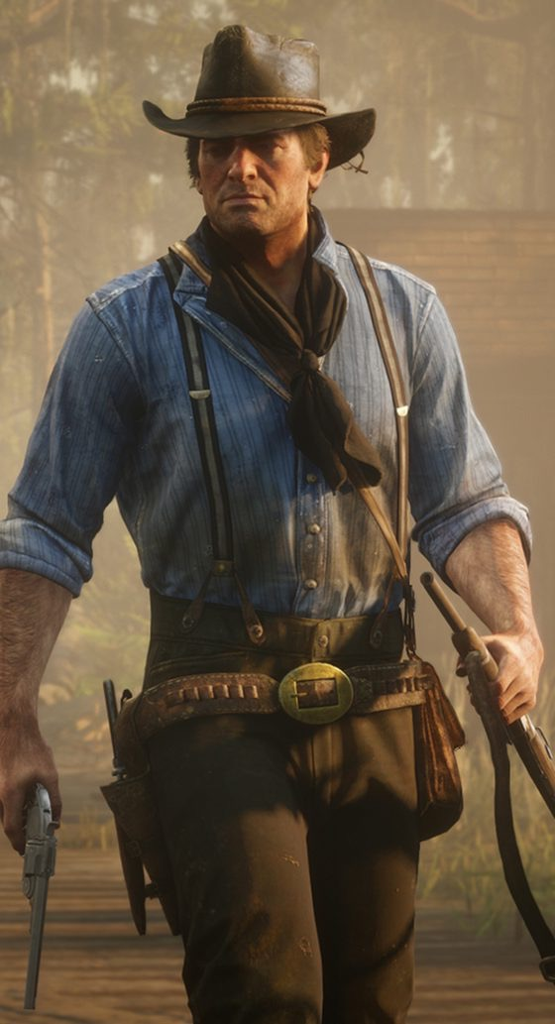
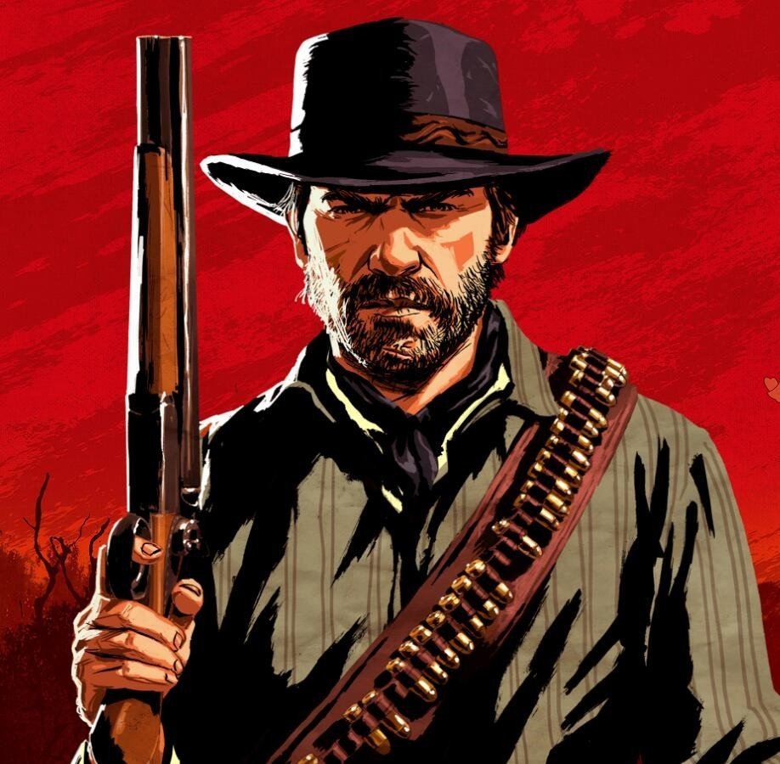
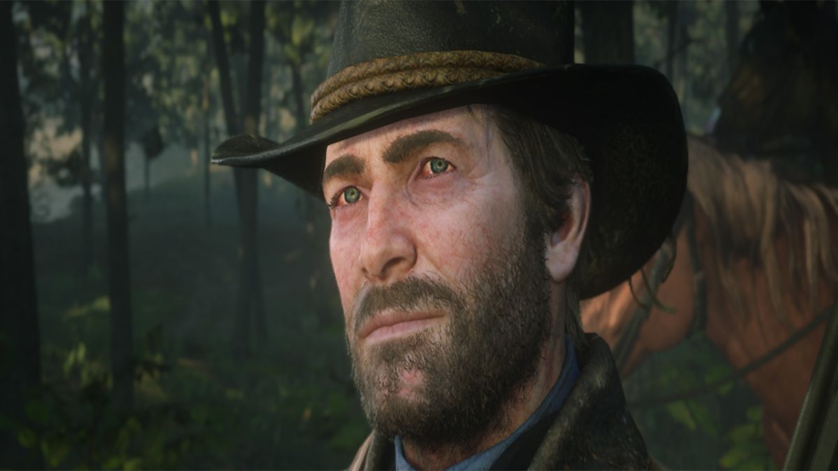
Authur Morgan
Appearance
Action Style
Voice
Rough face, untrimmed beard, robust body, worn clothes, leather hat & boots
After infection: Red eyes, pale face
Simple & direct, forceful, Swift
Loud, hoarse
After infection: Lots of cough,
Sometimes out of breath

Slide 4
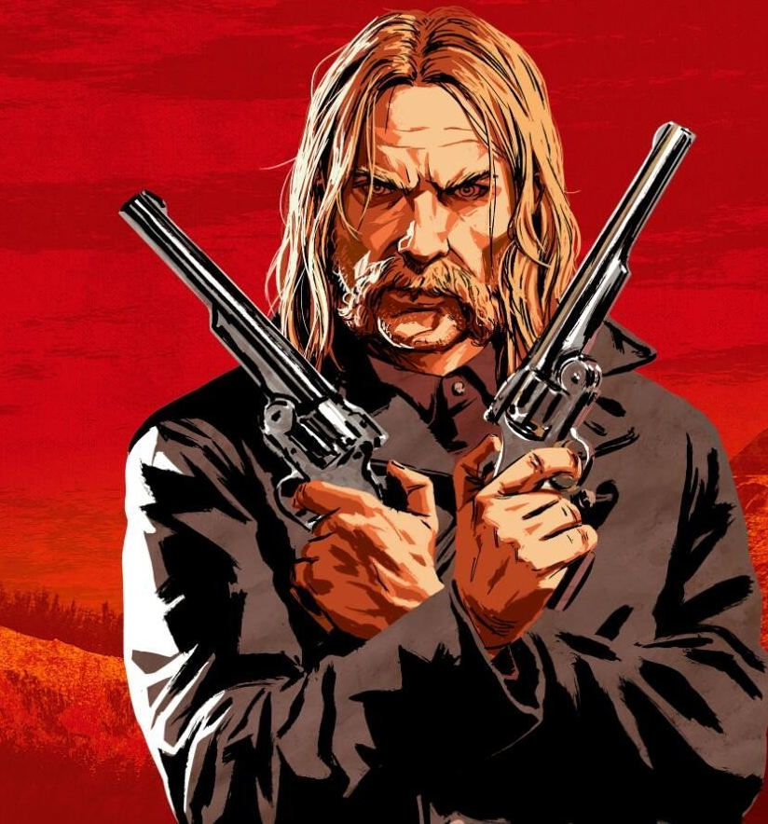
Mika Bell
Appearance
Insidious
Blood-thirsty
Selfish
Vicious
Tempt Dutch to carry on crazy plans
Kill almost half of Strawberry after prison break
Collude with Pinkertons for his own sake
Mock at Authur’s tuberculosis
Sturdy body, unpredictable face, small dangerous eyes,
long hair & moustache, two revolvers
Elbow Authur out of the core group
Kill Susan without hesitation
Risk Authur’s life to retrieve his revolvers
Induce Dutch to give up on gang members
Notes:
Mika is a major villain in the story and hated by most players.

Slide 5
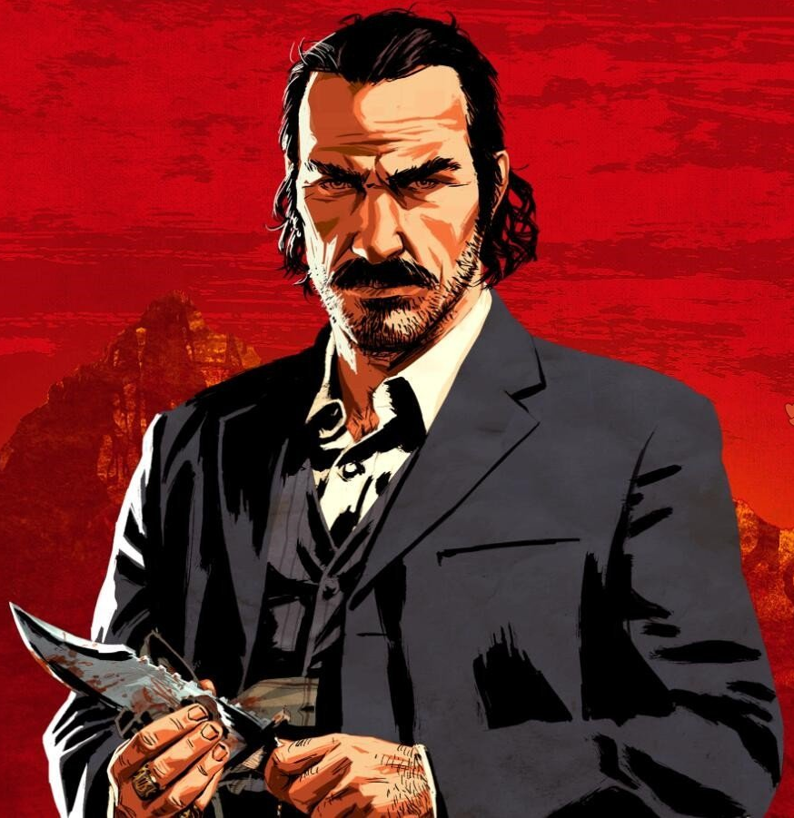
Dutch van der Linde
Stubborn
Principled
Imperious
Idealistic
Cruel
Insist that his plan is the right path
Fight against government and capitalism throughout life
Tolerate no doubt nor objectioncv
Believe in freedom and anarchism
Kill innocent people in Blackwater/Guarma
Emphasize on faith and loyalty
Promise that everything will be over when they have money
Appearance
Voice
Wide forehead, Roman nose, trimmed moustache, fine clothes
Calm, commanding, confident
Notes:
Dutch is the leader of the gang. He is quiet complicated and sometimes contradictory.

Slide 6
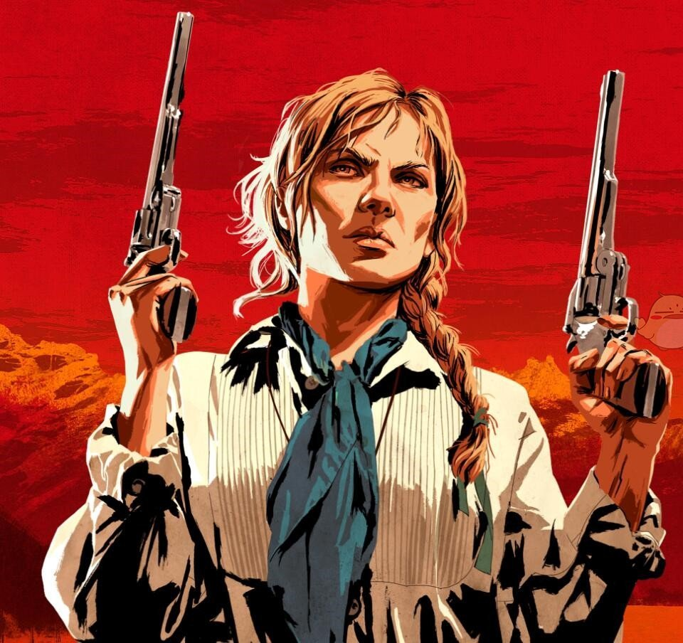
Sadie Adler
Revengeful
Adventurous
Fight better than a man
Make sure Colm hang
Cannot stand daily chores
Arrange the gang’s evacuation when Dutch is away
Attack the last of O’driscoll gang
Become a bounty hunter
Revenge for Authur with John
Appearance
Voice
Long braid, tough face, breeches & riding boots
Hoarse
Notes:
Sadie Adler, a tough woman

Slide 7
Doomed illness & death
Self Sacrifice
Search for redemption
Crazy, risky action
Hurtful
joke
Betrayal
Slander
Sympathy
Identification
Hate
Leadership
Eloquence
Insane Plan
Constant Failure
Abandon
Bravery in combat
Revenge for player
Respect
Doubt
Admiration

