Slide 1
EY Techathon 2021: #iSolve4aBillionChallenge

Slide 2
Problem statement: Prioritize vaccine delivery using AI/ML
We are Team Huskarls from Birla Institute of Technology and Science, Pilani
Team Members:
Ayushi Gaur (Email: p20190023@pilani.bits-pilani.ac.in)
Ayush Kumar (Email: f20170761@pilani.bits-pilani.ac.in)

Slide 3
Understanding the Problem Statement
Problems faced in Rollout of Vaccine

Slide 4
With limited supply of COVID-19 vaccines available at first and large demographic to cater to, a proper rollout plan is needed to break the infection chain in an efficient manner. This includes:
Analysis of number of cold storage facility at state and district level.
Analysis of district wise population to identify people with age more than 50 years and/or with pre-existing condition such as Asthma, Diabetes etc. and density of population in various region.
Focusing more on the area with high transmission rate at present to contain it.
Identifying the frontline workers and the type of employments unable to physically distance.
The country was in lockdown for a long period hence we need to identify the population associated with education and economically critical sector.

Slide 5
Since there are multiple criteria to decide the priority, a proper metric should be devised to do the ranking.
With proper analysis of data and using appropriate algorithms we can dynamically classify the rollout plan of vaccine for different districts depending on the availability of the vaccine and the dosage required in each area.

Slide 6
Solution
Designing a Model to provide insights on vaccine delivery

Slide 7
The two main challenges faced from the solution point of view are:
Creation of an Absolute Dataset
Accurate Algorithm for Analysis

Slide 8
Dataset
Population aged > 50 years
Cold storage facilities available in every state
Students missing school due to lockdown
Health workers, frontline rescue team
People with Comorbidities
Our compiled Dataset extensively covers all major aspects of the problem.
Current COVID Cases
District-wise population demographic

Slide 9
The algorithm That would help us do the task:
Compilation and Cleaning of Data
Data Analysis: Finding out the relation between different attributes which would help us in finding a suitable metric
Extracting the main features using PCA
Clustering using DBSCAN and KNN: Using the elbow curve we found out the number of levels districts can be divided for proper analysis.

Slide 10
Ranking Algorithm
Using SEIR (Susceptible → Exposed → Infected → Removed) analysis, we figure out the population susceptible for rapid spread which can be prioritised. (We consider the population which hasn’t contracted the disease yet as susceptible and combining it with rate of active cases form a priority)
We also factor comorbidities, population above 50 and ease of access to cold storage for the ranking.

Slide 11
Methodology
The whole analysis has been done in Python and the clustering algorithm has been implemented using scikit-learn library.
Used Seaborn and matplotlib for plotting the data and for further analysis.
We created Dashboard in Excel(using pivot table) to analyse data.

Slide 12
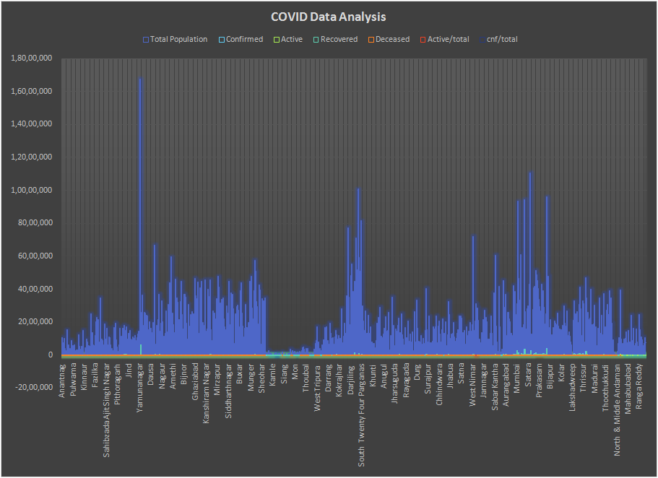
Output
Place your screenshot here

Slide 13
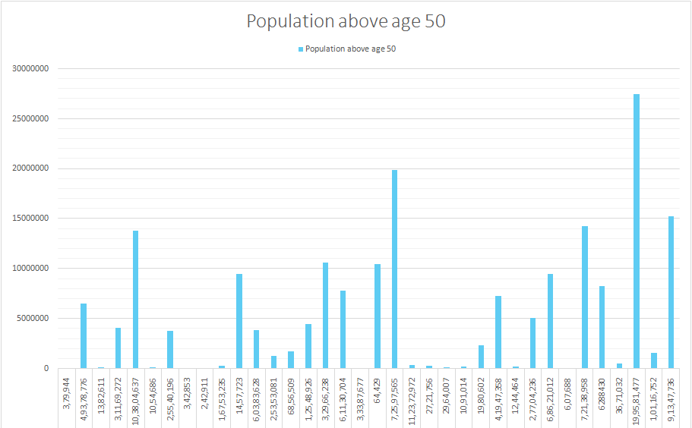

Slide 14
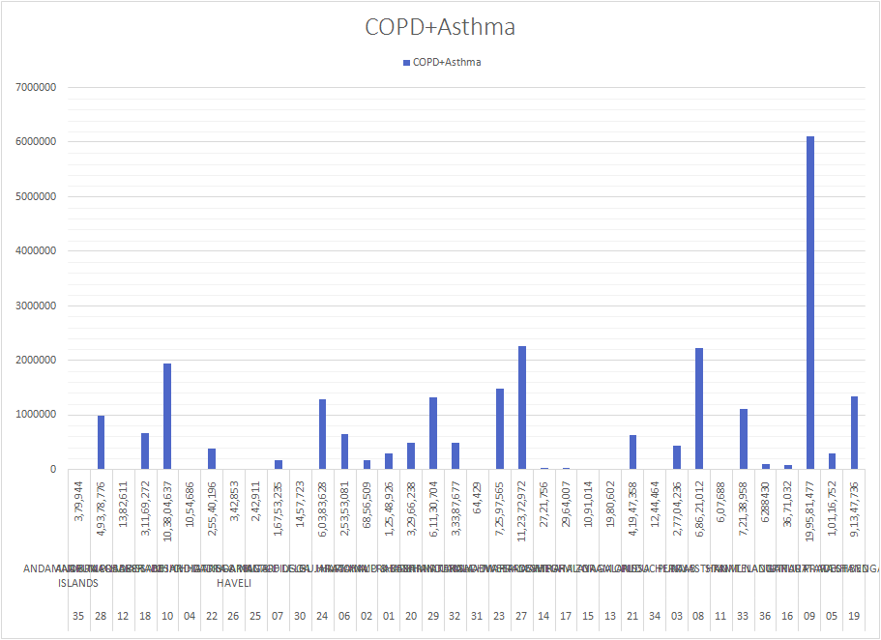

Slide 15
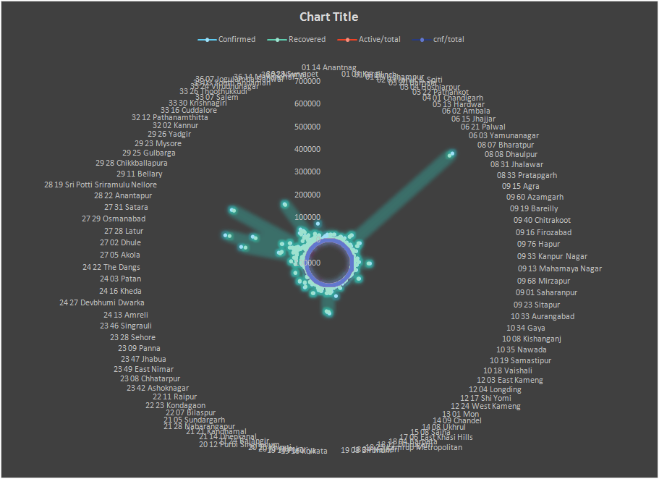

Slide 16
Appendix
GITHUB Repo: https://github.com/quasayush/EY-Techathon.git
Click Here to go to our GITHUB Repository
Interactive dashboard is available in GITHUB Repo.
Population demographic data taken from https://censusindia.gov.in/2011census/
Cold Storage data taken from https://www.indiastat.com/table/agriculture-data/2/cold-storages/32430/1230615/data.aspx
School Students Data taken from https://data.world/inderz/india-district-level-school-report-card
Pulmonary diseases data taken from here
SEIR related paper:
Mwalili, S., Kimathi, M., Ojiambo, V. et al. SEIR model for COVID-19 dynamics incorporating the environment and social distancing. BMC Res Notes 13, 352 (2020). https://doi.org/10.1186/s13104-020-05192

