Slide 1
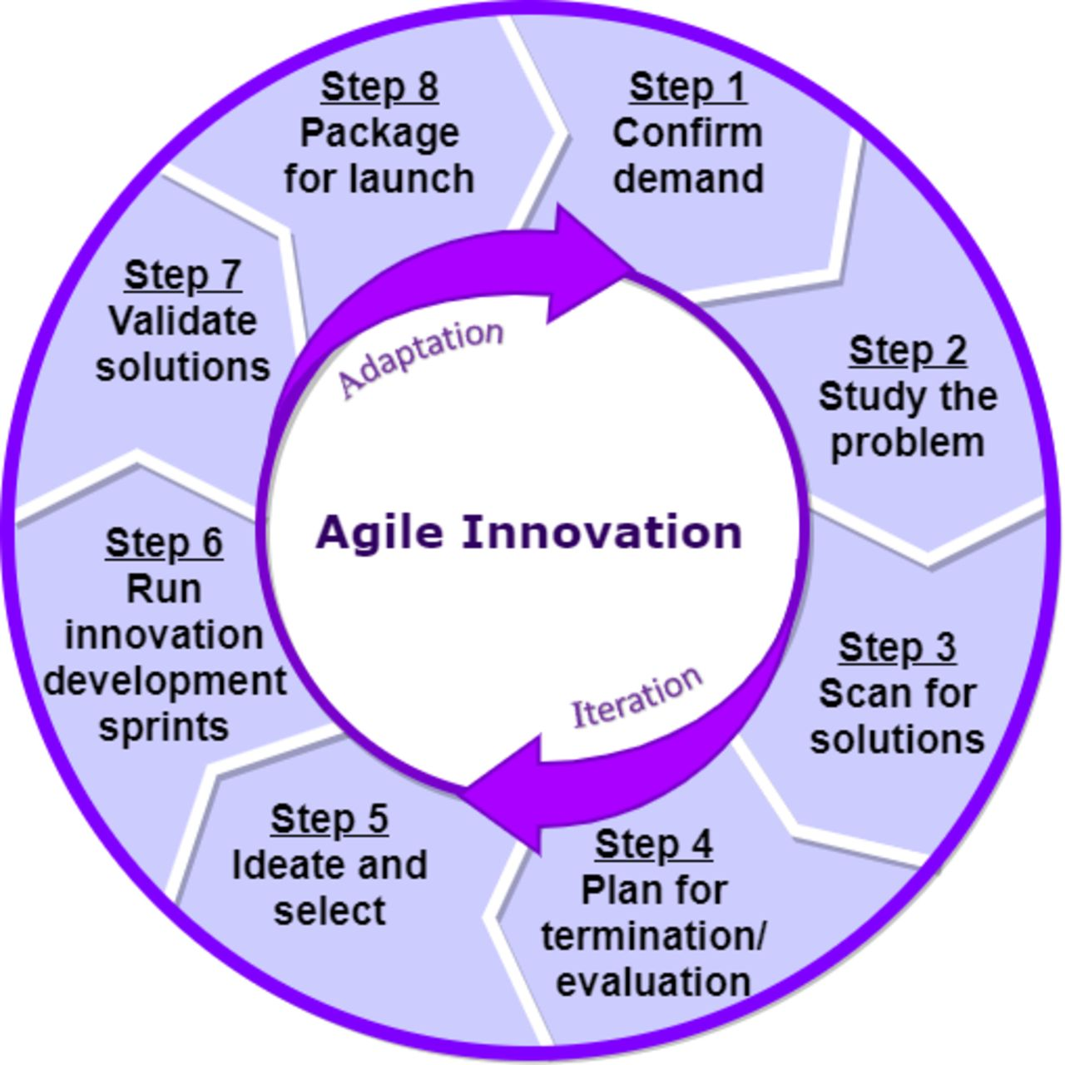

The eight-step Agile Innovation process.
Richard J Holden et al. BMJ Innov 2021;7:499-505
Copyright © BMJ Publishing Group Ltd & British Cardiovascular Society. All rights reserved.
Notes:
The eight-step Agile Innovation process.

