Slide 1
Word Vectors
Learning Representations of Words

Slide 2
Till now we’ve dealt with structured data such as a properly parametrised dataset or images – for mostly classification, regression and pattern recognition.
Now, work with text.
(Though we did see that a bit with RNNs*)

Slide 3
How do we represent meaning of a word?
Meaning is the “idea represented by the word/phrase expressed by speech/writing”
Word -------- denotes ------> Idea

Slide 4
How do we represent meaning of a word?
Something like a look-up table. A dictionary: each word uniquely defining an idea.
Computationally, this can be represented by one-hot vector encoding.
If vocabulary = {‘cat’, ‘mat’, ‘dog’, ‘bat’}
  cat = [ 1 0 0 0 ] mat = [ 0 1 0 0 ]
  dog = [ 0 0 1 0 ] bat = [ 0 0 0 1 ]
Each index corresponds to a word i.e. an idea.
But this is not good for computational systems

Slide 5
How do you represent relationships between words?
Error 404: Efficient method not found.
Only way is to hard-code relationships because each entity (word) is represented by an independent index in the one-hot vector.
There is no notion of similarity inherently.
But for stastical NLP we do have taxonomical resources like WordNet which has synonyms and hypernyms.

Slide 6
Problems with the localist/discrete representation
Good resource but missing nuances
Missing new words
Subjective – depends on person to person if they’d regard it a synonym or not (eg: Struggle with unquantifiable things such as “good”, “adept”, “practiced”, “proficient” -synoynms or not? Maybe.)
Requires human effort to create and adapt
What about new languages?

Slide 7
Distributional Similarity based Representations
So we need to explore a direct approach where representation of the word encodes its meaning in such a way that we similarity of words from the representations directly.

Slide 8
Distributional Similarity
Can get a lot of value for representing meaning of the word by means of its neighbours aka the CONTEXT in which the word appears.
So to represent meaning of the word “banking”, find instances of word “banking” in text and look at the environment in which it appears:
“Government debt problems turning into banking crises as has happened before. Europe needs unified banking regulations to replace the hodgepodge.”
Basically, all these words above represent the meaning of the word “banking”.

Slide 9
Distributional Similarity based Representations
So basically, word meaning is defined in terms of vectors.
We build a dense vector for each word, chosen so that it is good at predicting other words appearing in its context.
Two words that have similar context (read: meaning) will have similar vector representations. Therefore, it will be easy to find words that have similar meanings (synonyms).

Slide 10
Denotation contrasts with Distributional Similarity
(Direct Meaning) (Meaning defined by context words)
In the same way
One-hot vectors contrast w/ Distributed Representation
[0 0 0 ... 1 ... 0 0] [0.9 -0.1 ... 0.12 0.4 -0.32]
Sparse Vector (Matrix) Dense Vector (Matrix)

Slide 11
Basic Idea of learning neural word embeddings
Define a model that aims to predict between a center word and its context words in terms of word vectors.
Look at all words in a big text corpus and adjust vector representations until prediction loss is minimised.
All we want is a good vector embedding for each word such that meaning of the word is preserved.

Slide 12
word2vec – Mikolov et. al., Google, 2013
Just a 2 layer neural network that “processes” text. Not a deep network. There are two main algorithms for producing word vectors.
Skip Gram : predicts context word given target
Continuous Bag of Words : predicts target word given context

Slide 13
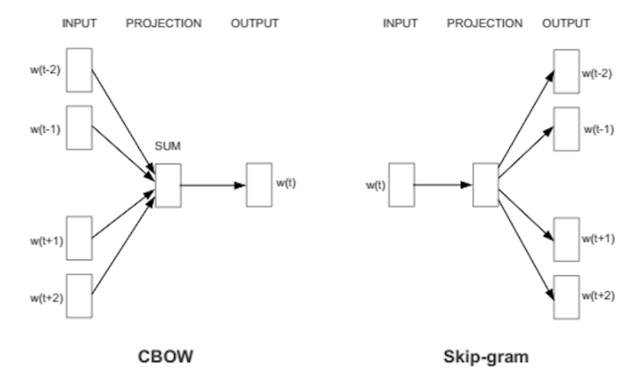

Slide 14
Skip Gram Model
Predict words in context upto some “window” size.
Model defines the probability distribution of a word appearing in context given the center word. Therefore, we have to choose a vector representation s.t. probability of predicting context word is maximised
Note: It doesn’t matter where in the window, it should just be in the window.
Each word has 2 representations – one as center word & one as context word (gives better results).

Slide 15
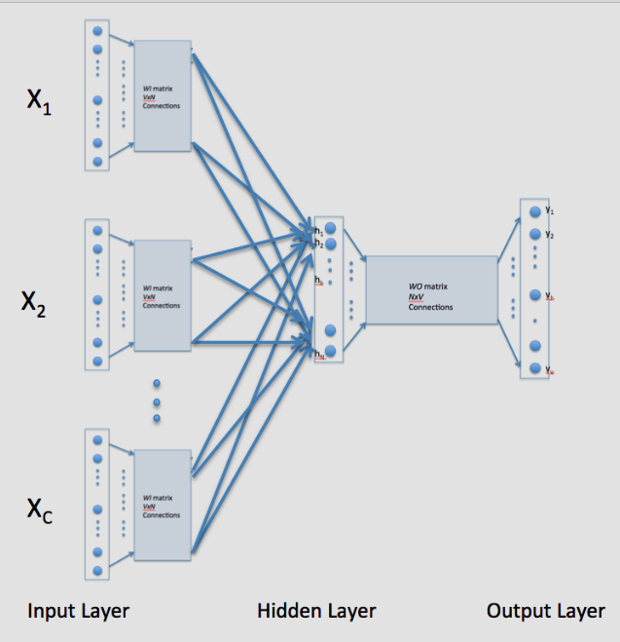
Continuous Bag of Words Model

Slide 16
Note that good vector embeddings are just a side product of the model. Model’s objective was to correctly predict the target/context word!
A well trained set of word vectors will place similar words close to each other in that space. See:
http://metaoptimize.s3.amazonaws.com/cw-embeddings-ACL2010/embeddings-mostcommon.EMBEDDING_SIZE=50.png
http://colah.github.io/posts/2014-07-NLP-RNNs-Representations/img/Turian-WordTSNE.png
Similar things and ideas are shown to be “close”. Their relative meanings have been translated to measurable distances. Qualities become quantities, and algorithms can do their work.

Slide 17
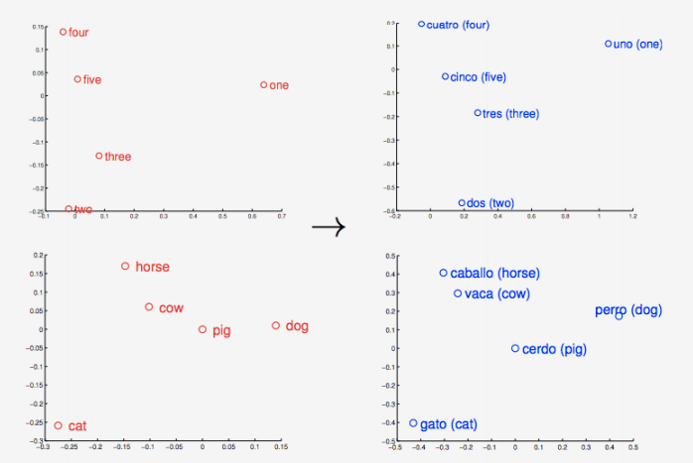
But similarity is just the basis of many associations that Word2vec can learn. For example, it can gauge relations between words of one language, and map them to another.

Slide 18
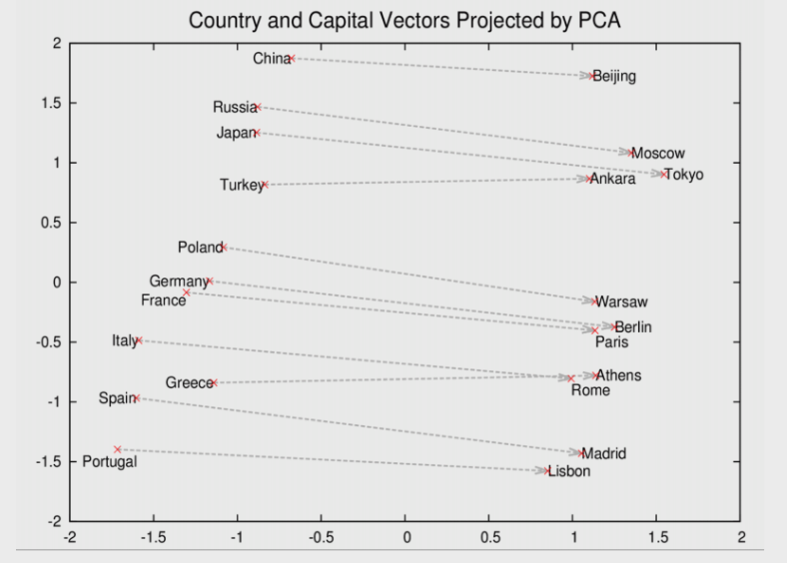
And some other types of relations..
Source: https://deeplearning4j.org/word2vec.html

Slide 19
Rome – Italy + China = Beijing

Slide 20
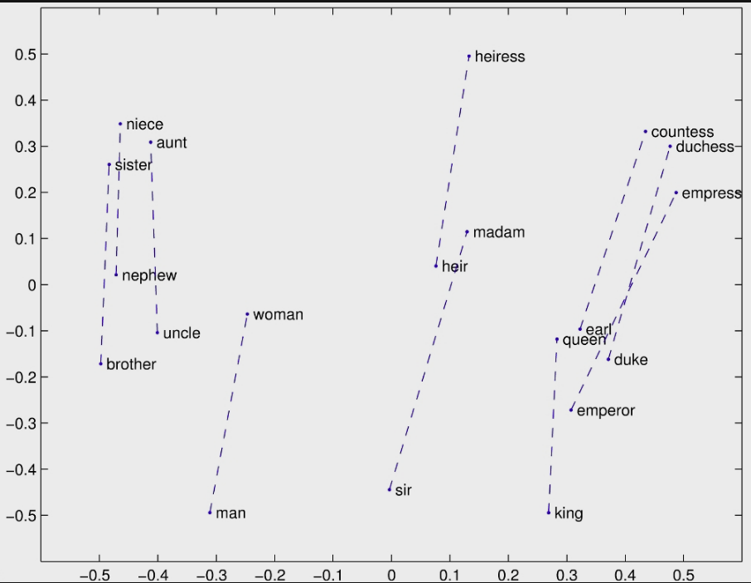
King – Man + Woman = Queen
Source: http://ruder.io/secret-word2vec/

Slide 21
Further Reading
Google’s Pre-Trained word2vec Model
Available to download at https://drive.google.com/file/d/0B7XkCwpI5KDYNlNUTTlSS21pQmM/edit
Hierarchical Softmax
The optimization over softmax used by word2vec developers. https://www.youtube.com/watch?v=B95LTf2rVWM might help.
GloVe : https://nlp.stanford.edu/projects/glove/
Alternative of word2vec to get a word’s vector representations. Developed by Stanford. Intuitively speaking, word-vectors were a by-product of word2vec, in GloVe, attaining word-vectors is the main objective. Can use the ‘spacy’ library for its implementation.

