Slide 1

QuiteOften
WEB APP

Slide 2
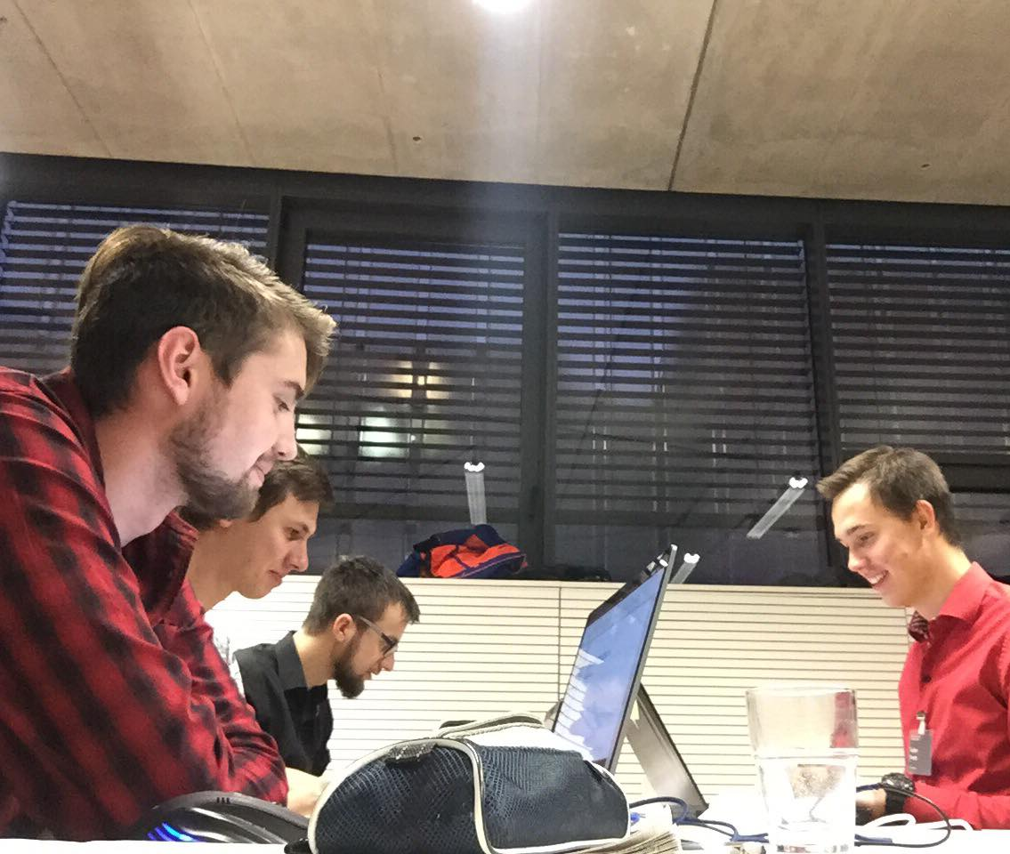
Sirius Purofesshonaru
Students from ČTU in Prague

Slide 3





The App

Slide 4
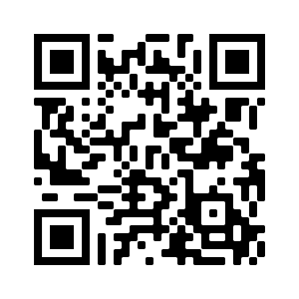

Slide 5
How it works?
It already runs on the Internet
Map
We are using user location
Searching by activity
Displaying searched places in map
Showing basic info about the place

Slide 6
For the future
Website for adding new places
User accounts
Firebase Firestore – scalable, safe, flexible, NoSQL, fast, horizontal scaling
already
Firebase Hosting
already
Superior graphical design
User interactions – e.g. notifications

Slide 7
Thank You!

