Slide 1
CAMPUS CAFE
A Full-Stack Point-of-Sale System for Campus Dining
NEU 5001 — Final Project Built with Python • FastAPI • React
Presented by:
Arja Sadhukhan
Yanyan Wang

Slide 2
Agenda
Project Overview — What we built and why
System Architecture — How the pieces fit together
The Main Function — CLI application flow and thought process
Class Design Deep Dive — Menu, Order, Inventory, Customer, Staff
Data Persistence — Excel-based tracking system (Special Feature)
Frontend Application — React web interface
Live Demo & Q&A
Campus Cafe

Slide 3
Project Overview
What is Campus Cafe?
Campus Cafe is a point-of-sale (POS) system for a campus dining environment, supporting customer ordering and staff inventory management. It runs on the terminal AND as a modern web application.
Customer Features
Staff Features
Browse menu by category (Salads, Drinks, Desserts, Sandwiches)
Add / remove items from cart with quantity control
Daily special with automatic 20% discount
Checkout with loyalty points & printed receipt
Secure login with ID + password
View real-time inventory levels
Restock items in bulk
Session summary on quit (all orders + total revenue)
Administrator features (Add/Update/Delete Staff information)
Dual Interface
Data Persistence
Terminal-based CLI application (main.py)
React web application (frontend/)
Both interfaces share the exact same backend classes
All data stored in Excel (.xlsx) files
Orders, customers, inventory, staff records
Loyalty points accumulate across sessions
Campus Cafe

Slide 4
System Architecture
How the pieces fit together
Terminal CLI
Backend Classes
FastAPI Server
React Frontend
main.py
→
Menu • Order • Inventory Customer • Staff
→
app.py (REST API)
→
Vite + React Router
↓
Excel Data Layer
Menu.xlsx • Orders.xlsx • Inventory.xlsx • Customers.xlsx • Staffs.xlsx
Design Principle
The backend classes are shared between the CLI and the web app. The FastAPI server wraps the same Python classes that main.py uses, ensuring consistent behavior across both interfaces.
Campus Cafe

Slide 5
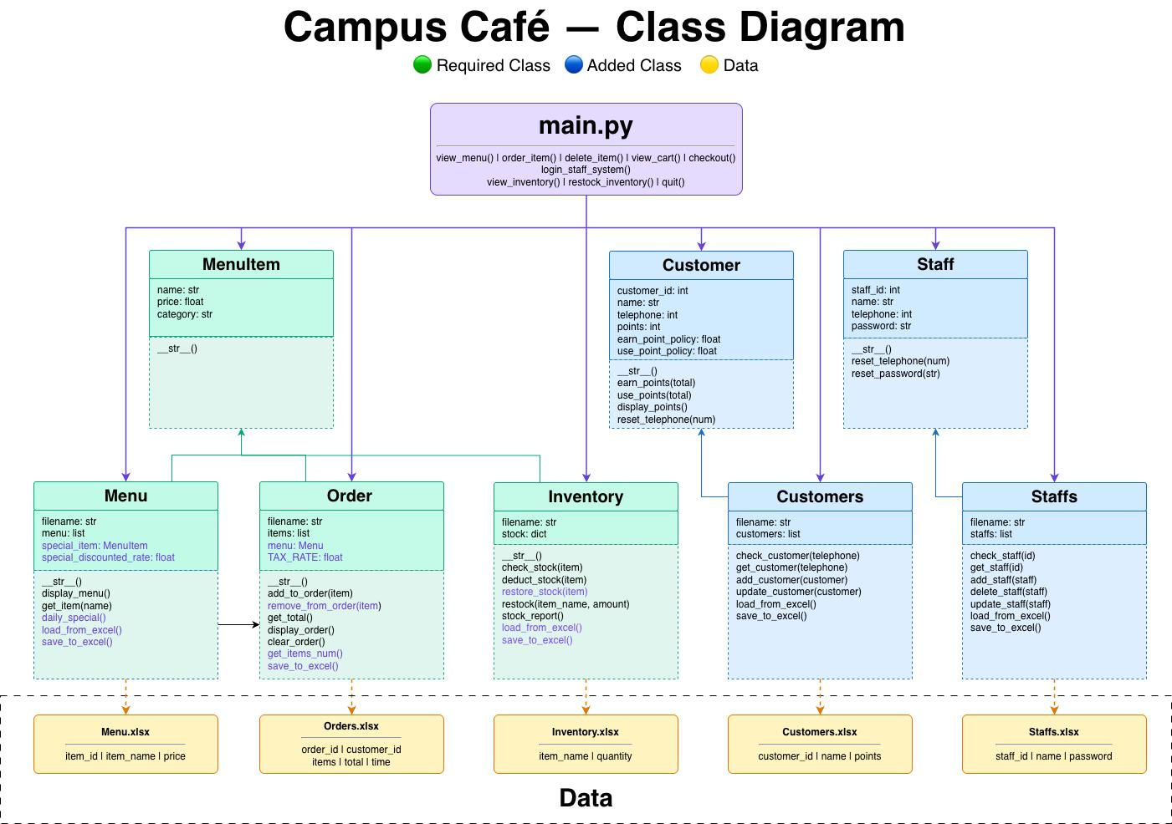
Campus Cafe

Slide 6
SECTION 1
The Main Function
CLI application flow and thought process

Slide 7
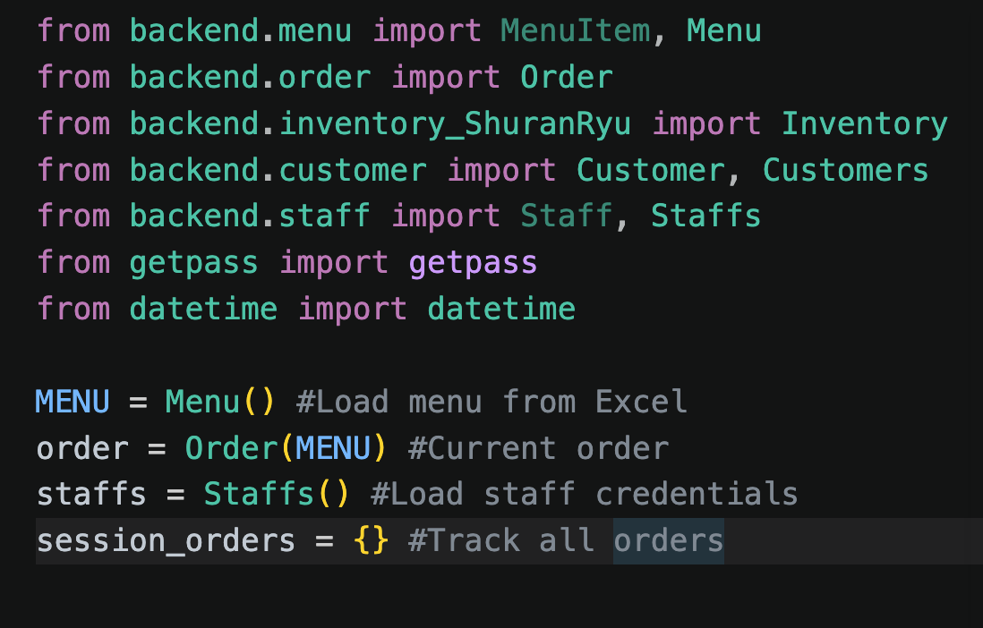
Main Function — Application Flow
main.py: the entry point that orchestrates everything
Thought Process: We designed main.py as a menu-driven loop. The user sees numbered options, picks one, and the program delegates to a dedicated function. This keeps each feature isolated and the main loop clean.
ENTRY POINT & GLOBAL STATE
Why This Design?
Each function (view_menu, order_item, checkout, etc.) is self-contained with its own input loop and validation. Global state (MENU, order, session_orders) is initialized once at the top and shared across functions. This mirrors how a real POS works — one session, one shared order, one menu.
Campus Cafe

Slide 8
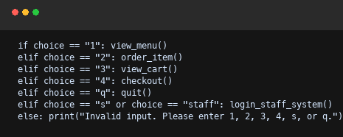
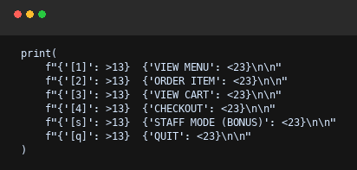
Main Function — Application Flow
main.py: the entry point that orchestrates everything
Thought Process: We designed main.py as a menu-driven loop. The user sees numbered options, picks one, and the program delegates to a dedicated function. This keeps each feature isolated and the main loop clean.
MAIN_MENU() — THE DRIVING LOOP
Why This Design?
Each function (view_menu, order_item, checkout, etc.) is self-contained with its own input loop and validation. Global state (MENU, order, session_orders) is initialized once at the top and shared across functions. This mirrors how a real POS works — one session, one shared order, one menu.
Campus Cafe

Slide 9
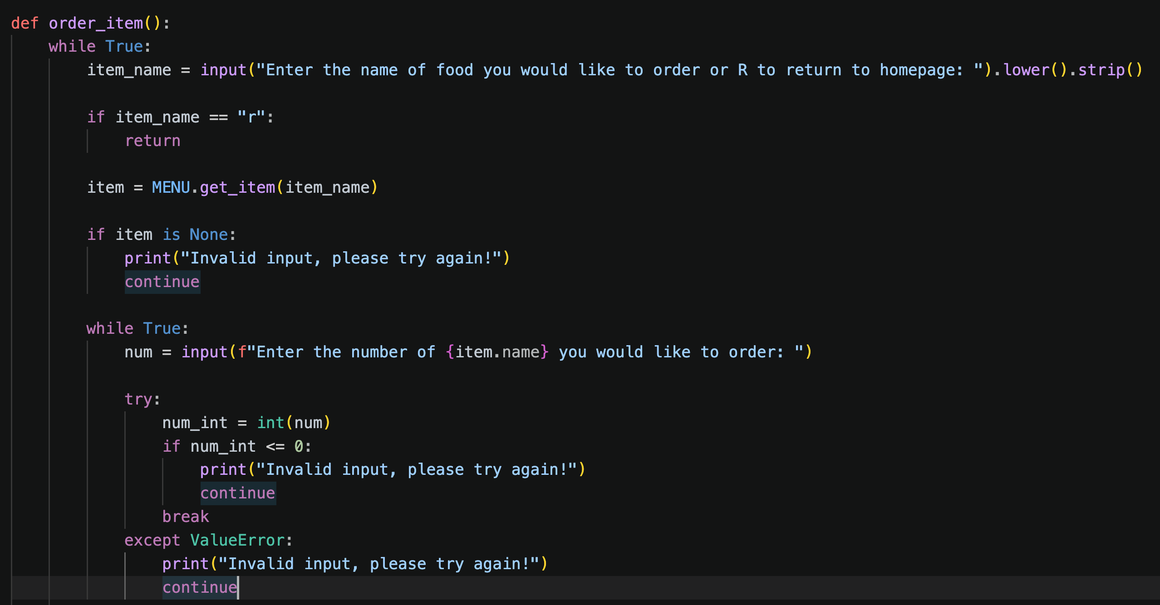
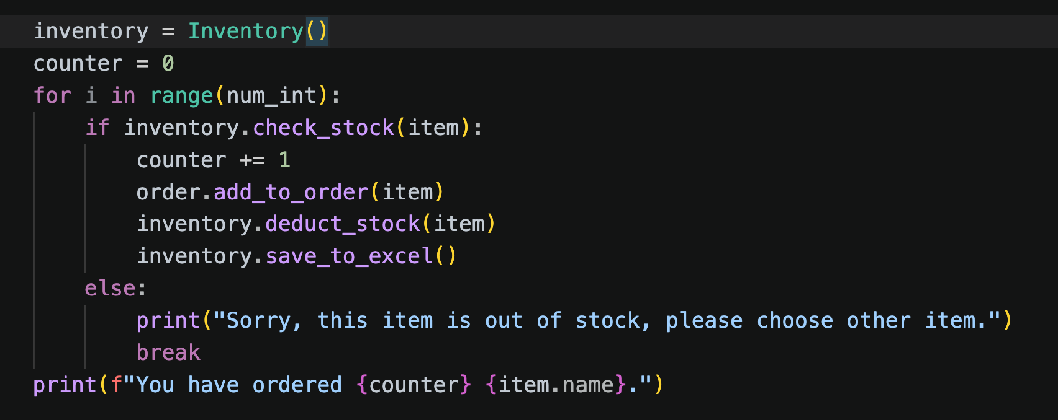
Main Function — Ordering & Checkout
Input validation, stock checking, and receipt generation
ORDER_ITEM() — WITH STOCK VALIDATION
Key Decision: Per-Unit Stock Check
We check stock per unit in a loop rather than checking total availability upfront. This enables partial fulfillment — if 3 are requested but only 2 remain, the customer gets 2 instead of 0.
Campus Cafe

Slide 10
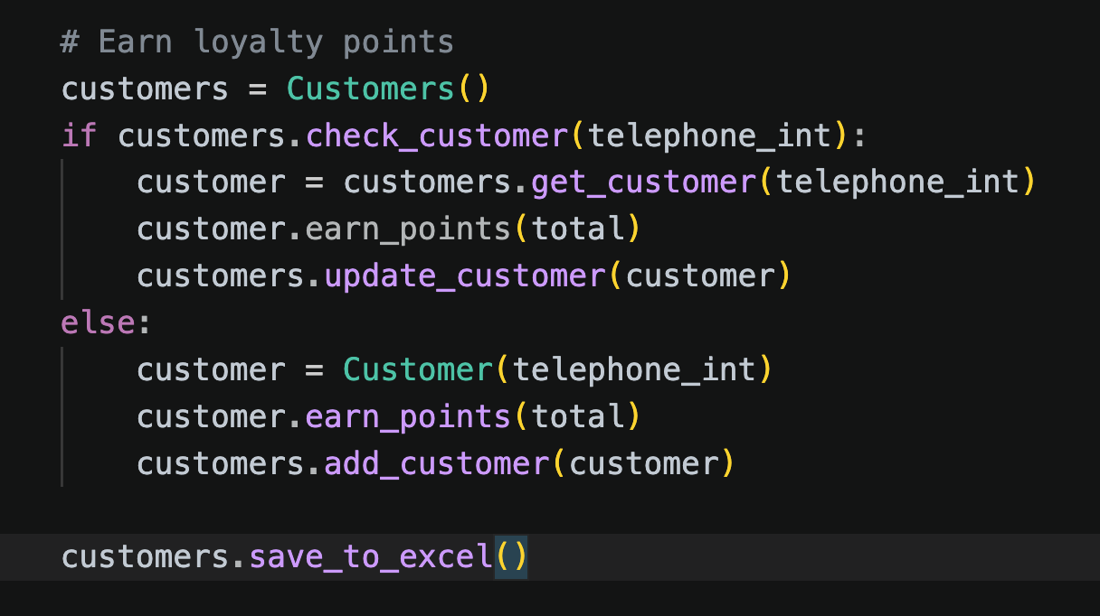
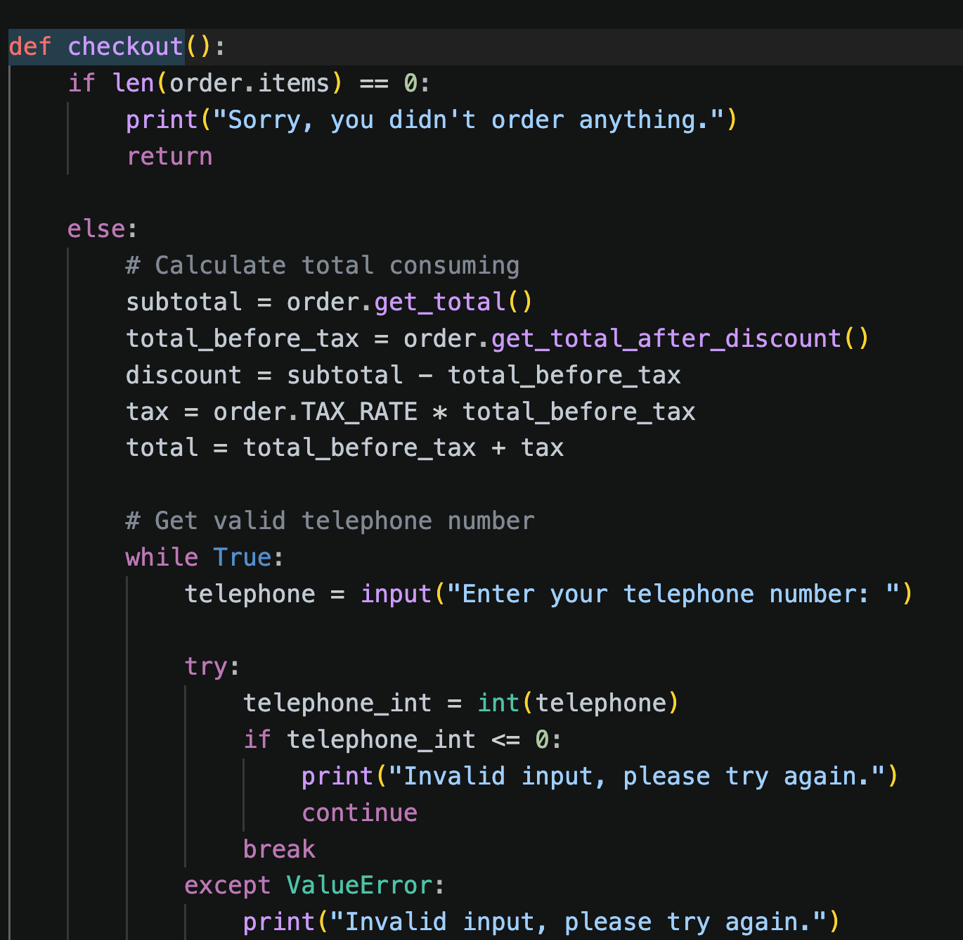
Main Function — Ordering & Checkout
Input validation, stock checking, and receipt generation
CHECKOUT() — RECEIPT & LOYALTY POINTS
Key Decision: Auto Customer Registration
At checkout, we check if the phone number exists. Returning customers earn more points; new customers are automatically registered. No signup flow needed — frictionless loyalty.
Campus Cafe

Slide 11
SECTION 2
Class Design Deep Dive
Object-oriented design for Menu, Order, Inventory, Customer, and Staff

Slide 12
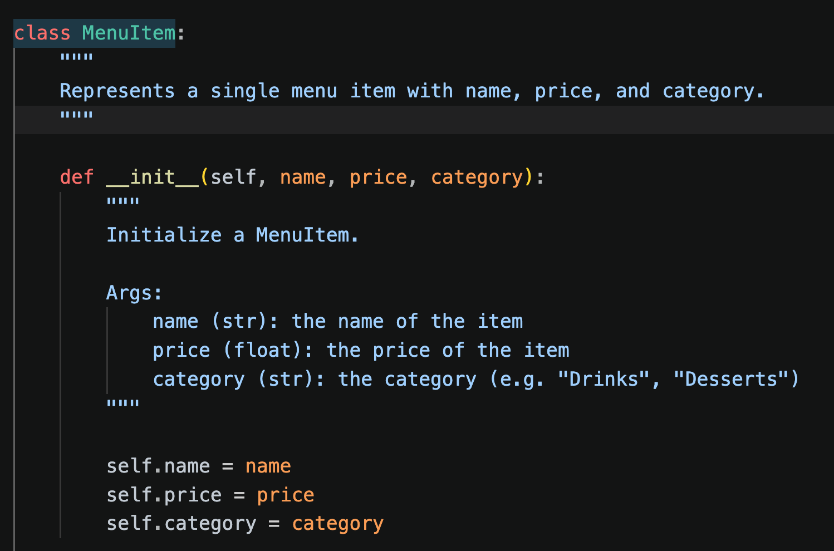
Class: Menu & MenuItem
backend/menu.py — Menu management with daily specials
Design Decisions
KEY METHODS
MenuItem is a simple data class — name, price, category
Menu loads all items from Menu.xlsx on initialization
Daily Special randomly chosen via random.choice() each session, with configurable discount rate (default 20%)
Fuzzy search: get_item() ignores case and spaces, so "fruitsalad" matches "Fruit Salad"
Campus Cafe

Slide 13
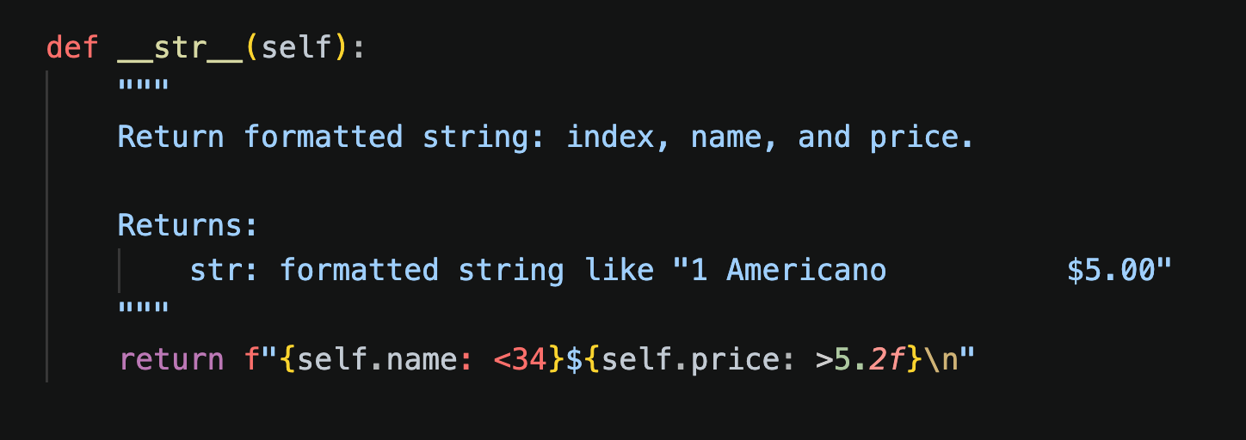
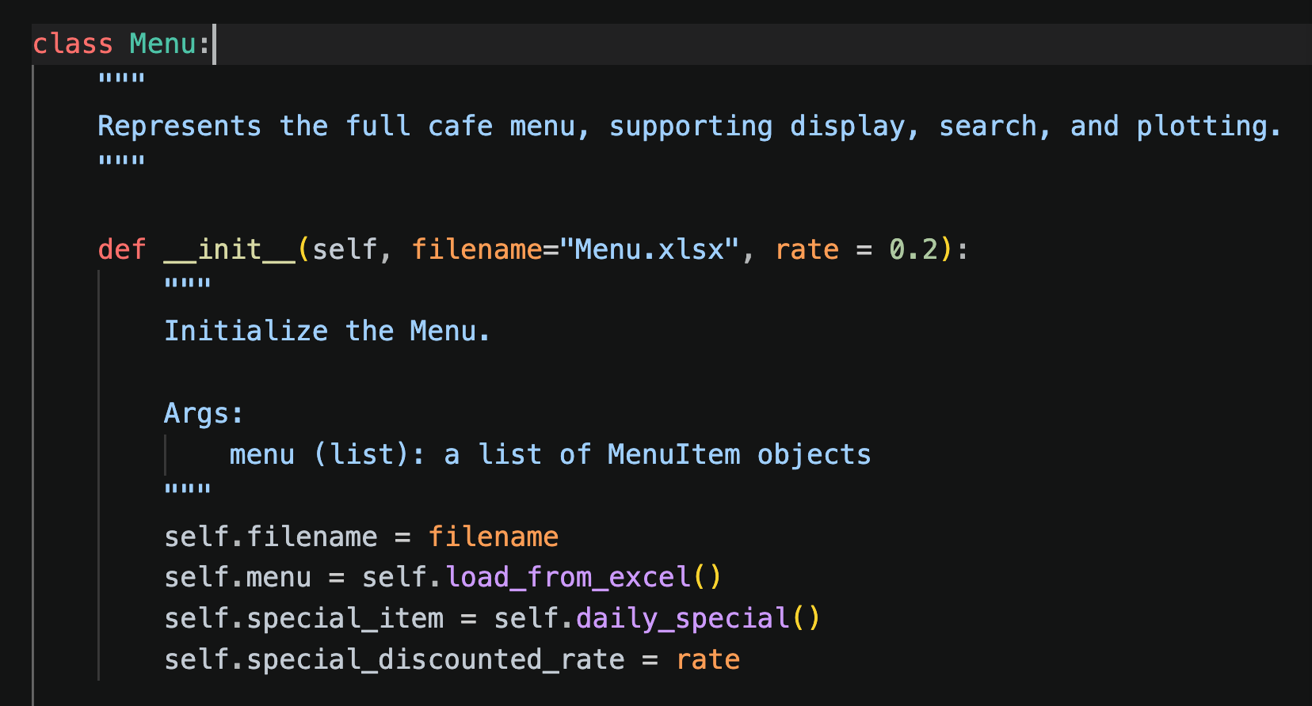
Class: Menu & MenuItem
backend/menu.py — Menu management with daily specials
Design Decisions
KEY METHODS
MenuItem is a simple data class — name, price, category
Menu loads all items from Menu.xlsx on initialization
Daily Special randomly chosen via random.choice() each session, with configurable discount rate (default 20%)
Fuzzy search: get_item() ignores case and spaces, so "fruitsalad" matches "Fruit Salad"
Campus Cafe

Slide 14
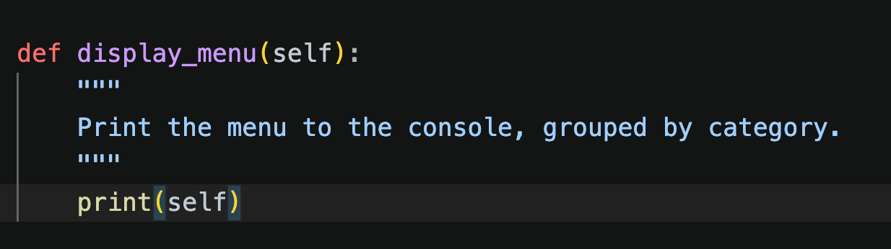
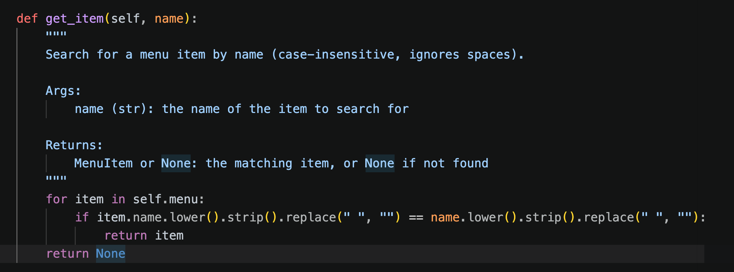
Class: Menu & MenuItem
backend/menu.py — Menu management with daily specials
KEY METHODS
Campus Cafe

Slide 15
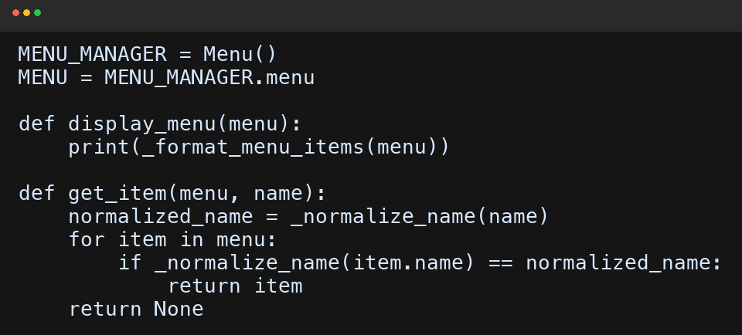
Class: Menu & MenuItem
backend/menu.py — Menu management with daily specials
KEY METHODS
Campus Cafe

Slide 16
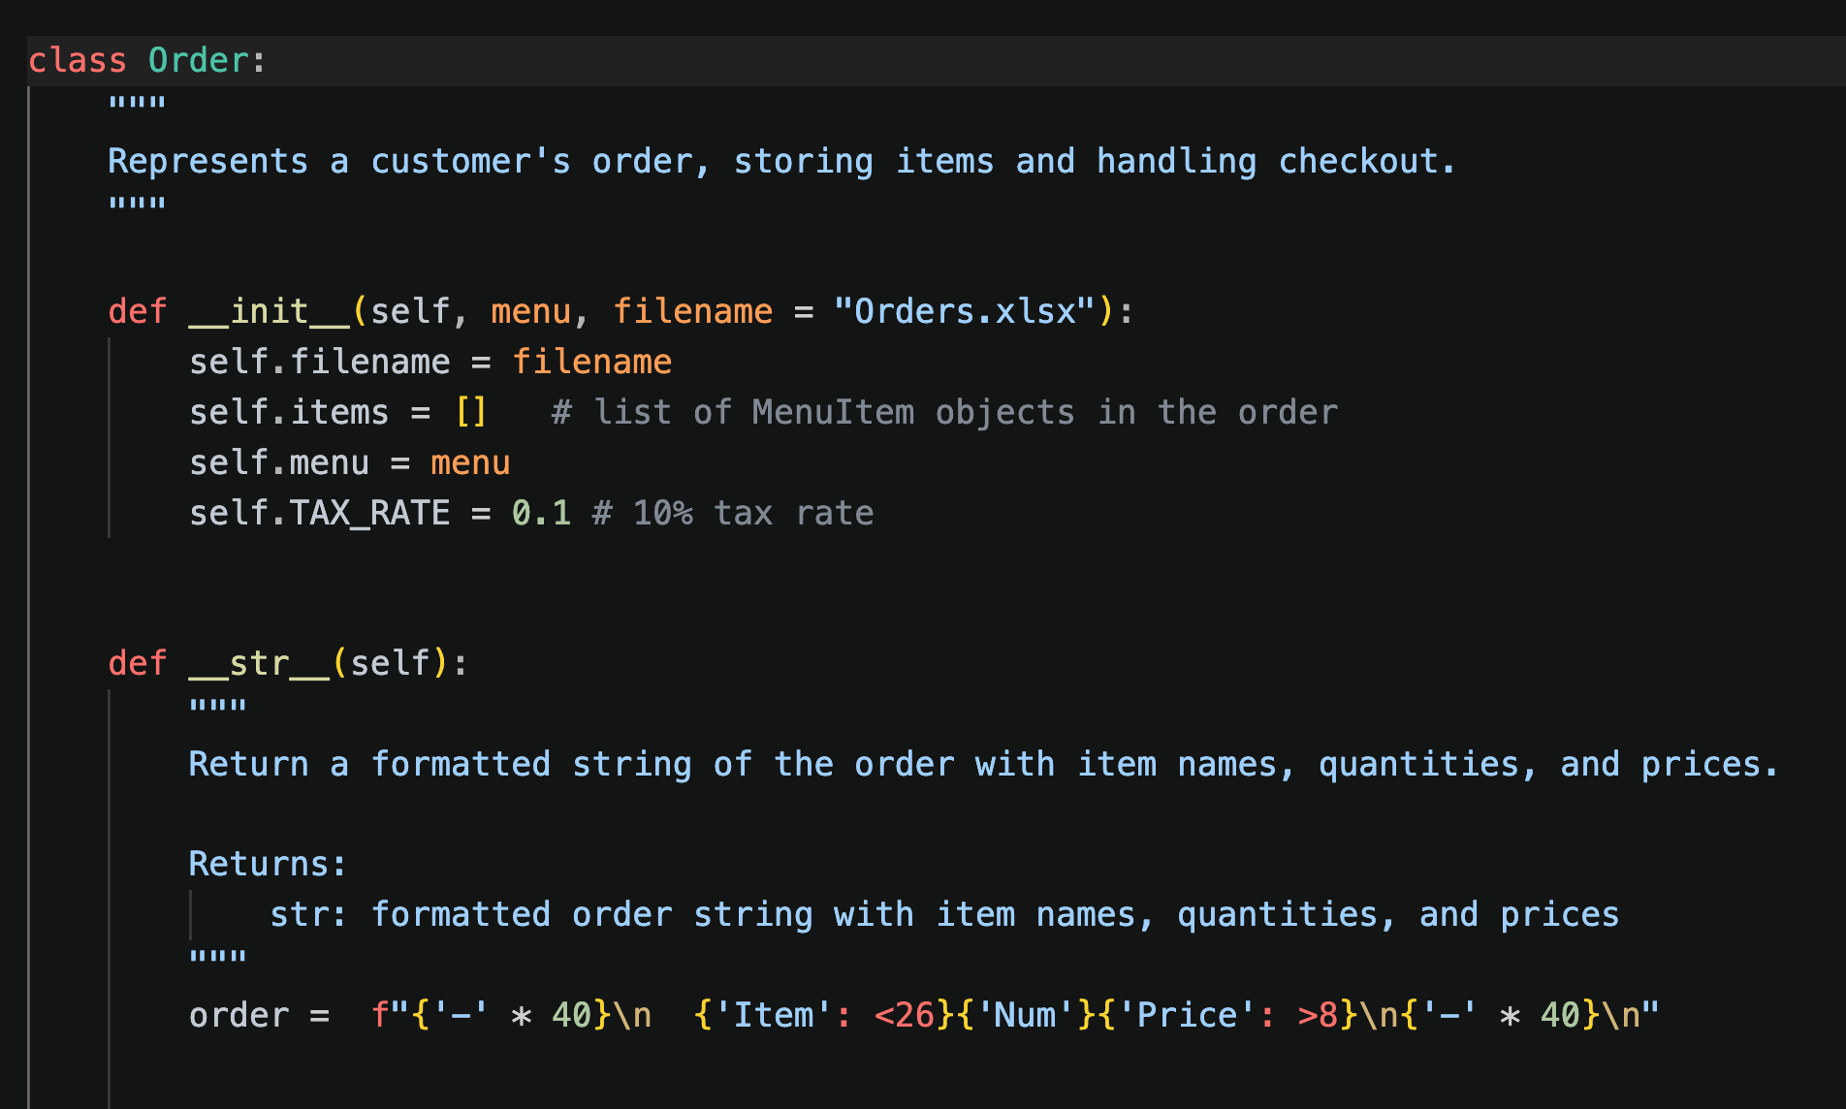
Class: Order
backend/order.py — Cart management, pricing, and tax calculation
Design Decisions
KEY METHODS
Items stored as a list (not dict) — each instance individually, making add/remove simple
Discount logic in get_total_after_discount() — only the daily special gets the discount
Tax rate is a class constant (0.1 = 10%), easy to adjust
save_to_excel() auto-increments order_id and appends to Orders.xlsx with timestamps
Campus Cafe

Slide 17
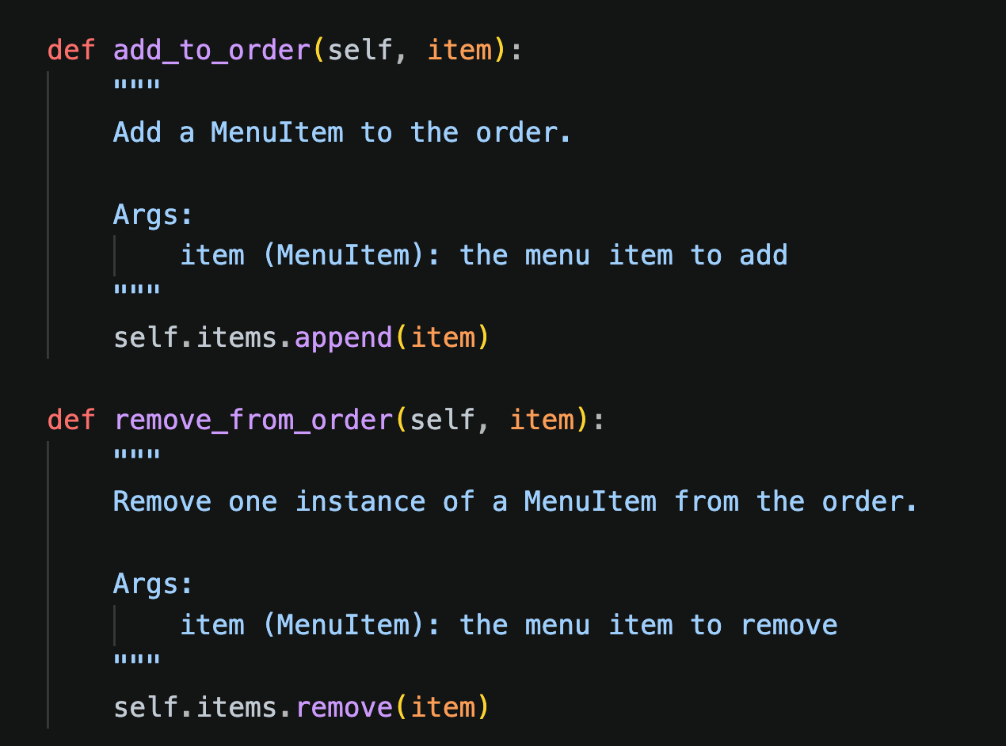
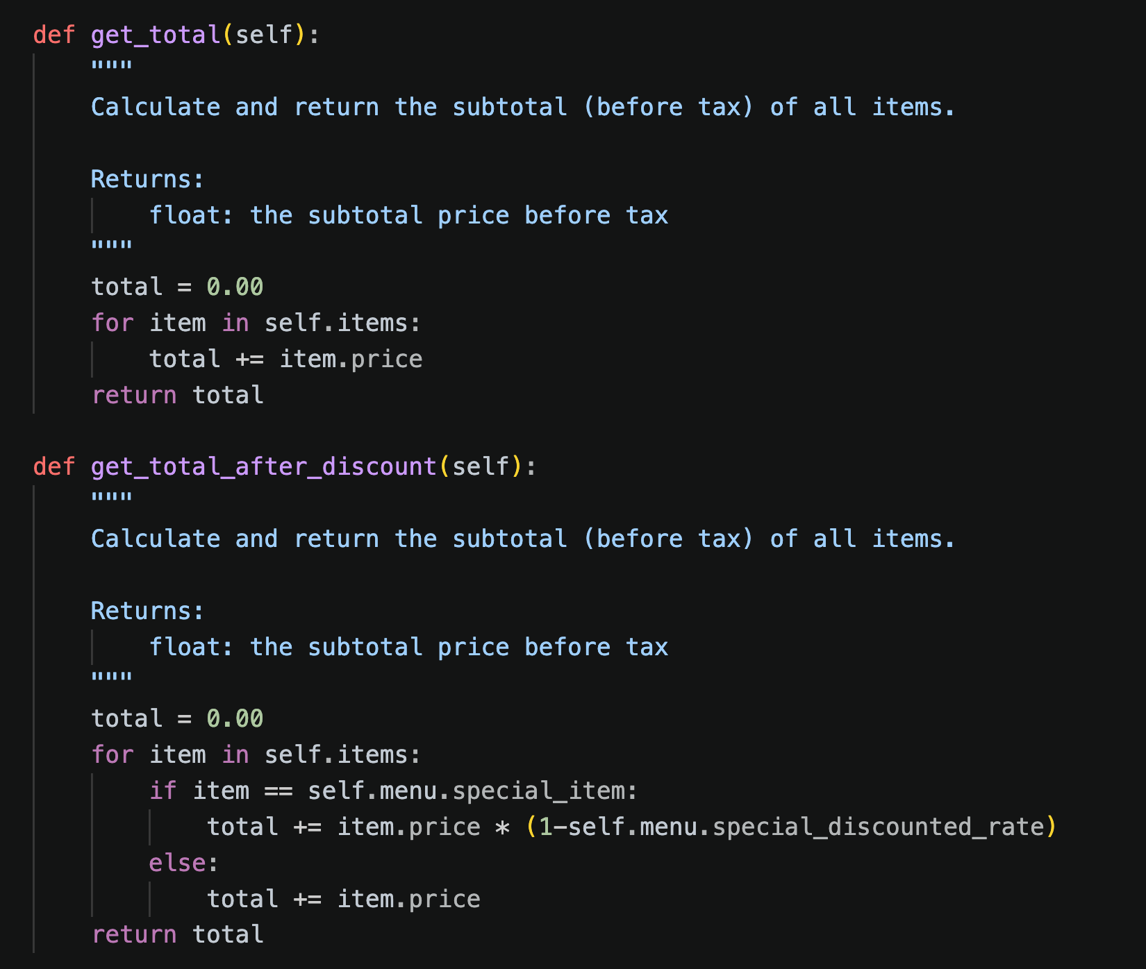
Class: Order
backend/order.py — Cart management, pricing, and tax calculation
KEY METHODS
Campus Cafe

Slide 18
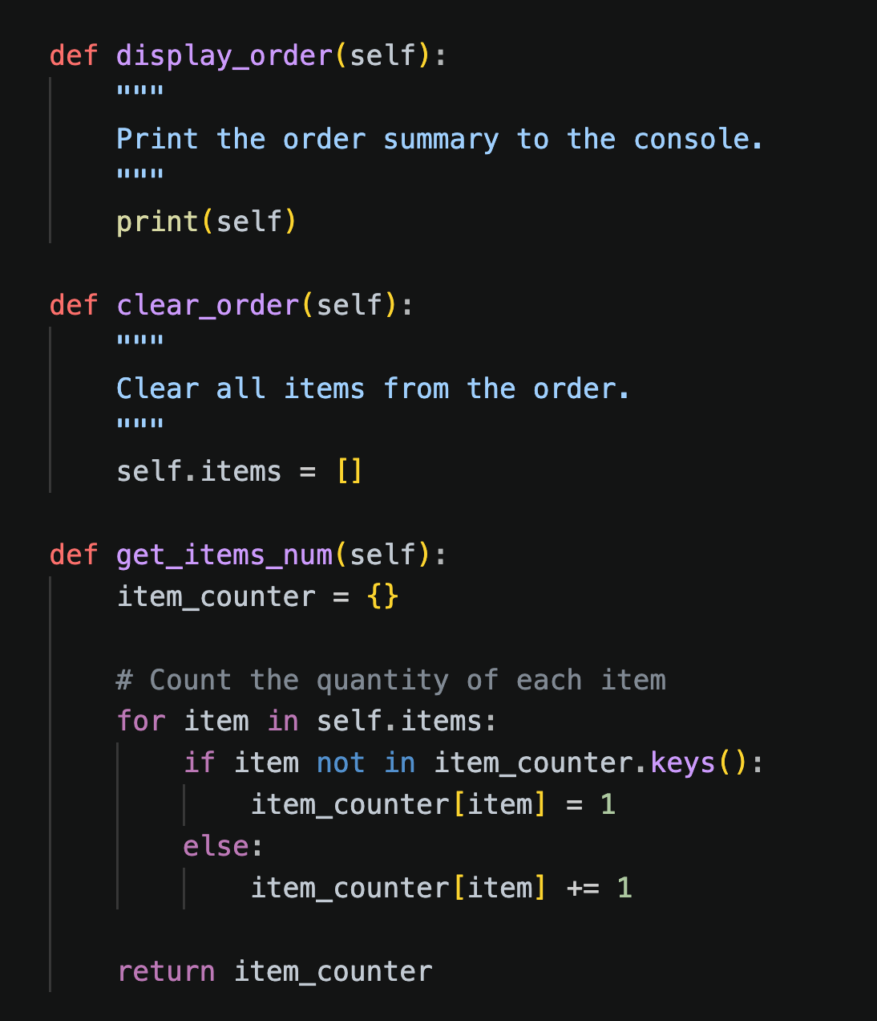
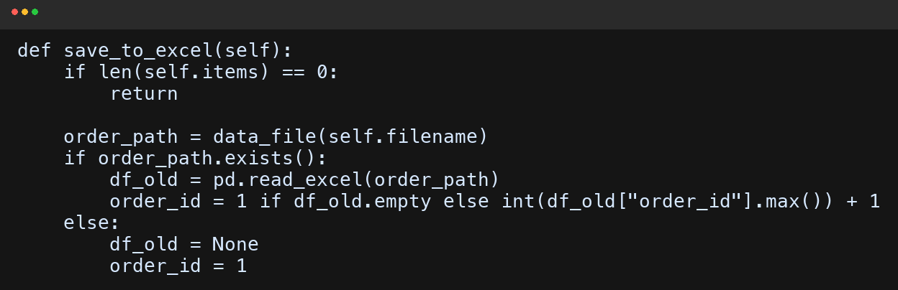
Class: Order
backend/order.py — Cart management, pricing, and tax calculation
KEY METHODS
Campus Cafe

Slide 19
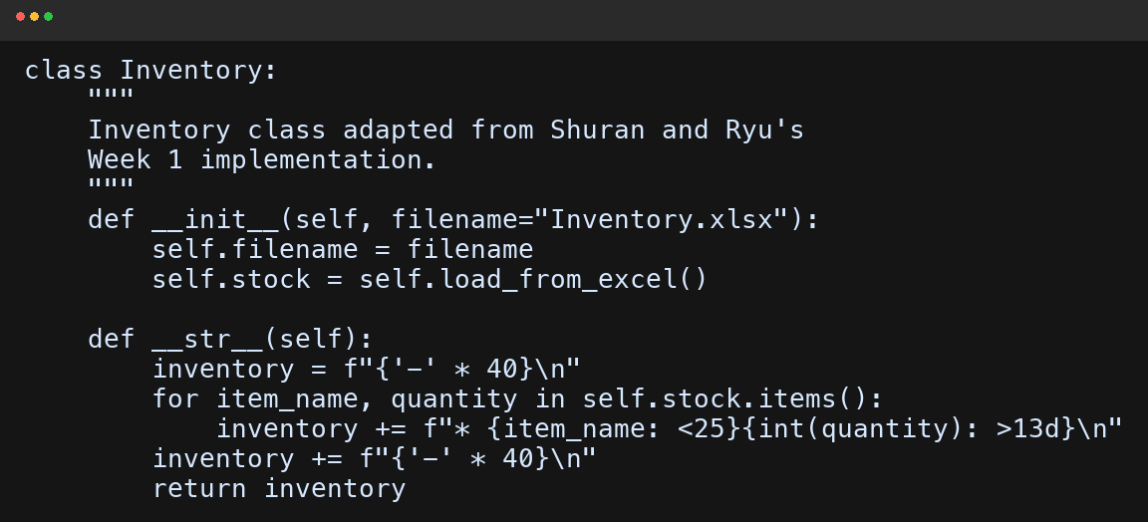
Class: Inventory
backend/inventory_ShuranRyu.py — adapted from Shuran and Ryu's Week 1 inventory class
Why We Chose This Class
We selected Shuran and Ryu's Inventory class because it followed the shared contract closely and kept the stock logic simple: a dictionary keyed by item name plus clear methods for checking, deducting, and restocking inventory. That made it the easiest Week 1 class to trust, extend, and wire into our Week 2 app controller.
What We Reused
COLLABORATIVE INTEGRATION
check_stock(item) returns a clean True/False guard before ordering
deduct_stock(item) reduces one unit at a time for accurate quantity loops
restock(name, amount) already matched the staff restock workflow
stock_report() gave us a solid foundation for the staff inventory view
Campus Cafe

Slide 20
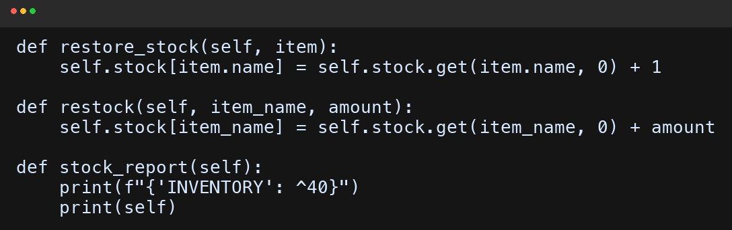
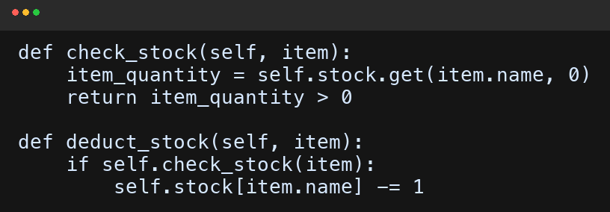
Class: Inventory
backend/inventory_ShuranRyu.py — compatibility changes for our full app
Compatibility Changes We Made
Shuran and Ryu's original version used a hard-coded stock dictionary and a local test Item class. We preserved the required stock contract, then connected inventory to real MenuItem objects, Excel persistence, restore-on-delete behavior, and the shared data_file() helper used by both the CLI and the deployed app.
COMPATIBILITY LAYER
Campus Cafe

Slide 21
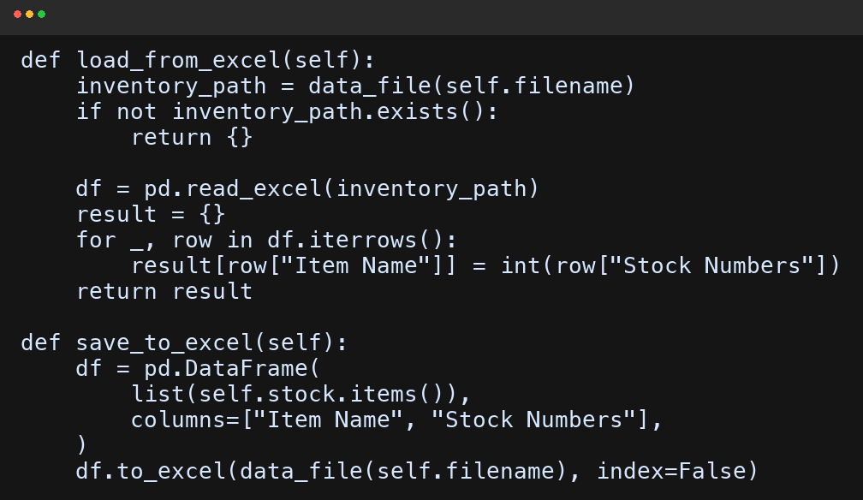
Class: Inventory
backend/inventory_ShuranRyu.py — debugging lessons and integration challenges
Challenges We Faced
The hardest part was interface mismatch and state synchronization. The original code printed stock messages directly, stored data only in memory, and assumed a local data/ path. We moved user-facing messages into the controller/API, matched stock keys to MenuItem.name, restored stock on cart deletion, and centralized file access through data_file().
ADAPTATION & DEBUGGING
Campus Cafe

Slide 22
Inventory Integration — What Broke And What We Fixed
Original Assumptions
Integration Problems
Stock lived in a hard-coded dictionary
A local Item test class stood in for real menu items
check_stock() handled user messaging itself
No Excel persistence or cart-delete restore path
main.py and app.py needed silent True/False stock checks
Deleting cart items had to put stock back immediately
CLI and frontend both needed the same inventory source
Raw data/ paths were fragile in deployment
Changes We Made
Why It Matters
Imported the real Menu/MenuItem workflow
Added restore_stock(item), load_from_excel(), and save_to_excel()
Routed all file access through data_file()
Saved inventory after order, delete, and restock actions
We extended the reused class without breaking its public contract methods
That made the inventory code judge-ready for Week 2 integration and Week 3 edge-case testing
Contract Impact
The final version still exposes check_stock(item), deduct_stock(item), restock(item_name, amount), and stock_report(), but now it also supports persistence, cart deletion, and the public frontend.
Campus Cafe

Slide 23
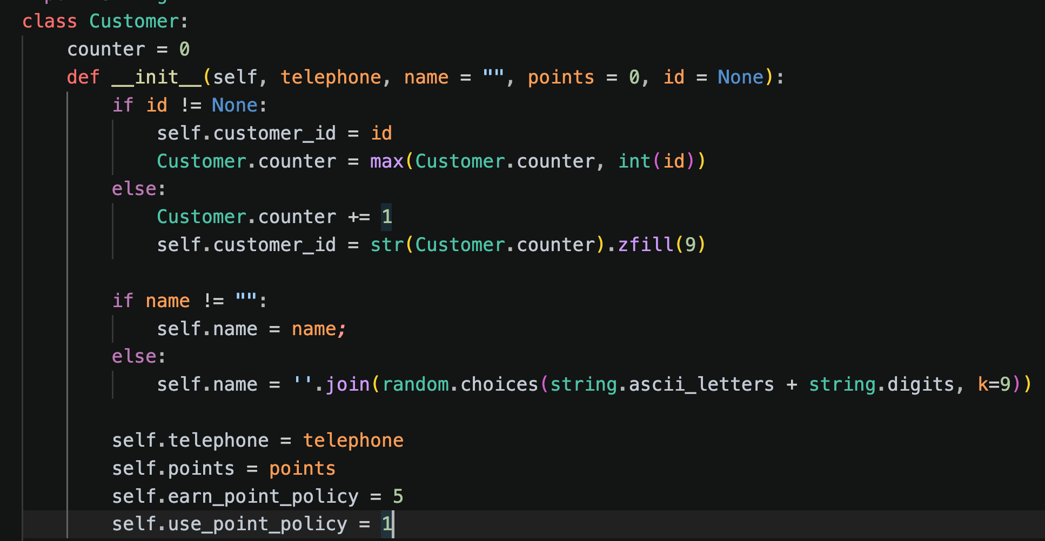
Class: Customer & Customers
backend/customer.py — Loyalty program with automatic point tracking
Design Decisions
KEY METHODS
Auto-generated IDs: class-level counter produces unique 9-digit IDs (e.g., 000000001)
Phone as identifier: customers looked up by phone number; duplicate prevention built in
Points policy: earn 1 point per $5 spent — clear, simple, configurable
Customers class manages the collection — CRUD operations + Excel persistence
Counter syncs with max existing ID on load to prevent duplicates
Campus Cafe

Slide 24
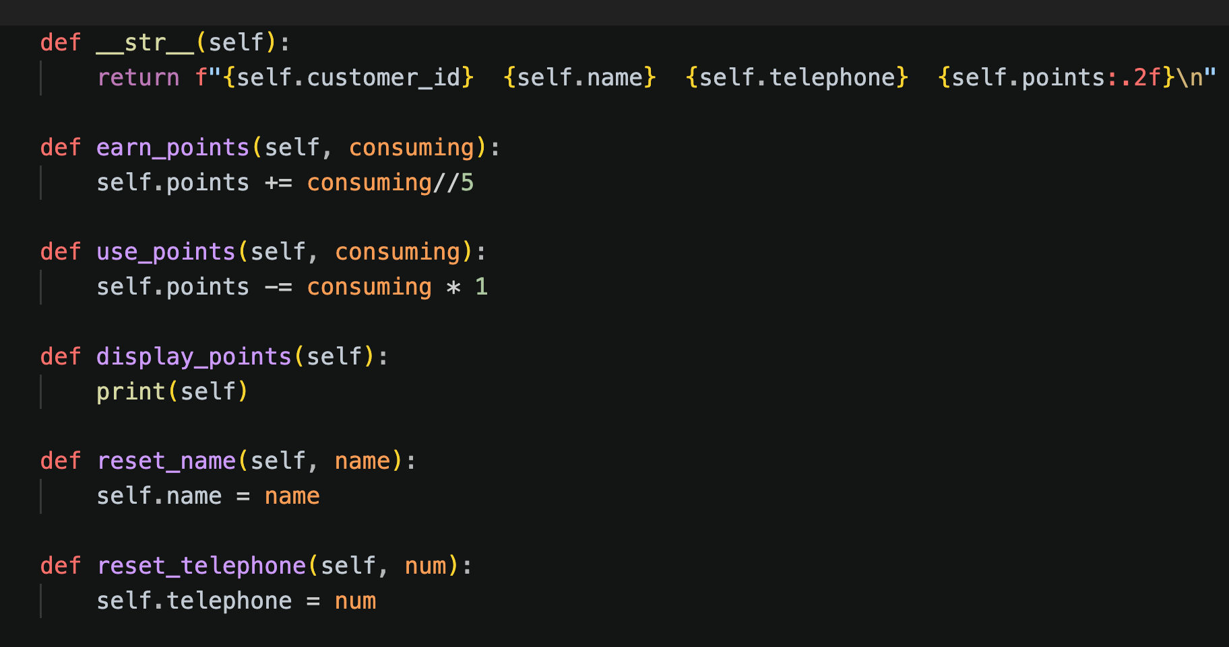
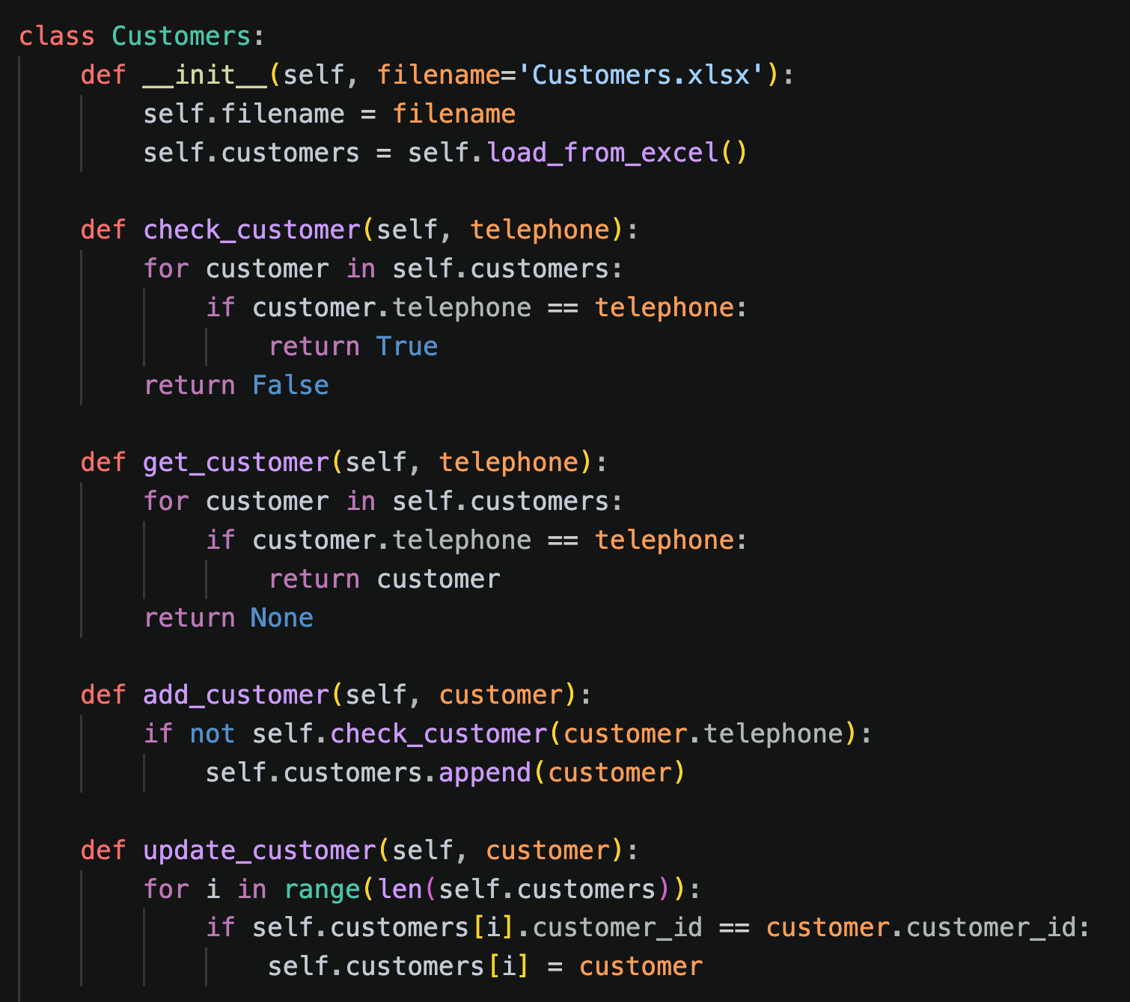
Class: Customer & Customers
backend/customer.py — Loyalty program with automatic point tracking
KEY METHODS
Campus Cafe

Slide 25
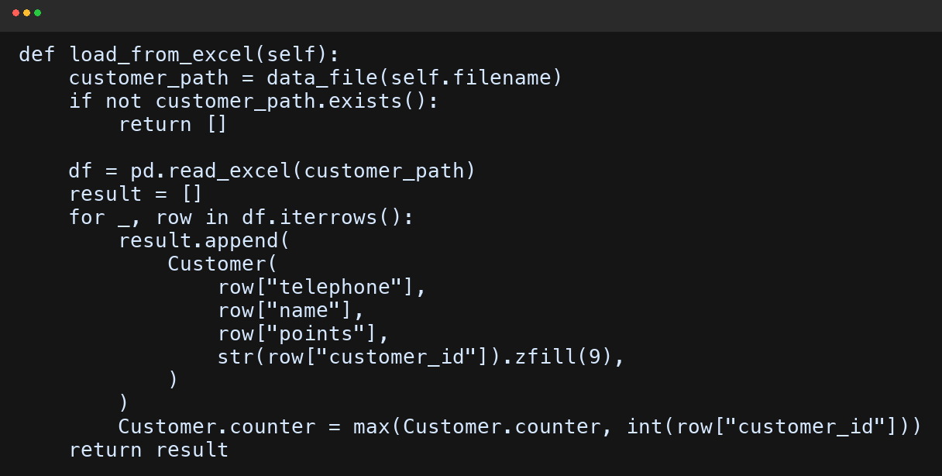
Class: Customer & Customers
backend/customer.py — Loyalty program with automatic point tracking
KEY METHODS
Campus Cafe

Slide 26
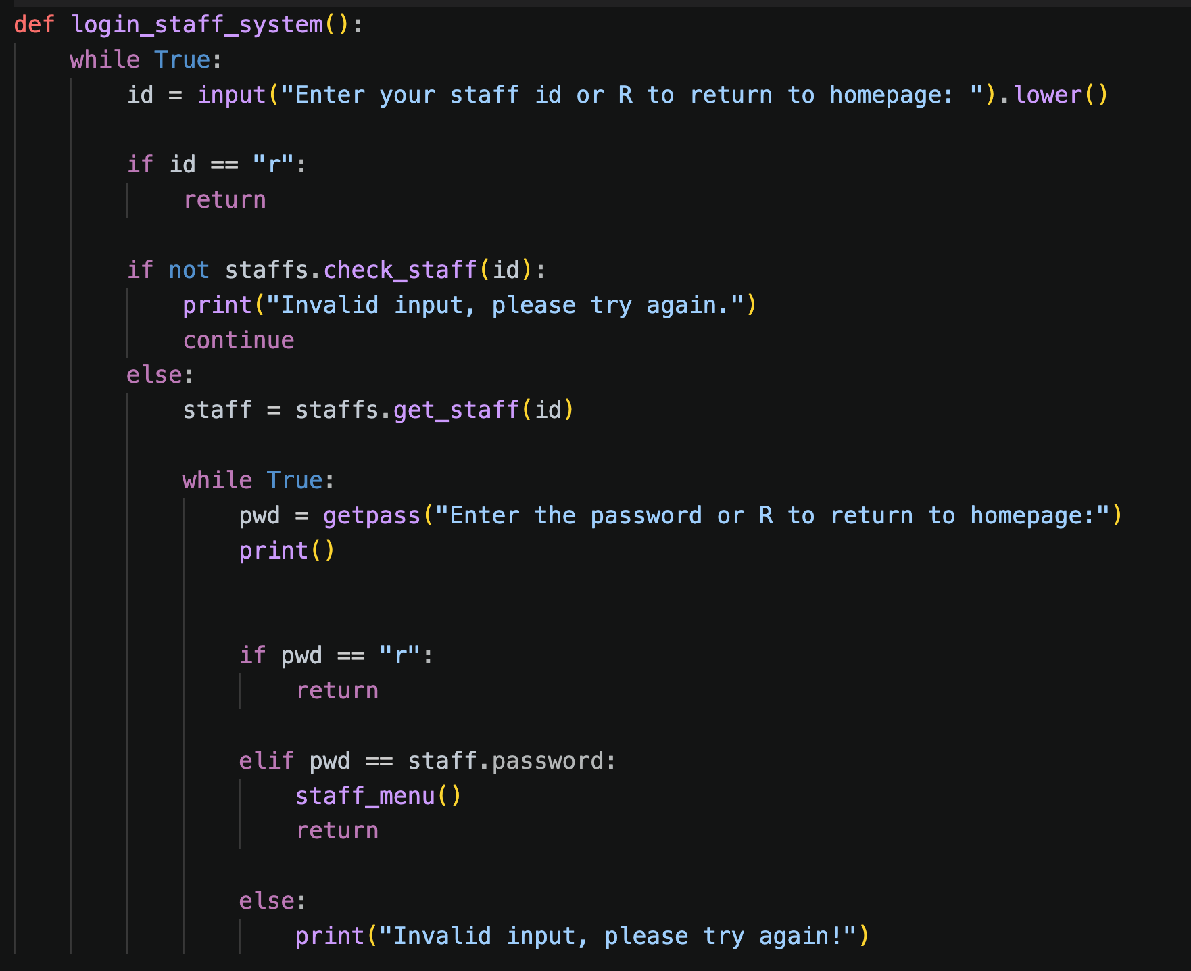
Class: Staff & Staffs
backend/staff.py — Secure staff authentication and management
Design Decisions
STAFF LOGIN FLOW (MAIN.PY)
Same ID pattern as Customer — 9-digit auto-increment with class-level counter
Password-protected: staff must enter both ID and password to access
In the CLI, getpass hides password input for security
Staffs collection mirrors the Customers pattern: check, get, add, delete, update + Excel I/O
Consistent Patterns
Customer and Staff follow the same architectural template — entity class + collection class + Excel persistence. This makes the codebase predictable and easy to extend.
Campus Cafe

Slide 27
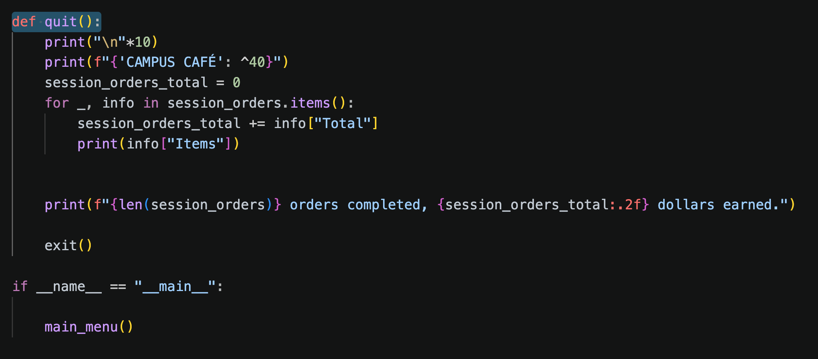
Class: Staff & Staffs
backend/staff.py — Secure staff authentication and management
Design Decisions
SESSION QUIT — SUMMARY ON EXIT
Same ID pattern as Customer — 9-digit auto-increment with class-level counter
Password-protected: staff must enter both ID and password to access
In the CLI, getpass hides password input for security
Staffs collection mirrors the Customers pattern: check, get, add, delete, update + Excel I/O
Consistent Patterns
Customer and Staff follow the same architectural template — entity class + collection class + Excel persistence. This makes the codebase predictable and easy to extend.
Campus Cafe

Slide 28
SECTION 3
Data Persistence
Excel-based tracking for orders, customers, and inventory

Slide 29
Excel Data Layer
All data persisted to .xlsx files using pandas + openpyxl
File | Purpose | Columns
Menu.xlsx | Menu items catalog | item_name, price, category
Orders.xlsx | Complete order history | order_id, total, date, time, [item quantities]
Inventory.xlsx | Current stock levels | Item Name, Stock Numbers
Customers.xlsx | Customer profiles & loyalty points | customer_id, name, telephone, points
Staffs.xlsx | Staff credentials | staff_id, name, telephone, password
★ Special Feature: Loyalty Points Tracking
Every checkout automatically identifies returning customers by phone number, accumulates their loyalty points in Customers.xlsx, and displays the updated balance on the receipt. New customers are auto-registered on first purchase with a unique 9-digit ID. All data persists across sessions — no data is lost when the program restarts.
Campus Cafe

Slide 30
SECTION 4
Frontend Application
A React web interface built on top of the same backend

Slide 31
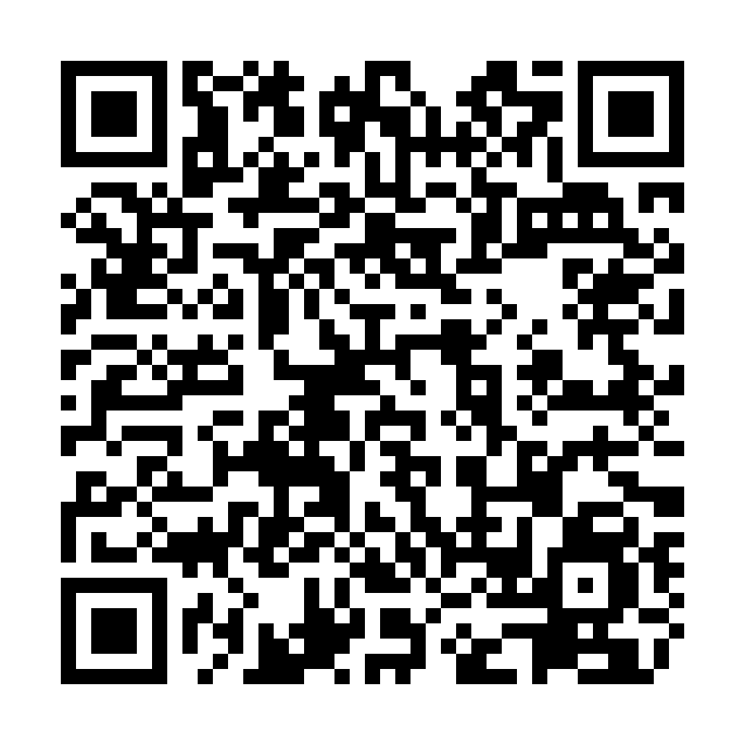
Test out our Live app here:
Scan the QR code or click on the link to check out our live frontend app:
QR Code:
Publicly hosted URL for our Campus Café web app:
https://campus-cafe-cs5001-production.up.railway.app/
Campus Cafe

Slide 32
React Frontend
Modern web interface for the Campus Cafe POS
To make our project more accessible and visually engaging, we built a full web application using React. A FastAPI server (app.py) wraps the exact same backend classes, exposing them as REST API endpoints.
Tech Stack
Customer Pages
Staff Pages
React 18 + Vite
React Router v6
FastAPI (Python)
Vite proxy for API calls
Home — landing page
Menu — browse by category
Cart — review & edit quantities
Checkout — pay & get receipt
Staff Login — secure auth
Inventory Management
Restock items in bulk
Session summary on quit
Same Backend, Two Interfaces
Both the terminal CLI and the React frontend call the same Python classes. The web app adds a visual layer on top without duplicating any business logic. This demonstrates clean separation of concerns — the backend handles data and rules, while the frontend handles presentation.
Campus Cafe

Slide 33
Frontend — Key Features
Interactive UI with real-time stock validation
Menu Page
Cart Page
4 category tabs (Salads, Drinks, Desserts, Sandwiches)
Daily special banner with discount badge
Inline quantity controls (+/-) with stock validation
Toast notifications when stock is insufficient
Editable quantities (type or +/- buttons)
Real-time price summary with tax & discount
Stock validation on quantity increase
Clear cart functionality
Checkout & Receipt
Staff Dashboard
Phone number entry for loyalty points
Full receipt with itemized breakdown
Auto-redirect to home after 8 seconds
Automatic customer registration
Inventory table with low-stock highlighting (red)
Restock form with dropdown item selection
Navbar "Quit" button triggers session summary
Modal shows all orders with item details + revenue
Campus Cafe

Slide 34
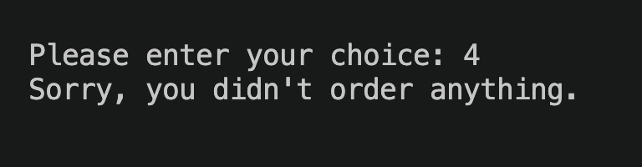
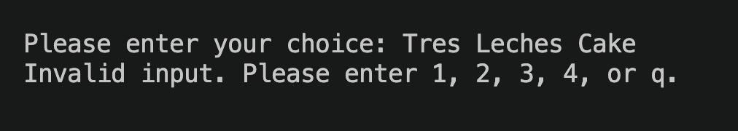
Edge Cases & Error Handling
Empty Cart Checkout
Item Not Found
checkout() first checks whether order.items is empty. If so, it prints a friendly message and returns to the main menu instead of producing a $0 receipt or crashing.
MENU.get_item() returns None for unknown names. order_item() catches that case, shows an error, and re-prompts the user without changing stock or cart state.
Why This Matters
These fixes map directly to the CS5001 Student Guide requirements for Week 3. We tested them in the terminal app so the demo flow stays stable even when the user makes mistakes.
Campus Cafe

Slide 35
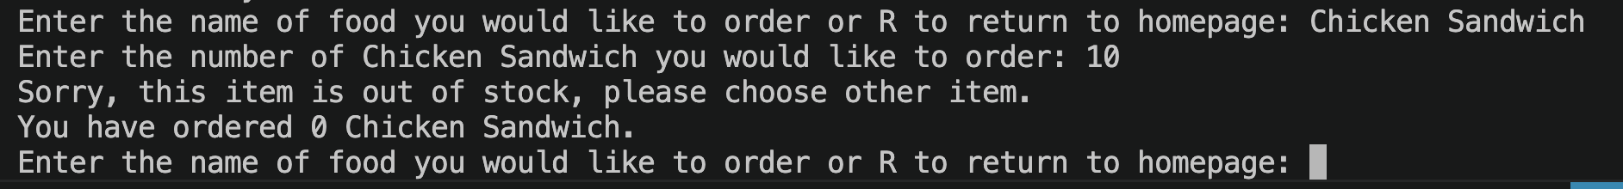
Edge Cases & Error Handling
Out of Stock
Inventory.check_stock() blocks unavailable items. If stock is 0, the app prints a clear message, does not deduct anything, and lets the customer choose a different item.
Why This Matters
These fixes map directly to the CS5001 Student Guide requirements for Week 3. We tested them in the terminal app so the demo flow stays stable even when the user makes mistakes.
Campus Cafe

Slide 36
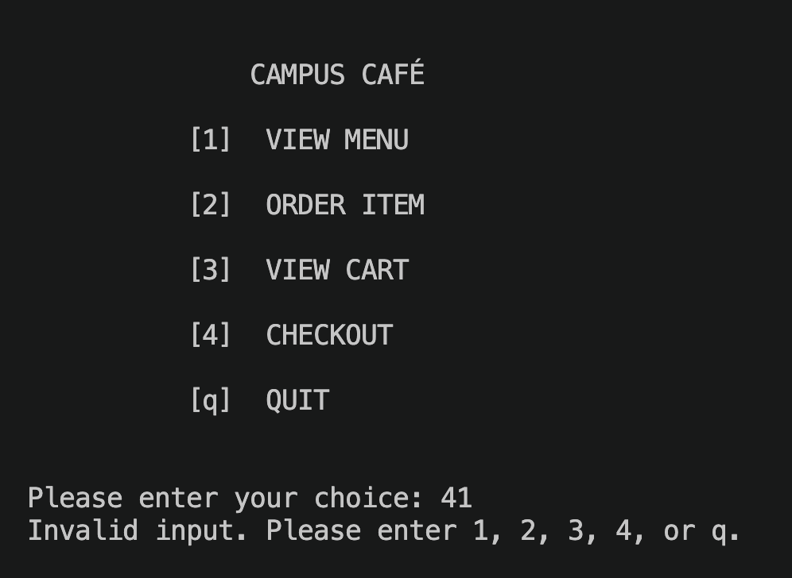
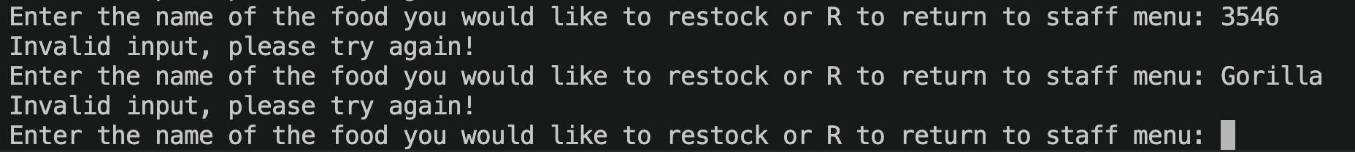
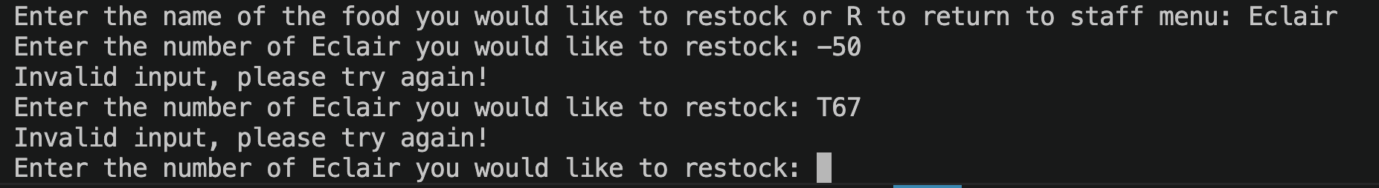
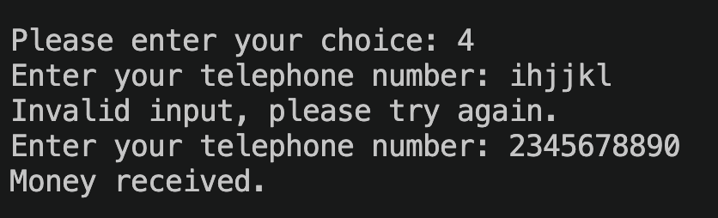
Edge Cases & Error Handling
Invalid Inputs
main_menu() rejects anything other than 1, 2, 3, 4, q, or staff. We also validate quantity, telephone, delete, and restock inputs so non-numeric or non-positive values never break the session.
Campus Cafe

Slide 37
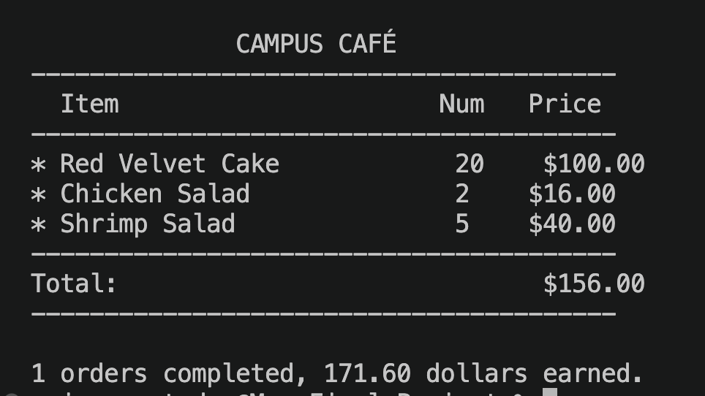
Session Summary
Session Summary
Session summary displays after the Staff quits the Staff mode. It shows the number of orders completed and the total revenue generated for the session.
Campus Cafe

Slide 38
Bonus Features & Code Improvements
Bonus Features
Persistence & Full Stack
Daily special with an automatic 20% discount, a loyalty-points system, staff restock mode, full session summaries, and a React frontend deployed to a public link all extend the base brief.
Orders, customers, staff, menu items, and inventory are stored in Excel and reused by both the CLI and the FastAPI + React frontend, so we did not duplicate business logic between interfaces.
Code Improvements
Public Demo Ready
We improved contract alignment, fixed test blocks, added clearer helper functions, and documented non-obvious logic such as daily-special pricing, inventory restoration, and deployment-safe data loading.
The frontend is now publicly hosted, and the presentation includes a QR code so judges can try the web interface directly during or after the talk.
Team Reflection
Our biggest growth came from integration work: comparing classmates' code, adapting it carefully instead of rewriting it, and then extending a terminal app into a deployable full-stack project.
Campus Cafe

Slide 39
Frontend Staff Demo Access
Access Steps
Staff Demo Credentials
Open the live Campus Cafe link and click the Staff tab in the top navigation bar. The app takes you to /staff/login, where you can sign in and continue directly to the staff dashboard.
Primary: 000000001 / demo123
Backup: 000000002 / demo456
What To Review
Synced Credentials
After login, judges can view the inventory table, see low-stock highlighting, restock items in bulk, and use the Quit button to display the staff session summary.
These demo credentials are now the same in both our local project data and the public hosted frontend, so the same login works in both environments.
Live App
Public URL: https://campus-cafe-cs5001-production.up.railway.app
Campus Cafe

Slide 40
Full Staff Account Management
BONUS FEATURE UPDATE
We expanded the staff system so managers can maintain staff login accounts from both the terminal CLI and the React frontend, not just restock inventory.
Terminal CLI
Frontend Dashboard
Shared Backend Logic
The staff menu now supports viewing, adding, updating, and deleting staff accounts. We also added validation for name, telephone, and password inputs and prevent deleting the final remaining staff login.
After staff login, the web dashboard now combines inventory restocking with staff account management. Staff can create new accounts, update existing records, and remove outdated accounts without editing Excel files manually.
main.py, app.py, and backend/staff.py now rely on the same Staffs model and persistence layer. That keeps the CLI app, FastAPI endpoints, and hosted frontend synchronized through Staffs.xlsx.
Why this matters
This improves our bonus features, demonstrates stronger encapsulation across interfaces, and gives us a clearer real-world admin workflow to test in the live app.
Campus Cafe
Campus Cafe

Slide 41
Thank You
Questions & Live Demo
Campus Cafe — NEU 5001 Final Project Python • FastAPI • React • Excel

