Slide 1

Machine Learning & Preprocessing
A visual, zero-jargon guide loaded with crystal-clear code snippets designed to make complex concepts incredibly easy to understand and present to others.
ML FOUNDATION DECK
SLIDE 1 OF 22

Slide 2
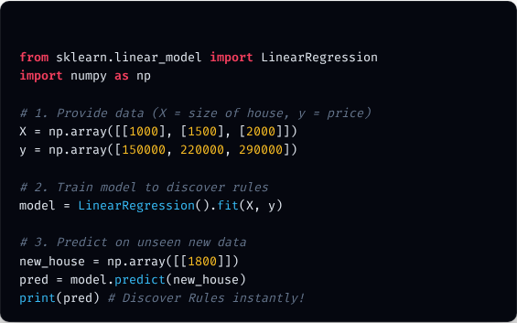

1. Introduction to Machine Learning
PYTHON
What is Machine Learning?
Instead of writing explicit rules (if-else statements) to solve a problem, we feed data into a statistical model and let it discover the underlying rules automatically.
Key Takeaway
Traditional Programming: Data + Rules → Answers. Machine Learning: Data + Answers → Rules.
CONCEPTS & CODE
SLIDE 2 OF 22

Slide 3
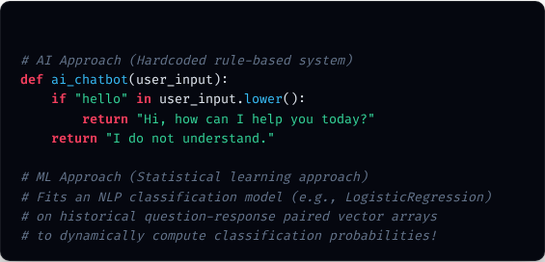
2. Artificial Intelligence vs. Machine Learning
Criteria | Artificial Intelligence (AI) | Machine Learning (ML)
Definition | Broad concept of machines acting "smart" like humans. | A specific subset of AI focused on learning from data.
Scope | Includes Rule-Based systems, NLP, Robotics, ML. | Focused entirely on algorithms & mathematical models.
Approach | Simulate cognitive tasks using any programmatic logic. | Identify hidden statistical patterns inside raw data.
PYTHON
ML is the actual engine that powers modern AI, enabling systems to dynamically scale and evolve as more data arrives.
CONCEPTS & CODE
SLIDE 3 OF 22

Slide 4






3. Types of Machine Learning
Supervised
Unsupervised
Reinforcement
Data has both input features (X) and labels (y). Model learns to predict labels.
Data has only input features (X). Model finds hidden structures or groups inside it.
An agent learns by interacting with an environment, receiving rewards (+) or penalties (-).
CONCEPTS & CODE
SLIDE 4 OF 22

Slide 5
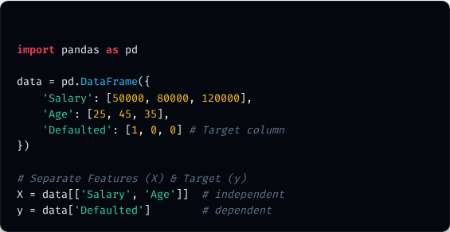
4. Features & Target Features
What is Feature vs. Target?
PYTHON
In a tabular dataset, think of it this way:
→
Features (Input / Independent Variables): The clues or columns we use to predict something (represented as ).
→
Target Features (Output / Dependent Variables): The actual column we are trying to predict (represented as ).
For example, predicting if a customer defaults: "Salary" and "Credit Score" are features, "Defaulted (Yes/No)" is the target.
CONCEPTS & CODE
SLIDE 5 OF 22

Slide 6
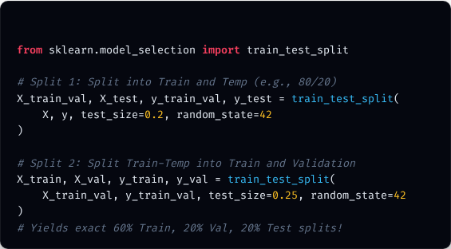
5. Training, Validation & Testing
Splitting Your Dataset
PYTHON
To evaluate our model realistically, we split our data into three partitions:
→
Training Set (60-80%): Used to train the model so it can learn underlying patterns.
→
Validation Set (10-20%): Used during tuning to adjust hyperparameters and prevent overfitting.
→
Test Set (10-20%): Kept completely hidden until the very end to evaluate final, unbiased performance.
CONCEPTS & CODE
SLIDE 6 OF 22

Slide 7






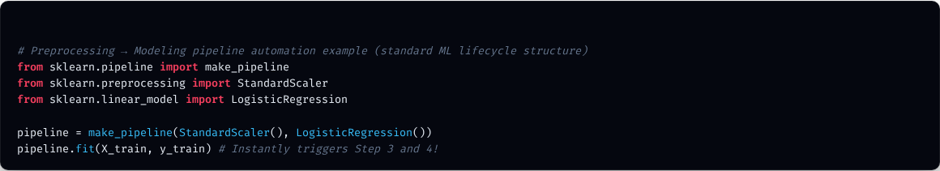
6. The Machine Learning Life Cycle
Business Goal
Data Gathering
Preprocessing
Model Training
Deployment
Monitoring
Identify the core business problem to solve.
Collect databases, CSVs, or API records.
Clean missing rows, outliers & duplicates.
Fit algorithms and optimize params.
Expose predictions via robust APIs.
Track accuracy drift over real-time.
PYTHON
CONCEPTS & CODE
SLIDE 7 OF 22

Slide 8
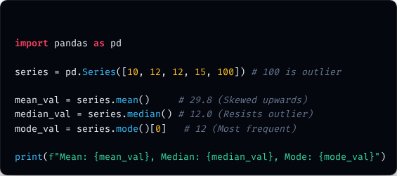
7. Basic Statistics in Machine Learning
Mean, Median & Mode
Fundamental metrics utilized extensively to understand central tendency and handle missing datasets:
PYTHON
→
Mean (Average): Sum of all values divided by total count. Extremely sensitive to outliers.
→
Median (Middle Value): The absolute center value when sorted. Highly resistant to outliers.
→
Mode (Most Frequent): The value that appears most often. Crucial for filling categorical columns.
CONCEPTS & CODE
SLIDE 8 OF 22

Slide 9
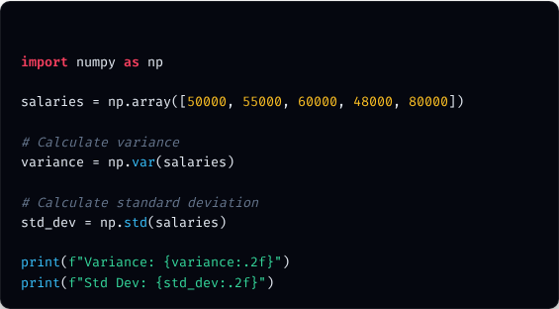


8. Variance & Standard Deviation
Measuring Data Spread
PYTHON
They measure how "spread out" your numeric data points are around the calculated mean value.
→
Variance: The average of squared differences from the mean.
→
Standard Deviation ( ): The square root of variance. It brings the metric back into the original units of your data, making it intuitive to explain.
CONCEPTS & CODE
SLIDE 9 OF 22

Slide 10
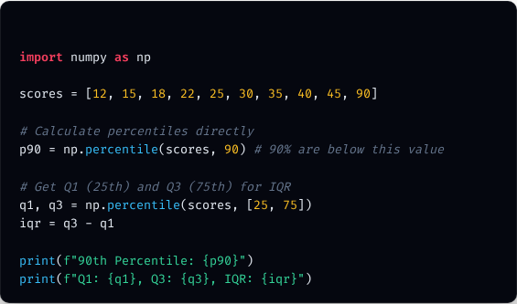

9. Percentiles & Quartiles
PYTHON
Dividing Your Data
→
Percentile: The value below which a given percentage of data falls. (e.g., scoring in the 90th percentile means you did better than 90% of peers).
→
Quartiles: Divide sorted dataset into 4 equal quarters: • Q1 (25th Percentile): Median of lower half. • Q2 (50th Percentile): The absolute median. • Q3 (75th Percentile): Median of upper half.
Used to calculate the IQR (Interquartile Range) = Q3 - Q1, which is the gold standard for statistical outlier detection.
CONCEPTS & CODE
SLIDE 10 OF 22

Slide 11
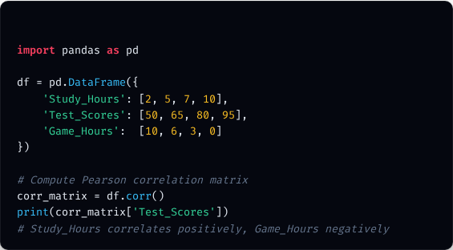
10. Correlation
PYTHON
Relationships Between Columns
Correlation measures the strength and direction of a linear relationship between two variables, ranging from -1.00 to +1.00.
→
+1.00: Perfect Positive (When X goes up, y goes up proportionally).
→
0.00: No relationship.
→
-1.00: Perfect Negative (When X goes up, y goes down proportionally).
⚠️ Caution: Correlation does not equal Causation!
CONCEPTS & CODE
SLIDE 11 OF 22

Slide 12
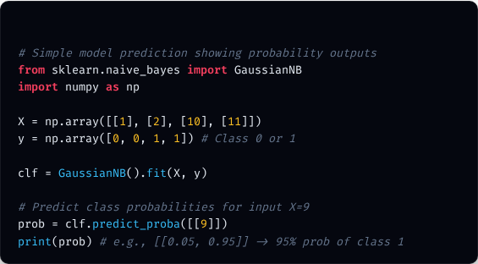
11. Probability Basics in ML
PYTHON
Why Probability Matters
ML models are not deterministic; they make probabilistic guesses. (e.g., "This image is 95% likely to be a cat.")
→
Standard Probability: Likelihood of event A occurring.
→
Conditional Probability: Likelihood of event A occurring given that event B has already occurred (represented as ). This serves as the foundation for the classic Naive Bayes classifier.
CONCEPTS & CODE
SLIDE 12 OF 22

Slide 13
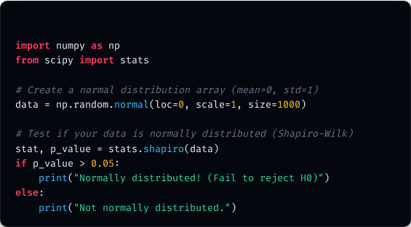

12. Normal Distribution
PYTHON
The Famous Bell Curve
Many real-world variables (heights, blood pressure, test scores) naturally form a symmetric distribution where the mean, median, and mode are all equal.
The Empirical Rule (68-95-99.7)
• 68% of data falls within 1 standard deviation of mean. • 95% of data falls within 2 standard deviations of mean. • 99.7% of data falls within 3 standard deviations of mean.
CONCEPTS & CODE
SLIDE 13 OF 22

Slide 14
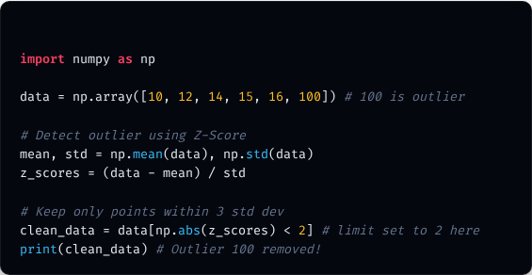
13. Outliers
What are Outliers?
PYTHON
Outliers are data points that lie abnormally far away from all other values. They can severely skew ML models and result in highly distorted predictions.
How do we detect them?
→
IQR Method: Any value below or above .
→
Z-Score Method: Any data point with a Z-score greater than 3 or less than -3 (meaning it is more than 3 standard deviations away from the calculated mean).
CONCEPTS & CODE
SLIDE 14 OF 22

Slide 15



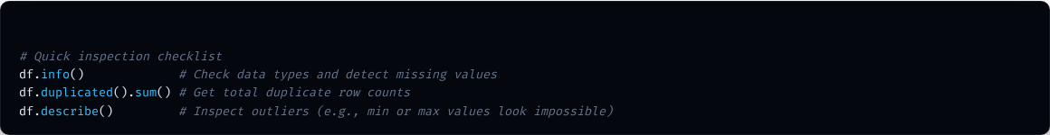
14. Data Quality Challenges
Raw data is incredibly messy. Before throwing algorithms at it, you must resolve these critical errors:
Duplicates & Typos
Missing & Invalid
Inconsistent Formats
Identical rows or mixed cases (e.g., "Male", "MALE", "male") will confuse categorical estimators.
Null entries or impossible values (such as an Age of -5, or Salary in a Name field).
Numbers loaded as string objects, mixed date schemas, or uncalibrated measurements.
PYTHON
CONCEPTS & CODE
SLIDE 15 OF 22

Slide 16
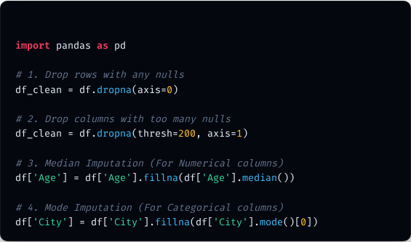
15. Missing Value Treatment
How to Handle Missing Data
PYTHON
→
Row Deletion: Drop rows containing nulls. Use only if missing rows are < 5% of dataset.
→
Column Deletion: Drop entire column if more than 50-60% of values are missing.
→
Mean Imputation: Fill missing numbers with column mean. Biases standard deviation.
→
Median Imputation: Fill with median. Preferred if data has outliers.
→
Mode Imputation: Fill with most frequent category (perfect for text columns).
CONCEPTS & CODE
SLIDE 16 OF 22

Slide 17
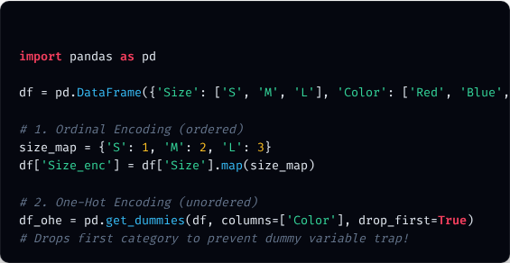
16. Handling Categorical Data
Converting Text to Numbers
PYTHON
Models only understand numbers. We must encode categories safely:
→
Ordinal Encoding: Used for ordered categories (e.g., Low=1, Medium=2, High=3).
→
One-Hot Encoding: Creates 1/0 binary columns for each category. Best for unordered categories (e.g., Red, Blue, Green).
→
Rare Category Handling: Merging high-cardinality values that occur rarely into a single group called "Other" to keep features compact.
CONCEPTS & CODE
SLIDE 17 OF 22

Slide 18
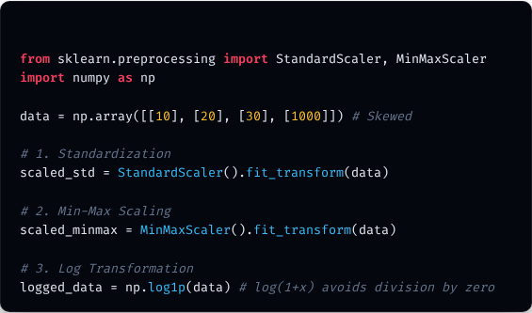
17. Numerical Data Preprocessing
Why We Scale Features
PYTHON
Distance-based algorithms (like KNN or SVM) get highly confused if one column ranges from 0 to 1 and another ranges from 0 to 1,000,000.
→
Standardization (Z-score Scaling): Centers data around mean=0 and std_dev=1.
→
Min-Max Scaling: Compresses all data points into a strict range between 0 and 1.
→
Robust Scaling: Uses median & IQR, making it highly robust to outliers.
→
Log Transform: Applies a logarithmic scale to compress highly skewed data distributions.
CONCEPTS & CODE
SLIDE 18 OF 22

Slide 19






18. Feature Engineering
Date/Time Features
Ratios & Interactions
Binning / Grouping
Convert datetime columns into actionable numeric properties like Hour, Day of Week, or Is_Weekend.
Combine features to highlight mathematical relationships. (e.g., Total Debt / Income = Debt_to_Income_Ratio).
Convert a continuous numerical column into categorized groups (e.g., converting Age into Teen, Adult, Senior).
Feature engineering relies heavily on domain knowledge. Crafting smart features provides a much higher boost to model accuracy than tuning hyperparameters ever could.
CONCEPTS & CODE
SLIDE 19 OF 22

Slide 20
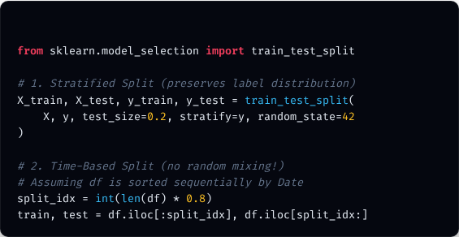
19. Advanced Data Splitting Methods
Splitting Strategies
PYTHON
→
Random Split: Default strategy. Splitting rows purely randomly. Works well only if data is well-balanced.
→
Stratified Split: Ensures that the ratio of classes (e.g., 90% non-default, 10% default) is preserved exactly in both train and test splits. Vital for imbalanced classification!
→
Time-Based Split: Trains on past data, validates/tests on future data. Crucial for time-series forecasting.
CONCEPTS & CODE
SLIDE 20 OF 22

Slide 21
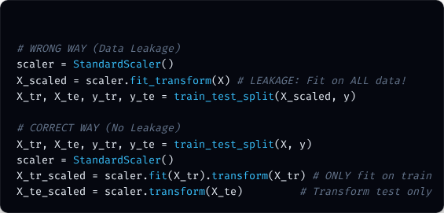
20. Data Leakage (The ML Silent Killer)
What is Data Leakage?
PYTHON
Data leakage occurs when information from outside the training dataset is accidentally used to train the model, resulting in overly optimistic validation scores but terrible real-world performance.
→
Target Leakage: Features containing clues about the target that wouldn't be available at prediction time (e.g., predicting bank default using a "Default Fee Paid" column).
→
Train Contamination: Calculating scaling values (Mean/MinMax) on the entire dataset before splitting.
CONCEPTS & CODE
SLIDE 21 OF 22

Slide 22



Questions & Answers
You are now armed with the comprehensive, step-by-step roadmap for core Machine Learning, statistics, and essential preprocessing pipelines.
Created for straightforward, simplified student & colleague presentations.
ML FOUNDATION DECK
SLIDE 22 OF 22

