Slide 1
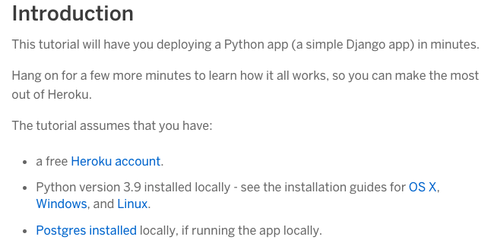
Creating a local Web-Server with Heroku

Slide 2
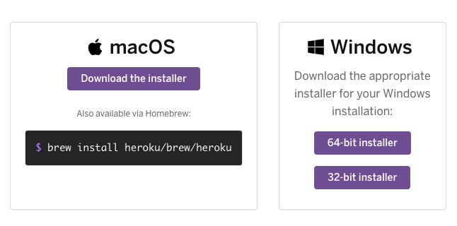
Creating a local Web-Server with Heroku

Slide 3
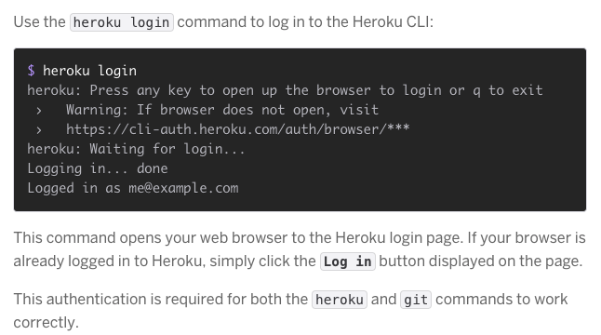
Creating a local Web-Server with Heroku

Slide 4
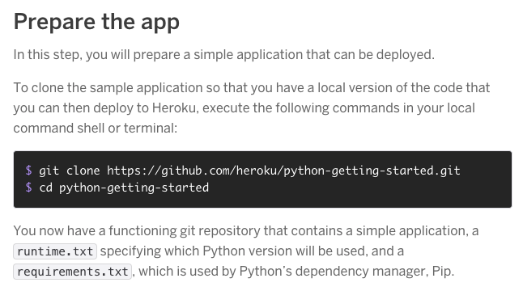
Creating a local Web-Server with Heroku

Slide 5
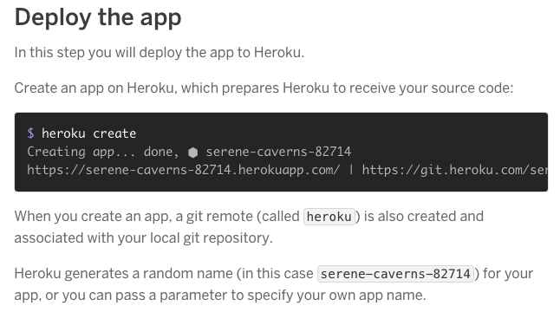
Creating a local Web-Server with Heroku

Slide 6
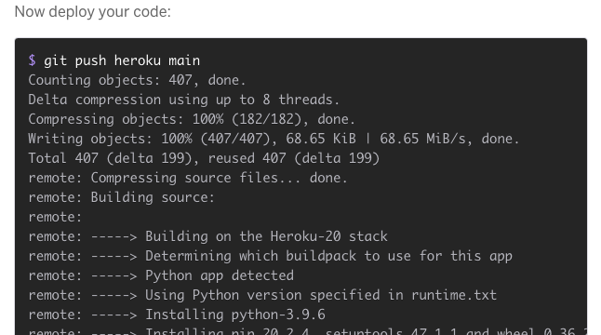
Creating a local Web-Server with Heroku

Slide 7
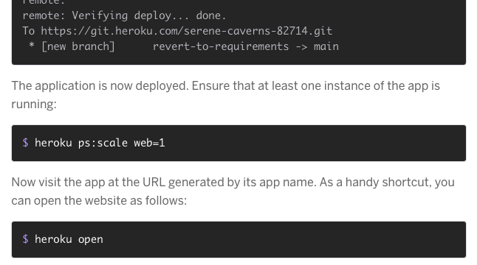
Creating a local Web-Server with Heroku

Slide 8
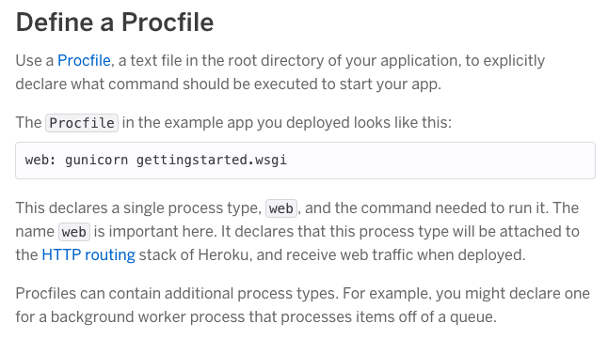
Creating a local Web-Server with Heroku

Slide 9
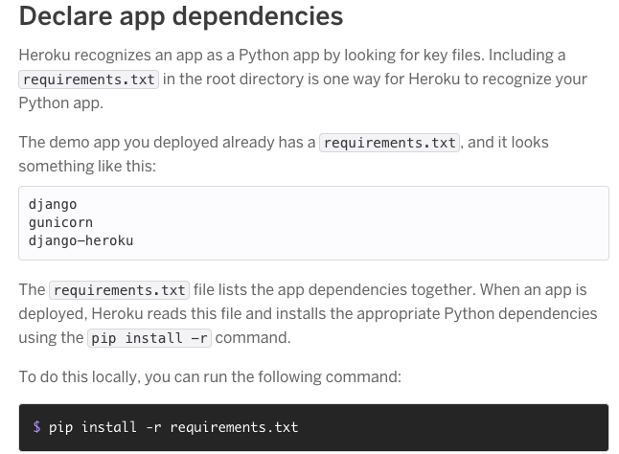
Creating a local Web-Server with Heroku

Slide 10
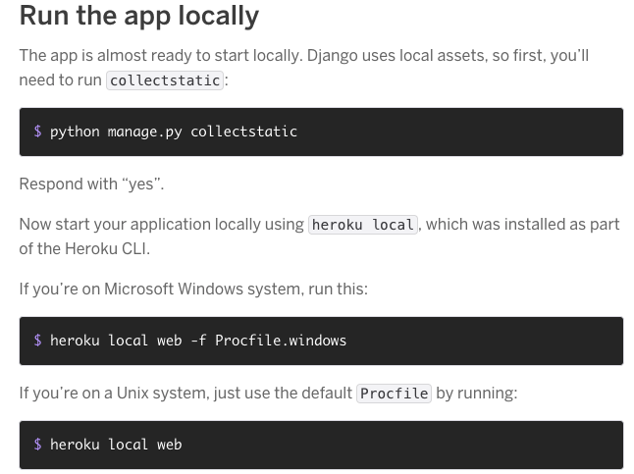
Creating a local Web-Server with Heroku

Slide 11
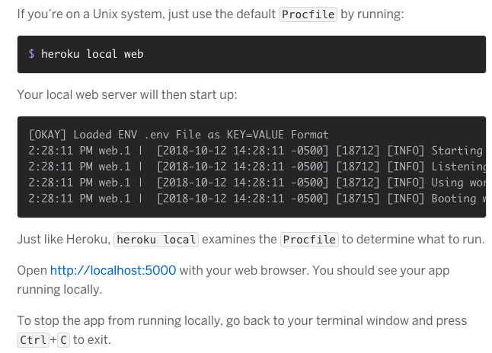
Creating a local Web-Server with Heroku

Slide 12
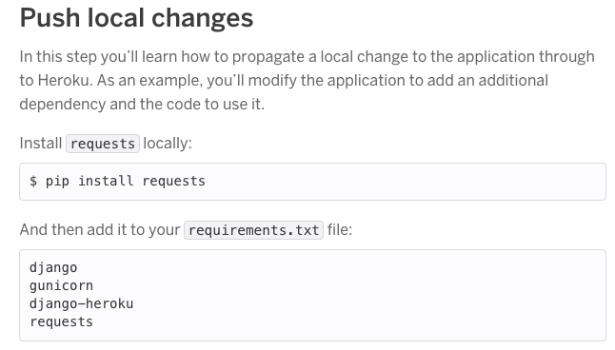
Creating a local Web-Server with Heroku

Slide 13
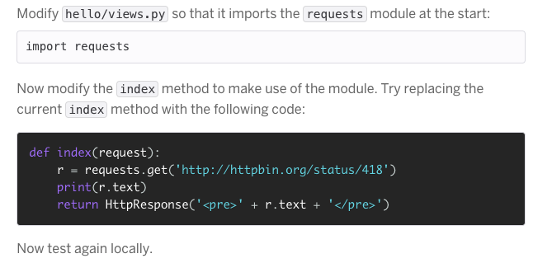
Creating a local Web-Server with Heroku

Slide 14
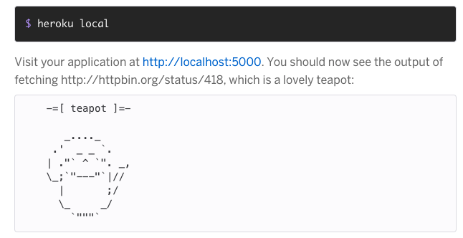
Creating a local Web-Server with Heroku

Slide 15
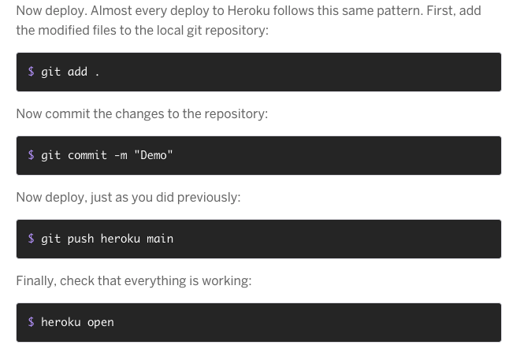
Creating a local Web-Server with Heroku

Slide 16
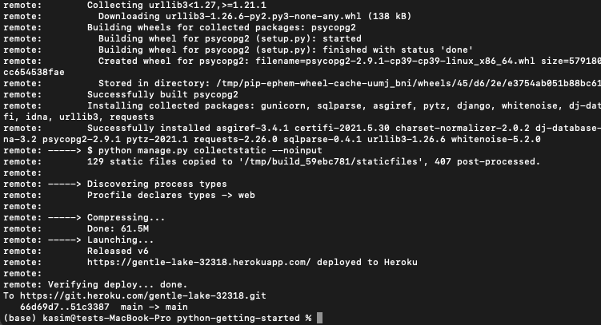
Creating a local Web-Server with Heroku

Slide 17
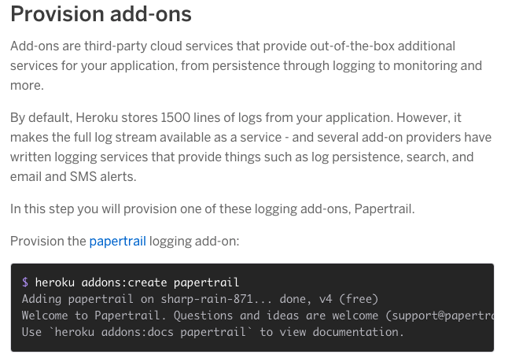
Creating a local Web-Server with Heroku

Slide 18
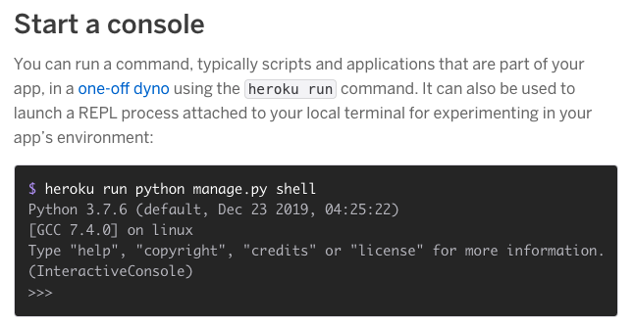
Creating a local Web-Server with Heroku

Slide 19
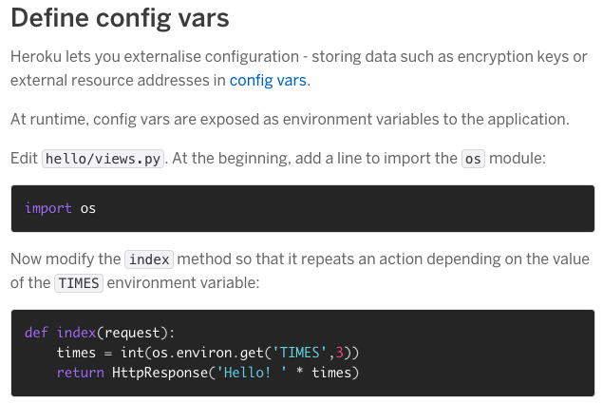
Creating a local Web-Server with Heroku

Slide 20
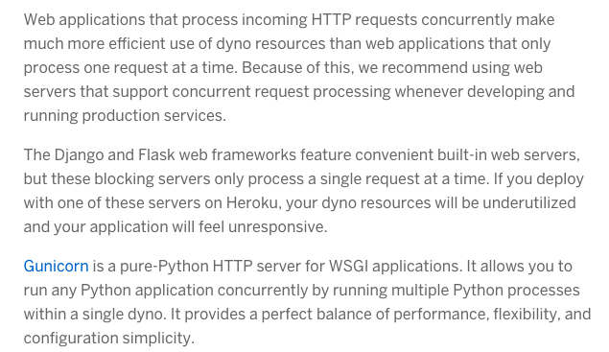
Creating a local Web-Server with Heroku

Slide 21
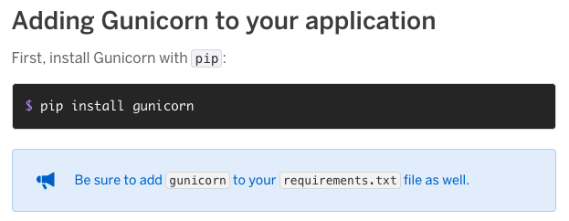
Creating a local Web-Server with Heroku

Slide 22
Creating a local Web-Server with Heroku

Slide 23
Creating a local Web-Server with Heroku

Slide 24
Creating a local Web-Server with Heroku

Slide 25
Creating a local Web-Server with Heroku

Slide 26
Creating a local Web-Server with Heroku

Slide 27
Creating a local Web-Server with Heroku

Slide 28
Creating a local Web-Server with Heroku

Slide 29
Creating a local Web-Server with Heroku

Slide 30
Creating a local Web-Server with Heroku

Slide 31
Creating a local Web-Server with Heroku

