Slide 1

Hyper-Document Structure
Representing Cognitive Coherence
in Non-Linear Documents
Clara Mancini and Donia Scott
Centre for Research in Computing
The Open University - UK

Slide 2
OVERVIEW
TEXT COMPREHENSION AND DISCOURSE STRUCTURE
COHERENCE REPRESENTATION IN TEXT
DIFFERENCE BETWEEN TEXT AND HYPERTEXT
COHERENCE REPRESENTATION IN HYPERTEXT
BACKGROUND WORK ON HYPERTEXT COHERENCE
AN APPLIED EXAMPLE
CONCLUSIONS

Slide 3
THE ASSUMPTION
TEXT COMPREHENSION
is constructing a
COHERENT COGNITIVE REPRESENTATION
of the intended meaning of the text
THIS INVOLVES
interpreting the constituent propositions
&
IDENTIFYING THE CONCEPTUAL RELATIONS BETWEEN PROPOSITIONS
THAT IS
RECOGNISING THE DISCOURSE STRUCTURE

Slide 4
THE ARGUMENT
INDICATORS OF COHERENCE IN TEXT
TEXTUAL
GRAPHICAL
RELATIONAL EXPRESSIONS
Lucia arrived at work late
because she had missed the bus.
PUNCTUATION
To fix the house (an old cottage)
I have to repair the roof, re-plaster
the walls, replace the floor.
REFERRING EXPRESSIONS
Lucia arrived at work late
because she had missed the bus.
LAYOUT
To fix the house I have to
• repair the roof
• re-plaster the walls
• replace the floors

Slide 5
THE ARGUMENT
TEXT IS DIFFERENT FROM HYPERTEXT
TEXT
HYPERTEXT
PAPER-BASED:
can be printed and read on a physical support
LINEAR:
is traversed in a set pattern from start to end
ELECTRONIC:
can only be read on a computer screen
NON-LINEAR:
there are several paths through the document
Notes:
Semantics and how we can render that. (swap left to right)
Do say right at the start why cinematic hypertext: because as cinema uses visual features to express local discourse patterns

Slide 6
THE ARGUMENT
HYPERTEXT IS NON-LINEAR
THIS MEANS
can only partially control on the order in which nodes are accessed
THIS MEANS
cannot always rely on textual devices
THIS MEANS
same information is repeated in different nodes
certain relations (e.g. CAUSALITY) are kept within the node
only certain relations hold between nodes (e.g. ELABORATION)
SO…
WHAT DEVICES CAN WE EXPLOIT
TO CONVEY COHERENCE IN HYPERTEXT?

Slide 7
THE PROPOSAL
connectives & punctuation
are
TEXTUAL
layout
is
VISUAL
I.E.
I.E.
SYMBOLIC
(association between signifier
and signified is arbitrary)
express abstract (relational)
concepts explicitly
relatively independent
of context of use
ICONIC ?
(association between signifier
and signified is partially motivated)
transform the text line
into a visual configuration
more dependent
on context of use

Slide 8
THE PROPOSAL
GRAPHICAL FEATURES (e.g., LAYOUT)
PART OF
ABSTRACT DOCUMENT STRUCTURE
all that is graphical
(and needs a tag in a mark-up language):
LAYOUT
SECTION TITLES
EMPHASIS
(formatting & graphics in general)

Slide 9
THE PROPOSAL
(what devices can we exploit
to convey coherence in hypertext?)
ABSTRACT HYPER-DOCUMENT STRUCTURE
THAT IS
expressing discourse coherence through
DYNAMIC VISUAL PATTERNS
THAT IS
CREATE SMALLER NODES
USE WHOLE SCREEN AS A VISUAL FIELD
USE NODE FORMAT+DISTRIBUTION TO SHAPE PATTERNS

Slide 10
THE PROPOSAL: IN PRACTICE
EXPRESSING DISCOURSE COHERENCE IN HYPERTEXT
using text coherence relations
to model hypertext connections
using hypertext graphic features
to render rhetorical patterns
(which coherence relations model?)
(which representational rules?)
Cognitive Coherence Relations
Document Design and Graphics
WHY?
WHY?
1. refer to cognitive principles underlying text interpretation
1. define the notion of ‘visual metadiscourse’
2. based on a minimal set of primitive relational concepts
2. draw parallel between textual and visual processing
3. provide a parametrical description of relations
3. provide rules to render abstract relations through graphics
Notes:
Semantics and how we can render that. (swap left to right)
Do say right at the start why cinematic hypertext: because as cinema uses visual features to express local discourse patterns

Slide 11
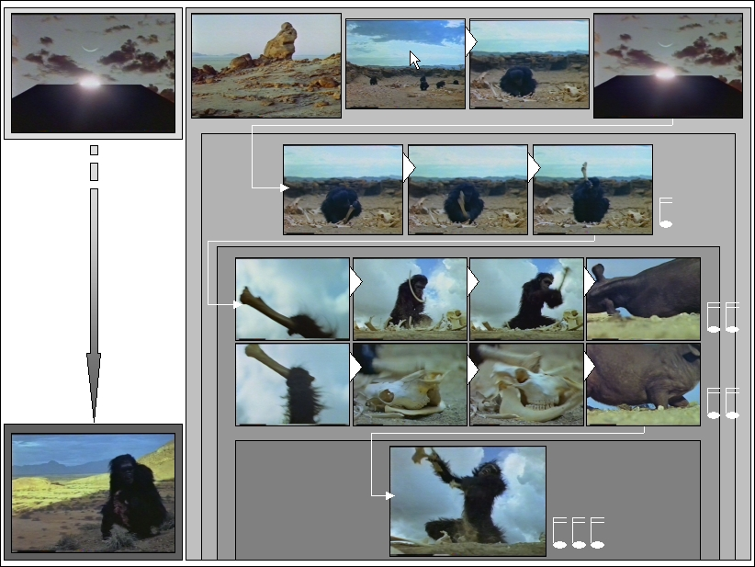
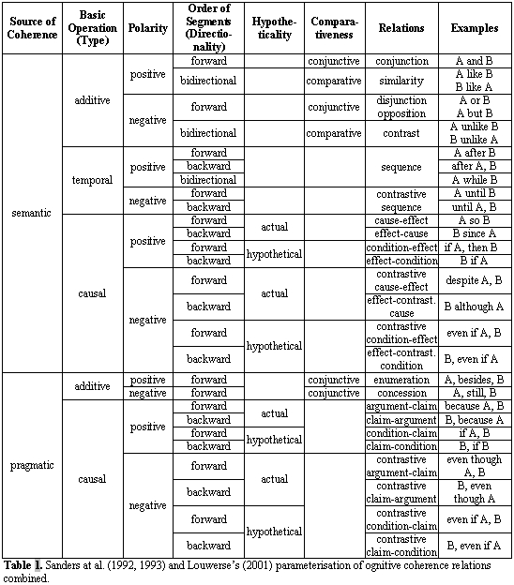
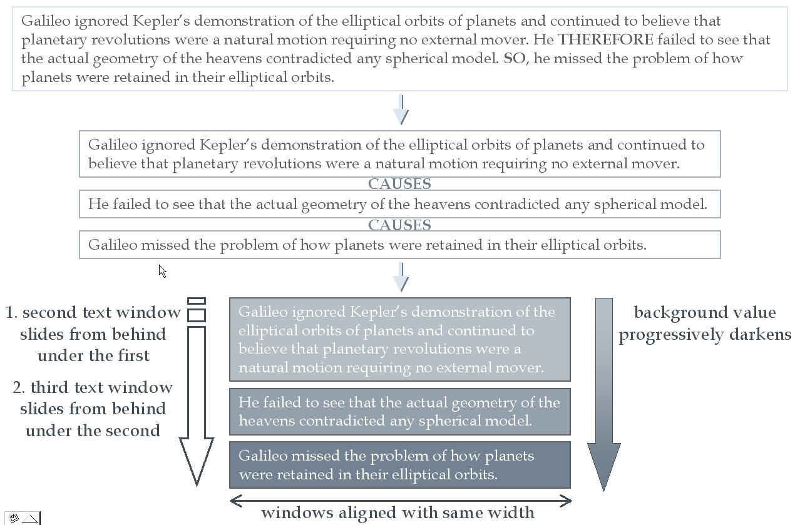
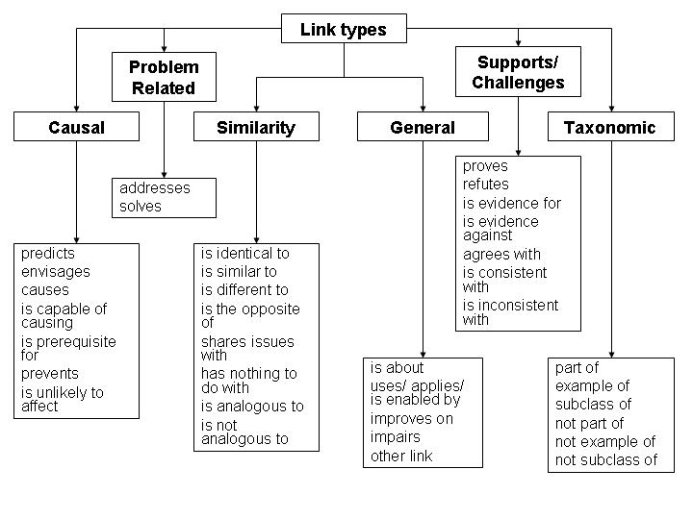
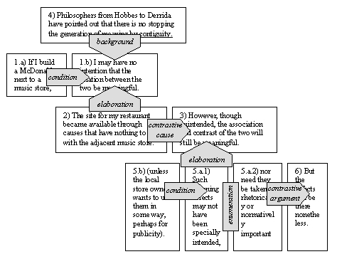
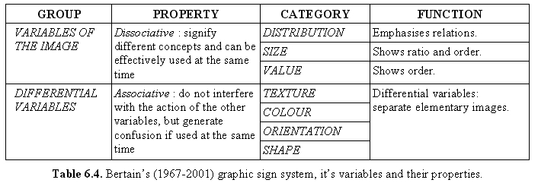
BACKGROUND WORK: OVERVIEW
EXPRESSING DISCOURSE COHERENCE IN HYPERTEXT
film discourse structures
discourse (cognitive) coherence relations
visual renderings of hypertext discourse patterns
hypertext link taxonomies
hypertext scholarly discourse
graphics rendering principles and rules
Notes:
Semantics and how we can render that. (swap left to right)
Do say right at the start why cinematic hypertext: because as cinema uses visual features to express local discourse patterns

Slide 12
THE PROPOSAL: IN PRACTICE
EXPRESSING DISCOURSE COHERENCE IN HYPERTEXT
using text coherence relations
to model hypertext connections
using hypertext graphic features
to render rhetorical patterns
(which coherence relations model?)
(which representational rules?)
Cognitive Coherence Relations
Document Design and Graphics
WHY?
WHY?
1. refer to cognitive principles underlying text interpretation
1. define the notion of ‘visual metadiscourse’
2. based on a minimal set of primitive relational concepts
2. draw parallel between textual and visual processing
3. provide a parametrical description of relations
3. provide rules to render abstract relations through graphics
Notes:
Semantics and how we can render that. (swap left to right)
Do say right at the start why cinematic hypertext: because as cinema uses visual features to express local discourse patterns

Slide 13
THE PROPOSAL: IN PRACTICE
EXPRESSING DISCOURSE COHERENCE IN HYPERTEXT
using text coherence relations
to model hypertext connections
using hypertext graphic features
to render rhetorical patterns
(which coherence relations model?)
(which representational rules?)
Cognitive Coherence Relations
Document Design and Graphics
WHY?
WHY?
1. refer to cognitive principles underlying text interpretation
1. define the notion of ‘visual metadiscourse’
2. based on a minimal set of primitive relational concepts
2. draw parallel between textual and visual processing
3. provide a parametrical description of relations
3. provide rules to render abstract relations through graphics
Notes:
Semantics and how we can render that. (swap left to right)
Do say right at the start why cinematic hypertext: because as cinema uses visual features to express local discourse patterns

Slide 14
BACKGROUND WORK
EXPRESSING DISCOURSE COHERENCE IN HYPERTEXT
using text coherence relations
to model hypertext connections
using hypertext graphic features
to render rhetorical patterns
(which coherence relations model?)
(which representational rules?)
Cognitive Coherence Relations
Document Design and Graphics
WHY?
WHY?
1. refer to cognitive principles underlying text interpretation
1. define the notion of ‘visual metadiscourse’
2. based on a minimal set of primitive relational concepts
2. draw parallel between textual and visual processing
3. provide a parametrical description of relations
3. provide rules to render abstract relations through graphics
Notes:
Semantics and how we can render that. (swap left to right)
Do say right at the start why cinematic hypertext: because as cinema uses visual features to express local discourse patterns

Slide 15
BACKGROUND WORK
DEFINING A COGNITIVE COHERENCE RELATIONS FRAMEWORK
relational primitive parameters:
CAUSAL/TEMPORAL/ADDITIVE
SEMANTIC/PRAGMATIC
POSITIVE/NEGATIVE
FORWARD/BACKWARD
CONJUNCTIVE/COMPARATIVE
ACTUAL/HYPOTHETICAL
Notes:
Say that I don’t expect them to read
Mention that there is experimental evidence of their cognitive foundation

Slide 16
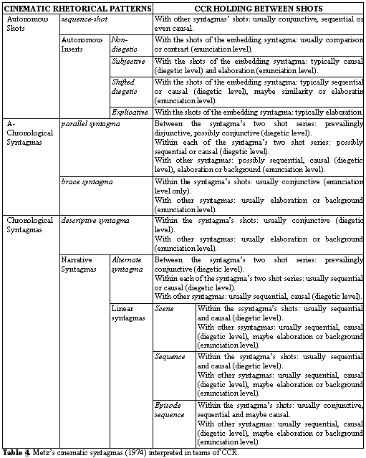
BACKGROUND WORK
USING COGNITIVE COHERENCE RELATIONS TO MODEL CINEMATIC DISCOURSE

Slide 17
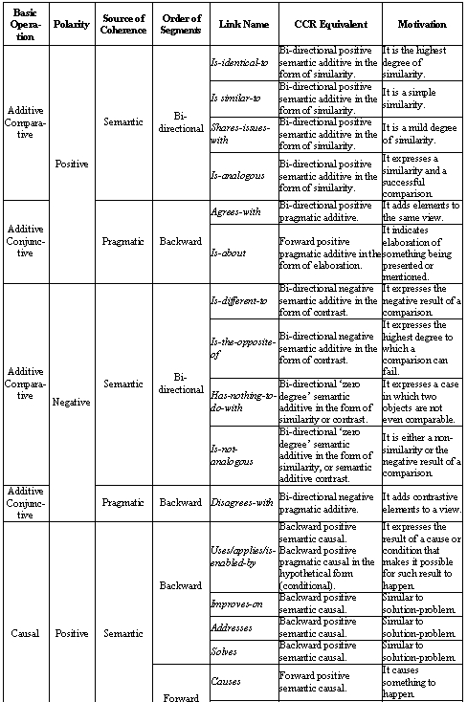
BACKGROUND WORK
USING COGNITIVE COHERENCE RELATIONS TO ANALYSE AND INFORM DISCOURSE MODELLING RELATIONAL ONTOLOGIES
Notes:
Mention that this is scholarly discourse ontology from an e-science application for modelling research literature

Slide 18
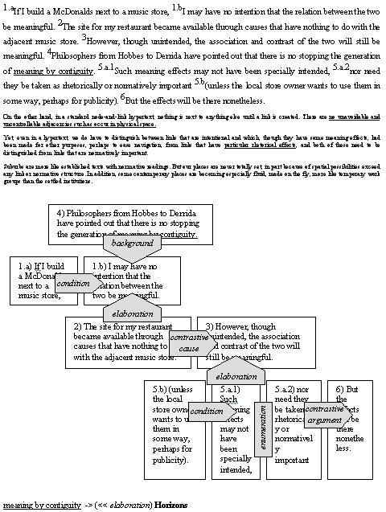
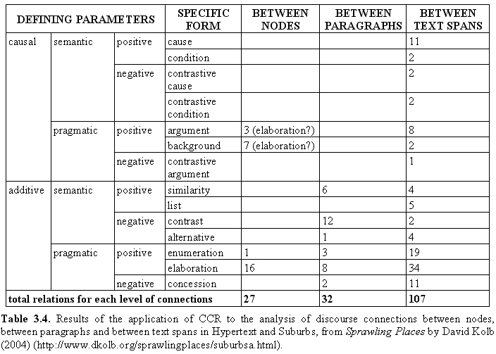
BACKGROUND WORK
USING COGNITIVE COHERENCE RELATIONS TO ANALYSE HYPERTEXT DISCOURSE

Slide 19
BACKGROUND WORK
EXPRESSING DISCOURSE COHERENCE IN HYPERTEXT
using text coherence relations
to model hypertext connections
using hypertext graphic features
to render rhetorical patterns
(which coherence relations model?)
(which representational rules?)
Cognitive Coherence Relations
Document Design and Graphics
WHY?
WHY?
1. refer to cognitive principles underlying text interpretation
1. define the notion of ‘visual metadiscourse’
2. based on a minimal set of primitive relational concepts
2. draw parallel between textual and visual processing
3. provide a parametrical description of relations
3. provide rules to render abstract relations through graphics
Notes:
Semantics and how we can render that. (swap left to right)
Do say right at the start why cinematic hypertext: because as cinema uses visual features to express local discourse patterns

Slide 20
BACKGROUND WORK
EXPRESSING DISCOURSE COHERENCE IN HYPERTEXT
using text coherence relations
to model hypertext connections
using hypertext graphic features
to render rhetorical patterns
(which coherence relations model?)
(which representational rules?)
Cognitive Coherence Relations
Document Design and Graphics
WHY?
WHY?
1. refer to cognitive principles underlying text interpretation
1. define the notion of ‘visual metadiscourse’
2. based on a minimal set of primitive relational concepts
2. draw parallel between textual and visual processing
3. provide a parametrical description of relations
3. provide rules to render abstract relations through graphics
Notes:
Semantics and how we can render that. (swap left to right)
Do say right at the start why cinematic hypertext: because as cinema uses visual features to express local discourse patterns

Slide 21
BACKGROUND WORK
EXPRESSING DISCOURSE COHERENCE IN HYPERTEXT
using text coherence relations
to model hypertext connections
using hypertext graphic features
to render rhetorical patterns
(which coherence relations model?)
(which representational rules?)
Cognitive Coherence Relations
Document Design and Graphics
WHY?
WHY?
1. refer to cognitive principles underlying text interpretation
1. define the notion of ‘visual metadiscourse’
2. based on a minimal set of primitive relational concepts
2. draw parallel between textual and visual processing
3. provide a parametrical description of relations
3. provide rules to render abstract relations through graphics
Notes:
Semantics and how we can render that. (swap left to right)
Do say right at the start why cinematic hypertext: because as cinema uses visual features to express local discourse patterns

Slide 22
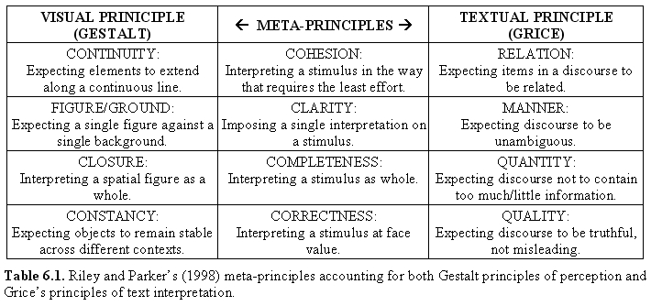
BACKGROUND WORK
USING DOCUMENT DESIGN AND GRAPHICS RULES TO RENDER DISCOURSE PATTERNS
common principles of visual and textual organisation
graphic variables & their properties expressing conceptual relations

Slide 23
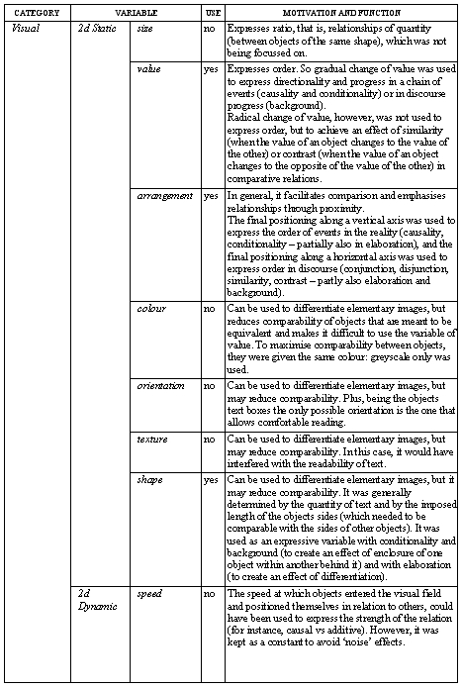
BACKGROUND WORK
VISUAL REPRESENTATION OF DISCOURSE PATTERNS FROM GRAPHIC VARIABLES
rendering graphically a subset of
Cognitive Coherence Relations:
CAUSALITY
CONDITIONALITY
CONJUNCTION
DISJUNCTION
SIMILARITY
CONTRAST
ELABORATION
BACKGROUND

Slide 24
BACKGROUND WORK
EXAMPLE: GRAPHICAL RENDERING OF CONJUNCTION
Part of Newton’s astronomical theory derives from Galileo’s kinematic laws of falling bodies and projectiles, and from the completion of his principle of inertia AND part of it derives from Kepler’s descriptive laws of planetary motion, and from the completion of his conception of gravitation.
Part of Newton’s astronomical theory derives from Galileo’s kinematic laws of falling bodies and projectiles, and from the completion of his principle of inertia.
Part of Newton’s astronomical theory derives from Kepler’s descriptive laws of planetary motion, and from the completion of his conception of gravitation.
IS
CONJUNCTED
TO
second text window appears next to the first
Part of Newton’s astronomical theory derives from Galileo’s kinematic laws of falling bodies and projectiles, and from the completion of his principle of inertia.
Part of Newton’s astronomical theory derives from Kepler’s descriptive laws of planetary motion, and from the completion of his conception of gravitation.
windows
aligned
with same
width
background value of second node is same as that of first node

Slide 25
BACKGROUND WORK
EXAMPLE: GRAPHICAL RENDERING OF DISJUNCTION
In Galileo’s times, one would have had to reject the heliocentric theory to be considered a good Catholic OR could have accepted the heliocentric theory and be considered an heretic by the Church.
In Galileo’s times, one would have had to reject the heliocentric theory to be considered a good Catholic.
IS
ALTERNATIVE
TO
In Galileo’s times, one could have accepted the heliocentric theory and be considered an heretic by the Church.
second text window appears next to the first
In Galileo’s times, one would have had to reject the heliocentric theory to be considered a good Catholic.
In Galileo’s times, one would have had to reject the heliocentric theory to be considered a good Catholic.
In Galileo’s times, one could have accepted the heliocentric theory and be considered an heretic by the Church.
windows aligned
with same width
background value of first node changes as second node appears
first node becomes unreadable with the change

Slide 26
BACKGROUND WORK
EXAMPLE: GRAPHICAL RENDERING OF CAUSALITY
Galileo ignored Kepler’s demonstration of the elliptical orbits of planets and continued to believe that planetary revolutions were a natural motion requiring no external mover. He THEREFORE failed to see that the actual geometry of the heavens contradicted any spherical model. SO, he missed the problem of how planets were retained in their elliptical orbits.
Galileo ignored Kepler’s demonstration of the elliptical orbits of planets and continued to believe that planetary revolutions were a natural motion requiring no external mover.
CAUSES
He failed to see that the actual geometry of the heavens contradicted any spherical model.
CAUSES
Galileo missed the problem of how planets were retained in their elliptical orbits.
1. second text window
slides from behind
under the first
2. third text window
slides from behind
under the second
Galileo ignored Kepler’s demonstration of the elliptical orbits of planets and continued to believe that planetary revolutions were a natural motion requiring no external mover.
background value
progressively darkens
He failed to see that the actual geometry of the heavens contradicted any spherical model.
Galileo missed the problem of how planets were retained in their elliptical orbits.
windows aligned with same width

Slide 27
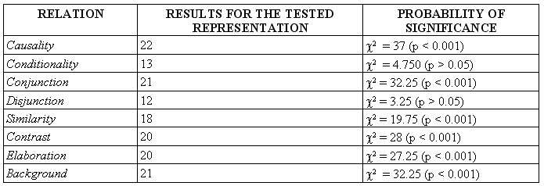
BACKGROUND WORK
TESTING THE SIGNIFICANCE OF GRAPHIC RELATIONAL RENDERINGS
χ² results for probability of significance for each relation rendering:
for CONDITIONALITY and DISJUNCTION
significance is more uncertain
due to the cognitive complexity of the relations
Notes:
We run a controlled experiment in which we proposed to people these graphic renderinds and the results showed that they recognised their rhetorical significance

Slide 28
AN EXAMPLE
Reciprocal Altruism
“Some animals are 'nice' to each other, especially those who live on the edge. For example, vampire bats have been shown to share meals. If a bat fails to find a meal it is often unable to survive until the next evening's hunting. A bat that has fed well, though, has more than enough to survive, and could easily spare some of its meal. So sometimes a full bat will regurgitate some of its meal to another that is starving.
These animals are showing behaviour known as 'reciprocal altruism', which simply means that they lend each other favours in the expectation that the favours will be repaid some time in the future. A bat which one day might be bloated by a great meal, might on another evening be less lucky and be in need of help itself. By being generous one day at little cost to itself, it might be saved from starvation the next by another bat returning the favour.
This process can be explained with a game called 'Prisoner's Dilemma'. In the game, two suspects have been arrested for a crime and the police question them in separate rooms. The police offer them each a deal. If they don't co-operate with each other (i.e. they give the police evidence that the other person is guilty) then they will be rewarded and the other person will be put away for the crime. If they both fail to co-operate, and give evidence against each other then they will both get locked up (although they will get a lesser sentence), but if they both co-operate with each other by keeping quiet then the police have no evidence and they will eventually both be released.
For the bats the risk of starvation if they do not feed is very high, while the cost of co-operating is low, so it should be no surprise to us that they have come to co-operate with each other, with every bat benefiting from the arrangement.
This sort of situation faces animals all the time, and by understanding what the rewards and costs are to them in each case, we can understand the way they behave.”
(from the BBC’s online learning website)

Slide 29
Some animals are 'nice' to each other, especially those who live on the edge.
For example, vampire bats have been shown to share meals. If a bat fails to find a meal it is often unable to survive until the next evening's hunting. A bat that has fed well, though, has more than enough to survive, and could easily spare some of its meal. So sometimes a full bat will regurgitate some of its meal to another that is starving.
These animals are showing behaviour known as 'reciprocal altruism', which simply means that they lend each other favours in the expectation that the favours will be repaid some time in the future.
[For example] A bat which one day might be bloated by a great meal, might on another evening be less lucky and be in need of help itself. By being generous one day at little cost to itself, it might be saved from starvation the next by another bat returning the favour.
This process can be explained with a game called 'Prisoner's Dilemma'. In the game, two suspects have been arrested for a crime and the police question them in separate rooms. The police offer them each a deal. If they don't co-operate with each other (i.e. they give the police evidence that the other person is guilty) then they will be rewarded and the other person will be put away for the crime. If they both fail to co-operate, and give evidence against each other then they will both get locked up (although they will get a lesser sentence), but if they both co-operate with each other by keeping quiet then the police have no evidence and they will eventually both be released.
[Going back to our example] For the bats the risk of starvation if they do not feed is very high, while the cost of co-operating is low, so it should be no surprise to us that they have come to co-operate with each other, with every bat benefiting from the arrangement.
This sort of situation faces animals all the time, and by understanding what the rewards and costs are to them in each case, we can understand the way they behave.

Slide 30
4. Vampire bats have been shown to share meals (>5). If a bat fails to find a meal it is often unable to survive until the next evening's hunting. A bat that has fed well, though, has more than enough to survive, and could easily spare some of its meal. So sometimes a full bat will regurgitate some of its meal to another (>6) that is starving.
1. Some animals are 'nice' to each (>2) other, especially those who live life on the edge (>4).
5. A bat which one day might be bloated by a great meal, might on another evening be less lucky and be in need of help (>4) itself. By being generous one day at little cost to itself, it might be saved from starvation the next by another bat returning the favour.
For the bats the risk of starvation if they do not feed is very high, while the cost of co-operating is low, so it should be no surprise to us that they have come to co-operate with each other (>6), with every bat benefiting from the arrangement (>3).
2. Certain animals show a behaviour known as 'reciprocal altruism‘ (>5), which simply means that they lend each other favours (>6) in the expectation that the favours will be repaid some time in the future (>3).
6. In the game 'Prisoner's Dilemma', two suspects have been arrested for a crime and the police question them in separate rooms. The police offer them each a deal. If they don't co-operate with each other (i.e. they give the police evidence that the other person is guilty) then they will be rewarded and the other person will be put away for the crime. If they both fail to co-operate, and give evidence against each other then they will both get locked up (although they will get a lesser sentence), but if they both co-operate (>5) with each other by keeping quiet then the police have no evidence and they will eventually be both released (>2).
3. Situations in which reciprocal altruism (>2) is necessary face animals all the time, and by understanding what the rewards and costs are to them in each case, we can understand the way they behave (>1).

Slide 31
Some animals are 'nice' to each other, especially those who live life on the edge.

Slide 32
Some animals are 'nice' to each other, especially those who live life on the edge.
Certain animals show behaviour known as 'reciprocal altruism‘, which simply means that they lend each other favours in the expectation that the favours will be repaid some time in the future.

Slide 33
Some animals are 'nice' to each other, especially those who live life on the edge.
Certain animals show behaviour known as 'reciprocal altruism‘, which simply means that they lend each other favours in the expectation that the favours will be repaid some time in the future.
Situations in which reciprocal altruism is necessary face animals all the time, and by understanding what the rewards and costs are to them in each case, we can understand the way they behave.
Situations in which reciprocal altruism is necessary face animals all the time, and by understanding what the rewards and costs are to them in each case, we can understand the way they behave.

Slide 34
Some animals are 'nice' to each other, especially those who live life on the edge.

Slide 35
Some animals are 'nice' to each other, especially those who live life on the edge.
Vampire bats have been shown to share meals. If a bat fails to find a meal it is often unable to survive until the next evening's hunting. A bat that has fed well, though, has more than enough to survive, and could easily spare some of its meal. So sometimes a full bat will regurgitate some of its meal to another that is starving.

Slide 36
Some animals are 'nice' to each other, especially those who live life on the edge.
Vampire bats have been shown to share meals. If a bat fails to find a meal it is often unable to survive until the next evening's hunting. A bat that has fed well, though, has more than enough to survive, and could easily spare some of its meal. So sometimes a full bat will regurgitate some of its meal to another that is starving.
In the game 'Prisoner's Dilemma', two suspects have been arrested for a crime and the police question them in separate rooms. The police offer them each a deal. If they don't co-operate with each other (i.e. they give the police evidence that the other person is guilty) then they will be rewarded and the other person will be put away for the crime. If they both fail to co-operate, and give evidence against each other then they will both get locked up (although they will get a lesser sentence), but if they both co-operate with each other by keeping quiet then the police have no evidence and they will eventually be both released.
In the game 'Prisoner's Dilemma', two suspects have been arrested for a crime and the police question them in separate rooms. The police offer them each a deal. If they don't co-operate with each other (i.e. they give the police evidence that the other person is guilty) then they will be rewarded and the other person will be put away for the crime. If they both fail to co-operate, and give evidence against each other then they will both get locked up (although they will get a lesser sentence), but if they both co-operate with each other by keeping quiet then the police have no evidence and they will eventually be both released.

Slide 37
Some animals are 'nice' to each other, especially those who live life on the edge.
A bat which one day might be bloated by a great meal, might on another evening be less lucky and be in need of help itself. By being generous one day at little cost to itself, it might be saved from starvation the next by another bat returning the favour.
For the bats the risk of starvation if they do not feed is very high, while the cost of co-operating is low, so it should be no surprise to us that they have come to co-operate with each other, with every bat benefiting from the arrangement.
Vampire bats have been shown to share meals. If a bat fails to find a meal it is often unable to survive until the next evening's hunting. A bat that has fed well, though, has more than enough to survive, and could easily spare some of its meal. So sometimes a full bat will regurgitate some of its meal to another that is starving.
A bat which one day might be bloated by a great meal, might on another evening be less lucky and be in need of help itself. By being generous one day at little cost to itself, it might be saved from starvation the next by another bat returning the favour.
For the bats the risk of starvation if they do not feed is very high, while the cost of co-operating is low, so it should be no surprise to us that they have come to co-operate with each other, with every bat benefiting from the arrangement.
In the game 'Prisoner's Dilemma', two suspects have been arrested for a crime and the police question them in separate rooms. The police offer them each a deal. If they don't co-operate with each other (i.e. they give the police evidence that the other person is guilty) then they will be rewarded and the other person will be put away for the crime. If they both fail to co-operate, and give evidence against each other then they will both get locked up (although they will get a lesser sentence), but if they both co-operate with each other by keeping quiet then the police have no evidence and they will eventually be both released.

Slide 38
CONCLUSIONS
text comprehension requires a recognition of the discourse structure
in text coherence indicators support the expression of the discourse structure
but hypertext is different: textual devices do not properly function in it
the use of new graphical devices needs to be explored
we PROPOSE: primitive relations to define links & graphic rules to render them
we have started and will continue to carry out empirical studies
our GOAL: generating different hypermedia documents of the same semantic content in addition and as an alternative to linear documents

Slide 39
THE PROPOSAL: IN PRACTICE
EXPRESSING DISCOURSE COHERENCE IN HYPERTEXT
using text coherence relations
to model hypertext connections
using hypertext graphic features
to render rhetorical patterns
(which coherence relations model?)
(which representational rules?)
Cognitive Coherence Relations
Document Design and Graphics
WHY?
WHY?
1. refer to cognitive principles underlying text interpretation
1. define the notion of ‘visual metadiscourse’
2. based on a minimal set of primitive relational concepts
2. draw parallel between textual and visual processing
3. provide a parametrical description of relations
3. provide rules to render abstract relations through graphics
Notes:
Semantics and how we can render that. (swap left to right)
Do say right at the start why cinematic hypertext: because as cinema uses visual features to express local discourse patterns

Slide 40
THE PROPOSAL
GRAPHICAL FEATURES
(e.g., PUNCTUATION AND LAYOUT)
ARE PART OF
ABSTRACT DOCUMENT STRUCTURE
all that is graphical
(and needs a tag in a mark-up language):
LAYOUT
SECTION TITLES
EMPHASIS
(formatting & graphics in general)

