Slide 1
conceptual coherence in the generation of referring expressions
Albert Gatt & Kees van Deemter
University of Aberdeen
{agatt, kvdeemte}@csd.abdn.ac.uk

Slide 2
some received wisdom…
  Choice is ultimately dependent on the perspective you decide to take on the referent for your interlocutor.
  Will it be more effective for me to refer to my sister as my sister or as that lady or as the physicist ? (Levelt `99, p. 226)
Notes:
This citation from Levelt brings to the fore the multiple possible ways of referring to an object. Standard algorithms for generating referring expressions tend to focus on producing distinguishing descriptions, and observing the Gricean maxims in the process.
However, it is easy to imagine situations in which several possible descriptions exist for an entity. Because they have different conceptual content, they shed different light on the nature of a referent. In this paper, we are concerned with an extension of this idea to PLURAL referents.

Slide 3
the rest of this talk…
Generation of Referring Expressions
Perspective and Conceptual Coherence
  reference to sets
  experimental work
An algorithm
  evaluation
Extensions:
  local (Conceptual) Coherence in discourse

Slide 4
Generation of Referring Expressions (GRE)
Part of micro-planning (Reiter/Dale `00)
At this stage, the content of a message is being determined, including descriptions of domain objects (Noun Phrases)
The task of GRE:
  given a set of intended referents, look up properties of these referents that will distinguish them from their distractors in a Knowledge Base
Notes:
[Imtiaz: I think this slide is clear enough. Let me know if it isn’t.]

Slide 5
Content determination strategies
entity | base type | occupation | specialisation | girth
e1 | woman | professor | physicist | Plump
e2 | woman | lecturer | geologist | thin
e3 | man | lecturer | biologist | plump
e4 | man | postgraduate |  | thin
Most algorithms inspired by the Gricean maxims (Grice `75)
  especially Brevity (Dale `89, Gardent `02)
But compare:
?? the professor and the plump [entity]
?? the professor and the plump man
➔ the biologist and the physicist
Despite their brevity, not all have an equally good ring to them.
Notes:
Here is an example of a domain. The top row indicates attributes, the leftmost column contains nonlinguistic identifiers for domain entities. Let us assume that we are after a distinguishing description for e1 and e3, that is, a plural. A lot of work has focused on the use of the Gricean maxims to generate the shortest possible description, thus avoiding redundancy for the hearer. But here, several possibilities exist, some of them equally brief. Our contention is that they’re not all equally good – some of these (for instance “the professor and the plump man”) will sound odd to a hearer.

Slide 6
the Conceptual Coherence constraint
Sets (and disjunction): ‘the p and the q’
  reference to a plurality suggests to the listener that there is a relationship holding between elements of the pluralities
  p and q should be related or “similar”
  semantic relatedness allows the listener to conceptualise the plurality more easily, and map its elements more easily to a common role in the discourse (Sanford and Moxey, `95)
Gatt and van Deemter (`02):
  People’s preference for descriptions of this form were highly correlated to the semantic similarity of disjuncts
  Best results achieved with a distributional definition of similarity (Lin `98)
Notes:
The production of a plural reference suggests to the reader/hearer that there is some relationship that holds between the elements of the plurality. This, we hypothesise, is a guiding constraint on the way people choose content for plural descriptions. Our hypothesis is that properties to describe a plurality should be as similar as possible, and that this will allow the listener to conceptualise the entity more easily, as suggested in some psycholinguistic work by Sanford and colleagues.
Obviously, context may play an important role in determining what properties are “related”. However, we shall focus on lexical constraints here.
In a previous study, we showed that people’s preferences for a description of the form “the X and the Y” was strongly correlated to the semantic similarity of “X” and “Y”. Having tried several measures of similarity, we found that the best correlation was achieved with the distributional (corpus-based) measure defined by Lin 1998.

Slide 7
Lin’s definition of distributional similarity
Let w₁, w₂ be two words of the same grammatical category.
E.g. dog, cat
We compare the extent to which dog and cat are found in the same grammatical relations in a corpus. (Data obtained from SketchEngine, a large-scale implementation of this theory, based on the BNC (Kilgarriff, `03)
<modifies, domestic, dog> <modifies, domestic, cat>
<modifies, stray, dog> <modifies, stray, cat>
<modifies, rabid, dog> <modifies, siamese, cat>
<subject-of, bark, dog> <subject-of, miaow, cat>
<subject-of, run, dog> <subject-of, run, cat>
….. …..
Notes:
The idea behind the distributional measure is that we can estimate the similarity of two words by comparing the grammatical environments in which they occur in a corpus.
In this work, we use the data from SketchEngine, an implementation of Lin’s theory by Kilgarriff 2003.
For instance, “dog” and “cat” are very similar, because they tend to be modified by the same adjectives, and tend to occur as arguments of the same verbs, and so on…. Although this is not always the case (e.g. “siamese” modifies “cat”, but not “dog”), the tendency is significant enough.
The measure is calculated, in an information-theoretic way, by comparing the environments that the two words have in common, and those they do not.
This is the measure that we use in our experiments and the implementation.

Slide 8
experiment 1: multimodal sentence completion
  If people have to refer to a set, they will prefer to refer using a plural when the conceptual coherence constraint is respected, else they will prefer to refer using singular references.
Notes:
Our hypothesis was tested in two experiments.
In the first experiment, we hypothesised that if people are presented with a domain, and have the choice of referring to 2 objects in a plurality, then they will prefer to do so if the objects are similar.

Slide 9
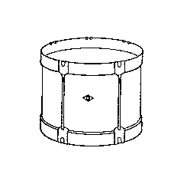
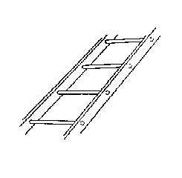
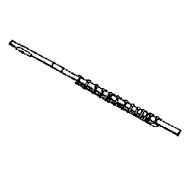
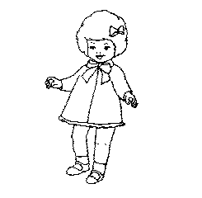
experiment 1: example domain
Experimental domain:
Participants completed the sentences by clicking on the pictures.
Manipulation of similarity of two of the objects (a,b).
Hypothesis:
If {a,b} are similar, they are more likely to be referred to in the plural.
a
d
£5
£20
c
b
£5
£5
Complete the following by clicking on the pictures:
S1: The _____________ and the _____________ cost £5.
S2: The _____________ also costs £5.
Notes:
Subjects played an online game in which they bought objects from an online store. They were shown domains like this one. Pictures were selected from a previously normed picture set, so that, for each picture, the most frequent noun used for it by British-English speaking subjects was known.
In each domain, there were 3 identically-priced objects (here, the drum, the doll and the flute).
Subjects’ task was to complete the discourse below, by CLICKING on the right pictures.
In each domain, we focused on two of the targets (called a and b). We manipulated whether they had semantically similar nouns. The third target, c, was always semantically dissimilar to the other two.
We also controlled for the visual similarity of the targets, by asking subjects to rate them in a pre-test. This was to ensure that visual similarity would not interfere with subjects’ decisions.
We expected a significant tendency for people to refer to {a,b} in the plural description (S1) if they had similar names, but not if they were dissimilar.
[IMTIAZ: if somebody asks, there were 38 native english-speaking subjects who did this study]

Slide 10
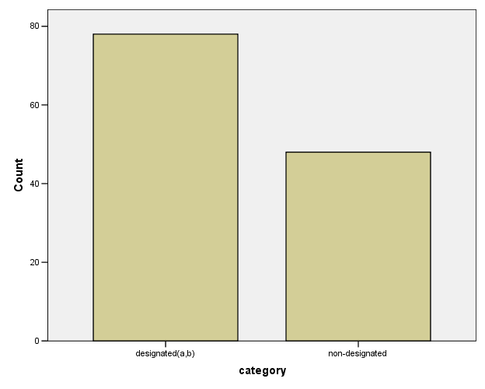
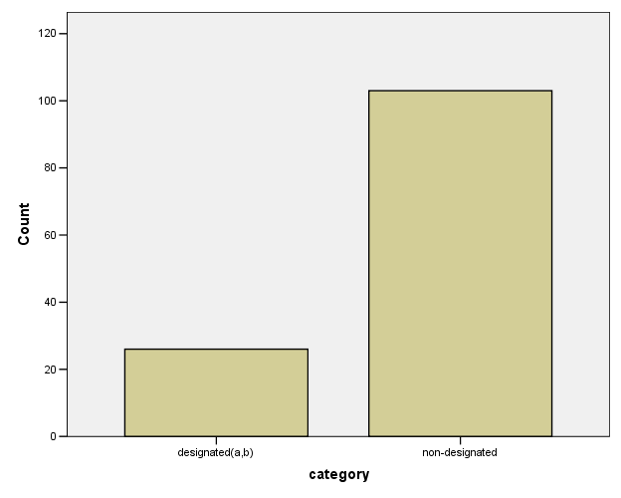
experiment 1: results
Plural references to {a,b} versus some other subset of the target set
when a and b are similar
when a and b are not similar
Notes:
We coded responses based on whether people referred to {a,b} in the plural description (S1).
As you can see in the left graph, when {a,b} had similar names, people tended to prefer to refer to those in the plural description.
The right graph shows that when the similarity of the targets was low, the opposite tendency was observed.
So this experiment suggests that, given an explicit choice, in which subjects refer using both a plural and a singular description, semantic similarity influences which entities people refer to in the plural.

Slide 11
experiment 2: sentence continuation
Does similarity play a role in content determination?
Distinguishing properties: nouns (12) or adjectives (12 ).
Expectation:
  Participants will select similar properties in the plural description, even though the alternative would also constitute a successful reference.
A university building was robbed last night. The police have detained three suspects for questioning, all of whom work or study at the university.
1. One of them is a postgraduate. He is a physicist.
2. Another is, a Greek, an undergraduate.
3. Also among the suspects is a cleaner. He is an Italian.
Both ______________________ were held in custody, but the physicist was released last night.
Notes:
In the second experiment, we tried to model the kind of situation in which a GRE algorithm selects content for a referring expression.
We showed people paragraphs like this one. Each paragraph had three entities, each introduced separately.
Each entity had two properties.
Any subset of two out of these three entities could be described using semantically similar or semantically dissimilar properties. For example, {e1,e2} can be described as “the postgraduate and the undergraduate” (similar) or “the physicist and the Greek”, among others.
In half the discourses, properties were nouns (as shown here). In the other half, they were adjectives. In the latter case, all the objects were of the same type. (E.g. all the objects were books.)
Each paragraph was followed by a sentence to be completed. The sentence made it clear that a plural subject NP was required, and also made it clear that two particular entities had to be referred to.
We expected subjects to show a greater tendency to refer to these sets using similar properties.
[Imtiaz: if somebody asks, the number of people who did this experiment was 18 native english speakers]

Slide 12
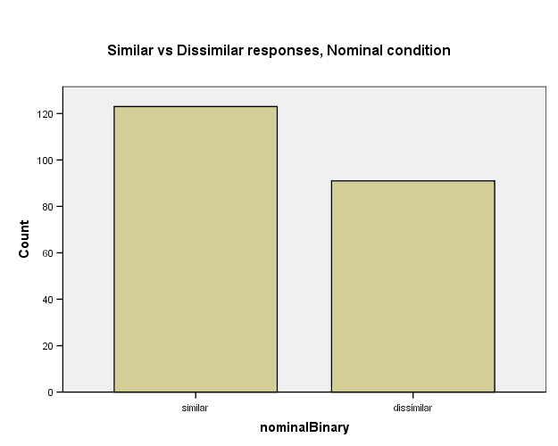
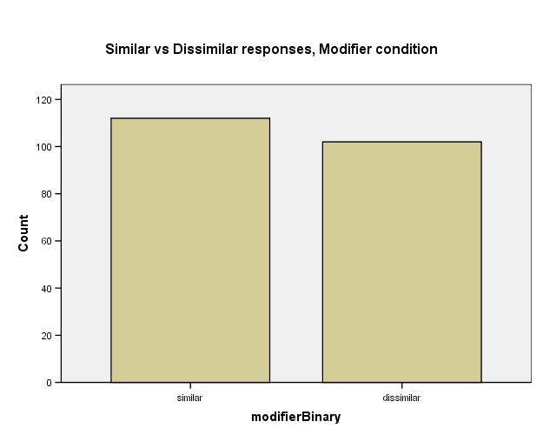
experiment 2: results
Proportion of references using pairwise similar properties:
Nouns:
Adjectives:
Significant tendency to use similar nominal properties
(p < .02)
No significant tendency to use similar modifiers
(p > .1)
Notes:
The arrow marks the bar showing the proportion of times people used similar properties to refer to entities.
There was a significant tendency to use similar properties in the plural, when the properties were nouns. So people preferred to say “the undergraduate and the “postgraduate”, rather than “the undergraduate and the greek”.
The trend was not significant when the properties were modifiers. So people showed no preference between, say, “the red book and the blue book” and “the red book and the thick book”

Slide 13
summary
In referential situations, people prefer to produce plural descriptions if the entities can be conceptualised under the same perspective.
This holds for properties realisable as nouns (“types”), but not adjectives/modifiers
  Types correspond to “concepts”, and are the way we carve up the world and categorise objects
  Modifiers correspond to properties of those objects.
Results have been corroborated in other experiments
Notes:
The results suggest that our hypothesis is on the right track.
However, the hypothesis does not hold when properties are modifiers.
This might be because nouns correspond to what is normally called “type” or “object class” or “concepts” in the literature. When people produce plural descriptions, similar object class allows them to conceptualise the plurality more easily. On the other hand, in the modifier case, all the objects were of the same class or type, so this constraint was already satisfied.
We’ve done other experiments that show similar results.

Slide 14
a GRE algorithm
Main knowledge source:
  a lexical database containing information about the similarity between words, based on distributional data from the BNC (Kilgarriff `03)
Input:
  Knowledge base
  Target referents (R )
Notes:
We now turn to a description of a generation algorithm.
It uses, as its main knowledge source, a lexical database containing information about the pairwise similarity of words.
Otherwise, it takes as input a knowledge base and the set of target referents to be distinguished, as usual.
The generation process proceeds in two steps, which we now describe in turn.

Slide 15
step 1
Lexicalise properties in the KB
Identify types (nominal properties) and modifiers
Cluster the types into perspectives using the clustering algorithm in Gatt `06. This recursively groups together semantic nearest neighbours.
Definition: Perspective
Assume that the set of types, together with the semantic similarity relation, define a semantic space.
A perspective is defined as a convex subset of this space.
Notes:
Since our distributional similarity definition is based on words, the first step is to lexicalise the properties in the KB. In other words, the algorithm does content determination based on words, not “semantic objects” like attribute-value pairs.
Next, using corpus-derived information, types are distinguished from modifiers, so that the set of lexicalised properties is divided into two (not necessarily disjoint) sets. They’re not necessarily disjoint because some words, like “italian” can be used both as nouns and as adjectives (“the italian” vs. “an italian man”)
The lexical database contains information about the semantic similarity between all pairs of words. We reduce this information by clustering the TYPES. The clustering algorithm, described in Gatt (2006), proceeds in two steps:
it finds, for each type, its nearest semantic neighbour
it then computes the transitive closure of the nearest neighbour relation.
The outcome is a set of clusters which we call PERSPECTIVES. A perspective is defined as a CONVEX SUBSET of the semantic space. This means that if there are two types t and t’ which are included in a perspective, any other type t’’ which falls between t and t’ is also in the same perspective.

Slide 16
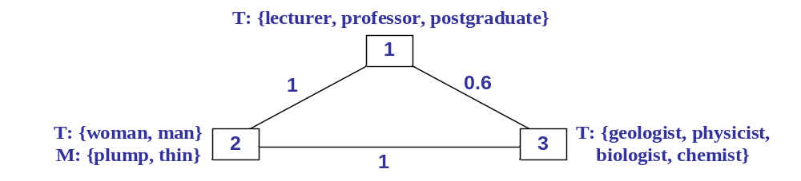
perspective graph
Aim: find a description for R that minimises the distance between perspectives from which properties are selected.
Weight of a description, w(D): the sum of distances between perspectives represented in D.
  w( ‘the professor and the plump man’ ) = 1
  w( ‘the biologist and the physicist’ ) = 0
Notes:
After the clustering of types into perspectives, we associate modifiers with the types, using corpus-derived information. A modifier is associated with the type with which it is most frequently found in the corpus. For example, “plump” tends to occur with “man” or “woman” more frequently than with “geologist”.
The perspectives are organised into a connected graph. The nodes of the graph are the perspectives themselves, the edges are weighted by the overall semantic distance between the clusters.
Here, you can see how the properties in our initial domain are organised into the perspective graph.
The content determination procedure finds a description for a set by selecting lexical items from the graph. The idea is to minimise the distance between the perspectives represented in the description. We call the sum of the distances between the perspectives represented in a description, its WEIGHT.
For example, the algorithm should prefer “the biologist and the physicist”, compared to “the professor and the plump man”, in our initial domain, because the WEIGHT of the second is higher.

Slide 17
descriptive coherence
Definition 2: Maximal coherence
D is maximally coherent if there is no D’ coextensive with D such that w(D’) < w(D)
  implies finding a shortest connection network in the perspective graph (intractable!)
Definition 3: Local coherence
D is locally coherent if there is no D’ coextensive with D s.t.:
  D’ is obtained by replacing a perspective in D
  w(D’) < w(D)
Notes:
We can now better define our initial notion of conceptual coherence.
We define a description for a set of referents as MAXIMALLY COHERENT if there is no other description for the same set, whose weight is lower.
However, requiring our algorithm to find the maximally coherent description entails traversing a shortest connection network in the perspective graph, a known NP-Hard problem.
So we define a greedy procedure, based on a weaker notion of LOCAL COHERENCE: A description is locally coherent if it is not possible to replace one of the perspectives in it with a different perspective, and obtain a more coherent description.

Slide 18
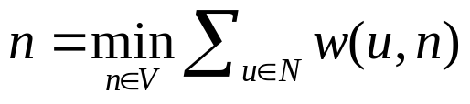
search procedure
N ← ∅ //the perspectives represented in D
root ← perspective with most referents in its extension
starting from root do:
  Check types and modifiers.
  If a property excludes distractors:
    add it to D
    add the perspective to N
  If R is not distinguished, go to the next perspective n:
Notes:
The content determination procedure starts by identifying a root node in the graph. This is defined as the node with the greatest number of referents in its extension.
Then it proceeds by visiting each perspective, starting from the root.
At each step, it checks the types and modifiers in the perspective.
If any property is found which excludes some distractors for the target referents, it is added to the description.
This implies that the perspective is represented in the description. The algorithm keeps track of this, by updating a set N, containing the nodes it has visited and from which it has selected properties.
If, upon exhausting the lexical items in a perspective, the referents are still not distinguished, the next perspective to be visited is selected greedily: It is defined as the perspective, from among the ones available, that will result in the least increase in the weight of the current description.

Slide 19
evaluation
Compare the coherence model to the model inspired by Grice
  Do people prefer coherence over brevity?
Method: subjects (N = 39) shown 6 discourses.
  Each discourse introduces 3 entities
  Followed by 2 possible continuations
  Subjects had to indicate their preferred continuation
Each of the 6 discourses represented a condition:
  Brevity: descriptions equally (in-)coherent, but one is brief
  Coherence: descriptions equally (non-)brief; only one is coherent
  Trade-off: coherent description is non-brief
Notes:
To evaluate the algorithm, we ran an experiment, where we compared our model with the dominant model in GRE. According to various authors (e.g. Gardent 2002, Horacek, 2004) people prefer descriptions which are BRIEF and SIMPLE. Our model predicts that people will prefer COHERENT descriptions, even if they’re overspecified (i.e. they contain too much information.
39 subjects were shown 6 paragraphs. Each one introduced 3 entities, described by various properties.
Each discourse was followed by a choice of 2 continuations, and subjects had to choose one.
The continuations represented the following conditions:
In 2 of them, the two descriptions were either both coherent, or both incoherent according to our model. But one was brief, and the other overspecified
In 2 others, descriptions were both equally long or equally short, but one was coherent and the other was not.
In the last case, the coherent description was overspecified, while the brief description was incoherent.
The difference between brief and non-brief descriptions was always that brief ones contained two properties and the non-brief ones contained 3.
People were always aware that the two descriptions were co-referential, because the domain made this clear.

Slide 20
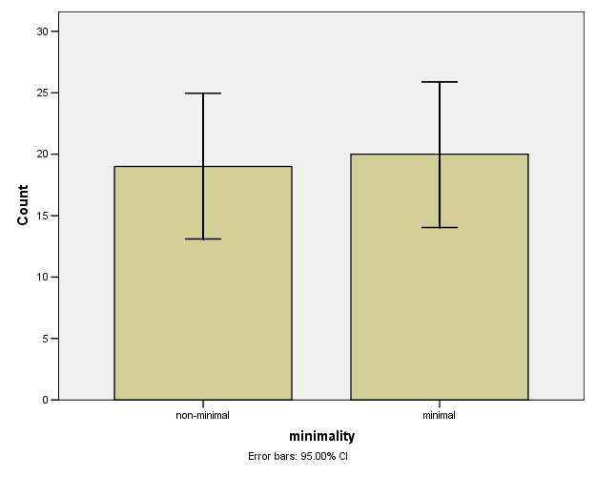
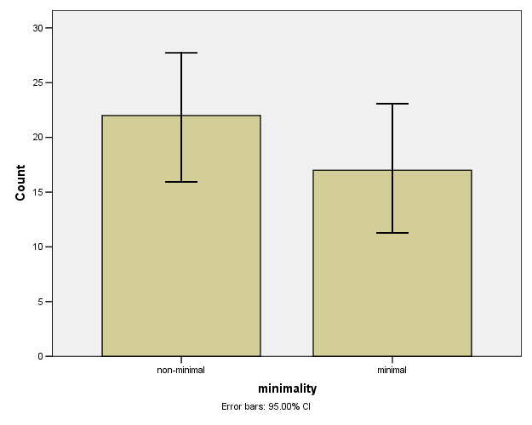
results: preference for brevity
both descriptions coherent
p = .8
both descriptions non-coherent
p = .4
Notes:
When the two descriptions are equally coherent, or equally incoherent, people show no particular preference for brief versus non-brief descriptions.
[Imtiaz: In case anyone asks what statistical tests we used: the test was a chi-square test, which compares frequencies of responses in two conditions. For example, it compares whether, in the case when both descriptions are coherent, the preference for minimal is greater than for non-minimal…]

Slide 21
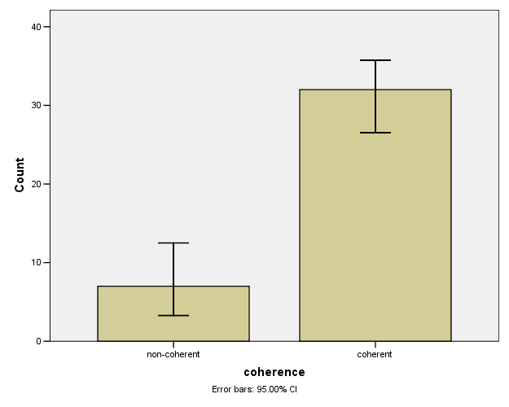
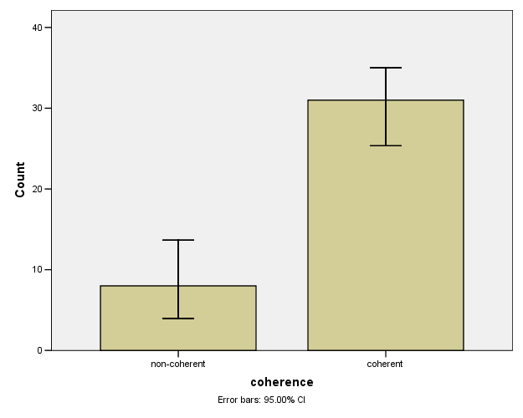
results: preference for coherence
both descriptions minimal
p < .001
both descriptions non-minimal
p < .001
Notes:
1. When the two descriptions are equally brief, or not, people strongly prefer the coherent one.

Slide 22
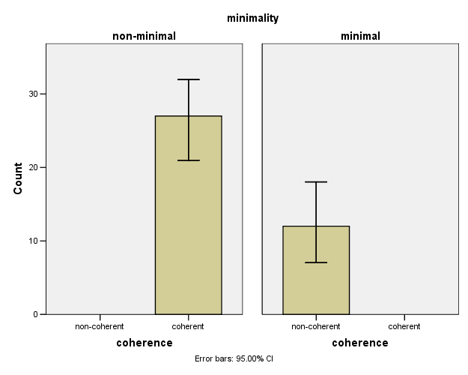
results: trade-off
coherent = non-minimal
p < .001
Notes:
When there is a trade-off, and one description is coherent and overspecified, while the other is non-coherent but brief, people have a strong tendency to go for the coherent, overspecified one.
Thus, our model seems to predict people’s choices quite well, in the kinds of domains we have investigated. In fact, the results suggest that, as long as descriptions are coherent, brevity (in the limited way we have defined it), does not play a role.

Slide 23
extension: discourse coherence
More work needed on the treatment of modifiers…
The algorithm has been extended with a discourse model, which keeps track of previous references.
Currently experimenting with a model of discourse coherence:
  when generating a new reference, prefer the perspectives that have been used in the previous n utterances
Problems:
  verifying this empirically
  defining n (cf. Centring Theory)
Notes:
Our results don’t shed much light on why there is a difference between nouns and modifiers in our experiment. We plan to look into this further.
In future work, we are experimenting with extending this model to conceptual coherence ACROSS NPs. This means we require some form of discourse model to keep track of entities referred to. The idea is that, when generating a new reference, the algorithm should try and use the same perspective as in the n previous references.
We still need to test this empirically.

Slide 24
cheers…
?

Slide 25
experiment 1
Participants ( N = 33 ) buying objects from an online store
Domain: (example)
  3 targets (a,b,c) + 1 distractor (d)
  sim(a,b) could be high or low
  sim(a,c) ≈ sim(b,c) = low
Expectation:
  if 2 of the targets have semantically similar types, they will be referred to in a plural description
  reference to any to targets in case similarity is constant is no better than chance

Slide 26
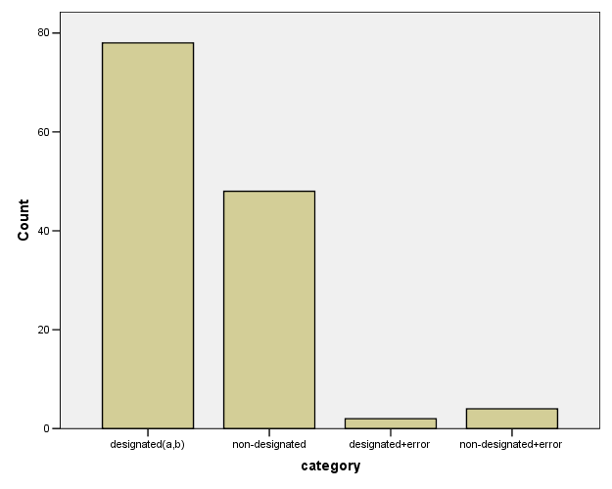
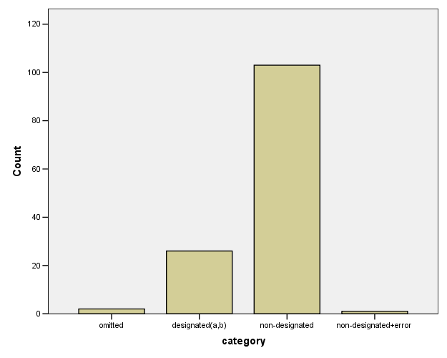
experiment 1: results
sim(a,b) high
sim(a,b) low

