Slide 1
SDRT and Multi-modal Situated Communication
SFB 360 –
Project B3 – Linguistics
Andy Lücking, Hannes Rieser, Marc Staudacher

Slide 2
Outline
Motivation
Exposition of Standard SDRT
Recent SDRT Developments
Representation of Situated Content in SDRT
SDRT as a MM Interface
Conclusions

Slide 3
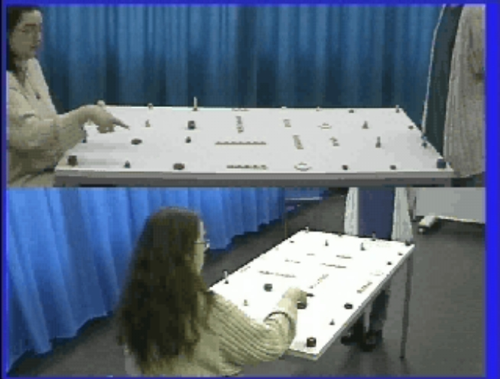
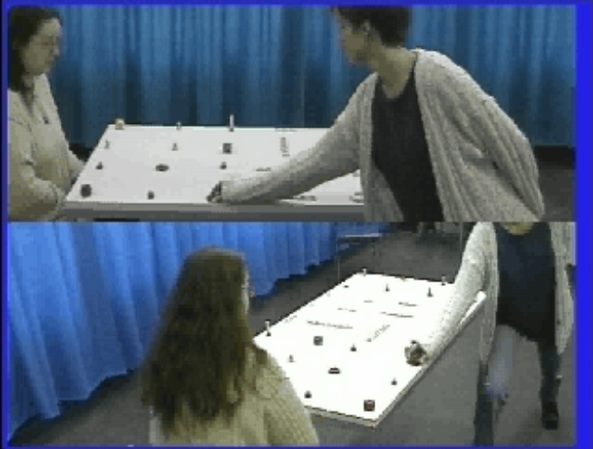
1. Motivation
Language use in situated communication differs from other kinds of communication.
Compare:
  World economic growth slowed noticeably in 2005 from the strong expansion in 2004.
  (1) I: The red _{a} wooden disc.
  (2) C: ↓↓_{a} This one?
  (3) I: Yes.
Characteristics:
  Non-sentential utterances
  Nonverbal behaviour
  Non-sentential utterances help to perform dialogue moves and to express sentential content.
Frequent use of fragments: In our corpus (see Lücking and Stegmann (2005), p. 15) 50 instructor's requests were realized as definite NPs out of a total of 92 dialogue moves including acceptances and repairs.

Slide 4
1. Aims
Goal: Develop theory of situated communication
Requirement: The theory must explain, given the use of non-sententials and nonverbal behaviour,
  which dialogue moves are performed and
  which sentential contents are communicated.
Observation 1: Pointing (demonstration) contributes to the meaning of an NP.
Observation 2: Graspings contribute to the communicative meaning of a dialogue.
Observation 3: Grounding of reference of multi-modal utterances is important for success of dialogue games.
Theory must account for observations 1 to 3.

Slide 5
1. Related Research
Gestures:
Kopp, Tepper, and Cassell (2004), Kranstedt, Lücking, Pfeiffer, Rieser, Staudacher (2006), McNeill (1992), Rieser (2004, 2005), van der Sluis and Krahmer (2004), van der Sluis (2005).
Fragments:
Elugardo and Stainton (eds., 2005), Poncin and Rieser (2000, 2006),Purver and Kempson (2004), Purver, Cann and Kempson (2005), Schegloff (1979), Skuplik (1999), Schlangen and Lascarides (2003).
Dialogue, Discourse, Dynamics:
Asher (2002, 2005), Asher and Lascarides (2003), Garrod and Pickering (2004), Kamp (1990), Muskens (1996, 2001), Poesio and Traum (1997).

Slide 6
1. Plan
We use SDRT as our framework. The concepts doing the explanatory work are introduced next.
We won't say much about the mapping from NL to syntax. Though we propose to use LTAG there.
We don’t treat fragments as sentences.
Sentence fragments
Syntactic structures
(set of) SDRS

Slide 7
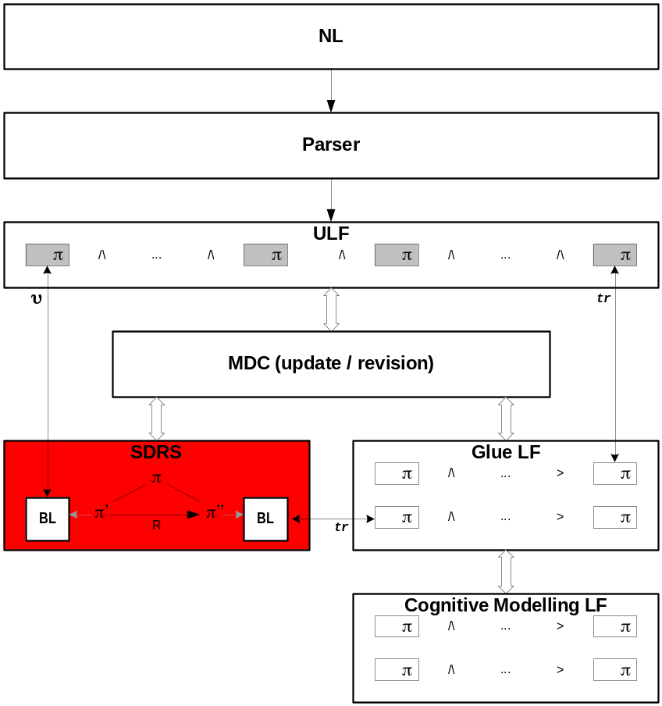
2. Exposition of Standard SDRT
Start: Asher & Lascarides: Logics of Conversation, 2003.
How SDRT works, applying it to example ii.:
Assume initial context C which contains the SDRSs described by the ULF of (1) I: The red _{a} wooden disc.
Update C with the ULF of
(2) C: ↓↓_{a} This one?.
Thus (2) is related by some Discourse Relation R to some Attachment Point X. In this case the only/most coherent one is (1).
However, Discourse Relations only relate content having (sentential) satisfaction conditions. Standard SDRT fails with sub-sententials.

Slide 8
2. Exposition of Standard SDRT
(Assume ii. had sentential content)
The ULF of (2) C: ↓↓_{a} This one? is translated to Glue and to Cognitive Modelling in order to resolve underspecification by
pragmatic reasoning.
The results of the reasoning
are translated back to ULF and added to the description of the new context C’. update restricts the resolutions to those that are consistent.
Apply best-update to (3) I: Yes.
Best-update is like update but it ranks the SDRSs in the final context C’’ by applying MDC.

Slide 9
2. Exposition of Standard SDRT
Standard SDRT cannot handle fragments, since ULFs are expected to describe Base Logical Forms of complete sentences.
  We would like to establish that Q-Elab(1,2) holds by pragmatic reasoning.
  However, in Standard SDRT, Discourse Relations cannot relate non-sentential content.
  Idea (not followed here): Construct sentential content from non-sentential content.

Slide 10
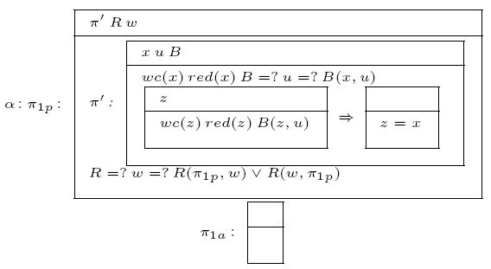
3. Recent SDRT Developments
Representation of NPs:
Distinguish between presupposed and “rest” information.
Definite NPs introduce
a Bridging relation
holding between the
NP’s referent and
some contextually
given antecedent.
Example: (1) The red wooden disc!

Slide 11
3. Recent SDRT Developments
Anchoring (see Asher (2002)):
Deicitically used definites anchored to some object in non-linguistic context.
Such a definite involves a de re attitude towards the object, some sort of knowing how needed to solve the Speech Act Related Goals (SARGs) of the speaker.
If an Anchoring Relation holds between a definite uttered by an agent A and some Attachment Point in the discourse, then A is supposed to have a computable means of getting to the referent of the definite from the present non-linguistic context of utterance under some given purpose P.
Anchoring amounts to coordination or alignment: If the anchoring function of a deictically used definite is accepted by the participants in dialogue, they are assumed to mutually believe that the definite picks out the same object for them.

Slide 12
3. Recent SDRT Developments
Schlangen and Lascarides (2003) treat fragments differently, using HPSG and MRS.
Fragments are assigned an
“S-frag” category, in essence an XP.
“S-frag” is interpreted in an inter-mediate language as “P([XP])” where [XP] is the compositional meaning of the XP (e.g. the red wooden disc) and P is some underspecified property.
We think that fragments have only their compositional meaning.
How a fragment’s sentential content is constructed out of [XP] needs to be addressed in any case.
Sentence fragments
Syntactic structures
(set of) SDRS

Slide 13
4. Representation of Situated Content in SDRT (1)
Empirical Findings from Two MM Corpora (Kranstedt, Lücking, Pfeiffer, Rieser, Wachsmuth (2006), Lücking, Kranstedt, Pfeiffer, Rieser (2006)):
In situations of certain types special conventions hold. They are mutually believed/known by the agents involved.
The conventions are special because they hold relative to situations of a certain type (and not in all situations). Special conventions are paired with situation types.
Situation types are partially characterized by agents, domains, agents’ intentions and plans, aims, appropriate actions (verbal and non-verbal), rights and obligations.
Observation: Frequently, appropriate actions are referred to using typical verbs, e.g. put, screw, plug or more complex expression (Pickering and Garrod’s routinization).

Slide 14
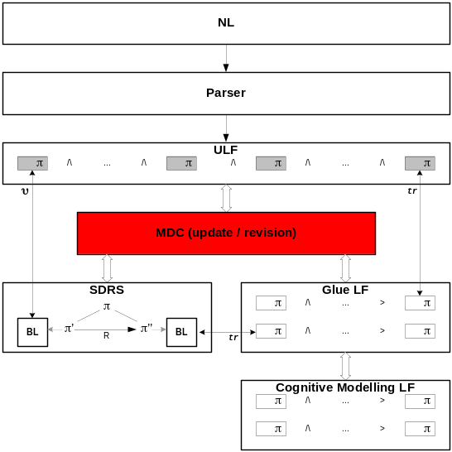
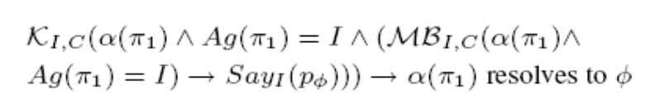
4. Representation of Situated Content in SDRT (2)
For SDRT this means that the conventions holding in a context are introduced into Cognitive Modelling theory.
The Cognitive Modelling theory also contains a description of the participants’ utterances.
So, the conventions plus the utterances can be used to derive what the participants have communicated.
As for our example, there exists such a special convention: If the Agent of (1) has uttered The red wooden disc, then he has commanded that C grasp the object pointed at.
Notes:
Das “p Index Phi” steht für die Satzkonstante in der Cognitive Modelling Theory, die mit der SDRS mit dem vollen Gehalt des Fragments verknüpft ist.

Slide 15
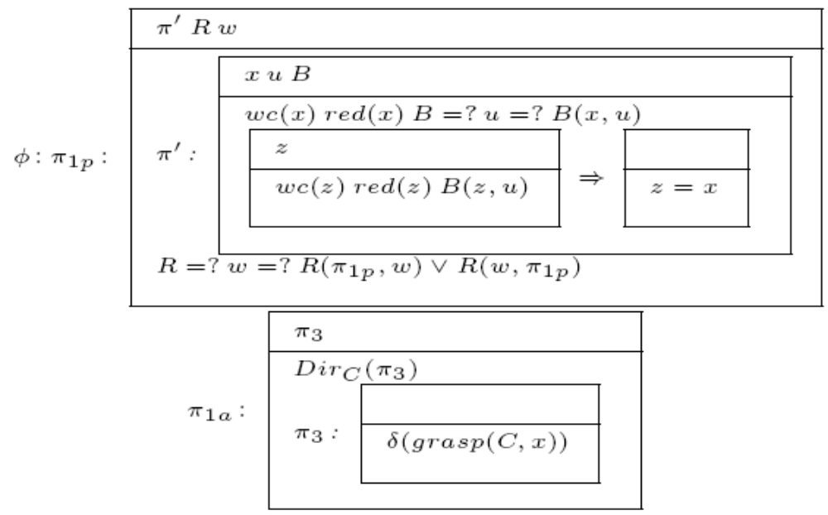
4. Representation of Situated Content in SDRT (3)
The existence of such conventions plus the Cognitive Modelling Logic allow to derive Φ from α:

Slide 16
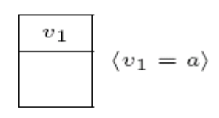
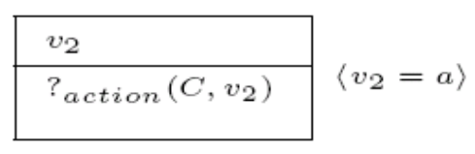
4. Representation of Situated Content in SDRT (4)
Demonstrations anchor Discourse Referents to objects and have no meaning beyond that.
Graspings also have meaning, but an underspecified one. They have a content of the type of an action.They also anchor Discourse Referents to objects.

Slide 17
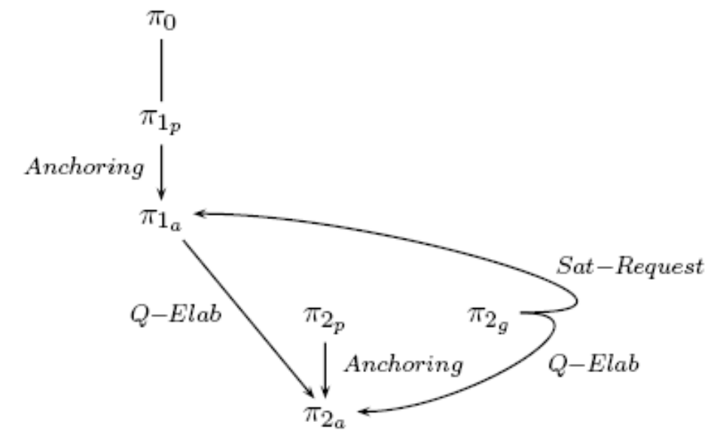
5. SDRT as a MM Interface (1)
Discourse structure of
(1) I: The red _{a} wooden disc.
(2) C: ↓↓_{a} This one?
There is a unique red wooden disc.
There is a unique anchored object
I: C should grasp this r-w-disc!
C grasps an object
C: This one I should grasp?

Slide 18
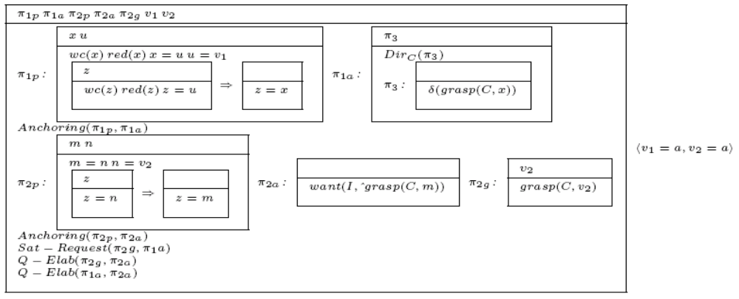
5. SDRT as a MM Interface (2)
By applying MDC we get:
The maximal specific content (= smallest model)
Resolving the Bridging Relation to identity
Resolving and maximizing the number of Discourse Relations
Anchoring and minimizing the number of Discourse Referents

Slide 19
6. Conclusions
Things done
  First sketch of a theory of situated communication by means of SDRT + special conventions used to determine the communicative meaning of non-sentential utterances.
  Relating gestures to NPs by presupposition representation, Anchoring and MDC.
Loose ends
  Alternative representations of graspings
  Statistical investigation concerning fragments of dialogue moves
  Coverage results for special convention(s)
  Generalizability
Future research
  Clear distinction between different cases of fragments (syntax based explanation vs. pragmatic explanation)
  Addressing loose ends

Slide 20
A1. Construction of Dialogue ii.
(1) I: The red wooden disc
Representation of presupposition
DRT-style representation of definite description
Underspecified content in presupposition:
  Bridging relation,
  discourse relation,
  DRs.
No content embedding the presupposition.

Slide 21
A2. Construction of Dialogue ii.
(1) I: The red _{a} wooden disc.
Content of directive
due to the convention
which is part of the
context as are the
words uttered.
The content of the demonstration is
provided by an anchor
to an external object.

Slide 22
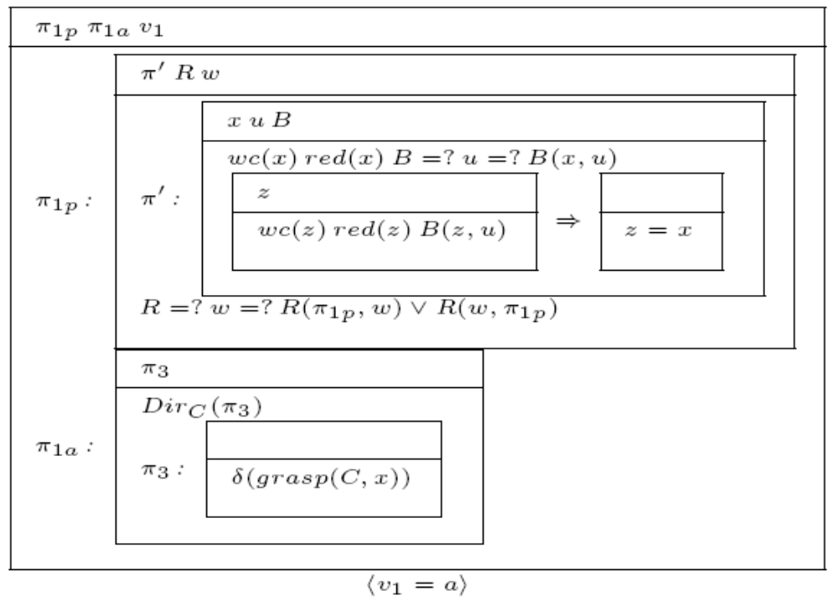
A3. Construction of Dialogue ii.
(1) I: The red _{a} wooden disc.
Presupposed and asserted information
Underspecified content
in presupposition:
  Bridging relation,
  discourse relation,
  DRs.
Demonstration yields anchor to external object with widest scope given to DR.
Content of directive due to the convention which is part of the context as are the words uttered.

Slide 23
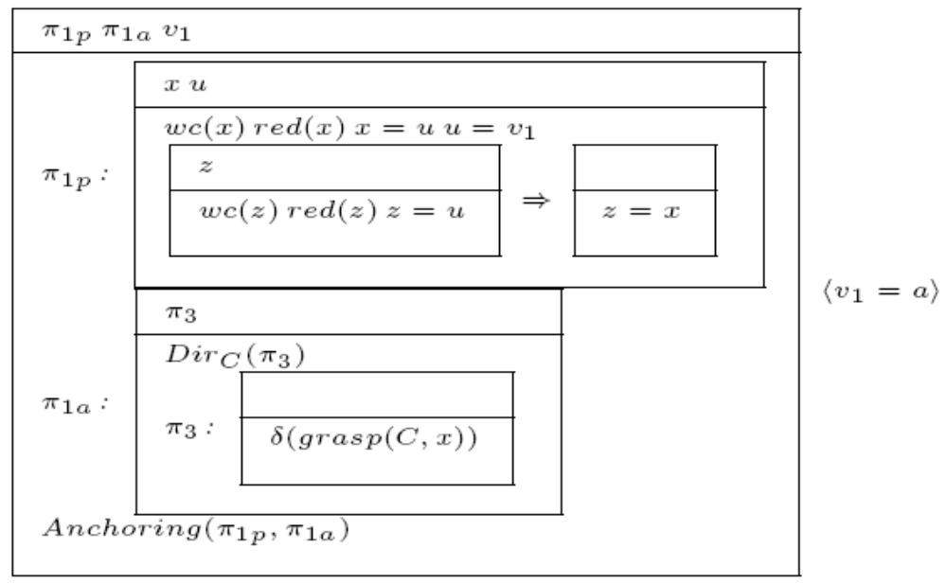
A4. Construction of Dialogue ii.
(1) I: The red _{a} wooden disc.
Presuppositional information and
content of the
directive are linked
by the discourse relation of Anchoring.

Slide 24
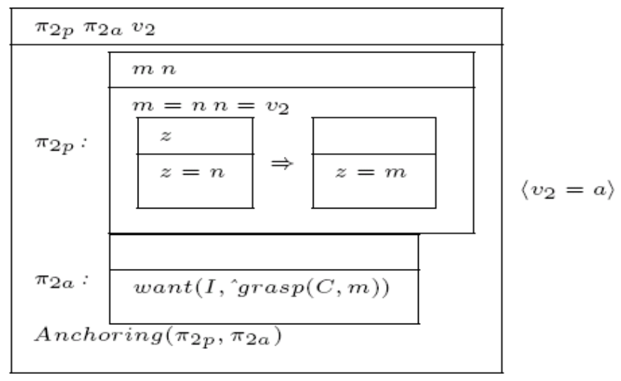
A5. Construction of Dialogue ii.
(2) C: ↓↓_{a} This one?
C’s check-back consists of a definite NP and a concurrent grasping.
The DR in the definite NP is anchored to an external object.
Content of the question is reconstructed.
C’s grasping is given the underspecified content of an action.
The action’s target is the external object.

Slide 25
A6. Construction of Dialogue ii.
Propositions are anchored by their presuppositions.
C’s action is instantiated by a grasping relation.
Demonstration and grasping are anchored to the same object.
C’s grasping satisfies I’s request.
Two Q-Elab relations are established.

