Slide 1
WRAPPING IT UP!

Slide 2
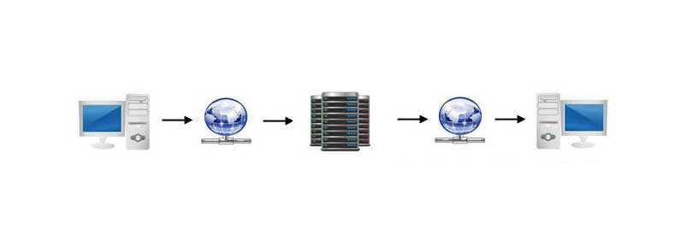
Server Side Scripting

Slide 3








Server Side Languages
ASP
C
Java
JavaScript (Node.js)
Perl
PHP
Python
Ruby

Slide 4
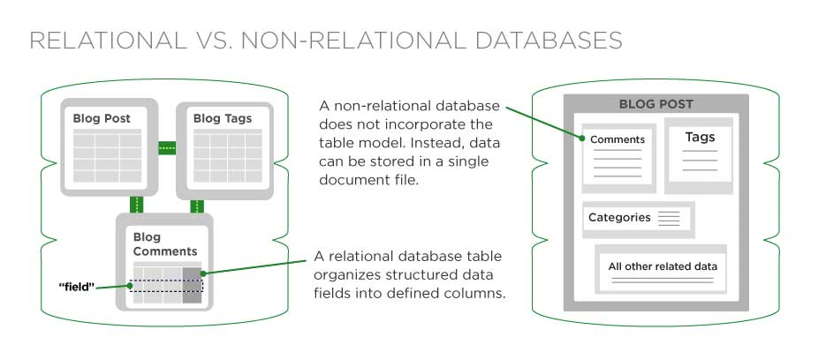
Database

Slide 5








Database
Relational Databases
Non-Relational Databases
Oracle
PostgreSQL
MySQL
PHPmyAdmin
MariaDB
MongoDB
Firebase
JSON

Slide 6






Hosting Companies
Bluehost
Hostgator
InMotion Hosting
Dreamhost
SiteGround
GoDaddy

Slide 7
Domains
A physical address in the internet
Can be secured or unsecured depending on license
Variety of domain extensions (.com, .net, .edu, .gov, .org, .biz, etc)
Subdomain (www.mysub.domain.com).

Slide 8

Code Transfer
File Manager
cPanel
Full control of code
Login once through connections
Access from local build
Full control of code
Login every time you need to access it
Access from any computer
Control of other features and server settings

Slide 9


Versioning Repositories
Code storage
Code comparison
Code retrieval
Code sharing

