Slide 1
502045
Software Engineering
Chapter 01
Lesson 01: Introduction to Software Engineering

Slide 2
Topics covered
Definition
Software costs
Software products
Specification
Some frequently asked questions
Good software
Software process activities
General issues that effect most software
SE diversity
Application types
SE fundamentals

Slide 3
Software engineering
Software engineering is an engineering discipline that is concerned with all aspects of software production from the early stages of system specification through to maintaining the system after it has gone into use.
Engineering discipline
Using appropriate theories and methods to solve problems bearing in mind organizational and financial constraints.
All aspects of software production
Not just technical process of development. Also project management and the development of tools, methods etc. to support software production.

Slide 4
Software costs
Software costs often dominate computer system costs. The costs of software on a PC are often greater than the hardware cost.
Software costs more to maintain than it does to develop. For systems with a long life, maintenance costs may be several times development costs.
Software engineering is concerned with cost-effective software development.
Notes:
dominate : trội hơn

Slide 5
Software products
Generic products
Stand-alone systems that are marketed and sold to any customer who wishes to buy them.
Customized products
Software that is commissioned by a specific customer to meet their own needs.

Slide 6
Product specification
Generic products
The specification of what the software should do is owned by the software developer and decisions on software change are made by the developer.
Customized products
The specification of what the software should do is owned by the customer for the software and they make decisions on software changes that are required.
Notes:
Specification: đặc điểm kỹ thuật

Slide 7
Frequently asked questions about software engineering
Question | Answer
What is software? | Computer programs and associated documentation. Software products may be developed for a particular customer or may be developed for a general market.
What are the attributes of good software? | Good software should deliver the required functionality and performance to the user and should be maintainable, dependable and usable.

Slide 8
Frequently asked questions about software engineering
Question | Answer
What is software engineering? | Software engineering is an engineering discipline that is concerned with all aspects of software production.
What are the fundamental software engineering activities? | Software specification, software development, software validation and software evolution.

Slide 9
Frequently asked questions about software engineering
Question | Answer
What is the difference between software engineering and computer science? | Computer science focuses on theory and fundamentals; software engineering is concerned with the practicalities of developing and delivering useful software.

Slide 10
Frequently asked questions about software engineering
Question | Answer
What are the key challenges facing software engineering? | Coping with increasing diversity, demands for reduced delivery times and developing trustworthy software.
What are the costs of software engineering? | Roughly 60% of software costs are development costs, 40% are testing costs. For custom software, evolution costs often exceed development costs.

Slide 11
Essential attributes of good software
characteristic | Description
Maintainability | Software should be written in such a way so that it can evolve to meet the changing needs of customers. This is a critical attribute because software change is an inevitable^{[sure]} requirement of a changing business environment.
Dependability and security | Software dependability^{[reliable]} includes a range of characteristics including reliability, security and safety. Dependable software should not cause physical or economic damage in the event of system failure. Malicious^{[harmful]} users should not be able to access or damage the system.
Efficiency | Software should not make wasteful use of system resources such as memory and processor cycles. Efficiency therefore includes responsiveness, processing time, memory utilisation, etc.
Acceptability | Software must be acceptable to the type of users for which it is designed. This means that it must be understandable, usable and compatible with other systems that they use.

Slide 12
Software process activities
Software specification, where customers and engineers define the software that is to be produced and the constraints on its operation.
Software development, where the software is designed and programmed.
Software validation, where the software is checked to ensure that it is what the customer requires.
Software evolution, where the software is modified to reflect changing customer and market requirements.

Slide 13
Discussion (20’)
Discuss about some applications: training management, Caro game application.
Cover:
Specification
Development
Validation
Evolution (option)

Slide 14
General issues that affect most software
Heterogeneity
Increasingly, systems are required to operate as distributed systems across networks that include different types of computer and mobile devices.
Business and social change
Business and society are changing incredibly quickly as emerging economies develop and new technologies become available. They need to be able to change their existing software and to rapidly develop new software.
Security and trust
As software is intertwined with all aspects of our lives, it is essential that we can trust that software.

Slide 15
Software engineering diversity
There are many different types of software system and there is no universal set of software techniques that is applicable to all of these.
The software engineering methods and tools used depend on the type of application being developed, the requirements of the customer and the background of the development team.
Notes:
Diversity: sự đa dạng

Slide 16
Application types
Stand-alone applications
These are application systems that run on a local computer, such as a PC. They include all necessary functionality and do not need to be connected to a network.
Interactive transaction-based applications
Applications that execute on a remote computer and are accessed by users from their own PCs or terminals. These include web applications such as e-commerce applications.
Embedded control systems
These are software control systems that control and manage hardware devices.
Notes:
Numerically: Về số lượng

Slide 17
Application types (cont.)
Batch processing systems
These are business systems that are designed to process data in large batches. They process large numbers of individual inputs to create corresponding outputs.
Entertainment systems
These are systems that are primarily for personal use and which are intended to entertain the user.
Systems for modelling and simulation
These are systems that are developed by scientists and engineers to model physical processes or situations, which include many, separate, interacting objects.

Slide 18
Application types (cont.)
Data collection systems
These are systems that collect data from their environment using a set of sensors and send that data to other systems for processing.
Systems of systems
These are systems that are composed of a number of other software systems.

Slide 19
Software engineering fundamentals
Some fundamental principles apply to all types of software system, irrespective of the development techniques used:
Systems should be developed using a managed and understood development process. Of course, different processes are used for different types of software.
Dependability and performance are important for all types of system.
Understanding and managing the software specification and requirements (what the software should do) are important.
Where appropriate, you should reuse software that has already been developed rather than write new software.

Slide 20
Case studies
A personal insulin pump
An embedded system in an insulin pump used by diabetics to maintain blood glucose control.
A mental health case patient management system
A system used to maintain records of people receiving care for mental health problems.
A wilderness weather station
A data collection system that collects data about weather conditions in remote areas.

Slide 21
Insulin pump control system
Collects data from a blood sugar sensor and calculates the amount of insulin required to be injected.
Calculation based on the rate of change of blood sugar levels.
Sends signals to a micro-pump to deliver the correct dose of insulin.
Safety-critical system as low blood sugars can lead to brain malfunctioning, coma and death; high-blood sugar levels have long-term consequences such as eye and kidney damage.

Slide 22
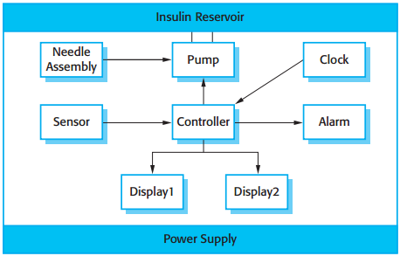
Insulin pump hardware architecture

Slide 23
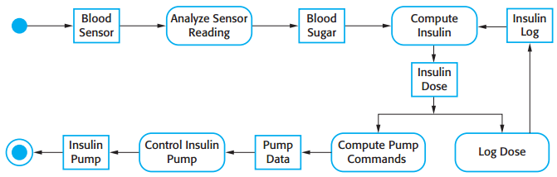
Activity model of the insulin pump

Slide 24
Essential high-level requirements
The system shall be available to deliver insulin when required.
The system shall perform reliably and deliver the correct amount of insulin to counteract the current level of blood sugar.
The system must therefore be designed and implemented to ensure that the system always meets these requirements.
Notes:
reliably : đáng tin cậy

Slide 25
A patient information system for mental health care
A patient information system to support mental health care is a medical information system that maintains information about patients suffering from mental health problems and the treatments that they have received.
Most mental health patients do not require dedicated hospital treatment but need to attend specialist clinics regularly where they can meet a doctor who has detailed knowledge of their problems.
To make it easier for patients to attend, these clinics are not just run in hospitals. They may also be held in local medical practices or community centres.

Slide 26
MHC-PMS
The MHC-PMS (Mental Health Care-Patient Management System) is an information system that is intended for use in clinics.
It makes use of a centralized database of patient information but has also been designed to run on a PC, so that it may be accessed and used from sites that do not have secure network connectivity.
When the local systems have secure network access, they use patient information in the database but they can download and use local copies of patient records when they are disconnected.

Slide 27
MHC-PMS goals
To generate management information that allows health service managers to assess performance against local and government targets.
To provide medical staff with timely information to support the treatment of patients.

Slide 28
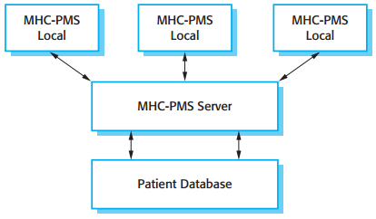
The organization of the MHC-PMS

Slide 29
MHC-PMS key features
Individual care management
Clinicians can create records for patients, edit the information in the system, view patient history, etc. The system supports data summaries so that doctors can quickly learn about the key problems and treatments that have been prescribed.
Patient monitoring
The system monitors the records of patients that are involved in treatment and issues warnings if possible problems are detected.
Administrative reporting
The system generates monthly management reports showing the number of patients treated at each clinic, the number of patients who have entered and left the care system, number of patients sectioned, the drugs prescribed and their costs, etc.
Notes:
prescribed : chỉ định

Slide 30
MHC-PMS concerns
Privacy
It is essential that patient information is confidential and is never disclosed to anyone apart from authorised medical staff and the patient themselves.
Safety
Some mental illnesses cause patients to become suicidal or a danger to other people. Wherever possible, the system should warn medical staff about potentially suicidal or dangerous patients.
The system must be available when needed otherwise safety may be compromised and it may be impossible to prescribe the correct medication to patients.
Notes:
suicidal : tự tử
must be available when needed : phải sẵn sàng lúc cần

Slide 31
Wilderness weather station
The government of a country with large areas of wilderness decides to deploy several hundred weather stations in remote areas.
Weather stations collect data from a set of instruments that measure temperature and pressure, sunshine, rainfall, wind speed and wind direction.
The weather station includes a number of instruments that measure weather parameters such as the wind speed and direction, the ground and air temperatures, the barometric pressure and the rainfall over a 24-hour period. Each of these instruments is controlled by a software system that takes parameter readings periodically and manages the data collected from the instruments.

Slide 32
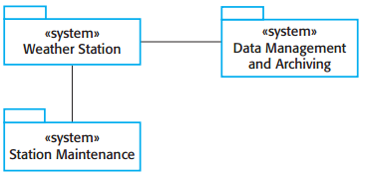
The weather station’s environment

Slide 33
Weather information system
The weather station system
This is responsible for collecting weather data, carrying out some initial data processing and transmitting it to the data management system.
The data management and archiving system
This system collects the data from all of the wilderness weather stations, carries out data processing and analysis and archives the data.
The station maintenance system
This system can communicate by satellite with all wilderness weather stations to monitor the health of these systems and provide reports of problems.

Slide 34
Additional software functionality
Monitor the instruments, power and communication hardware and report faults to the management system.
Manage the system power, ensuring that batteries are charged whenever the environmental conditions permit but also that generators are shut down in potentially damaging weather conditions, such as high wind.
Support dynamic reconfiguration where parts of the software are replaced with new versions and where backup instruments are switched into the system in the event of system failure.

Slide 35
Key points
Software engineering is an engineering discipline that is concerned with all aspects of software production.
Essential software product attributes are maintainability, dependability and security, efficiency and acceptability.
The high-level activities of specification, development, validation and evolution are part of all software processes.
The fundamental notions of software engineering are universally applicable to all types of system development.

Slide 36
Key points
There are many different types of system and each requires appropriate software engineering tools and techniques for their development.
Three case studies are used in the book:
An embedded insulin pump control system
A system for mental health care patient management
A wilderness weather station

