Slide 1
PHP – Very sort not
Internet Programming II

Slide 2
PHP: Hypertext Preprocessor
Slower performance for certain types of applications
Not ideal for real-time applications or parallel programming
Relatively simple object-oriented model, which can make it less powerful and flexible than other languages like Java and C++
Global namespace makes it more challenging to manage and organize large PHP codebases
CGI program do collect form data, generate dynamic page content, or send and receive cookies.
Command line scripting: You can make a PHP script to run it without any server or browser. You only need the PHP parser (CGI ) to use it this way.
One of the most powerful development models for the Web has been the notion of AMP.

Slide 3
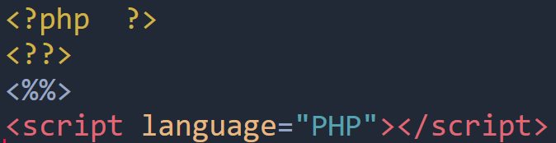
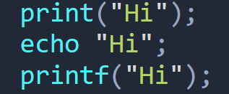
Apache a web server, it is not a physical server, but rather a software that runs on an HTTP server
Performance problems on extremely traffic-heavy websites.
Too many configuration options can lead to security vulnerabilities
Four ways the PHP parser engine can differentiate PHP code in a webpage:
all user-defined functions, classes, and are NOT case-sensitive. But variables are case-sensitive.
print returns a value. It always returns 1.

Slide 4
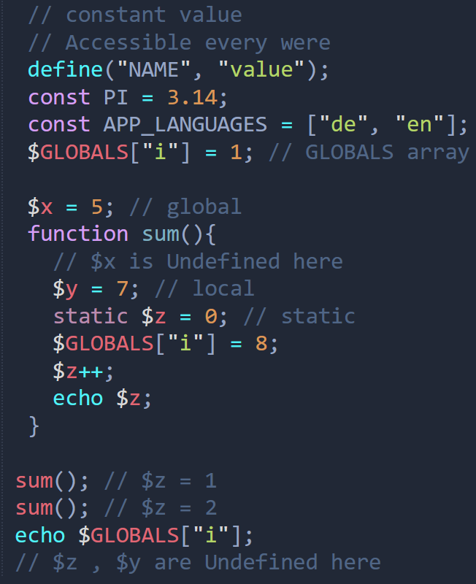
local: declared within a function and only be accessed within that function global: declared outside a function and only be accessed outside a function static: a variable is used after a function is completed/executed
The scope of a variable is the part of the script where the variable can be referenced/used. PHP has three different variable scopes:
Also, you can use a global array to store global variables. $GLOBALS[index];

Slide 5
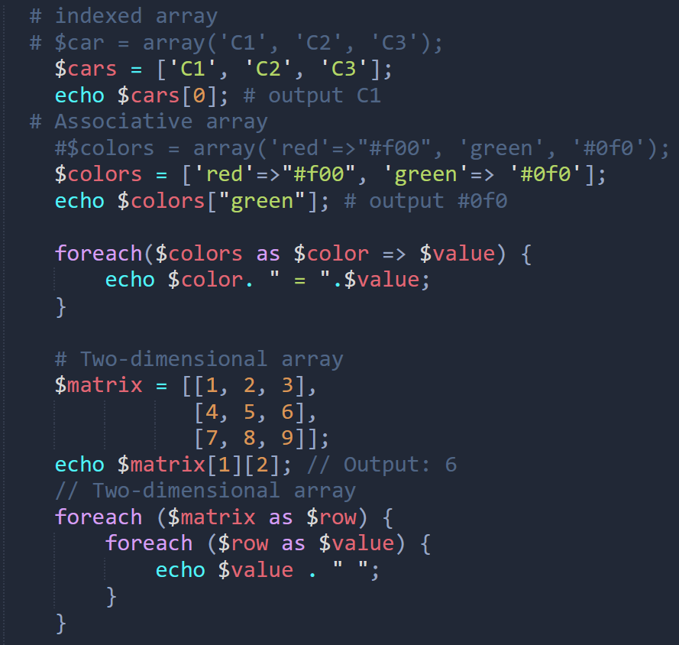
sort(): Sorts a numeric array in ascending order.
rsort(): Sorts a numeric array in descending order.
asort(): Sorts an associative array in ascending order by value.
arsort(): Sorts an associative array in descending order by value.
ksort(): Sorts an associative array in ascending order by key.
krsort(): Sorts an associative array in descending order by key

Slide 6
count(): Returns the number of elements in an array
Superglobals are prefixed with a special character "$" and are available in all scopes.

