Slide 1
Stacks
Chapter 11

Slide 2
Chapter Contents
Specifications of the ADT Stack
Using a Stack to Process Algebraic Expressions
  Checking for Balanced Parentheses, Brackets, and Braces in an Infix Algebraic Expression
  Transforming an Infix Expression to a Postfix Expression
  Evaluating Postfix Expressions
  Evaluating Infix Expressions
The Program Stack
  Recursive Methods
Java Class Library: The Class Stack

Slide 3
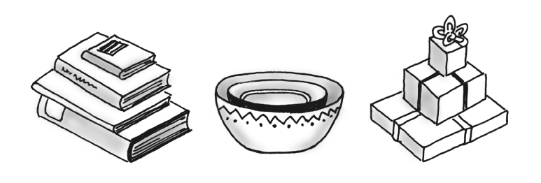
Specifications of the ADT Stack
Organizes entries according to order in which added
Additions are made to one end, the top. The item most recently added is always on the top
Remove an item, you remove the top one that is recently added.
Last in, first out, LIFO
Queue: FIFO
Some familiar stacks.

Slide 4
Specifications of the ADT Stack
Specification of a stack of objects
public interface StackInterface
{ /** Task: Adds a new entry to the top of the stack.
* @param newEntry an object to be added to the stack */
public void push(Object newEntry);
/** Task: Removes and returns the top of the stack.
* @return either the object at the top of the stack or null if the stack was empty */
public Object pop();
/** Task: Retrieves the top of the stack.
* @return either the object at the top of the stack or null if the stack is empty */
public Object peek();
/** Task: Determines whether the stack is empty.
* @return true if the stack is empty */
public boolean isEmpty();
/** Task: Removes all entries from the stack */
public void clear();
} // end StackInterface

Slide 5
ADT Stack Operations
A stack has restricted access to its entries. A client can only look at or remove the top entry.
Typically, a stack has no search operation. However, the stack within the Java Class Library does have a search method.
Operation that adds an entry is called push
Remove operation is pop
Retrieves the top without removing it is peek.

Slide 6
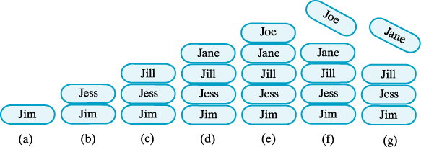
Specifications of the ADT Stack
A stack of strings after (a) push adds Jim;
(b) push adds Jess; (c) push adds Jill; (d) push adds Jane; (e) push adds Joe; (f) pop retrieves and removes Joe; (g) pop retrieves and removes Jane

Slide 7
Algebraic Expressions
Algebraic Expressions is composed of operands that are variables or constants and operators such as +, -, * and /.
Operators have two operands are called binary operators.
Operators have only one operand are called unary operator.
When an algebraic expression has no parentheses, operations occur in a certain order. Exponentiations occur first;
Exponentiations take precedence over the other operations. Next, multiplications and division occur, and then additions and subtractions
  20 – 2*2^3
  Evaluates as 20 – 2*8 = 20 – 16 = 4
Adjacent operators have the same precedence? Exponentiation occur right to left: 2^2^3 = 2^(2^3) = 2^8
Other operations occur left to right: 8-4+2 = (8-4) +2 = 4+2 = 6

Slide 8
Using a Stack to Process Algebraic Expressions
Expression Notations
Infix expressions
  Binary operators appear between operands
  a + b
Prefix expressions
  Binary operators appear before operands
  + a b
Postfix expressions
  Binary operators appear after operands
  a b +
  Easier to process – no need for parentheses nor precedence

Slide 9
Delimiters
Braces, square brackets, parentheses
(), [], {}
These delimiters must be paired correctly. Open parenthesis must correspond to a close parenthesis.
Pairs of delimiters must not intersect.
Legal: { [ () () ] () }
Illegal: [ ( ] )
Say that a balanced expression contains delimiters that are paired correctly.
Compiler will detect whether an expression is balanced or not.

Slide 10
Algorithm for Balanced Expression
Scan the expression from left to right, looking for delimiters and ignoring any characters that not delimiters.
When we encounter an open delimiter, we save it.
When we find a close delimiter, we see if it corresponds to the most recently encountered open delimiter. If it does, we discard the open delimiter and continue scanning
We can scan the entire expression without a mismatch, the delimiters in the expression are balanced.
Use stack to store and remove the most recent one.

Slide 11
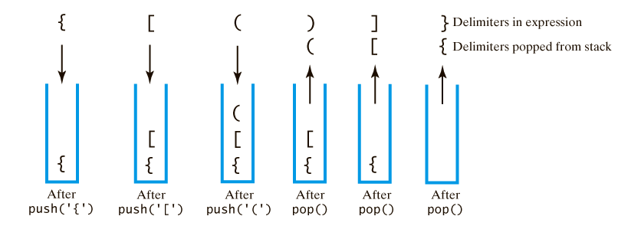
Checking for Balanced (), [], {}
The contents of a stack during the scan of an expression that contains the balanced delimiters {[()]}
a{b[c(d+e)/2 – f] +1}

Slide 12
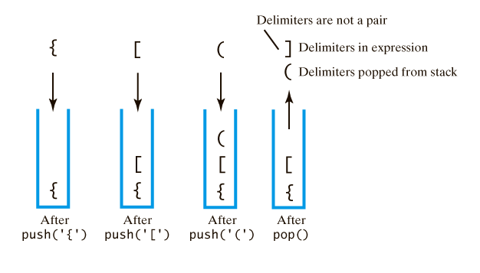
Checking for Balanced (), [], {}
The contents of a stack during the scan of an expression that contains the unbalanced delimiters {[(])}

Slide 13
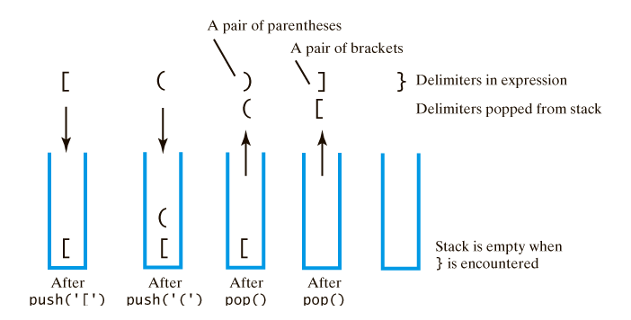
Checking for Balanced (), [], {}
The contents of a stack during the scan of an expression that contains the unbalanced delimiters [()]}

Slide 14
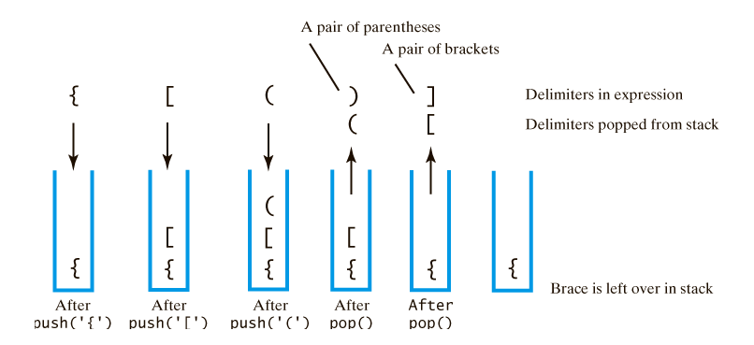
Checking for Balanced (), [], {}
The contents of a stack during the scan of an expression that contains the unbalanced delimiters {[()]

Slide 15
Checking for Balanced (), [], {}
Algorithm checkBalance(expression)
// Returns true if the parentheses, brackets, and braces in an expression are paired correctly.
isBalanced = true
while ( (isBalanced == true) and not at end of expression)
{ nextCharacter = next character in expression
switch (nextCharacter)
{ case '(': case '[': case '{':
Push nextCharacter onto stack
break
case ')': case ']': case '}':
if (stack is empty) isBalanced = false
else
{ openDelimiter = top of stack
Pop stack
isBalanced = true or false according to whether openDelimiter and
nextCharacter are a pair of delimiters
}
break
}
}
if (stack is not empty) isBalanced = false
return isBalanced

Slide 16
Exercises
[a { b / (c-d) + e / (f+g) } - h]
{a [ b + (c+2) / d ] = e) + f }
[a {b + [ c (d+e) –f ] + g }
Check them for balance by using stack.

Slide 17
Answers
[ { [
[{ {[ [{
[{( {[( [{[
[{ {[ [{[(
[{( { [{[
[{ [{
[ [
empty
Balanced Non-balanced Non-balanced

Slide 18
Transforming Infix to Postfix
Goal is show you how to evaluate infix algebraic expression, postfix expressions are easier to evaluate.
So first look at how to represent an infix expression by using postfix notation.
Infix Postfix
a+b ab+
(a+b)*c ab+c*
a + b*c abc*+

Slide 19
Pencil and paper scheme
We write the infix expression with a fully parenthesized infix expression.
For example: (a+b)*c as ((a+b)*c). Each operator is associated with a pair of parentheses.
Now we move each operator to the right, so it appears immediately before its associated close parenthesis:
((ab+)c*)
Finally, we remove the parentheses to obtain the postfix expression. ab+c*

Slide 20
Exercises
a + b * c
a * b / (c - d)
a / b + (c - d)
a / b + c - d

Slide 21
Answers
abc*+
ab*cd-/
ab/cd-+
ab/c+d-

Slide 22
Transforming Infix to Postfix
Scan the infix expression from left to right.
Encounter an operand, place it at the end of new expression.
Encounter an operator, save the operator until the right time to pop up
  Depends on the relative precedence of the next operator.
    Higher precedence operator can be pushed
    Same precedence, operator gets popped.
Reach the end of input expression, we pop each operator from the stack and append it to the end of the output

Slide 23
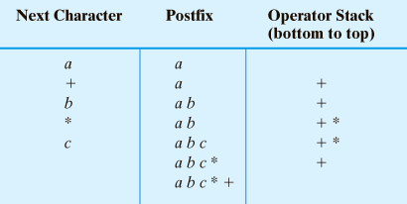
Transforming Infix to Postfix
Converting the infix expression
a + b * c to postfix form

Slide 24
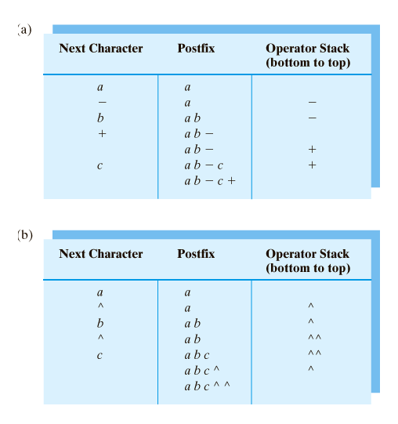
Transforming Infix to Postfix
Converting infix expression to postfix form:
a – b + c

Slide 25
Transforming Infix to Postfix
Converting infix expression to postfix form:
a ^ b ^ c
An exception: if an operator is ^, push it onto the stack regardless of what is at the top of the stack

Slide 26
Infix-to-Postfix Algorithm
Symbol in Infix | Action
Operand | Append to end of output expression
Operator ^ | Push ^ onto stack
Operator +,-, *, or / | Pop operators from stack, append to output expression until stack empty or top has lower precedence than new operator. Then push new operator onto stack
Open parenthesis | Push ( onto stack, treat it as an operator with the lowest precedence
Close parenthesis | Pop operators from stack, append to output expression until we pop an open parenthesis. Discard both parentheses.

Slide 27
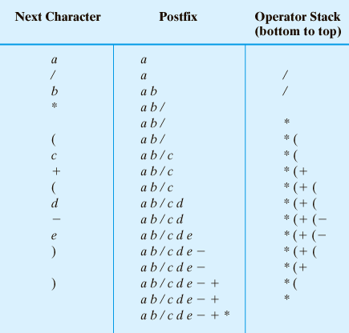
Transforming Infix to Postfix
Steps to convert the infix expression
a / b * ( c + ( d – e ) ) to postfix form.

Slide 28
Exercises
(a + b)/(c - d)
a / (b - c) * d
a-(b / (c-d) * e + f) ^g
(a – b * c) / (d * e ^ f * g + h)

Slide 29
Answers
ab+cd-/
abc-/d*
abcd-/e*f + g^-
abc* -def^*g*h+/

Slide 30
Evaluating Postfix Expression
Save operands until we find the operators that apply to them.
When see operator, is second operand is the most recently save value. The value saved before it – is the operator’s first operand.
Push the result into the stack. If we are at the end of expression, the value remains in the stack is the value of the expression.

Slide 31
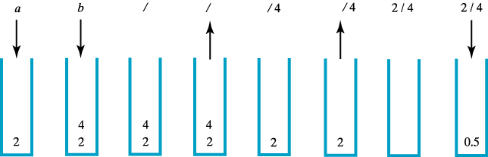
Evaluating Postfix Expression
The stack during the evaluation of the postfix expression a b / when a is 2 and b is 4

Slide 32
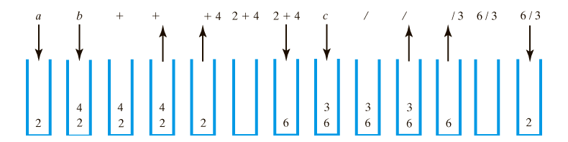
Evaluating Postfix Expression
The stack during the evaluation of the postfix expression
a b + c / when a is 2, b is 4 and c is 3

Slide 33
Evaluating Postfix Expression
Algorithm evaluatePostfix(postfix) // Evaluates a postfix expression.
valueStack = a new empty stack
while (postfix has characters left to parse)
{ nextCharacter = next nonblank character of postfix
switch (nextCharacter)
{ case variable:
valueStack.push(value of the variable nextCharacter)
break
case '+': case '-': case '*': case '/': case '^':
operandTwo = valueStack.pop()
operandOne = valueStack.pop()
result = the result of the operation in nextCharacter and its operands
operandOne and operandTwo
valueStack.push(result)
break
default: break
}
}
return valueStack.peek()

Slide 34
Exercises
Evaluate the following postfix expression. Assume that a=2, b=3, c=4, d=5, and e=6
ae+bd-/
abc*d*-
abc-/d*
ebca^*+d-

Slide 35
Answers
-4
-58
-10
49

Slide 36
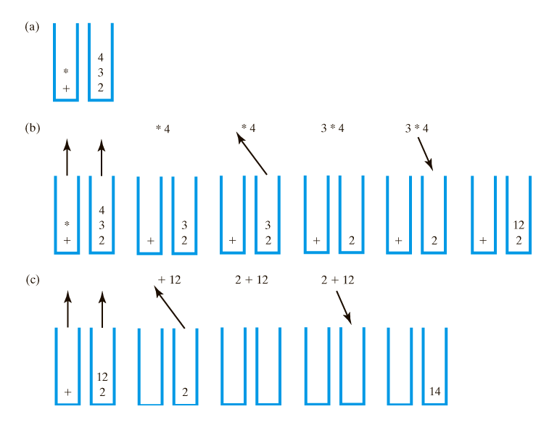
Evaluating Infix Expressions
Two stacks during evaluation of a + b * c when
a = 2, b = 3, c = 4; (a) after reaching end of expression;
(b) while performing multiplication;
(c) while performing the addition

Slide 37
The Program Stack
When a method is called
  Runtime environment creates activation record
  Shows method's state during execution
Activation record pushed onto the program stack (Java stack)
  Top of stack belongs to currently executing method
  Next method down is the one that called current method

Slide 38
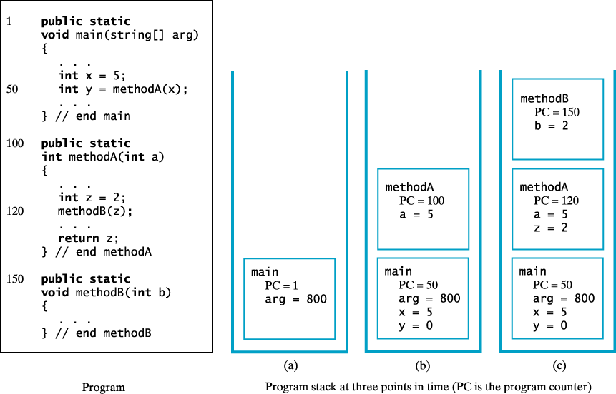
The Program Stack
The program stack at 3 points in time; (a) when main begins execution; (b) when methodA begins execution, (c) when methodB begins execution.

Slide 39
Recursive Methods
A recursive method making many recursive calls
  Places many activation records in the program stack
  Thus the reason recursive methods can use much memory

Slide 40
Java Class Library: The Class Stack
Methods in class Stack in java.util
public Object push(Object item);
public Object pop();
public Object peek();
public boolean empty();
public int search(Object desiredItem);
public Iterator iterator();
public ListIterator listIterator();
Note differences in StackInterface from this chapter.

