Slide 1

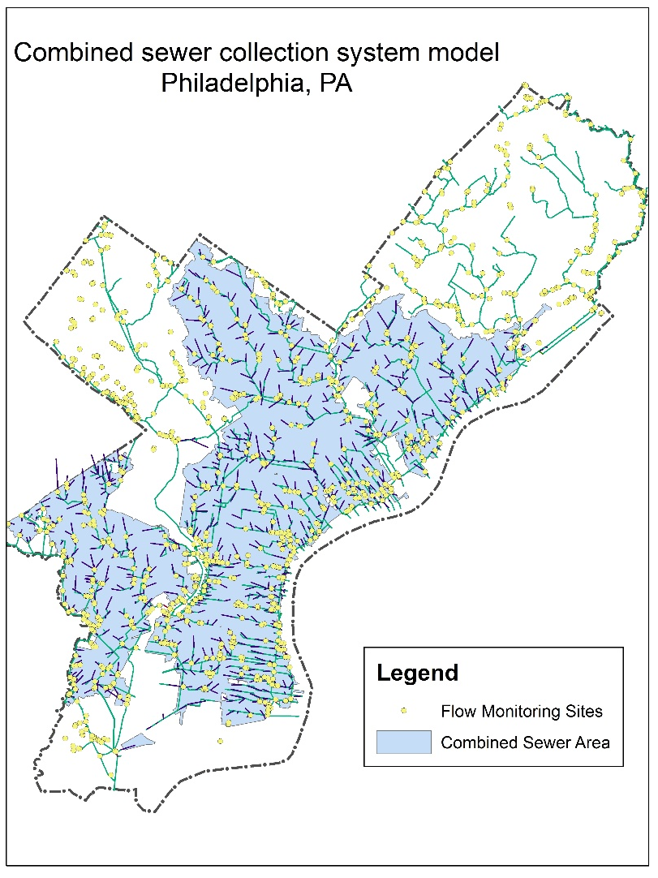
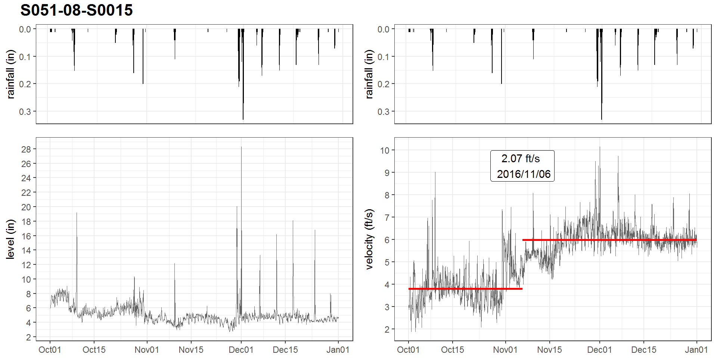
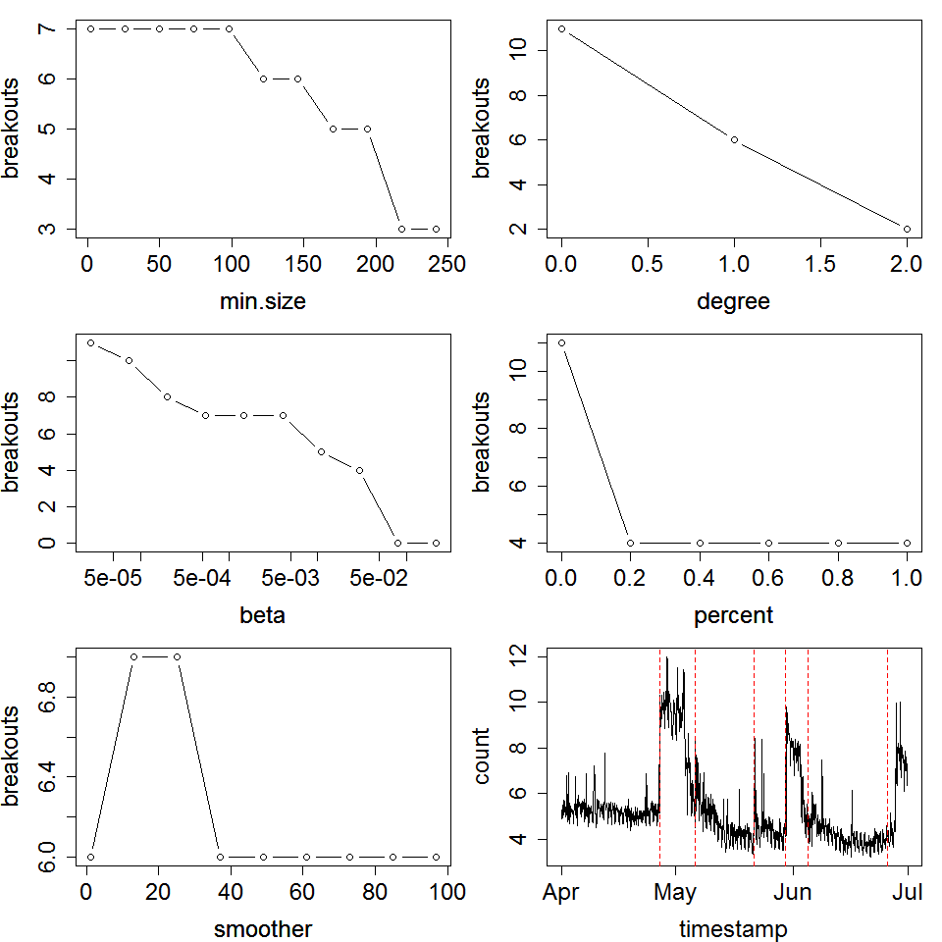
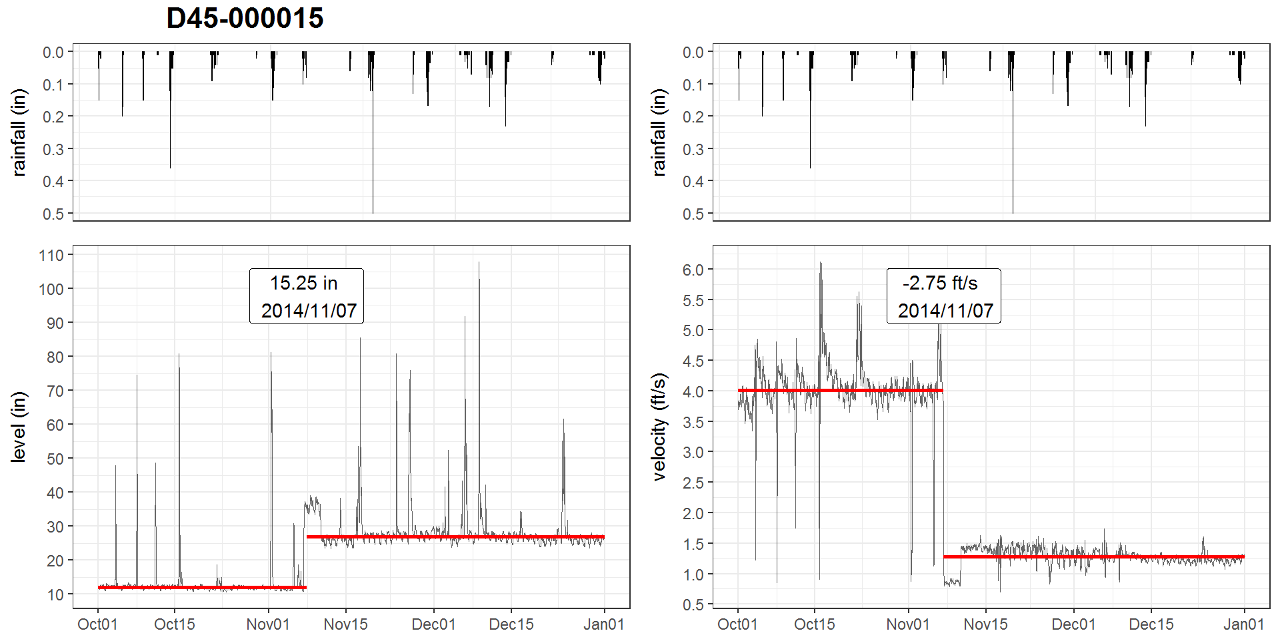
Breaking Bad: Robust Breakout Detection Based on E-Divisive with Medians (EDM) for Modeling Data Quality Control
Hao Zhang, Ph.D., Philadelphia Water Department, Philadelphia, PA, USA
INTRODUCTION
results
Example: Ramping
Example: Mean shift (up, down)
The Philadelphia Water Department (PWD) maintains hydrologic and hydraulic (H&H) models of the combined sewer collection system for planning, management and compliance purposes
For model calibration/validation, sewerage level and velocity at over 400 manholes have been monitored since the 2000s, with a monitoring period of at least one year
A stringent Quality Control (QC) protocol is conducted before the data can be used for Hydrologic & Hydraulic modeling tasks
Due to the high solid content in sewage, monitored data may suffered from breakouts caused by
sensor ragging, clogging
pipe surcharging, etc.
Visual detection of breakouts may not be feasible as some breakouts are not obvious. Thus, a programmatic approach that can automatically detect breakouts is imperative for modeling data quality control. Also, field crew (monitoring, Operation & Maintenance, etc.) can be notified for quickly responding to the issue
The EDM algorithm is implemented by the BreakoutDetection, which is an open-source R package developed by Twitter Engineers and has been used for analyzing cloud data on a daily basis at Twitter Inc.
breakout() : the detector function, contains several non-trivial argument:
Z: The input time series. In this study, quarterly time-series at 1 hour interval are used
min.size: The minimum number of observations between change points. In this study, min.size = 120, i.e., 5 days (5 x 24 = 120)
method: 'amoc' (At Most One Change) or 'multi' (Multiple Changes). In this study, method = ‘multi’
degree: The degree of the penalization polynomial; can be 0, 1, or 2. In this study, degree = 1
beta: the default form of penalization, In this study, beta = 0.008 for velocity, 0.002 for level.
The values of argument are determined through a series of trials with the assistance of elbow plots:
Implementation:
Breakouts are detected by the breakout() function in the BreakoutDetection package in R
A custom function to plot breakouts with time-series is developed using the ggplot2 package
A R markdown template is created for generating quarterly reports
objectives
Overall, monitored data quality determines the model quality. This study aims to develop a workflow as a quality control (QC) measure for detecting various types of breakouts in flow monitoring data by utilizing a sound breakout detection algorithm.
First, select a breakout detection algorithm that is:
able to detect various types of change (mean shift, ramp up, variance change, etc.)
robust against the presence of anomalies (as runoff response tends to be the interference)
able to detect multiple breakouts
not assuming sample distribution (as it is usually unknown a-priori)
fast enough for routine tasks
Next, tune the parameters of the breakout detection algorithm to optimize the outcome
Finally, develop an application using the R statistical programming language to analyze flow monitoring data, and generate quarterly reports. Set up a routine workflow for this process.
conclusions
methods
With properly tuned parameters, the E-divisive with Median (EDM) method can effectively detect multiple breakouts in sewage level and velocity time-series with known anomalies (runoff), and is expected to be applicable for other monitored time-series data.
This application provides Quality Control (QC) to the modeling data, and can be used as an early warning system for field crew.
A novel statistical technique, E-divisive with medians (EDM), is utilized for this study.
As compared to the other algorithms, EDM has the following advantages:
EDM utilizes a local smoother (rolling median) to raw data, and therefore is robust to the presence of anomalies;
EDM employs energy statistics (E-divisive) to detect divergence of means that can detect 'mean shift' (sudden change), 'ramping' (gradual change), and distribution changes at multiple change points. This method is proven to have comparable or better efficacy
EDM is non-parametric, the method will adapt to the data's underlying distribution, and can detect when distribution changes
EDM is 3.5x faster due to the usage of interval trees to approximate median.
REFERENCES
James, Nicholas A., Kejariwal, Arun, and Matteson, David S. 2016.“Leveraging cloud data to mitigate user experience from ‘Breaking Bad’: The Twitter Approach.” 2016 IEEE International Conference on Big Data 3499-3508.
Matteson, David S., and James, Nicholas A. 2014. “A non-parametric approach for multiple change point analysis of multivariate data.” Journal of the American Statistical Association 109(505): 334-345.
Killick, Rebecca, and Eckley, Idris 2014. “changepoint: An R package for changepoint analysis.” Journal of statistical software 58(3): 1-19.

Slide 2
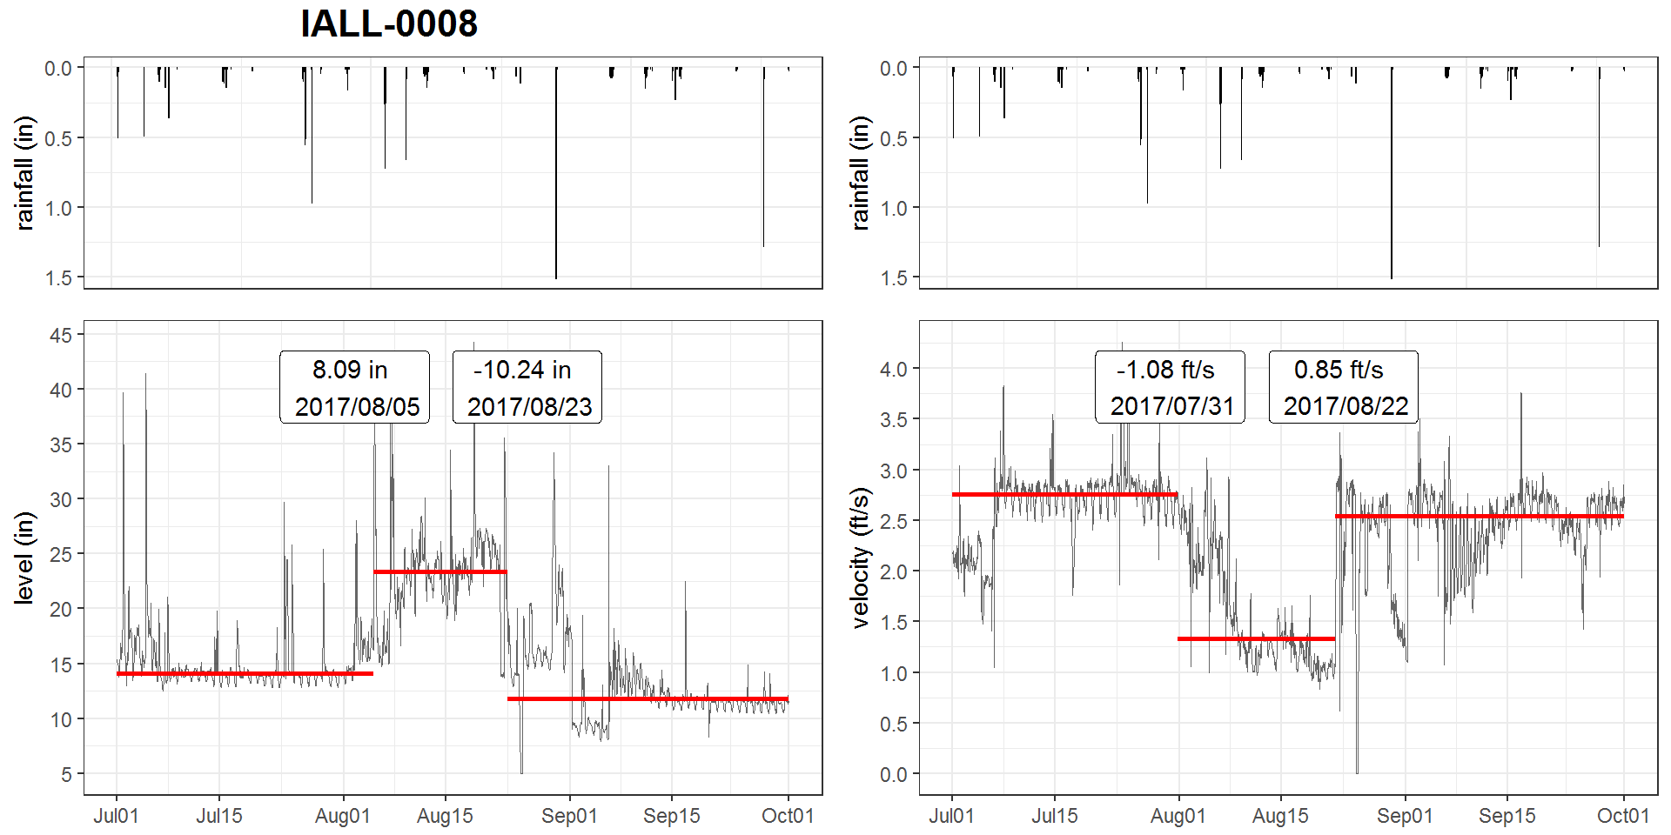
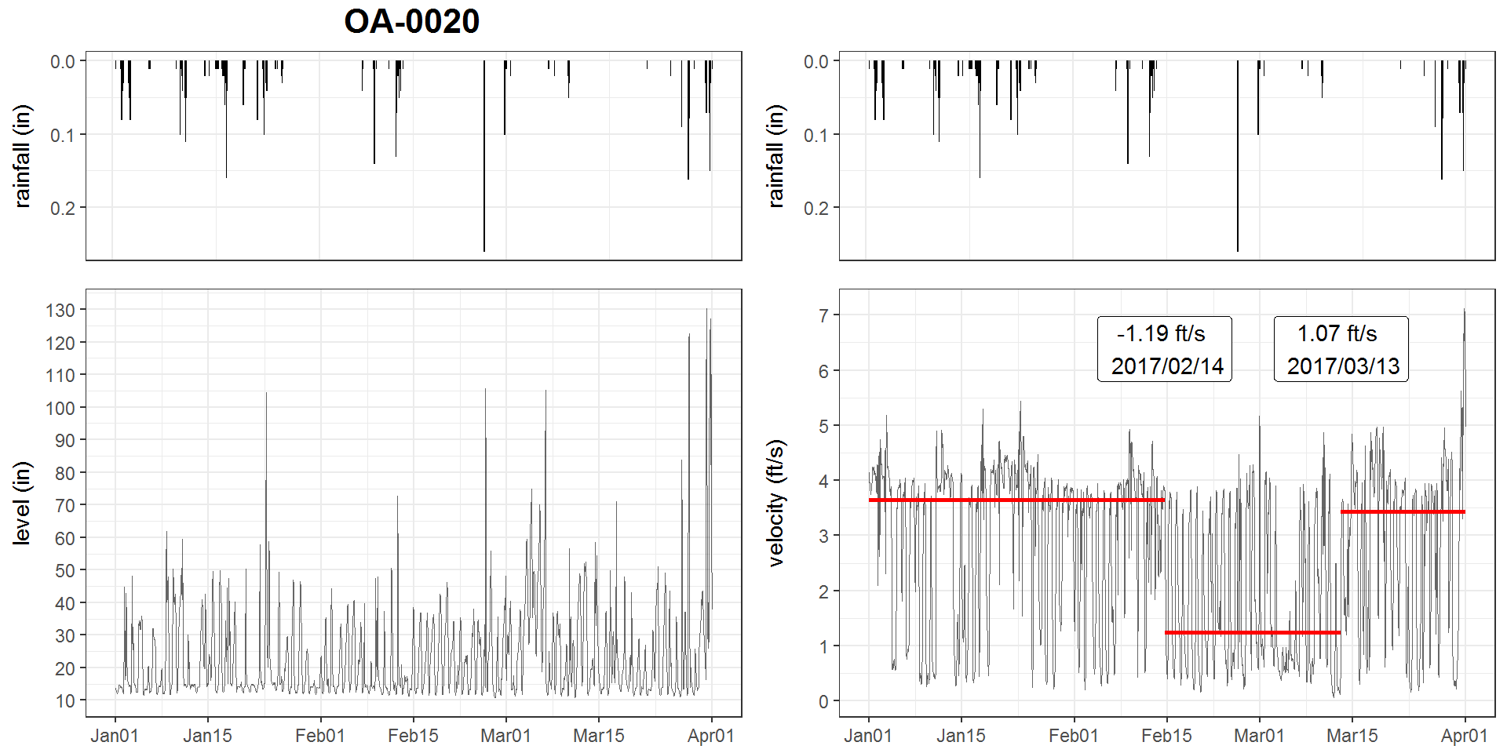
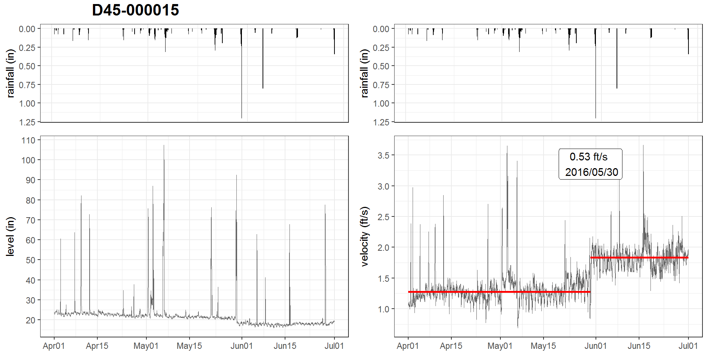
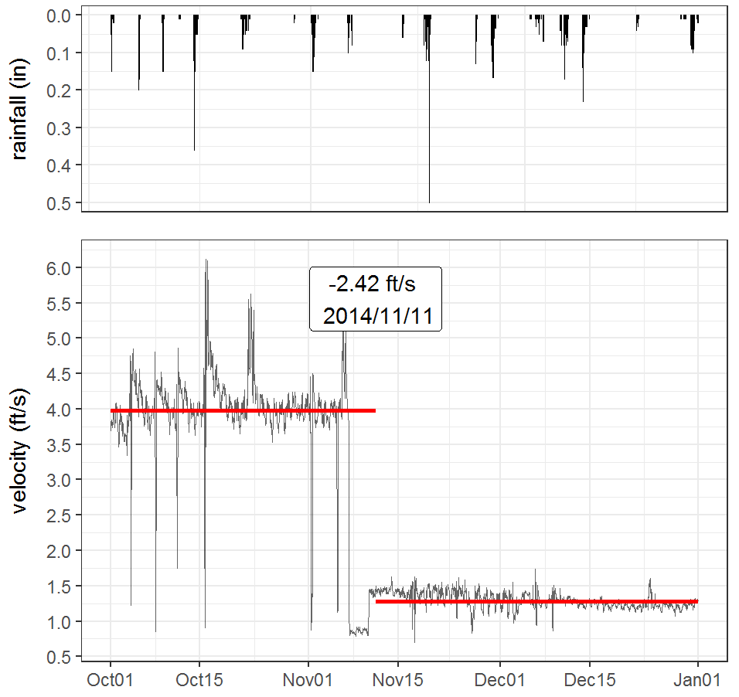
Breaking Bad: Robust Breakout Detection Based on E-Divisive with Medians (EDM) for Modeling Data Quality Control
Hao Zhang, Ph.D., Philadelphia Water Department, Philadelphia, PA, USA
INTRODUCTION
methods
results
PWD maintains hydrologic and hydraulic (H&H) models of the combined sewer collection system for planning, management and compliance purposes
For model calibration/validation purposes, sewerage level and velocity at over 400 manholes have been monitored since the 2000s
A stringent Quality Control (QC) protocol is conducted before the data can be used for Hydrologic & Hydraulic modeling tasks
Due to the high solid content in sewage, monitored data may suffered from breakouts caused by
sensor ragging, clogging
pipe surcharging, etc.
Since a breakout isn’t always obvious due to the range of the observed values, visual detection of breakouts may not be sufficient, and thus a programmatic approach that can automatically detect breakouts is imperative.
Major change point analyses, e.g., PELT, binary segmentation, etc. all have their limitations.
PELT can only detect one change point, and the data distribution must be specified;
E-divisive is computational intensive, and it may take hours to execute
A novel statistical technique, E-divisive with medians (EDM), is utilized for this study. Compared to the other algorithms, EDM has the following advantages:
EDM utilizes a local smoother (rolling median) to raw data, and therefore is robust to the presence of anomalies;
EDM employs energy statistics (E-divisive) to detect divergence of means that can detect 'mean shift' (sudden change), 'ramping' (gradual change), and distribution changes at multiple change points. This method is proven to be comparable or better in efficacy
EDM is non-parametric, the method will adapt to the data's underlying distribution, and therefore can detect when distribution changes;
EDM is 3.5x faster due to the usage of interval trees to approximate median. Since the median is approximated, the breakout location is a roughly estimate.
The BreakoutDetection is an open-source R package that implements the EDM algorithm for detecting breakouts. The package is developed by Twitter Engineers and has been used for analyzing cloud metrices on a daily basis at Twitter.
The breakout() function contains a few non-trivial parameters.
Z: The input time series. This is either a numeric vector or a data frame which has 'timestamp' and 'count' components.
min.size: The minimum number of observations between change points.
method: either 'amoc' (At Most One Change) or 'multi' (Multiple Changes). For 'amoc' at most one change point location will be returned.
For multiple change analysis (method='multi"):
degree: The degree of the penalization polynomial; can be 0, 1, or 2
beta: the default form of penalization
percent: the minimum percent change in the goodness of fit statistic to consider adding an additional change point.
Ramping
Multiple breakouts
pipe-surcharging
Velocity meter clogging
Mean shift (up, down)
Motivation
objectives
results
Measurement Accuracy determines the overall model quality. This study aims to develop a workflow as a quality control (QC) measure for flow monitoring data by utilizing a sound breakout detection algorithm.
First, select a breakout detection algorithm from major breakout detection algorithms that is:
Able to detect various types of change (mean shift, ramp up, variance change, etc.)
robust against the presence of anomalies (as runoff response tends to interfere with the breakout detection)
Able to detect multiple breakouts
no assumption on sample distribution (as it is usually unknown a-priori)
Fast enough for routine tasks
Then, tune the parameters to match the expected outcome
Finally, develop an application using the R statistical programming language to analyze flow monitoring data, and generate quarterly reports. Set up a routine workflow for this process
Model parameters:
Z : hourly averaged data is used for runtime efficiency
min.size = 240: the steady states must be at least 10 days (10 x 24 = 240)
method = 'multi’: multiple breakouts detection is desired
degree=1: set the penalization polynomial to 1 (default)
beta=0.008: determined via elbow plot
percent=0.10: determined via elbow plot
Implementation:
Breakout detection through breakout() from the BreakoutDetection package;
A custom plot showing the breakouts are developed using the ggplot2 package;
The R script is embed into a R markdown template, which generates a quarterly report when rendered.
conclusions
EDM can satisfactorily detect multiple breakouts in the time-series
Parameter selection (min.size, degree, beta, percent) is critical for optimizing the outcome
Velocity measurements tends to show more breakouts
Breakouts at the end of the time series could not be determined
EDM may recognize large runoff response as breakouts

