Slide 1

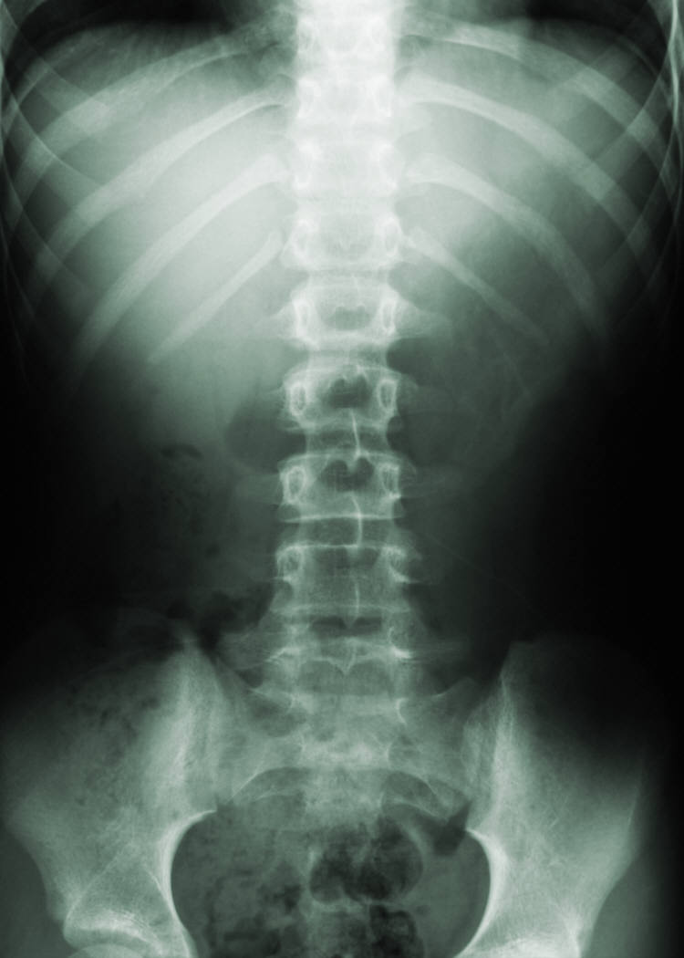


Breaking Bad: robust Breakout detection based on E-Divisive with Medians (EDM) for modeling data quality control
Hao Zhang, Ph.D., Philadelphia Water Department, Philadelphia, PA, USA
abstract
methods
results
The Philadelphia water department (PWD) has been actively monitoring flow data at over 400 sites over Philadelphia since the 2000s. Data are collected twice a month through contractors. Due to the high solid content in sewage, flow data at sewer pipes (level, velocity) suffered from breakouts (mean shift, ramp up) over the time caused by sensor ragging, pipe clogging, etc. A stringent Quality Control (QC) protocol is conducted before the data can be used for Hydrologic & Hydraulic modeling tasks. As one QC measure, the water level and velocity are examined to detect any potential breakout.
Since flow data fluctuates with rainfall-runoff events, the breakout detection algorithm must be robust to avoid the interference of runoff responses. Several breakout detection techniques were compared, and the E-Divisive with Medians (EDM) algorithm is adopted in this study. EDM recursively partitions a time series and uses a permutation test to determine change points, and has the following advantages: 1. EDM uses moving median as opposed to the mean, which is robust to the presence of anomalies; 2. EDM can detect both ‘mean shift’ (sudden change) and ‘ramping’ (gradual change) for multiple change points; 3. EDM takes a non-parametric approach, meaning the model will adapt to the data’s underlying distribution, and can detect when the distribution changes; 4. EDM is fast due to the usage of interval trees that efficiently approximates the median.
The breakout analysis is implemented in a program written in R, where the EDM algorithm is implemented via the ‘breakoutDetection’ package developed by Twitter Inc. engineers. Non-trivial parameters of the EDM model are carefully tuned to best match the expected outcome. This analysis provides an additional assurance to the data quality. Also, field crews (monitoring, Operation & Maintenance, etc.) can quickly respond to the issue once a breakout has been detected. This analysis is also applicable for other monitored data, such as the trunk and outfall levels at drainage system regulators.
BreakoutDetection is an open-source R package that makes breakout detection simple and fast. The underlying algorithm – referred to as E-Divisive with Medians (EDM) – employs energy statistics to detect divergence in mean. Note that EDM can also be used detect change in distribution in a given time series. EDM uses robust statistical metrics, viz., median, and estimates the statistical significance of a breakout through a permutation test.
 | Heading | Heading | Heading
Item | 122 | 233 | 345
Item | 759 | 856 | 290
Item | 228 | 134 | 238
Item | 954 | 875 | 976
Item | 324 | 325 | 301
Item | 199 | 137 | 186
background
Sensor-monitored data may suffer from trend change due to:
sensor drifting
sensor ragging
pipe surcharging, etc.
Type a caption for the data content or pictures here.
objectives
results
conclusions
As a data QA measure, a method to detect potential changes in trend (breakouts) needs to be developed for the level and velocity measurements in sewer pipes.
Since flow data fluctuates with rainfall-runoff events, the algorithm must be robust to avoid the interference of runoff responses
Result 1
Result 2
Result 3
Conclusion 1
Conclusion 2
Conclusion 3

