Slide 1

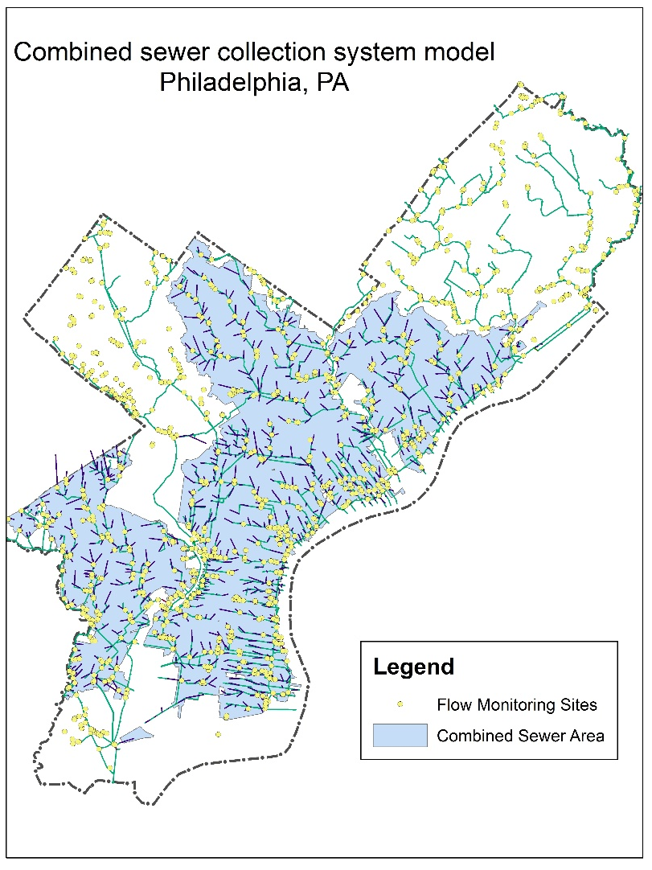
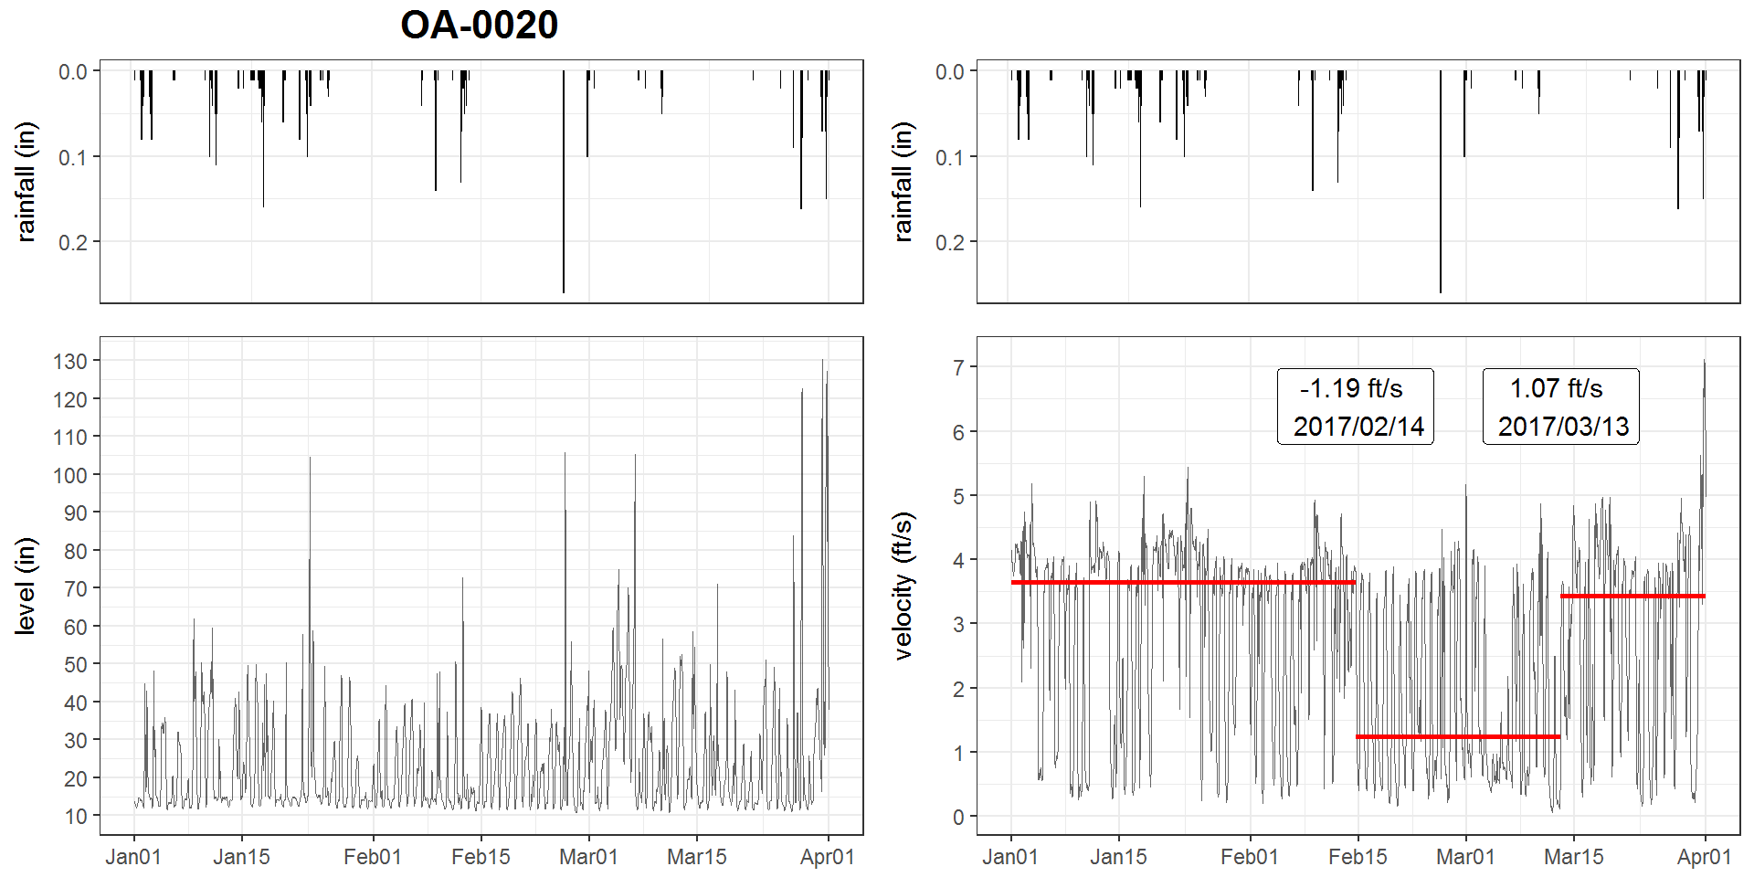
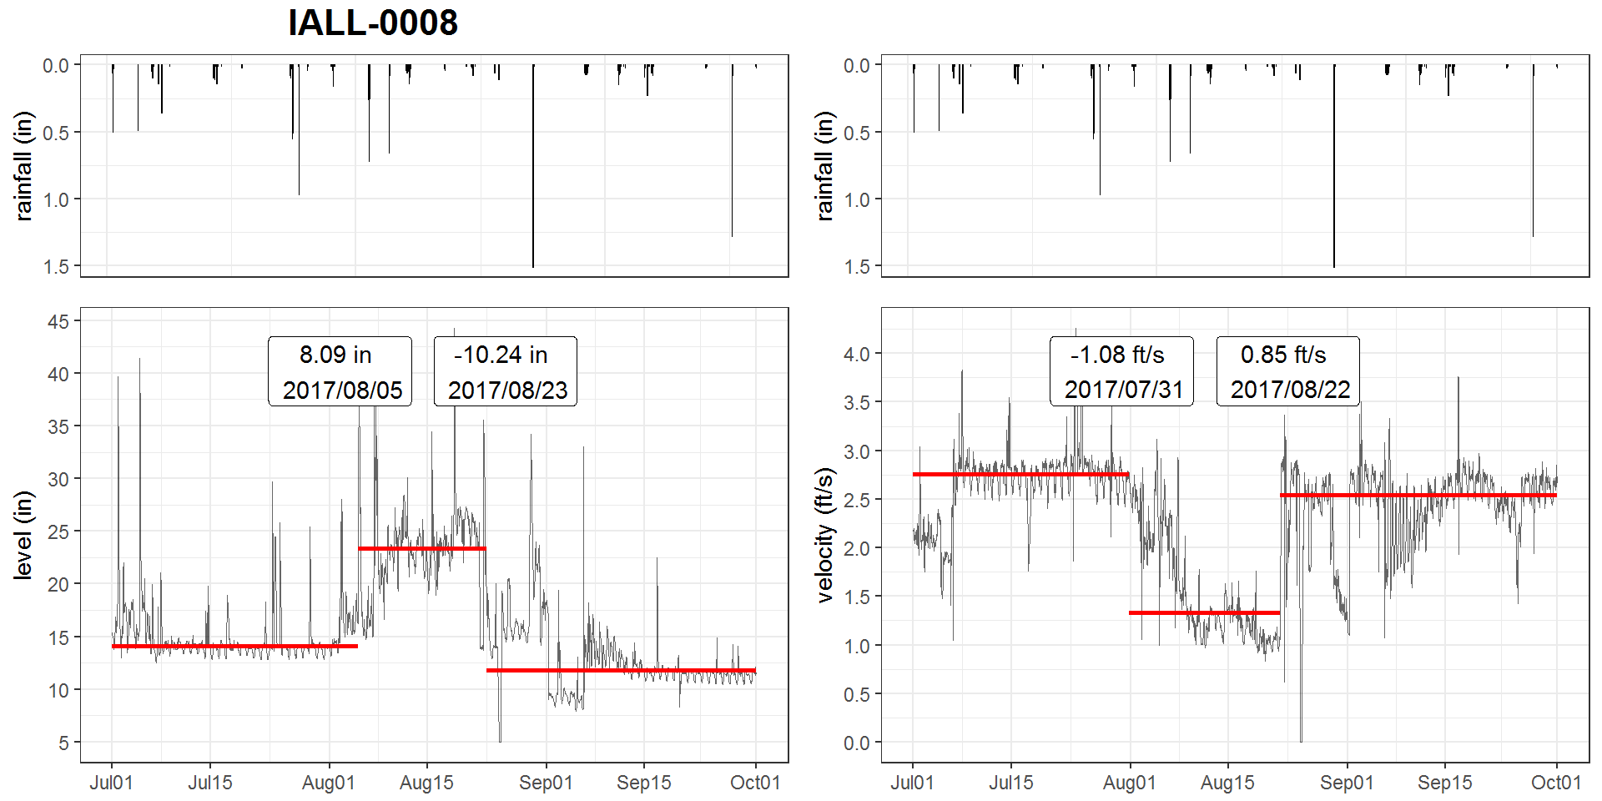
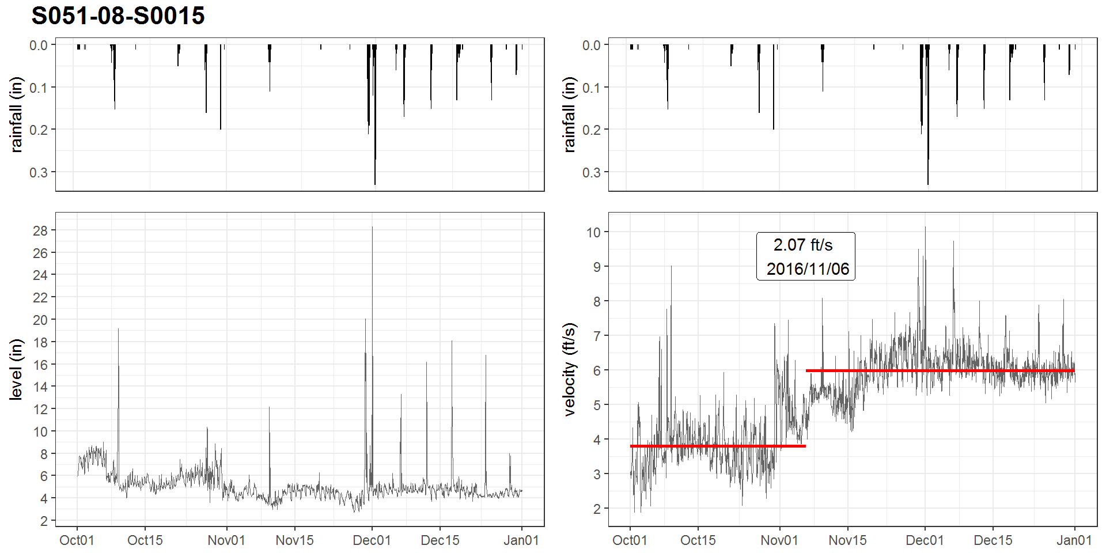
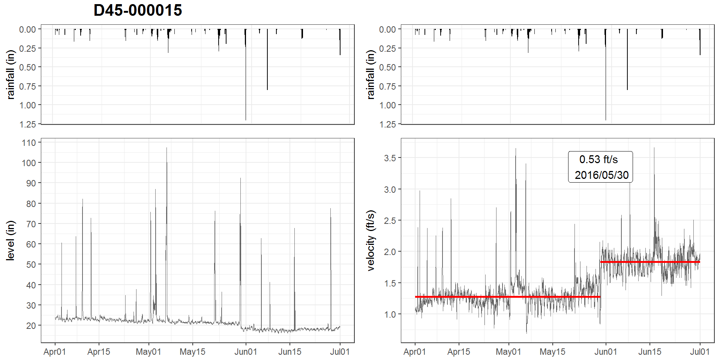
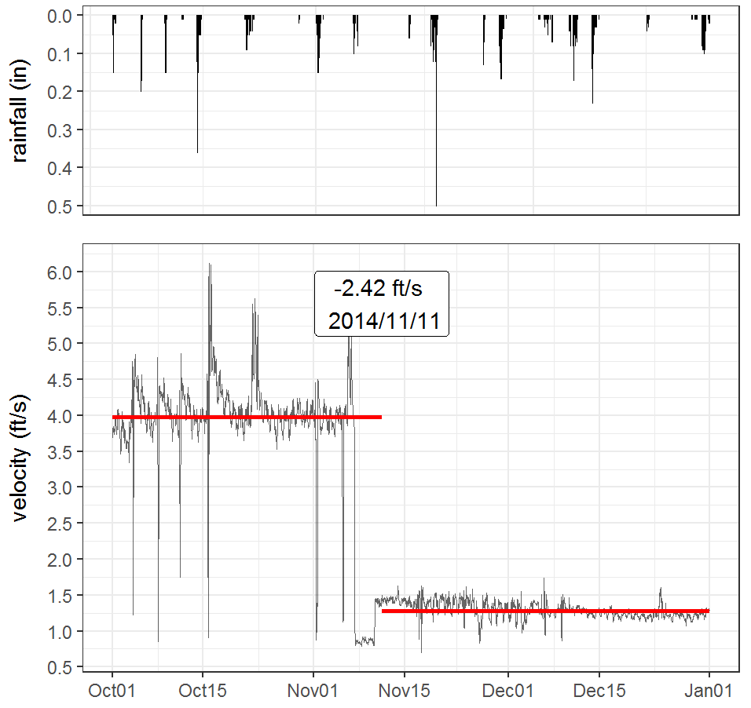
Breaking Bad: Robust Breakout Detection Based on E-Divisive with Medians (EDM) for Modeling Data Quality Control
Hao Zhang, Ph.D., Philadelphia Water Department, Philadelphia, PA, USA
INTRODUCTION
results
Velocity meter clogging
pipe-surcharging
The Philadelphia Water Department (PWD) maintains hydrologic and hydraulic (H&H) models of the combined sewer collection system for planning, management and compliance purposes
For model calibration/validation, sewerage level and velocity at over 400 manholes have been monitored since the 2000s, with a monitoring period of at least one year
A stringent Quality Control (QC) protocol is conducted before the data can be used for Hydrologic & Hydraulic modeling tasks
Due to the high solid content in sewage, monitored data may suffered from breakouts caused by
sensor ragging, clogging
pipe surcharging, etc.
Visual detection of breakouts may not be feasible as some breakouts are not obvious. Thus, a programmatic approach that can automatically detect breakouts is imperative for modeling data quality control. Also, field crews (monitoring, Operation & Maintenance, etc.) can quickly respond to the issue
The EDM algorithm is implemented by the BreakoutDetection, which is an open-source R package developed by Twitter Engineers and has been used for analyzing network breakouts on a daily basis at Twitter.
The breakout() function contains several non-trivial parameters:
Z: The input time series. In this study, the hourly averaged data is used for efficiency
min.size: The minimum number of observations between change points. E.g., in this study, it is set to 240, i.e., the steady state must be at least 10 days (10 x 24 = 240)
method: 'amoc' (At Most One Change) or 'multi' (Multiple Changes). In this study, ‘multi’ is chosen as multiple breakouts are desired
degree: The degree of the penalization polynomial; can be 0, 1, or 2. In this study, degree = 1
beta: the default form of penalization, In this study, 0.008 is determined via elbow plot
percent: the minimum percent change in the goodness of fit statistic to consider adding an additional change point. In this study, 0.10 (10%) is used
Implementation:
Breakouts are detected by the breakout() function in the BreakoutDetection package in R
A custom function to plot breakouts with time-series is developed using the ggplot2 package
A R markdown template is created for generating quarterly reports
Ramping
Mean shift (up, down)
objectives
Overall, monitored data quality determines the model quality. This study aims to develop a workflow as a quality control (QC) measure for detecting various types of breakouts in flow monitoring data by utilizing a sound breakout detection algorithm.
First, select a breakout detection algorithm that is:
able to detect various types of change (mean shift, ramp up, variance change, etc.)
robust against the presence of anomalies (as runoff response tends to be the interference)
able to detect multiple breakouts
not assuming sample distribution (as it is usually unknown a-priori)
fast enough for routine tasks
Next, tune the parameters of the breakout detection algorithm to optimize the outcome
Finally, develop an application using the R statistical programming language to analyze flow monitoring data, and generate quarterly reports. Set up a routine workflow for this process.
conclusions
EDM can effectively detect multiple breakouts in monitored time-series with the presence of anomalies (runoff response)
Velocity measurements tends to show more breakouts than level measurements
EDM has a few limitations:
Breakouts at both ends of the time series could not be identified
large runoff response may be recognized as breakouts
methods
A novel statistical technique, E-divisive with medians (EDM), is utilized for this study.
As compared to the other algorithms, EDM has the following advantages:
EDM utilizes a local smoother (rolling median) to raw data, and therefore is robust to the presence of anomalies;
EDM employs energy statistics (E-divisive) to detect divergence of means that can detect 'mean shift' (sudden change), 'ramping' (gradual change), and distribution changes at multiple change points. This method is proven to have comparable or better efficacy
EDM is non-parametric, the method will adapt to the data's underlying distribution, and can detect when distribution changes
EDM is 3.5x faster due to the usage of interval trees to approximate median. Since the median is approximated, the breakout location may be not exact.
REFERENCES
James, Nicholas A., Arun Kejariwal, and David S. Matteson. "Leveraging cloud data to mitigate user experience from ‘Breaking Bad’." In Big Data (Big Data), 2016 IEEE International Conference on, pp. 3499-3508. IEEE, 2016.
Matteson, David S., and James, Nicholas A. "A nonparametric approach for multiple change point analysis of multivariate data." Journal of the American Statistical Association 109, no. 505 (2014): 334-345.
Rebecca Killick, Paul Fearnhead, and IA Eckley. "Optimal detection of changepoints with a linear computational cost." Journal of the American Statistical Association, 107(500):1590–1598, 2012
Rodionov, S. N. "A brief overview of the regime shift detection methods." Large-scale disturbances (regime shifts) and recovery in aquatic ecosystems: challenges for management toward sustainability (2005): 17-24.
Pohlert, Thorsten. "Non-parametric trend tests and change-point detection." CC BY-ND 4 (2018).

Slide 2
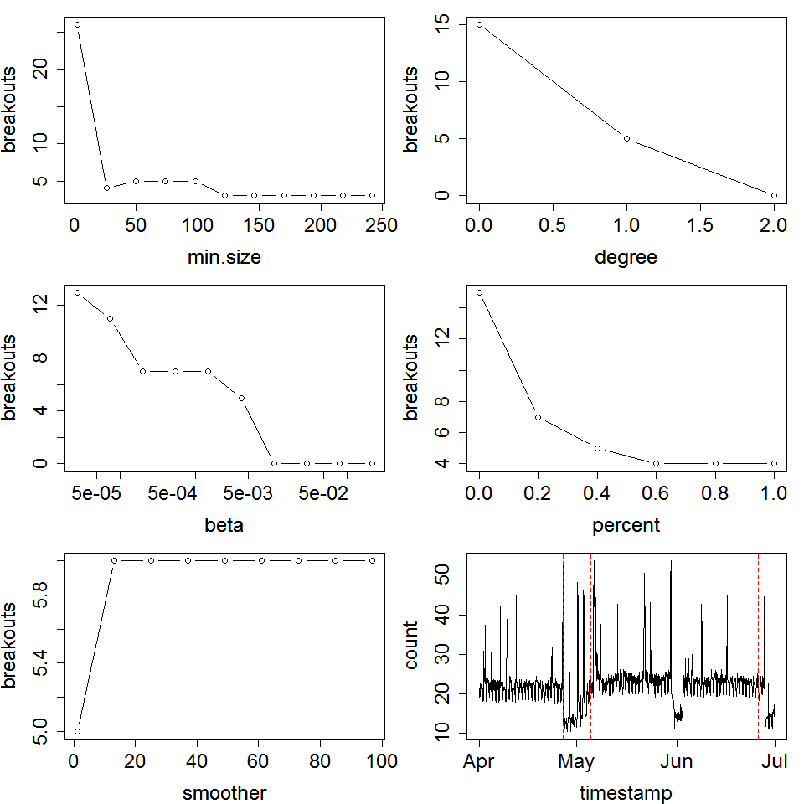
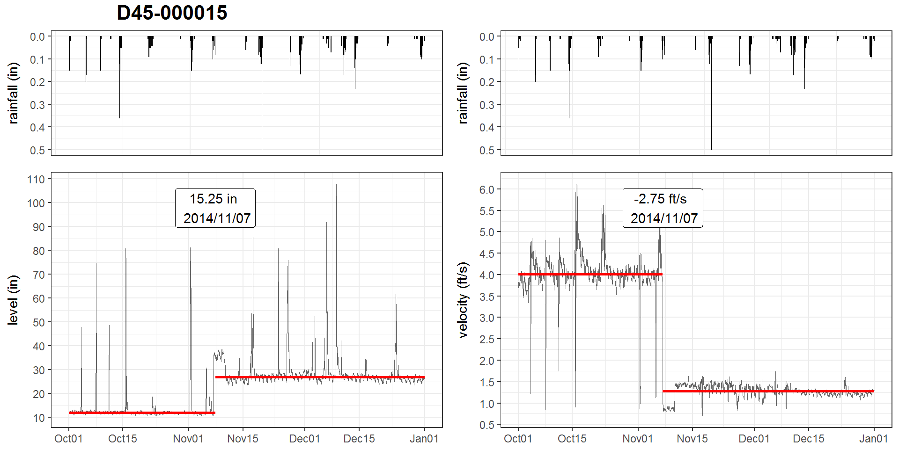
Breaking Bad: Robust Breakout Detection Based on E-Divisive with Medians (EDM) for Modeling Data Quality Control
Hao Zhang, Ph.D., Philadelphia Water Department, Philadelphia, PA, USA
INTRODUCTION
results
Example: Ramp (up, down)
Example: Mean shift
The Philadelphia Water Department (PWD) maintains hydrologic and hydraulic (H&H) models of the combined sewer collection system for planning, management and compliance purposes
For model calibration/validation, sewerage level and velocity at over 400 manholes have been monitored since the 2000s, with a monitoring period of at least one year
A stringent Quality Control (QC) protocol is conducted before the data can be used for H&H modeling tasks
Due to the high solid content in sewage, monitored data may suffered from breakouts caused by
ragging, clogging
surcharging, etc.
Visual breakout detection may not be feasible as some breakouts are not obvious. Thus, a programmatic approach that can automatically detect breakouts is imperative for modeling data quality control.
Also, field crew (monitoring, Operation & Maintenance, etc.) can be notified for quickly responding to field issues
The EDM algorithm is implemented by BreakoutDetection, an open-source R package developed by Twitter Engineers, which has been used for analyzing cloud data on a daily basis at Twitter
breakout(): the detector function, includes several non-trivial argument:
Z: The input time series. In this study, Z = quarterly time-series @ 1 hour interval
min.size: The minimum number of observations between change points. In this study, min.size = 120, i.e., 5 days (5 x 24 = 120)
method: 'amoc' (At Most One Change) or 'multi' (Multiple Changes). In this study, method = ‘multi’
degree: The degree (0, 1, or 2) of the penalization polynomial. In this study, degree = 1
beta: the default form of penalization. In this study, beta = 0.008 for velocity, 0.002 for level
The values of argument are determined through a series of trials with the assistance of elbow plots:
Implementation:
Breakouts are detected by the breakout() function in the BreakoutDetection package in R
A custom function to plot breakouts with time-series is developed using the ggplot2 package
A R markdown template is created for generating quarterly reports
The report is updated bi-weekly when new data becomes available
objectives
Monitored data quality determines model quality. This study aims to develop a workflow as a quality control (QC) measure for detecting various types of breakouts in flow monitoring data by utilizing a sound breakout detection algorithm.
First, select a breakout detection algorithm that is:
able to detect various types of change (mean shift, ramp up/down, variance change, etc.)
robust against the presence of anomalies (as the runoff component tends to be the interference)
able to detect multiple breakouts in a time-series
not rely on sample distribution (as it is usually unknown a-priori)
fast enough for routine tasks
Next, tune the argument of selected breakout detection algorithm to optimize the outcome
Finally, develop an application using the R statistical programming language to analyze flow monitoring data, and generate quarterly reports. Set up a routine workflow for this process.
conclusions
methods
With properly tuned argument, the E-divisive with Median (EDM) method can effectively detect multiple breakouts in sewage level and velocity time-series with known anomalies (runoff), and is expected to be applicable for other monitored time-series data.
This application provides Quality Control (QC) to the modeling data, and can be used as an early warning system for field issues.
A novel statistical technique, E-divisive with medians (EDM), is utilized for this study.
As compared to the other algorithms, EDM has the following advantages:
EDM utilizes a local smoother (rolling median) to raw data, and therefore is robust against the presence of anomalies;
EDM employs energy statistics (E-divisive) to detect divergence of means that can detect 'mean shift' (sudden change), 'ramping' (gradual change), and distribution changes at multiple change points.
EDM is non-parametric, which will adapt to the data's underlying distribution, and can detect when the distribution changes
EDM is proven to have comparable or better efficacy, and it is 3.5x faster due to the usage of interval trees to approximate median.
REFERENCES
James, Nicholas A., Kejariwal, Arun, and Matteson, David S. 2016.“Leveraging cloud data to mitigate user experience from ‘Breaking Bad’: The Twitter Approach.” 2016 IEEE International Conference on Big Data 3499-3508.
Matteson, David S., and James, Nicholas A. 2014. “A non-parametric approach for multiple change point analysis of multivariate data.” Journal of the American Statistical Association 109(505): 334-345.

