Slide 1
EASY Local development
with
Elastic Cloud on Kubernetes
using Skaffold
Joe Zack
Coding Blocks

Slide 2
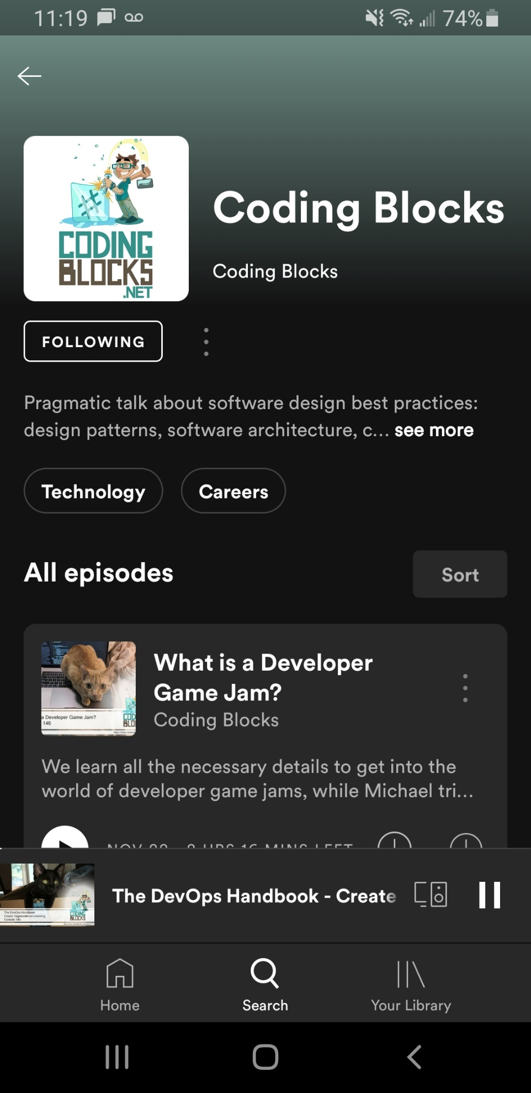

Notes:
I’m Joe Zack,
I have a podcast with a couple friends where we talk about stuff we like, like Code, and DevOps, and Elastic Stack

Slide 3
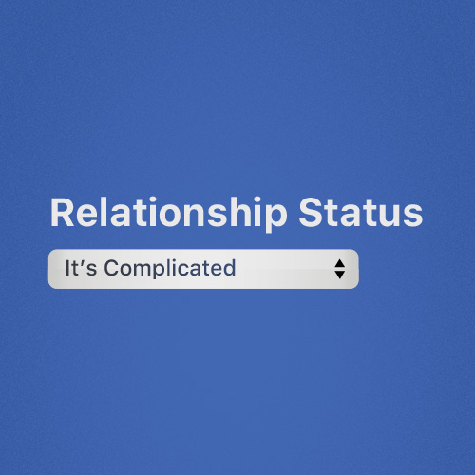
DO you have a local Dev
Environment That mirrors
production?
Notes:
Point: Local Development is important:
Similarity means less errors, easier to reproduce problems or experiment
Mutate your environment without breaking anybody else
Why Kubernetes?
You can explorer different versions of your environment
You can find problems sooner
Your devs can get more experience with a production-like environment?

Slide 4
It’s complicated
Notes:
Development environments should be as similar to production, as is reasonable. Kubernetes can give you that, bu
The problem
Kubernetes is difficult, and complicated
Docker/Compose came along and made it easier to dynamically create, and destroy, and modify environments
That’s good for local dev

Slide 5
It doesn’t
Have to be
Notes:
Here is what I want to show you tonight:
You can have a modular Elastic Stack environment that is easy to create and maintain locally, and in production, on Kubernetes with the ECK

Slide 6
