Slide 1
EASY Local development
with
Elastic Cloud on Kubernetes
using Skaffold
Joe Zack
Coding Blocks
Notes:
Elastic, Kubernetes, are Important – and strong dev environment is important
Building a local development environment for the Elastic Stack that will be easy to work with.
Everything you need to run this environment is up on Github, there is a link in the description. Of course, I tried to make it as easy as possible to get started. I tried to be really careful when I did this, because sometimes presentations or videos or blogs will boil something down to it's simplest components to make a tidy prototype but that prototype is kind of an illusion. As soon as you try to make any changes, the whole thing falls apart because the prototype was designed to be demonstratable, not for real-life.
I want this demonstration to be the opposite of that. I want to give you something you can take and make your own. Now, we will be using on a couple big technologies and you don't need to know much about them, but if you are serious about taking this infrastructure to production then you're going to need to learn more about tools like Kubernetes, and Helm, and Skaffold. Because this demonstration is not a product, it's a good foundation.

Slide 2
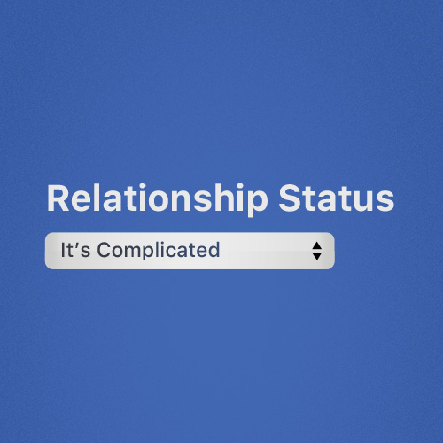
DO you have a local Dev
Environment That mirrors
production?
Notes:
Point: Local Development is important:
Fast iteration
Similarity means less errors, easier to reproduce problems or experiment
Mutate your environment without breaking anybody else
Why Kubernetes?
You can explorer different versions of your environment
You can find problems sooner
Your devs can get more experience with a production-like environment?

Slide 3
It’s complicated
Notes:
Development environments should be as similar to production, as is reasonable. Kubernetes can give you that, but…Kubernetes

Slide 4
It doesn’t
Have to be
Notes:
Here is what I want to show you tonight:
You can have a modular Elastic Stack environment that is easy to create and maintain locally, and in production, on Kubernetes with the ECK
The problem
Kubernetes is difficult, and complicated
Docker/Compose came along and made it easier to dynamically create, and destroy, and modify environments
That’s good for local dev

Slide 5
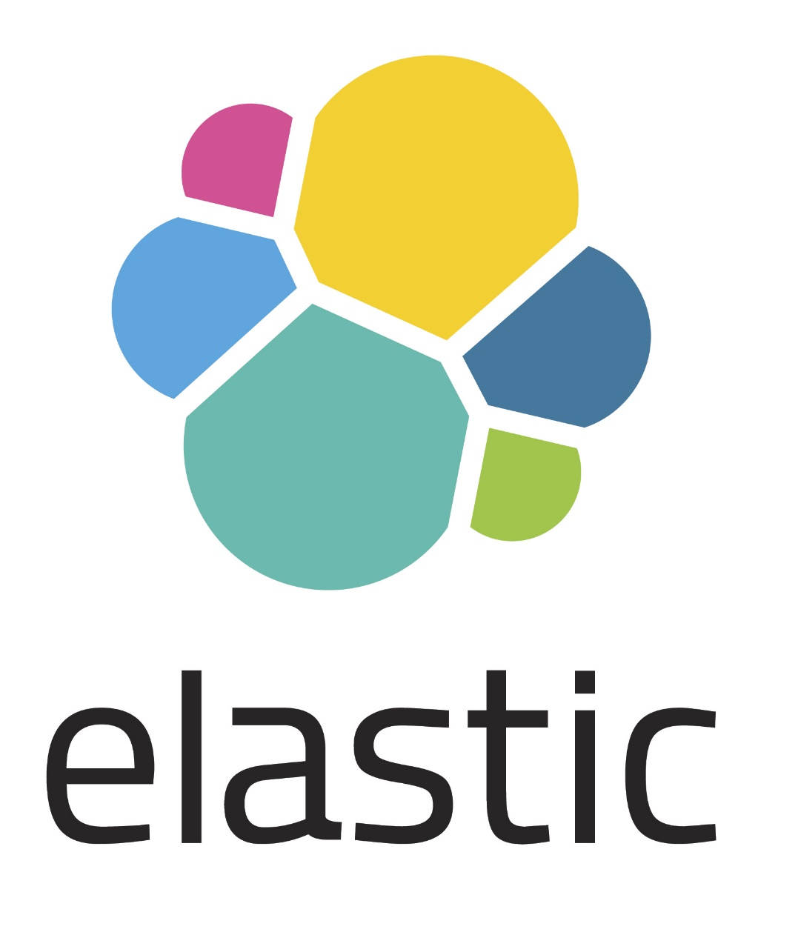
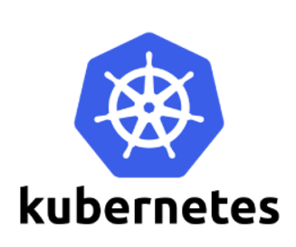


Slide 6
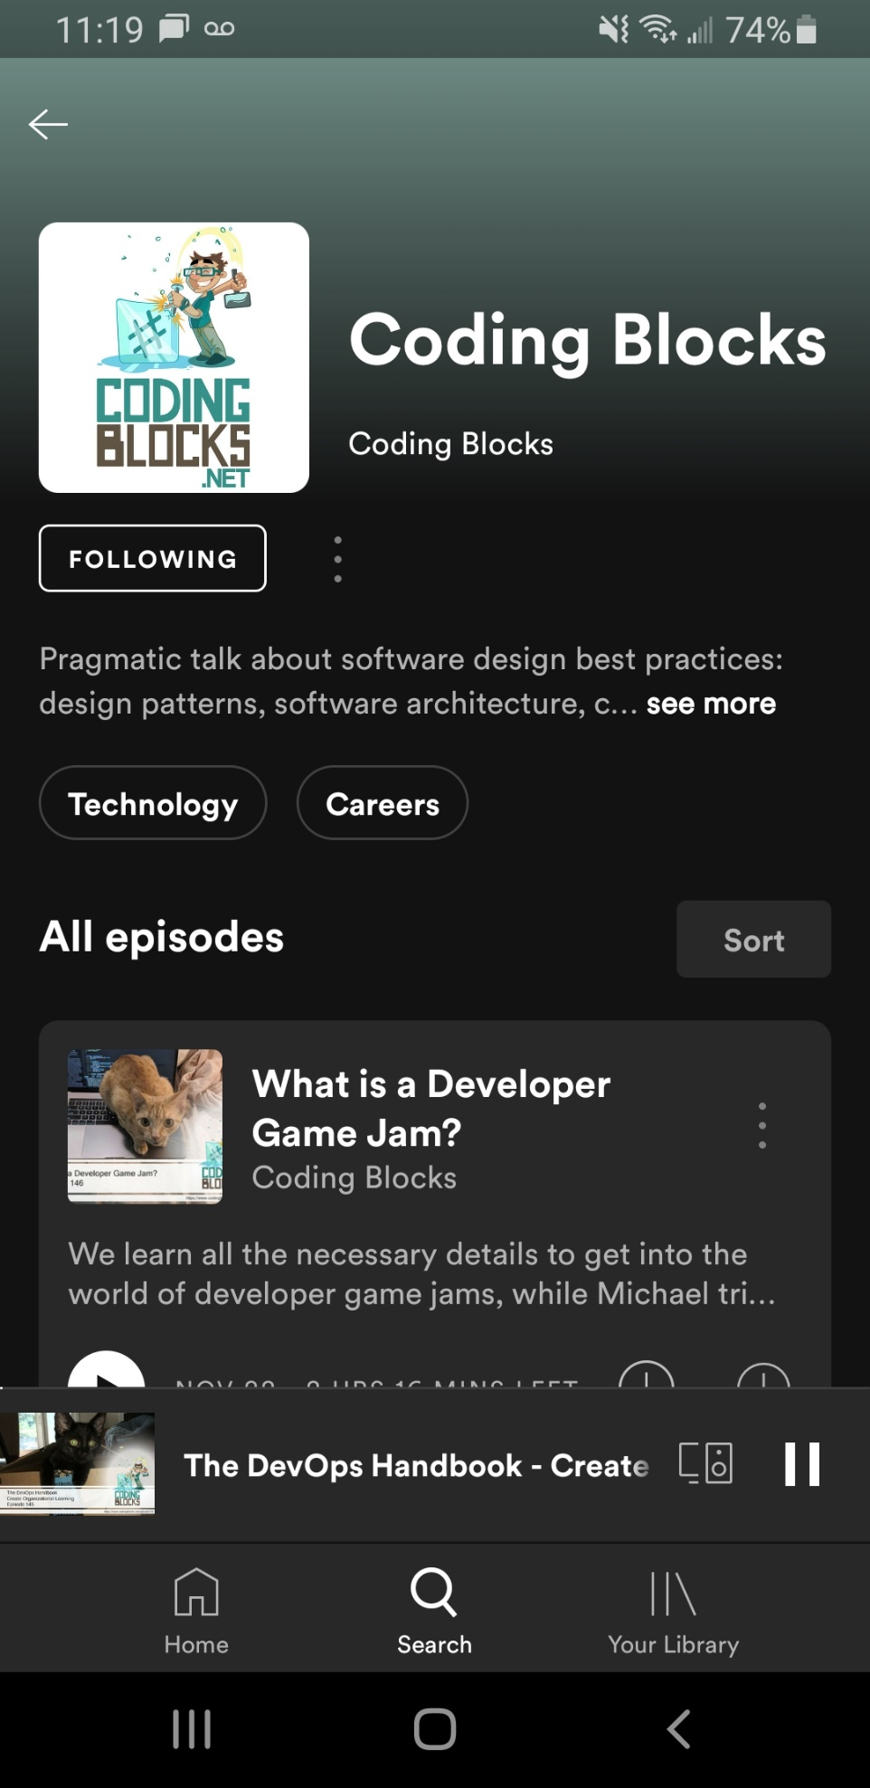

Notes:
I’m Joe Zack,
I have a podcast with a couple friends where we talk about stuff we like, like Code, and DevOps, and Elastic Stack

