Slide 1

AlgoExplorers

Slide 2

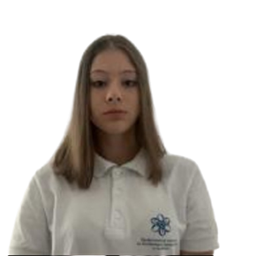


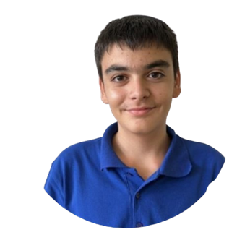
Our team
Yoana Georgieva Back-End Developer
Zarko Vladkov Front-End Developer
Rostislav Nikolov Scrum Trainer

Slide 3

Our idea
Our e-library makes it easy for readers to sort and select books. It gives a variety of options that you can set according to your choice.

Slide 4

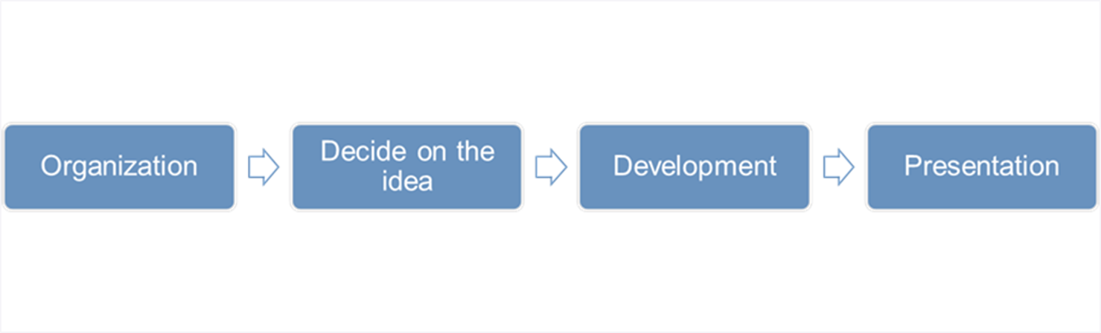
Stages of realization

Slide 5





Technology and Innovation

Slide 6
Thank you for your attention

