Slide 1
CacheOut

Slide 2


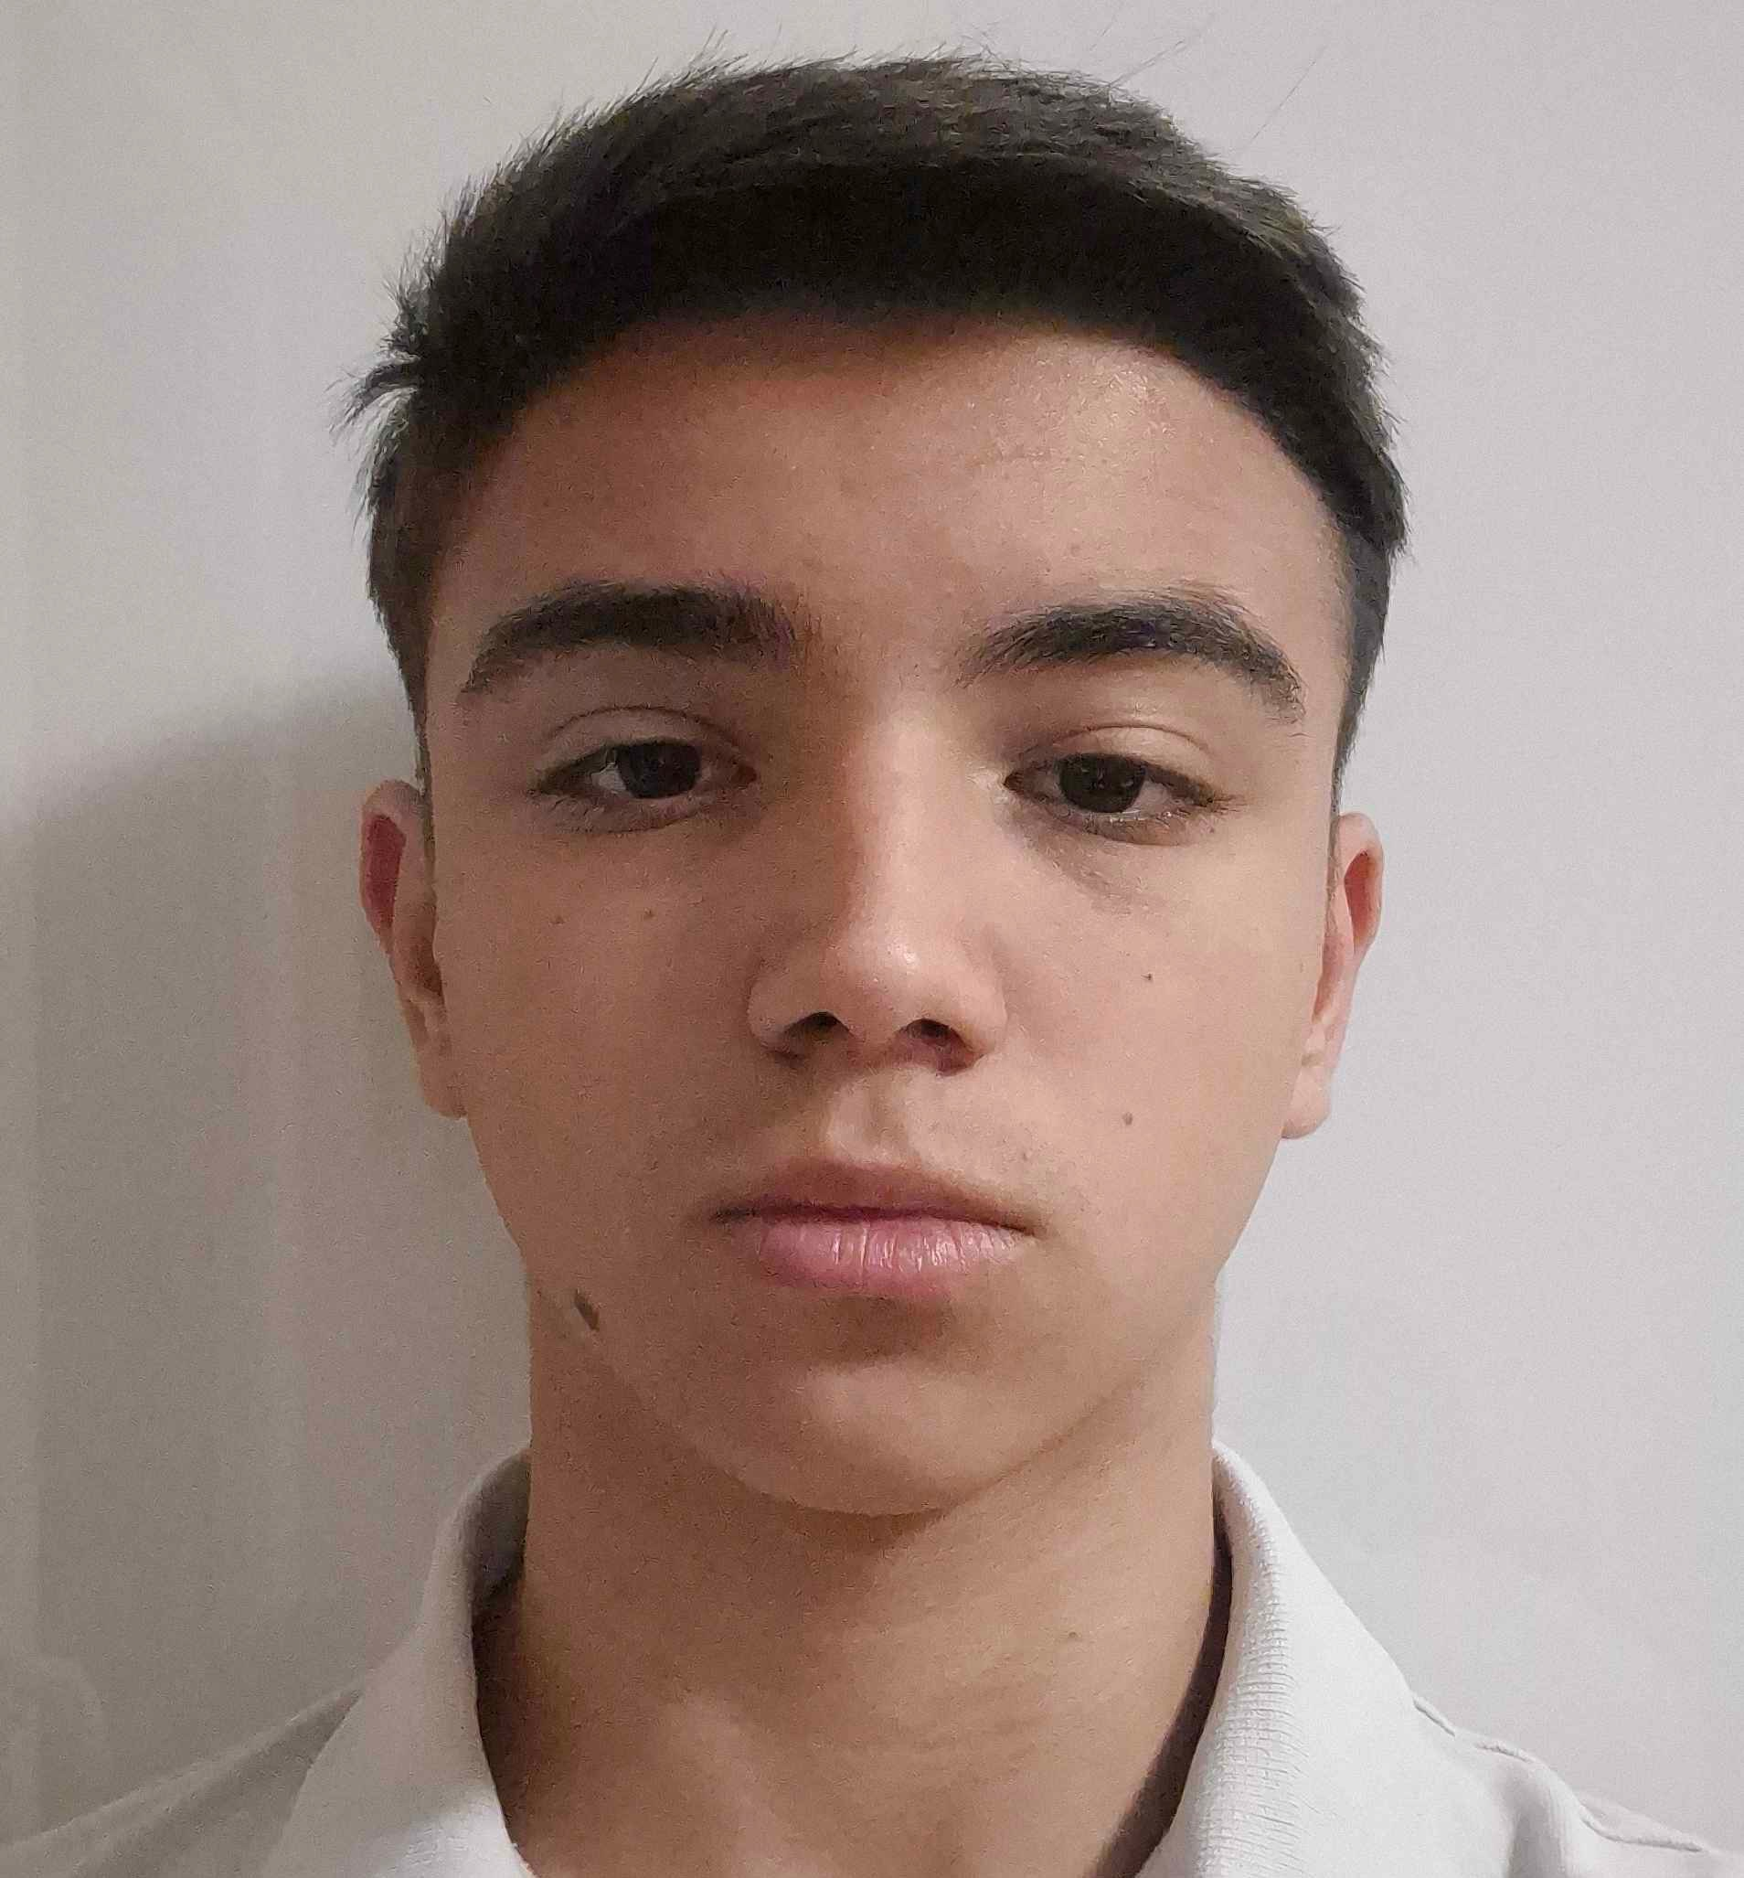
The team
Nikol Stoyanova
Scrum trainer
Natali Ribareva
Developer
Alexandar Georgiev
Developer

Slide 3
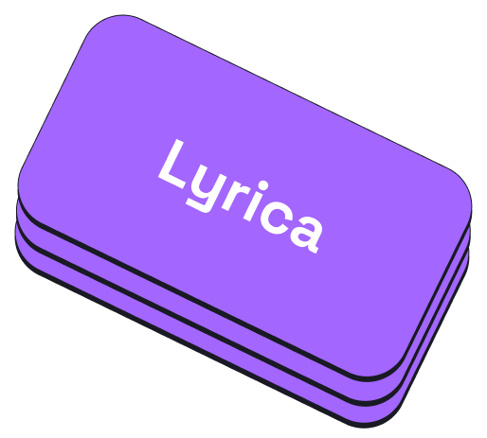
Project’s name
Just like lyrics help us connect to the emotions of a song, Lyrica helps you connect with the words you're learning.

Slide 4
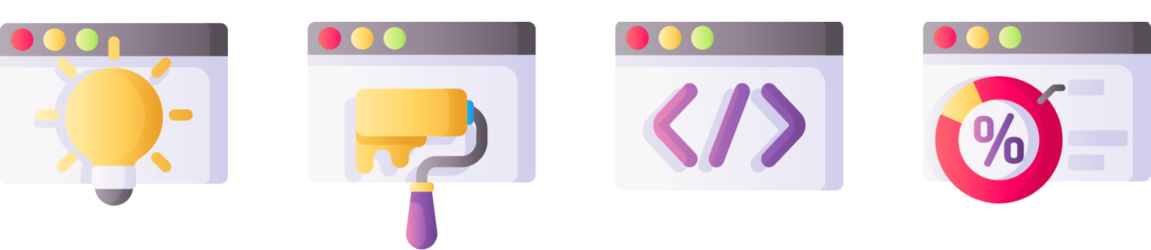
Stages of development

Slide 5
The task
Our task was to create an app to help people learn a language. We chose to focus on vocabulary, as we believe that it is the foundation of language learning and essential for building skills like speaking, reading, and writing.

Slide 6



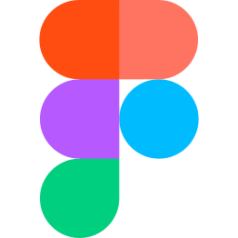

Technologies

Slide 7
Let's dive into the project!​

