Slide 1
CodeCrafters

Slide 2
Table of contents
01
02
03
04
Our team
How we managed our time
Our idea
Tech stack

Slide 3
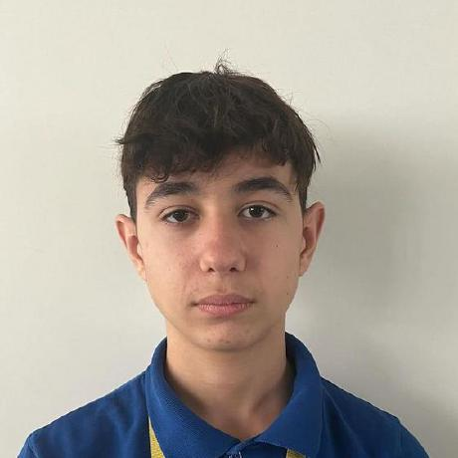
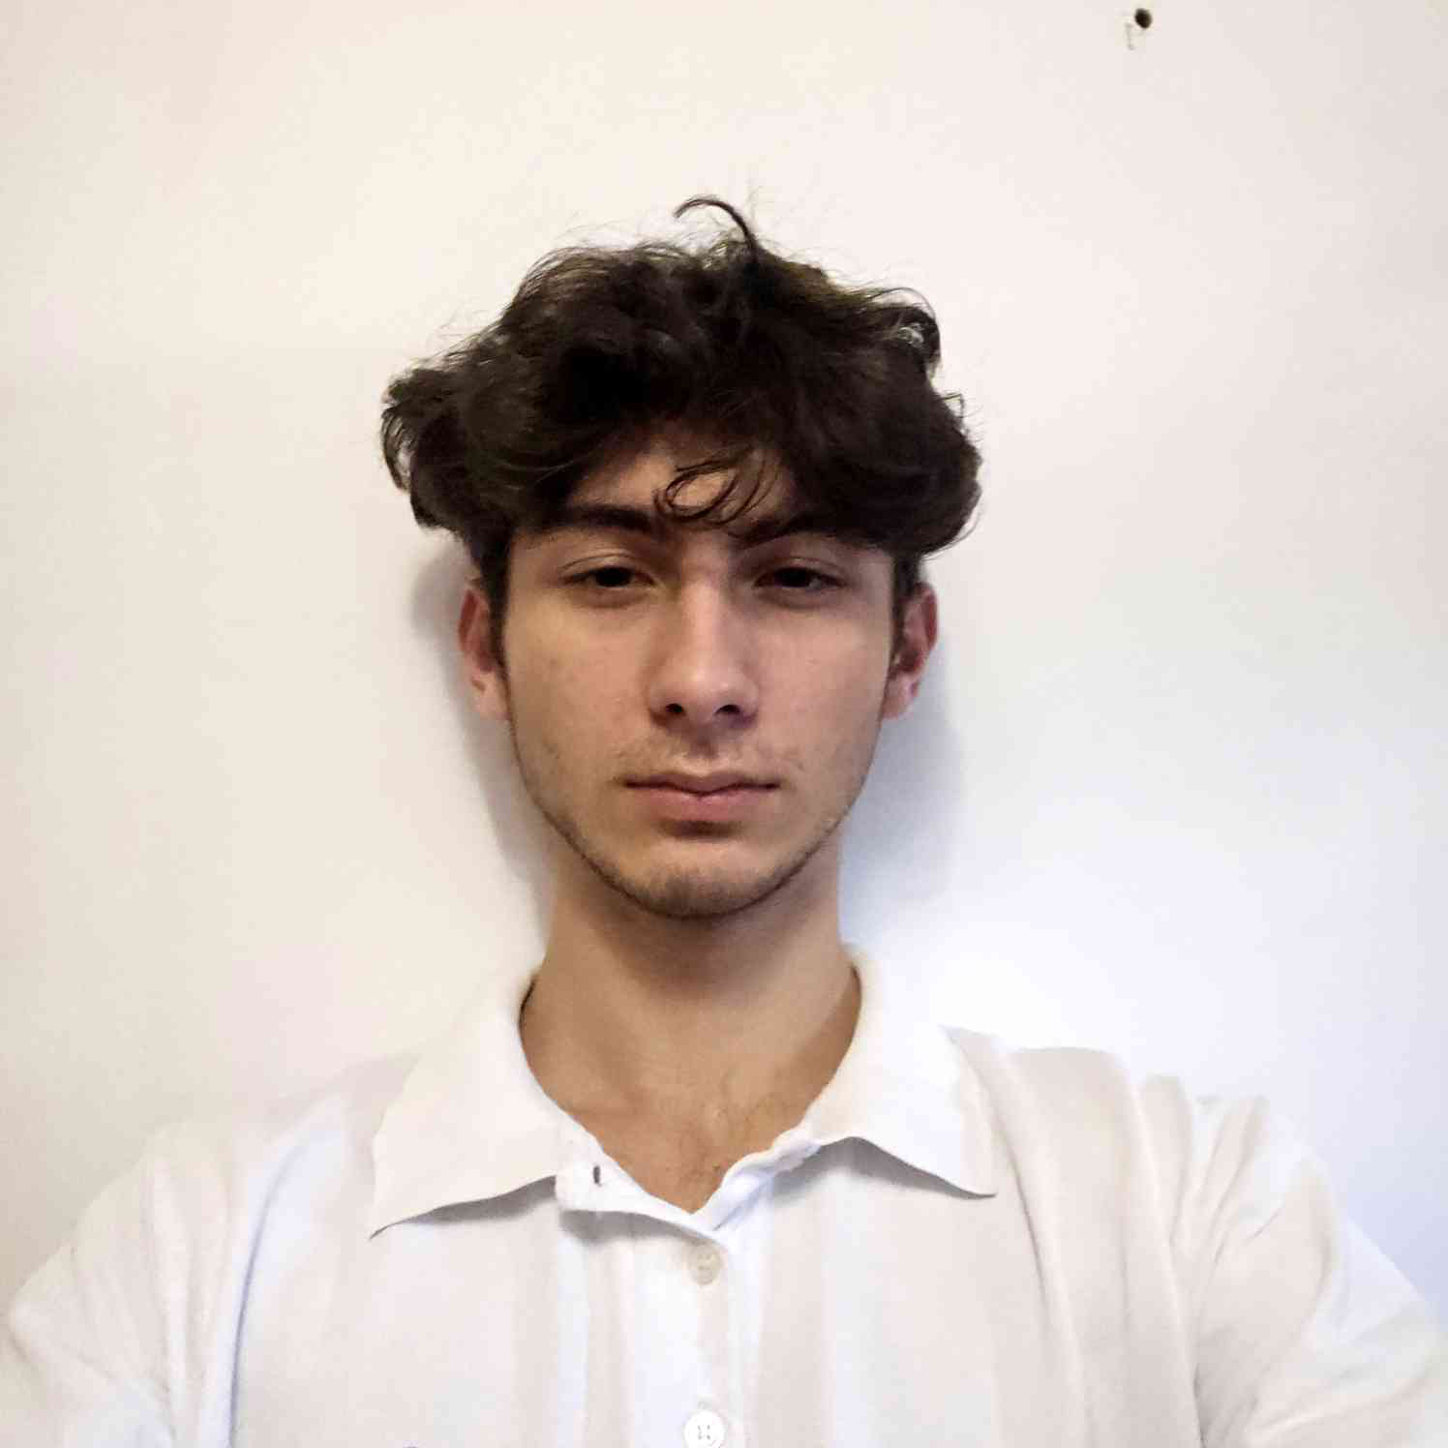
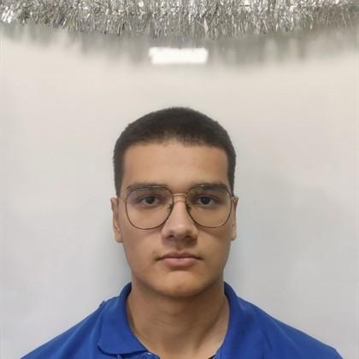
Our team
VBBoyanov
Full-stack developer
PAAndonov
Designer
DPDimitrakov
Scrum-Leader

Slide 4
How we managed our time
Gather a team 01.12
Choose mentor
Come up with an idea 02.12 - 04.12
Write the code 05.12-06.01
Write documentation and presentation 05.01

Slide 5

The idea
The idea is AstrophysicsDataViewer that allows the user to view and to understand how planets are structured in a 3D animation.

Slide 6









Tech Stack

Slide 7
Lets move on with our project…

