Slide 1
Null Pointers

Slide 2
Table of contents
Our team
How we managed our time
Our idea
Tech stack

Slide 3
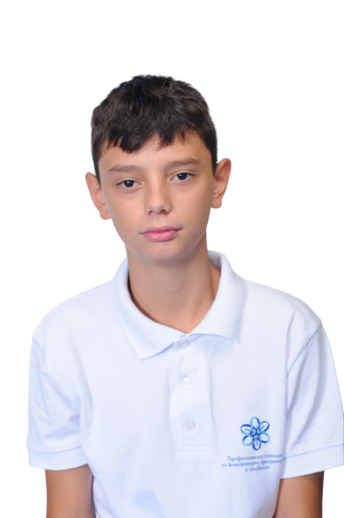
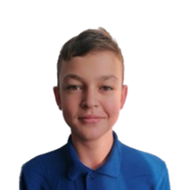
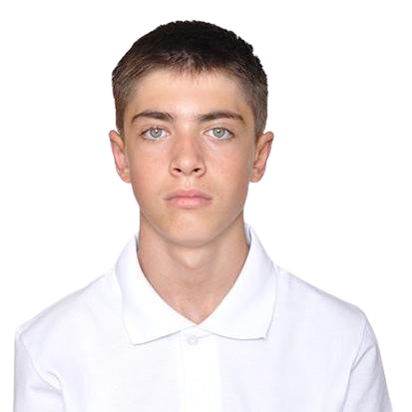
Our team
GSStoyanov
Back-end developer
GPGeorgiev
Back-end developer
AZGeorgiev
Scrum trainer

Slide 4
How we managed our time
Gather a team 2.12
Select an idea 3.12-9.12
Write the code 10.12-6.01
Do the documentation 6.01

Slide 5

Our idea
Our idea was to create a program that was a Species Data Organizer

Slide 6





Tech stack

Slide 7
Lets move on with our project.

