Slide 1
RUNTIMERS
· lab inventory ·

Slide 2
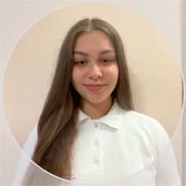
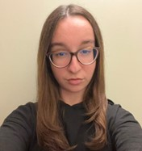
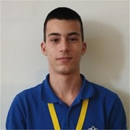
OUR TEAM
Back-End Developer
Scrum Trainer
Front-End Developer
Zhaklin Yankova
Gabriela Encheva
Nedyalko Libchev

Slide 3
OUR IDEA
Our idea was to create a "Lab Inventory Tracker" to help labs stay organized and safe. The app allows workers to sort chemicals by quantity, search for materials quickly, and track changes automatically. This makes managing supplies easier, reduces risks from expired chemicals, and ensures more efficient lab work.

Slide 4
STAGES OF DEVELOPMENT
1st WEEK
2nd WEEK
3rd WEEK
5th WEEK
ORGANISATION
DESIGN
4th WEEK
DOCUMENTS
Creating logo and discussing ideas about the app
Making the design
and implementing our ideas through code
Creating the documentation and presentation
CODE
Developing the code

Slide 5









USED TECHNOLOGIES
POWER POINT
WORD
VISUAL STUDIO
C++
RAYLIB
ASEPRITE
CANVA
GITHUB
TEAMS

Slide 6
THANK YOU FOR THE ATTENTION!
LET’S MOVE TO THE DEMONSTRATION!

