Slide 1

Final Project

Slide 2
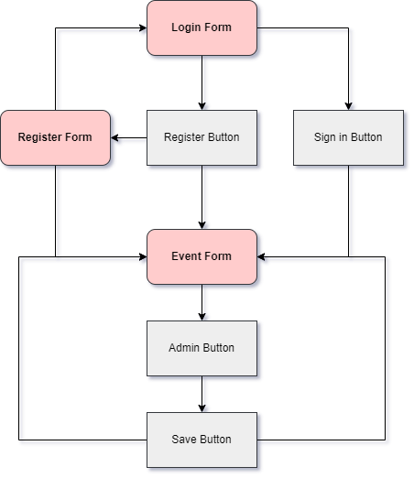
Flowchart

Slide 3





Used Programs and Technologies

Slide 4

Future Ideas

Slide 5
Thank You For Your Attention!

