Slide 1
On-the-job training project
By Stefan Hristov

Slide 2
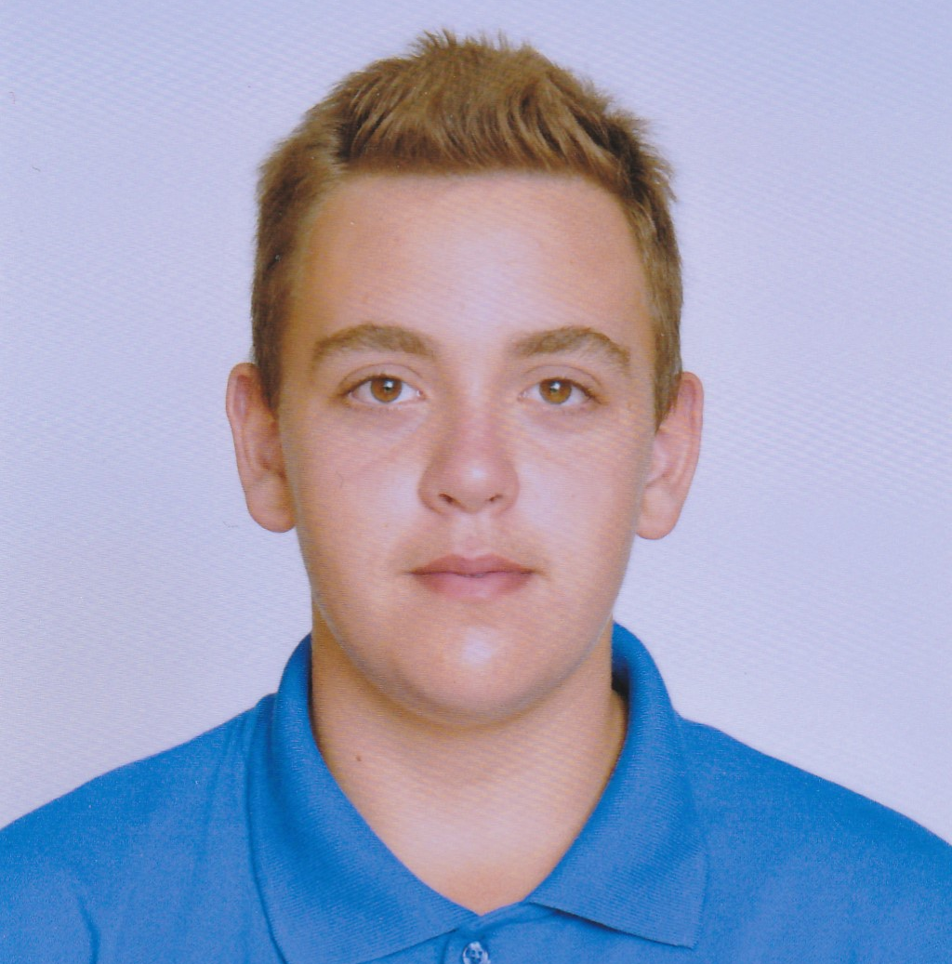
ABOUT ME
Stefan Hristov
Student at VSCPI Burgas
10 grade with a major in Software Assurance

Slide 3
STAGES OF WORKING OUT
PRESENTIN
RESEARCH
CODING
NOW
01
02
03
04

Slide 4
AIM

Slide 5





USED APPLICATIONS

Slide 6
THANKS

