Slide 1

OTJ Project
By Teodora Kompanska

Slide 2
Project’s idea

Slide 3



Stages of realization
FIRST STAGE –
LEARNING
Second stage –
PLANNING
Third stage –
REALIZATION AND
presentation

Slide 4





Used programs

Slide 5
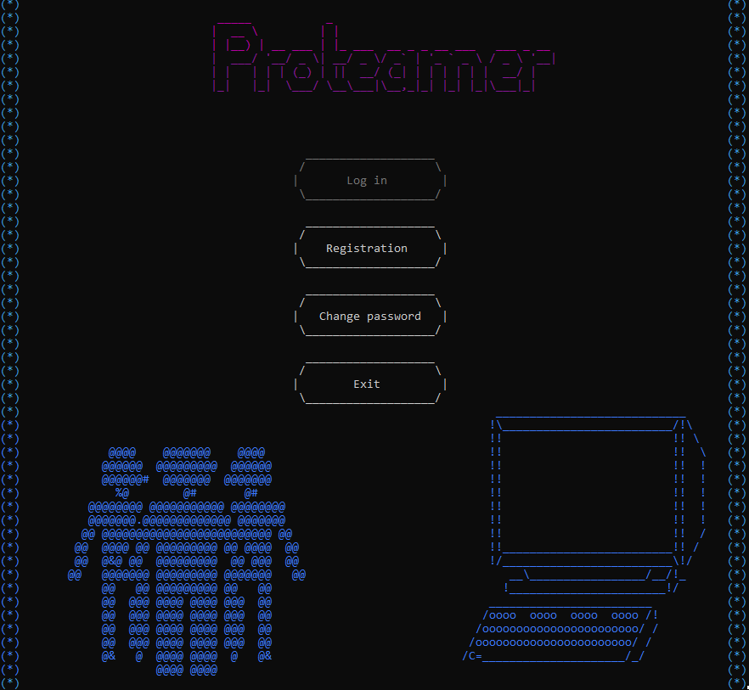
My project

Slide 6


Thank you for your attention!

