Slide 1

7he-b0ts-1

Slide 2

Our team

Slide 3
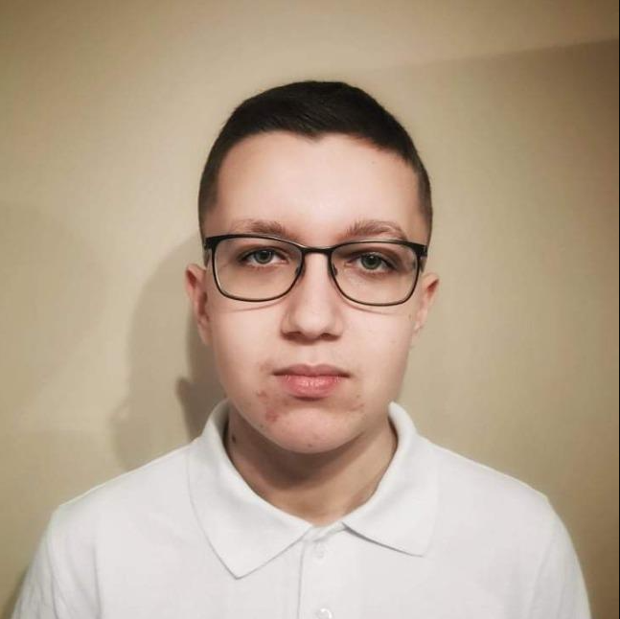
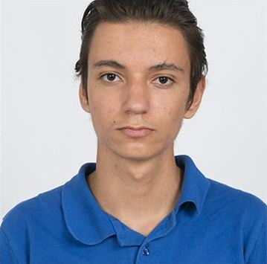
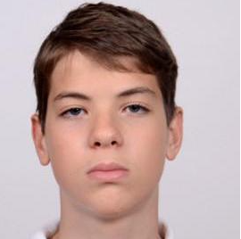
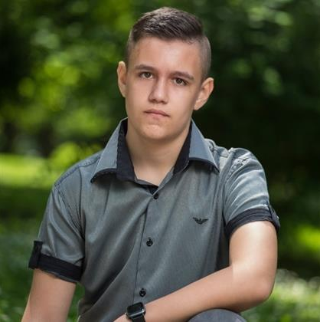
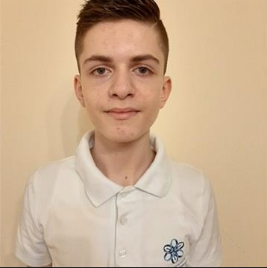
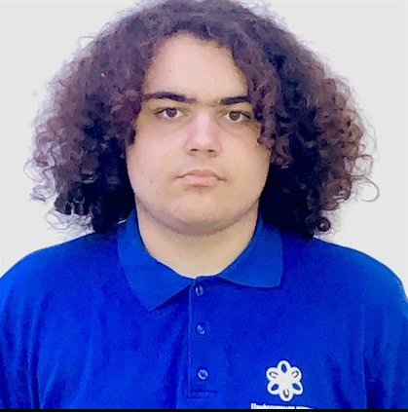
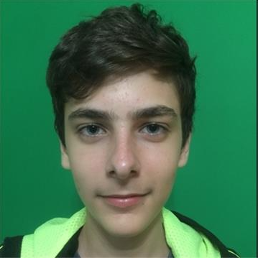
IVAILO ABADZIEV
Scrum trainer
ZAHARI BONEV
Scrum trainer
GEORGI TABANOV
Front-End Developer
NIKOLA PASKOV
Front-End Developer
VLADISLAV KARSHAKOV
Back-End Developer
SVILEN TODOROV
Back-End Developer
DIMITUR STAYKOV
Designer

Slide 4

The Idea

Slide 5
Stages of work

Slide 6
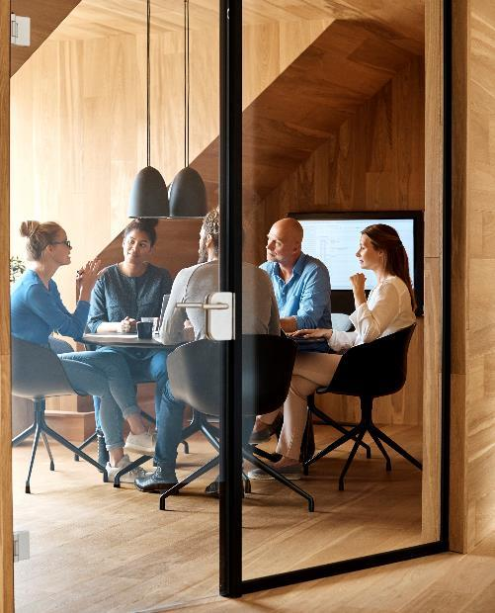

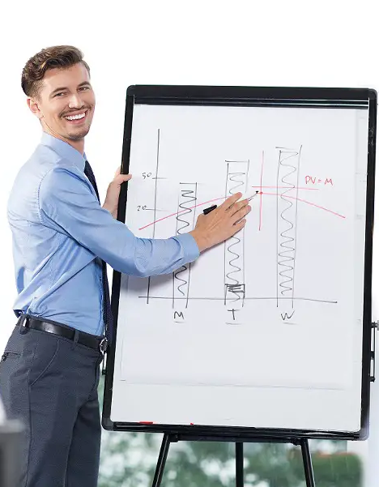



We discussed the idea and allocated the tasks
We started work about game, website, the presentation and documentation
And now we present our work

Slide 7








Used technologies
Discord
GitHub
Visual Studio Code
Word
PowerPoint
Visual Studio
HTML 5
CSS 3

Slide 8


Showtime

Slide 9
Thanks for your attention

