Slide 1

Chimera

Slide 2
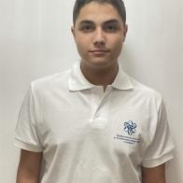
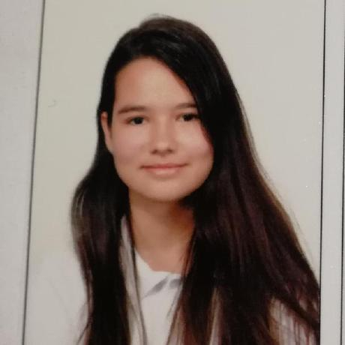
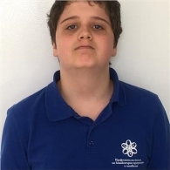
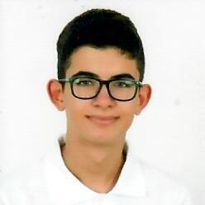
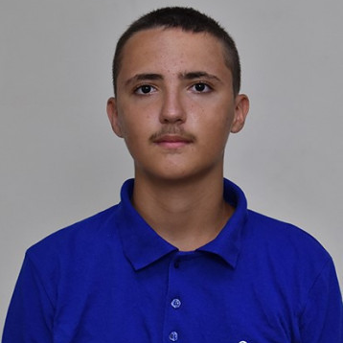
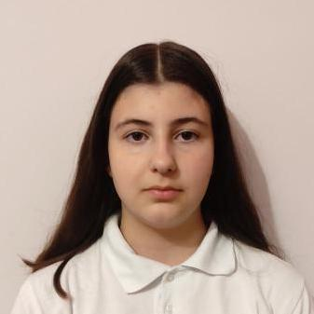
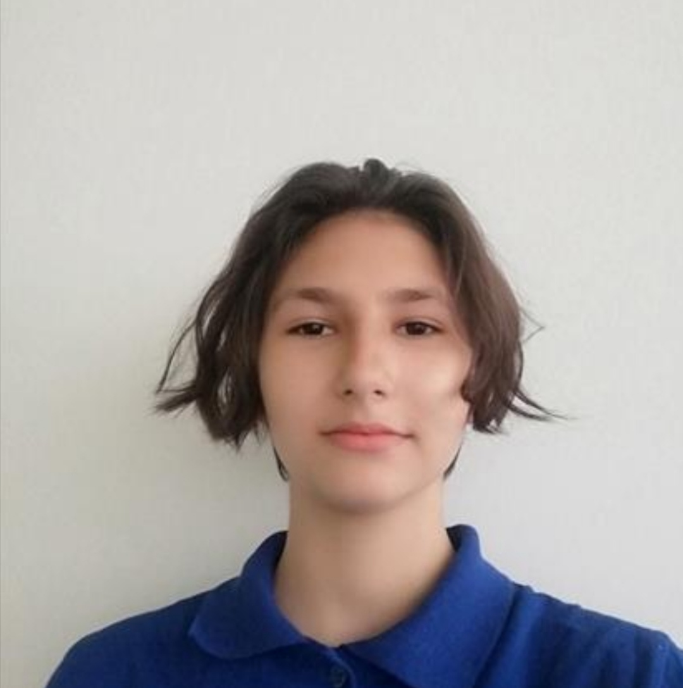
Hristo Kovachev: Scrum Trainer
Galq Ivanova: Backend Developer
Yoan Gavrilov:
QA Engineer
Konstantin Dinev: Backend Developer
Hristiyan Petrov: Backend Developer
Valeriq Chavdarova: Frontend Developer
Teodora Lozeva: Frontend Developer

Slide 3


Our idea

Slide 4
Stages of realization
Forming the team
Developing the game
Presenting
Developing the website

Slide 5













Languages and tools

Slide 6
Now let’s visit the website!

Slide 7
Thank you for the attention!

