Slide 1

KodKodKod
Our Team

Slide 2
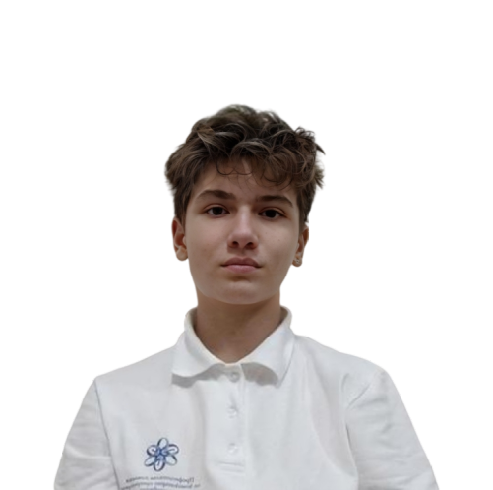
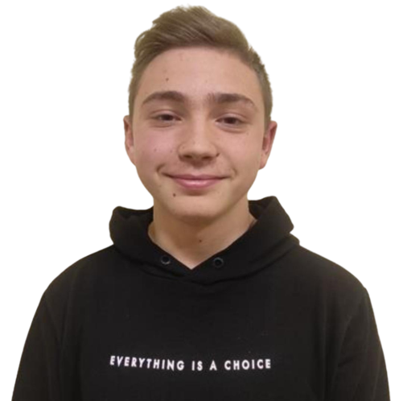
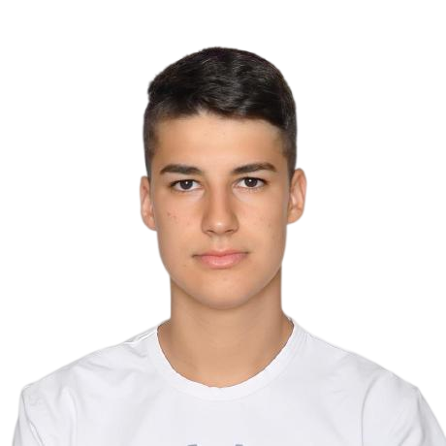
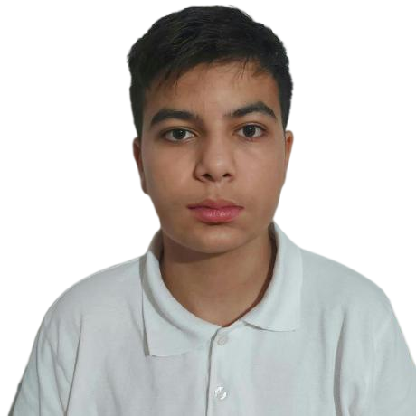
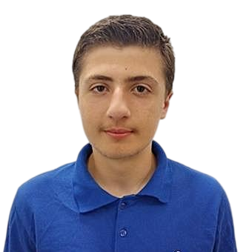
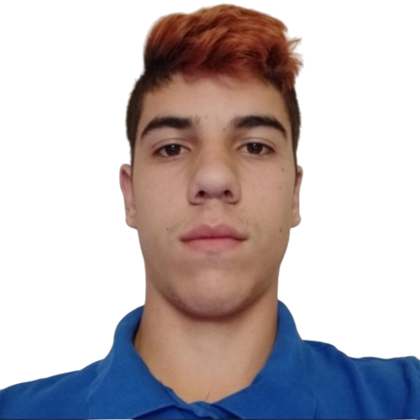
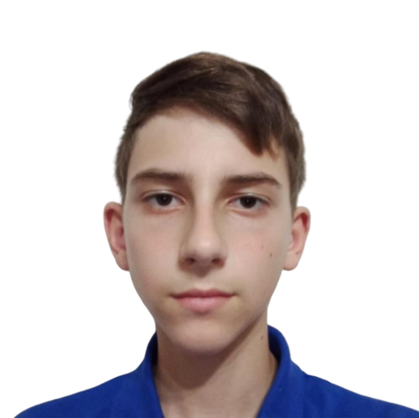
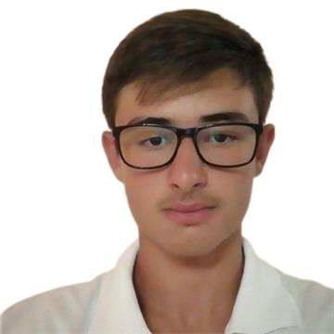
QA engineer
Alex Kazakov
Denislav Bratoevski
Alexander Tsvyatkov
Web
Developers
Game
Developers
Scrum Trainers
Denis Yusein
Hakan Chandur
Table of Contents
Ivailo Stoqnov
Georgi Milev
Ivan Dimov

Slide 3
Table of Contents
01.Our Project
02.Realisation
03.Used Technologies
04.Demonstration
Our Project

Slide 4
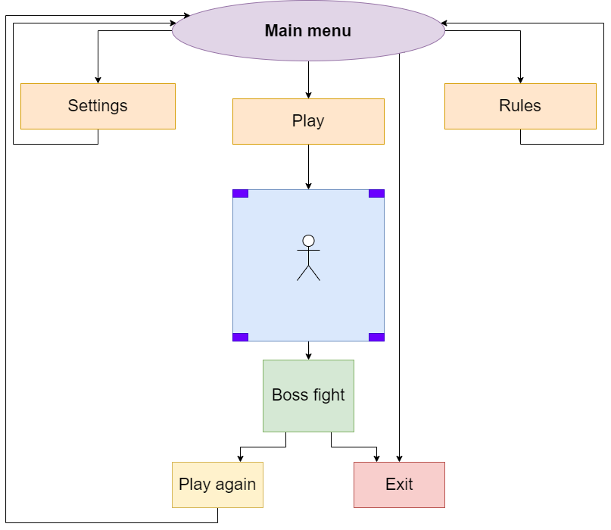
Our Project
Our project includes an adventurous game and a website about it.
Realisation

Slide 5
Realisation
Role Selection
Work selection by role
Help each other with the work
Used Technologies

Slide 6















Used Technologies
Finish

Slide 7
Let’s jump onto
our repo!

Slide 8
Thank you for you attention.
If you have any questions, you can ask them.

