Slide 1
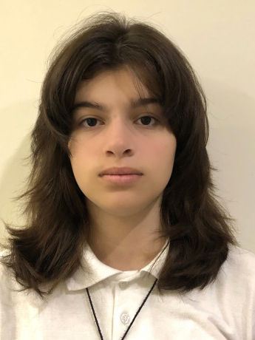
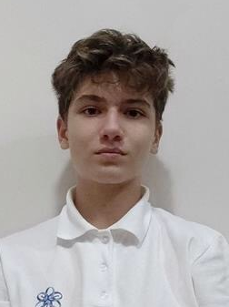

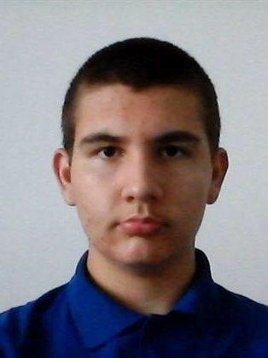
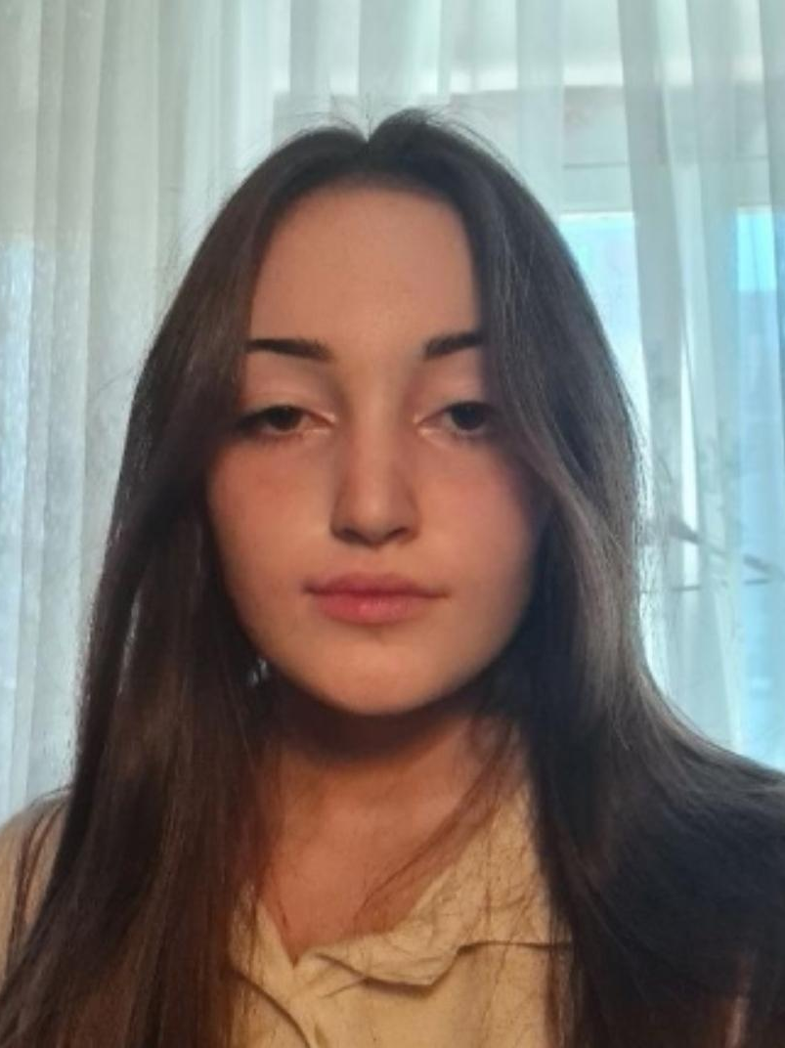

Slide 2
Our Team
Miroslav Ganev
Polina Dineva
Filipa Popova
Alex Kazakov
Scrum Trainer
9A
QA Engineer
9G
Front-end Developer
9B
Back-end Developer
9V

Slide 3











Stages
1st week
2nd week
3rd week
4th week
Stage 1
Stage 2
Stage 3
Stage 4
The last week we have been focusing on finishing the game and the documentation.
We created our logo and discussed ideas about the game
We made the basic design of the game and created our main character
We started implementing our game idea through code

Slide 4

Used Technologies

Slide 5
Let’s get to the game

