Slide 1

Bargain Team

Slide 2
01
02
Our team
Our idea
03
04
Programs we used
Stages of realization
Table of contents

Slide 3



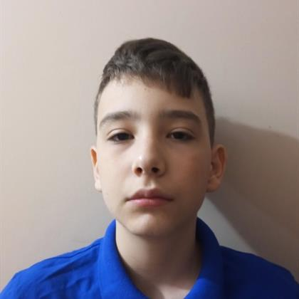
Our team
Atanas Apostolov
Georgi Filipov
Ivailo Dandarinov
Angel Angelov
Scrum Trainer
Back-end developer
Front-end developer
QA Engineer

Slide 4

Our idea

Slide 5



Stages of realization
STEP 1
STEP 2
STEP 3
Planning
Realization
Presentation

Slide 6





Used languages

Slide 7









Used tools

Slide 8
Let’s continue to our game

