Slide 1

Bargain

Slide 2
Table of contents
01
02
Our team
Our idea
03
04
Programs we used
Stages of realization

Slide 3



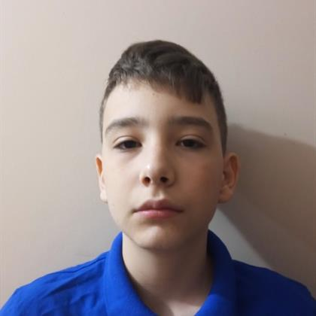
Our team
Atanas Apostolov
Georgi Filipov
Ivailo Dandarinov
Angel Angelov
Scrum Trainer
Back-end developer
Front-end developer
QA Engineer

Slide 4

Our Idea

Slide 5



Stages of realization
STEP 1
STEP 2
STEP 3
Planning
Realization
Despite being red,

Slide 6




Used languages

Slide 7









Used Tools

Slide 8

Let’s show you our game

