Slide 1

PROJECT PRESENTATION

Slide 2
TABLE OF CONTENTS
01
02
03
04
OUR TEAM
OUR GOAL
STAGES OF REALIZATION
USED TECHNOLOGIES

Slide 3
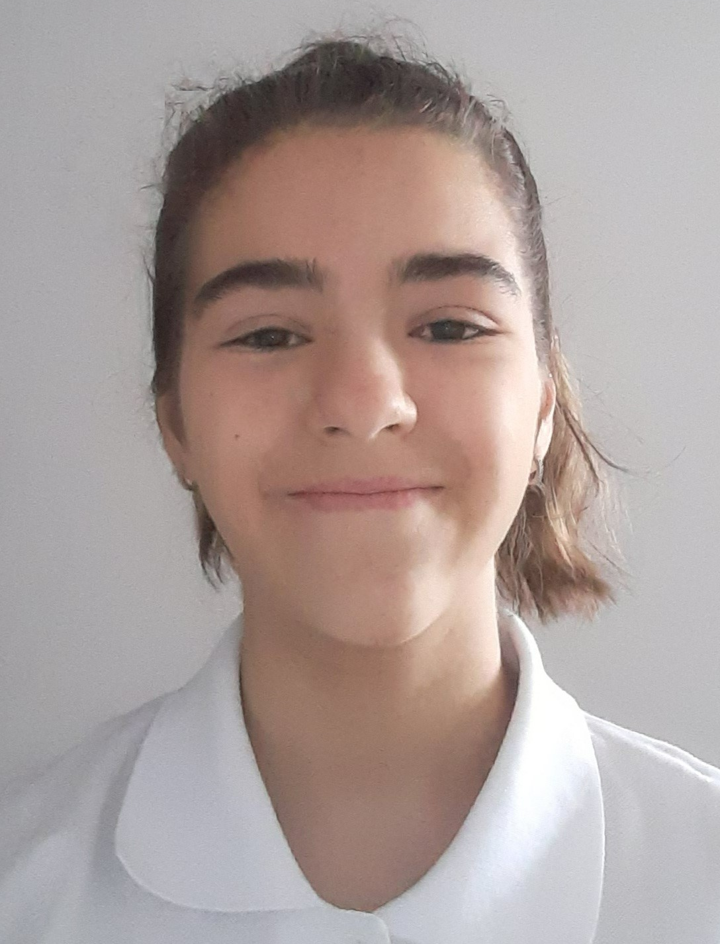
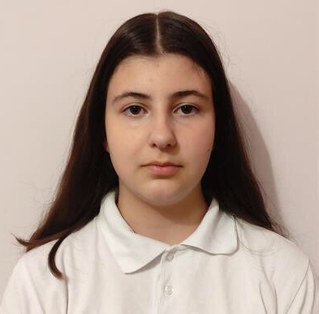
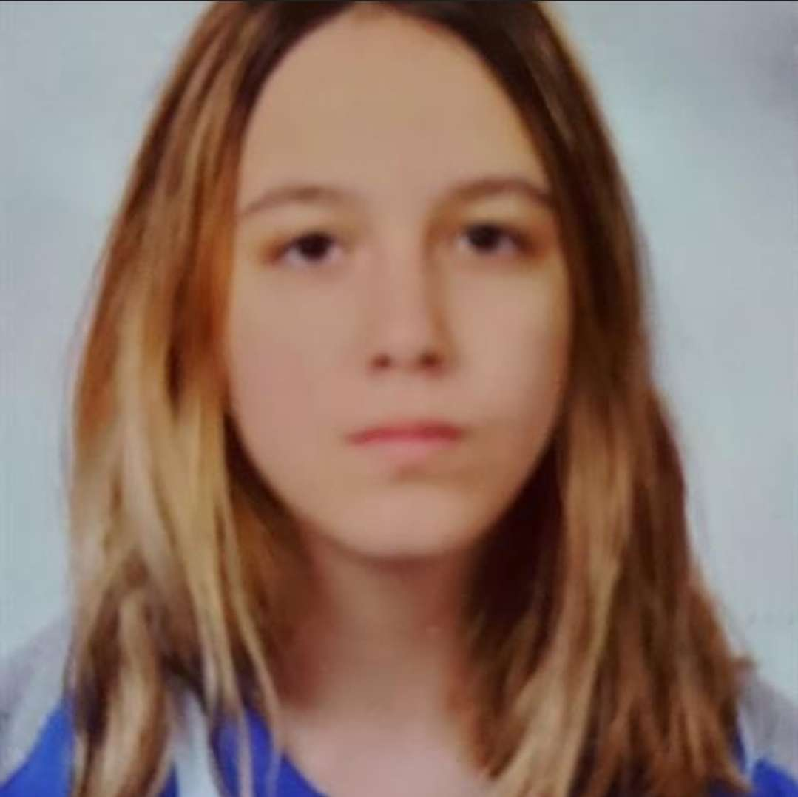

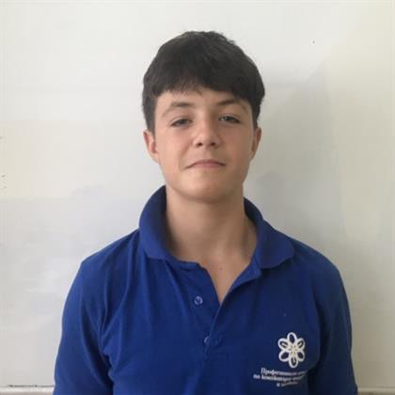
OUR TEAM
NADEZHDA
IVANOVA
VALERIA
CHAVDAROVA
ANTONIA
TANEVA
STELIYAN
NIKOLOV
SCRUM TRAINER
BACK-END DEVELOPER
FRONT-END DEVELOPER
QA DEVELOPER

Slide 4

OUR GOAL
Our goal is to make the player use logic, mathematics and bitwise operation while they are enjoying their game.
,

Slide 5
STAGES OF REALISATION
ORGANISATION
DECIDE ON THE IDEA
DEVELOPMENT
PRESENTATION

Slide 6









USED TECHNOLOGIES
,

Slide 7
LET’S CONTINUE WITH THE GAME!

Slide 8
THANK YOU FOR THE ATTENTION!

