Slide 1

int main() {
header_slide.cpp
table_of_contents.cpp
#include <EDUWISE>
cout << “Team CodeRunners”;
}
C++

Slide 2
Table Of ‘Contents’ {
01
02
03
table_of_contents.cpp
team.cpp
Our Team
/* Who are we and our roles. */
About the Game
/* What is our game about and our game map. */
Used Software
/* What software we have used. */
}
C++

Slide 3
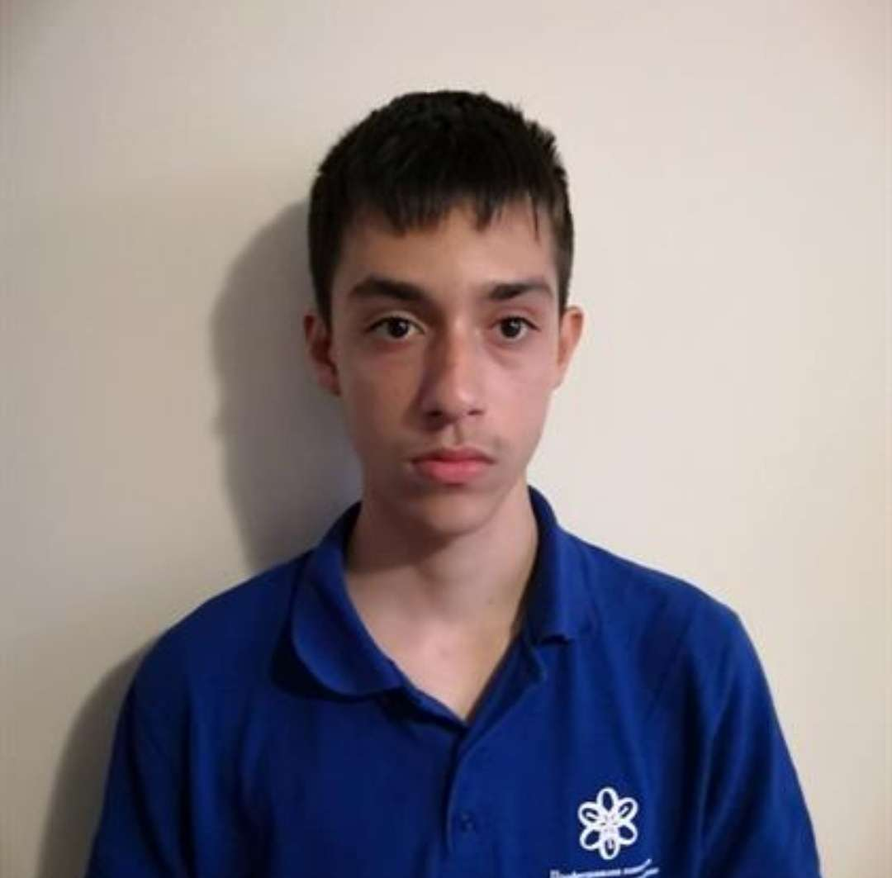
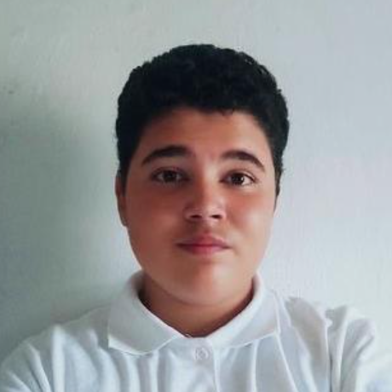
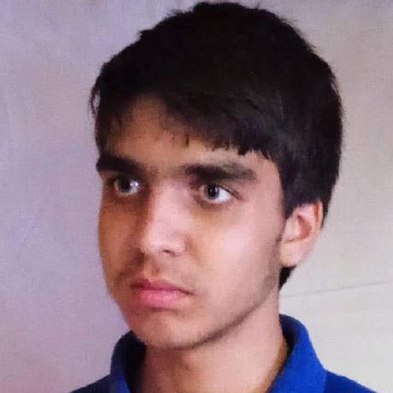
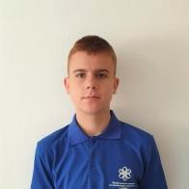
void team {
Our Team
team.cpp
about_the_game.cpp
}
Lyubo Dimov – 9G
Scrum Trainer;
Bozhidar Dimov – 9V;
Front-End Developer;
Gospodin Radev – 9A;
Back-End Developer;
Kristian Gaidov – 9B;
QA Engineer;
C++

Slide 4
char about_the_game {
about_the_game.cpp
game_map.cpp
The name of our game is “EDUWISE™”. It is named like that because it is a mix of two concepts: “education” & “bitwise”, because it is educational, and it teaches you number systems using bitwise operations. It consists of 2 games called “Bitwise Test” & “Guess the Number”.
}
C++

Slide 5
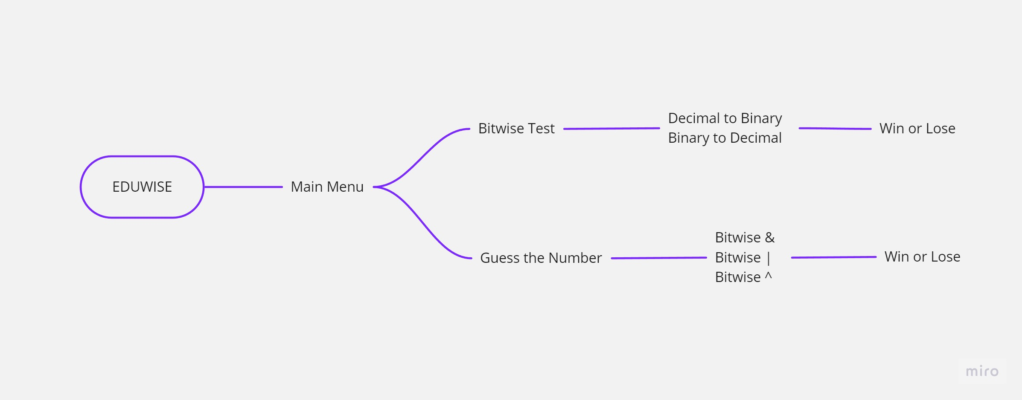
void game_map{
game_map.cpp
software.cpp
}
C++

Slide 6







void software {
software.cpp
final.cpp
string software = “Software which we have used:”;
}
C++

Slide 7
void final {
final.cpp
Thank you for your attention!
Now let’s jump into the project!
}
C++

